Slide 1
Object-based graphs
Remove dependency on GUI otqs
Create and run object-based otqs
Leverage pure Python API
Model EPs as objects in Python
1

Slide 2
The PASSTHROUGH EP, …
Often the first EP in chain or graph. In this case, it is used as a source of ticks. This is very useful for nested queries or joins.
Can be used to provide an initial tick from before the query start time (using the GO_BACK_TO_FIRST_TICK parameter)
Often used as the first or last EP to reduce the number of columns (using the FIELDS and DROP_FIELDS parameters)

Slide 3
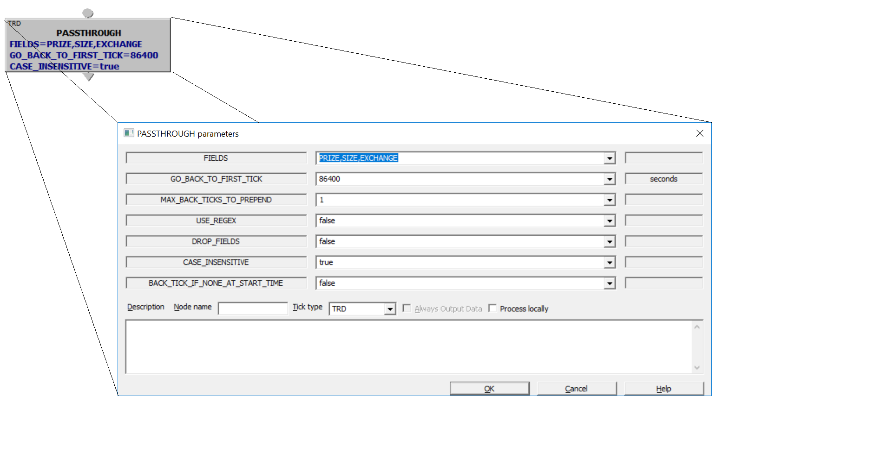
Modeling the EPs - State

Slide 4
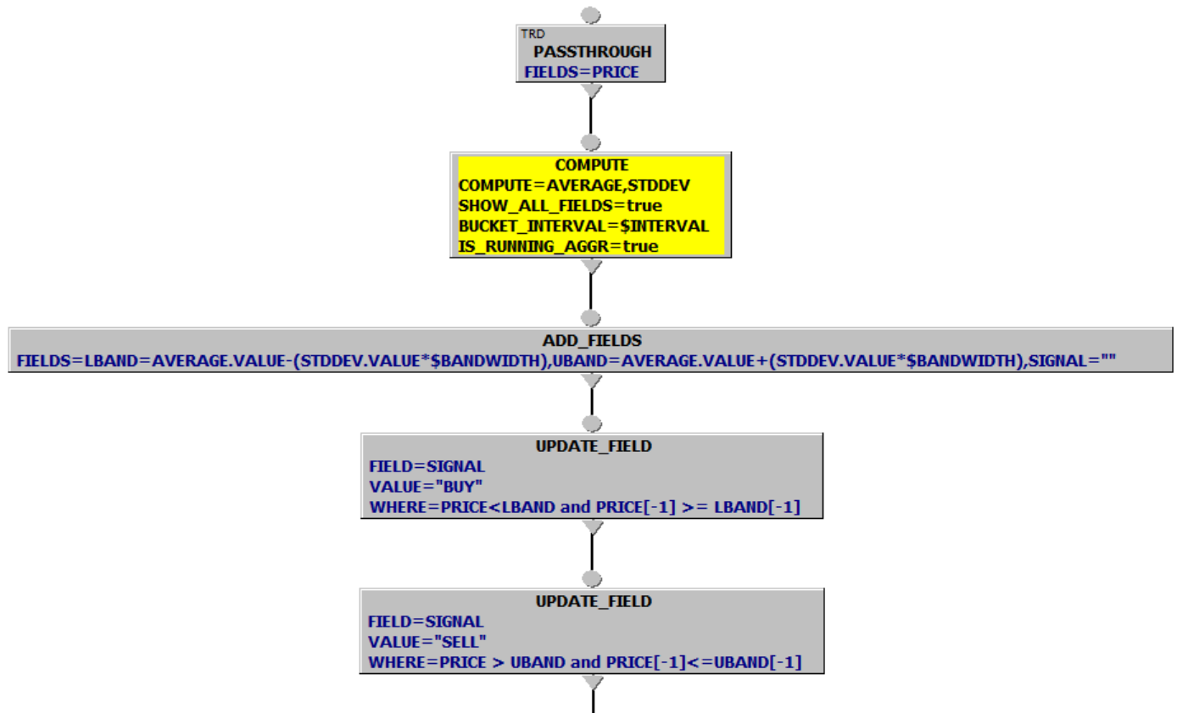

Modeling the EPs - Behavior

Slide 5
EventProcessor
EP State captured as fields to the object in the ctor and exposed as properties
Other ‘descriptor’ fields captured as methods that return ‘self’
(tick_type, node_name)
Behavior captured as ‘sink’ and ‘source’ methods

Slide 6
Sinking EPs
The sink method returns ‘self’
Allows for chaining
Sinking multiple EPs together can lead to difficult code to read
‘>>’ operator is overloads the ‘sink’ method
90% of all (simple) queries are simple chains – helper Chainlet object

Slide 7
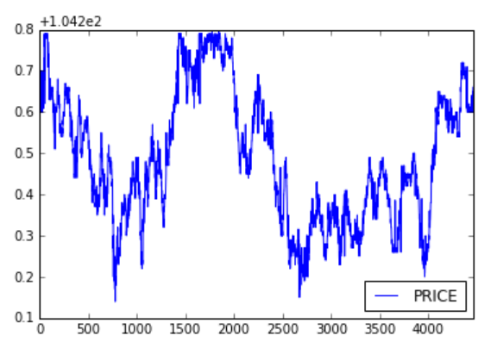
Simple Example
Graph with a single Passthrough EP
For symbol “FULL_DEMO_L1::GS”
Filter on PRICE < 105
Print and plot results
PRICE Time
0 104.9 2005-01-03 09:31:52.011
1 104.9 2005-01-03 09:31:53.008
2 104.9 2005-01-03 09:31:53.508
3 104.9 2005-01-03 09:31:53.511
4 104.9 2005-01-03 09:31:53.515

Slide 8
Exercise 2 – Compute Bars
Compute the High, Low, Last, Average, and VWAP prices and the volume for ‘FULL_DEMO_L1::IBM’ for the date 12/1/2003 during NY trading hours.
Filter on COND by characters ‘BCGLM’
  Hint: use CharacterPresent object
Compute for 300,600,900 seconds
Print in a Pandas DataFrame
Plot the High, Low, and VWAP

