Slide 1
Sourcing EPs
EPs can be added as a Sink or a Source
Allows for complex Graphs to be created and processed
Render graphs if need to see the forest for the trees
1

Slide 2
JOIN EPs
OneTick tries to use terminology similar to relational DB terminology.
The main difference is that we are dealing with time series information
When people want to join several time series they usually want to join the “latest” data from each time series together

Slide 3
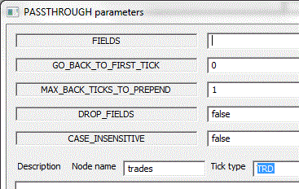
Takes multiple time series as input
Each time series in the graph is named by setting the EP
Node Name in GUI
An OUTER join will create a new tick with the latest tick from each source that sent at least one tick, whenever a LEADING source has a new tick. If any source has not yet produced a tick, the fields from this source will not exist in the output tick.
An INNER join will create a new tick with the latest tick from all sources whenever a LEADING source has a new tick
When doing a join of trades and quotes, the desired result is usually an INNER join with the trades as the LEADING source

Slide 4
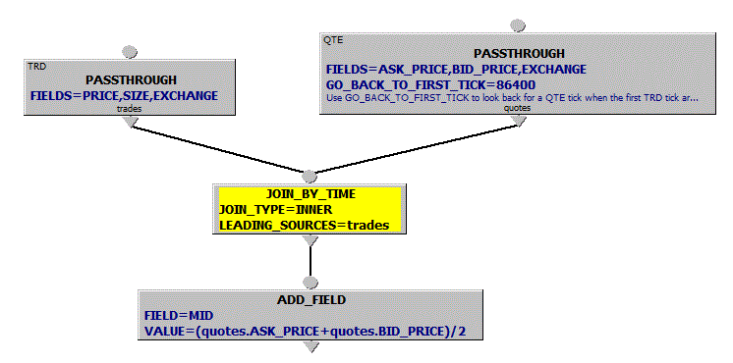
JOIN_BY_TIME (cont.)
Example:
Join
each trade
with the prevailing quote
Tips:
INNER join produces ticks with both trades and quotes info
Refer to the JOINed fields by [source node name].[field name]
When using OUTER JOIN use TABLE after JOIN node to create placeholders for the fields referenced in further calculations
Use RENAME_FIELDS to get rid of [source node name]. if not needed
Use PASSTHROUGH with GO_BACK_TO_FIRST_TICK to make sure there is a prevailing quote when the first trade arrives, otherwise the first trade[s] may not find a quote to match with.

Slide 5
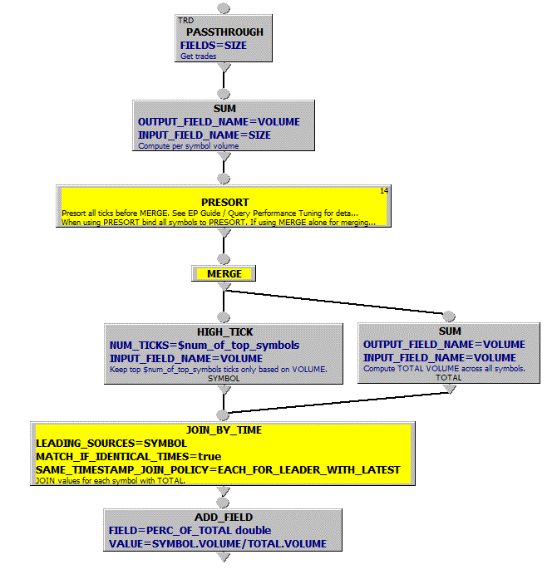
MERGE
Per
Symbol
Example:
Top Market Players
Merge daily volumes for a list of symbols into 1 time series to output top 5 volumes.
Show what percent these volumes represent of the overall daily total volume.
MERGE
Across
Symbols
Note: See EP Guide / Query Performance Tuning
on the details of using PRESORT EP with MERGE.

Slide 6
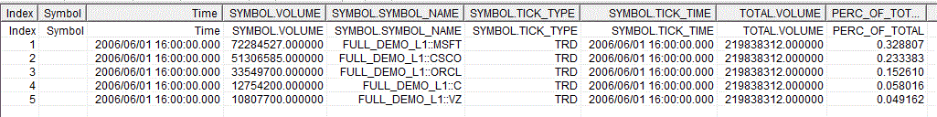
MERGE
Per
Symbol
Example:
Top Market Players
Query output:
MERGE
Notes:
Binding symbols to MERGE or PRESORT followed by MERGE merges all time series into 1 based on timestamps and omdseq (if available)
Across
Symbols

Slide 7
Exercise 3
Write a query to join trades and quotes
Add quote mid point
Calculate trade price vs mid spread
Print only the trades below the mid

Slide 8
Utility functions
onetick.query.merge(…)
onetick.query.attach(…)

Slide 9
Exercise 4
Implement the same graph as Exercise 3 using the ‘join’ function

