Slide 1
INTERFACING WITH 8086
1.8259 : Interrupt Controller
2.8255 : Peripheral interface
3.I/O interfacing
4.8279 :Keyboard/Display interface
5.8257 : DMA Controller

Slide 2
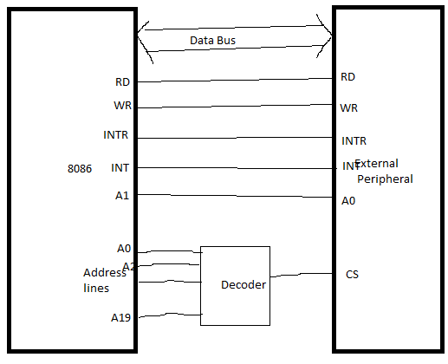
Basic Interfacing Diagram

Slide 3
8259 PROGRAMMABLE INTERRUPT CONTROLLER

Slide 4
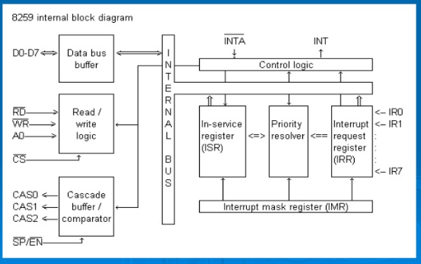

Slide 5
Operation Cycle
1.Interrupt receive through IR0-IR7
2.Set the corresponding bit of IRR
3.Priority resolver resolve priority and send INT signal to 8086.
4.8086 acknowledges through INTA signal
5.Set corresponding bit in ISR ,reset IRR bit
6.Place CALL opcode to bus
7.Send lower and higher address of ISR in response to subsequent INTA
8.Reset ISR register.

Slide 6
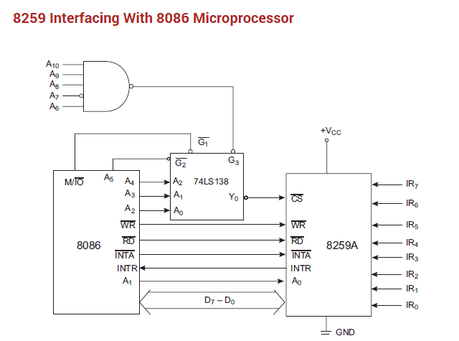

Slide 7
OPERATING MODES OF 8259
1.Fully Nested Modes
Default mode.
IR0 has the highest priority and IR7 has the lowest one.
If the ISR (in service) bit is set, all the same or lower priority interrupts are inhibited.

Slide 8
2.Automatic Rotation
Used in the applications where , all the interrupting devices are of equal priority.
In this mode, an IR level receives lowest priority after it is served while the next device to be served gets the highest priority in sequence.
3.Edge And Level Triggered Mode
Decides whether the interrupt should be edge triggered or level triggered.

Slide 9
4.Reading 8259 Status
Used to read the , status of the internal registers of 8259.
5.Special Fully Nested Mode
Used in more complicated systems.
Similar to, normal nested mode.
When an interrupt request from a certain slave is in service, this slave can further send requests to the master.
The master interrupts the CPU only.

Slide 10
6.Buffered Mode
When the 8259A is used in the system in which bus driving buffers are used on the data buses, the problem of enabling the buffers arises.
7.Cascade Mode
The slave INT outputs are connected with master IR inputs. When a slave request line is activated and acknowledged, the master will enable the slave to release the vector addresses during the second pulses of /INTA sequence.

Slide 11
8.End Of Interrupt
The ISR bit can be reset either with AEOI bit of ICW1 or by EOI command.
Two types of EOI command;
a)Specific
b)Non-specific
9.Specific Rotation
A bottom priority level can be selected
The selected bottom priority fixes other priorities.

Slide 12
10.Special Mask Mode
When a mask bit is set , it inhibits further interrupts at that level and enables interrupt from other levels, which are not mastered.

Slide 13
8255 PROGRAMMABLE PERIPHERAL INTERFACE

Slide 14
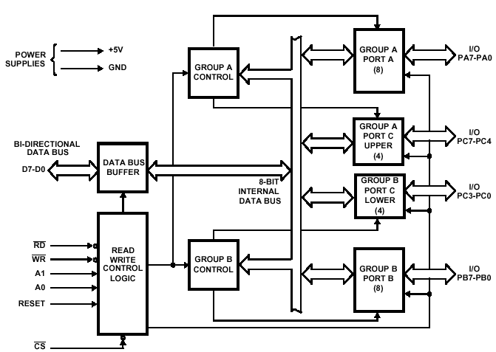

Slide 15
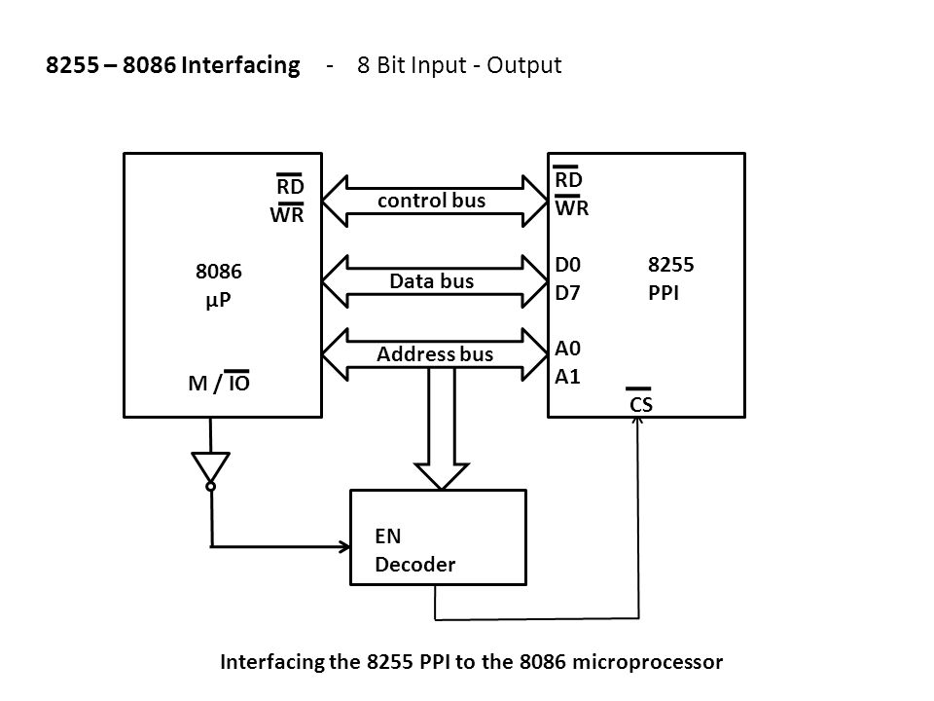

Slide 16
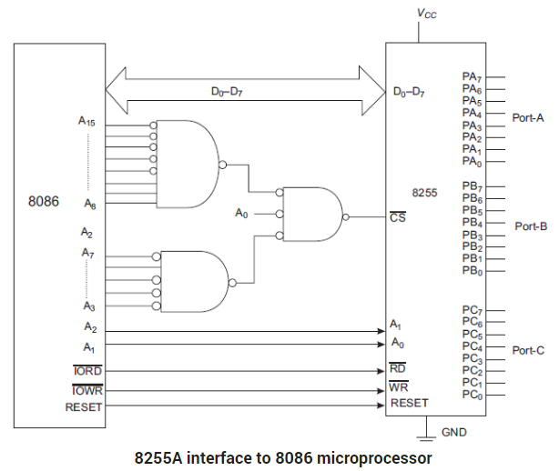

Slide 17
Operation Modes
BIT SET/RESET MODE:
The PORT C can be Set or Reset by sending OUT instruction to the CONTROL registers.
I/O MODES:

Slide 18
FOR BIT SET/RESET MODE:
This is bit set/reset control word format.
X X X
Don’t care
Bit select
B0
B1
B2
D7 | D6 | D5 | D4 | D3 | D2 | D1 | D0
BIT SET/RESET
1=SET
0=RESET
0 | 1 | 2 | 3 | 4 | 5 | 6 | 7
0 | 1 | 0 | 1 | 0 | 1 | 0 | 1
0 | 0 | 1 | 1 | 0 | 0 | 1 | 1
0 | 0 | 0 | 0 | 1 | 1 | 1 | 1
BIT SET/RESET FLAG
=0 Active

Slide 19
I/O MODES:
MODE 0(Simple input / Output):
In this mode , port A, port B and port C is used as individually (Simply).
Any port can used as input or output
Outputs are latched , Inputs are buffered not latched.
Ports do not have Handshake or interrupt capability
Maximum four ports available so total 16 configuration

Slide 20
MODE 1 :(Input/output with Hand shake)
In this mode, input or output is transferred by hand shaking Signals.
Two groups A,B available
Each group has 8bit I/O port and 4bit control port
Both input ,output ports latched
PC0-PC2 generate control signal for Port B
PC3-PC5 generate control signal for Port A
PC6,PC7 independent data lines

Slide 21
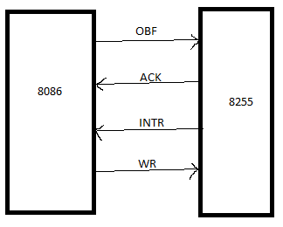
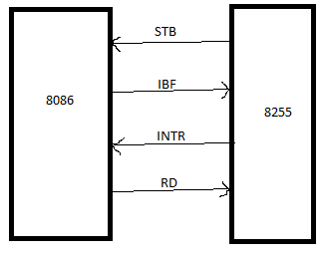
Input handshaking
Output Hand Shaking

Slide 22
MODE 2:bi-directional I/O data transfer:
This mode allows bidirectional data transfer over a single 8-bit data bus using handshake signals.
This feature is possible only Group A
Port A is working as 8-bit bidirectional.
PC3-PC7 is used for handshaking purpose.
The data is sent by CPU through this port , when the peripheral request it.
Both input and output are latched

Slide 23
FOR I/O MODE:
The mode format for I/O as shown in figure
D7 | D6 | D5 | D4 | D3 | D2 | D1 | D0
Group A
Port C Upper 1=Input 0=Output
Port A 1=Input 0=Output
Mode selection 00=mode 0 01=mode 1 1x=mode 2
Group B
Port C Lower 1=Input 0=Output
Port B 1=Input 0=Output
Mode selection 0=mode 0 1=mode 1
Mode set flag=1=Active

Slide 24
INTERFACING I/O PORTS
1.Memory Mapped I/O
2.I/O Mapped I/O

Slide 25
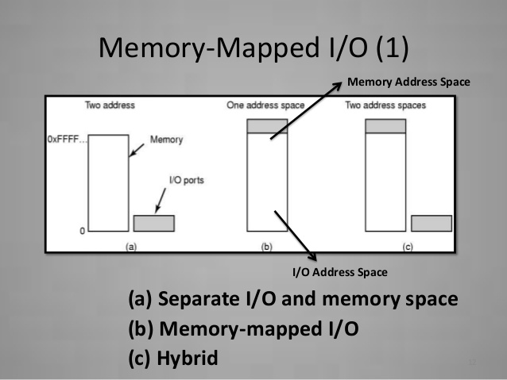

Slide 26
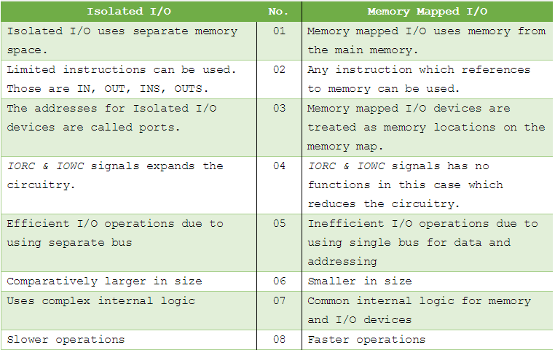

Slide 27
I/O Mapped I/O
Memory Mapped I/O
Maximum 16 address lines are used for interfacing
So simple address decoding circuit
So 64K byte I/O devices can interfaced
IORD,IOWR signals used for interfacing
All 20 lines are used
Complex circuit
1M byte I/O can interfaced
MRDC,MRTC signals used.

Slide 28
Steps for Interfacing
Connect data bus of 8086 to that of I/O device.
Address bus to decoder and to Chip select.
Connect IORD to RD for input device.
Connect IOWR to WR for output device.

Slide 29
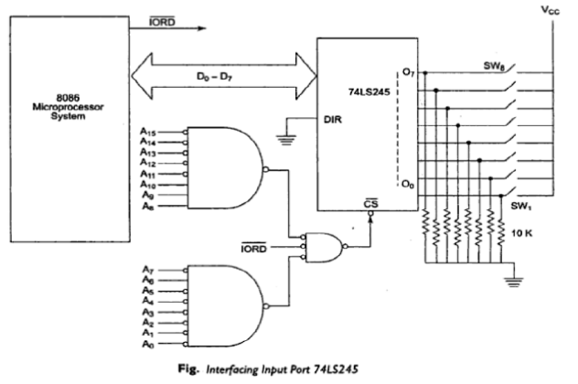

Slide 30
8279 PROGRAMMABLE KEYBOARD/DISPLAY INTERFACE

Slide 31
Simultaneously drive display and interface keyboard.
Keyboard section can interface array of 64 keys with CPU.
Keyboard entries are debounced and stored in 8byte FIFO RAM.
Provides sixteen 7 segment display interface with CPU.
It has 16 byte RAM used either as block of 16X8 or two blocks of 16x4 RAM.

Slide 32
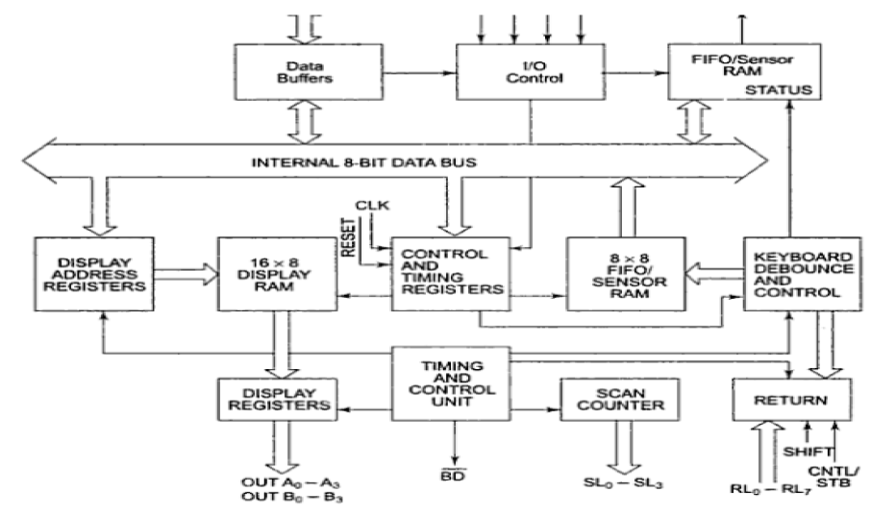

Slide 33
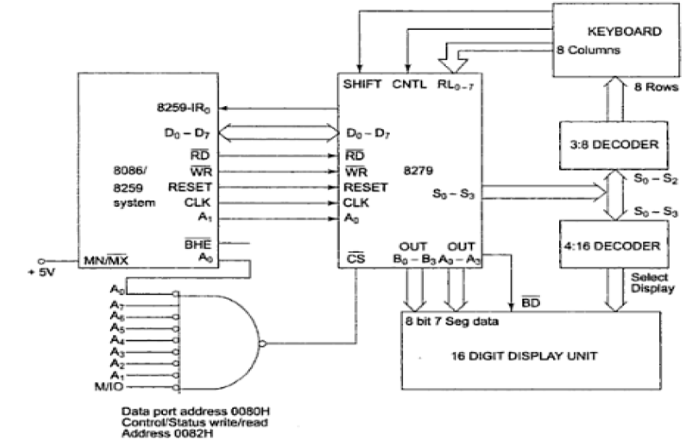

Slide 34
The Modes of operation of 8279
Input (Keyboard) modes
Scanned Keyboard Mode
2. Scanned Sensor Matrix
3. Strobbed Input
Output (Display) modes
1.Left Entry mode (note book)
2. Right Entry mode (Calculator)

Slide 35
1. Scanned Keyboard Mode : This mode allows a key matrix to be interfaced using either encoded or decoded scans.
In the encoded scan, an 8 x 8 keyboard or in decoded scan , a 4 x 8 Keyboard can be interfaced.
The code of key pressed with SHIFT and CONTROL status is stored into the FIFO RAM.
1.Scanned key board 2 key lockout
2.Scanned keyboard N key rollover
3.Scanned keyboard special error mode(under N key rollover)

Slide 36
2. Scanned Sensor Matrix:
In this mode, a sensor array can be interfaced with 8279 using either encoder or decoder scans.
With encoder scan 8 x 8 sensor matrix or with decoder scan 4 x 8 sensor matrix can be interfaced .
The sensor codes are stored in the CPU addressable sensor RAM

Slide 37
3. Strobed Input :
In this mode, if the control line goes low, the data on return lines, is stored in the FIFO byte by byte.

Slide 38
8257 DMA CONTROLLER

Slide 39
Four independent channels with its own 16 bit address and count register.
Two common channels for all channels mode set and status register.
Total ten registers
Two modes of operation
1.Fixed priority
2.Rotating priority.

Slide 40
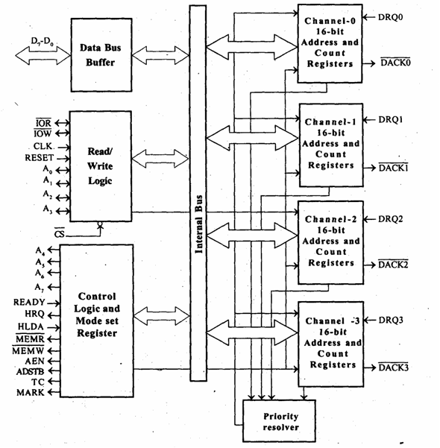

Slide 41
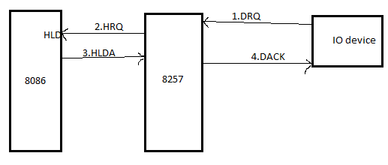
Operation Cycle

Slide 42
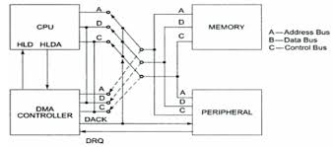
Interfacing with 8086

