Slide 1
Module 2 Assembler

Slide 2
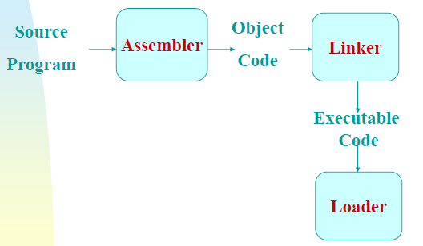
Assembler

Slide 3
Assembler Functions
Fundamental functions
translating mnemonic operation codes to their machine language equivalents
assigning machine addresses to symbolic labels
Convert symbolic operands to their equivalent machine addresses
Build the machine instructions in the proper format
Convert the data constants to internal machine representations
Write the object program and the assembly listing

Slide 4
Assembly language concepts
An assembly language is a machine dependent low level programming language which is specific to a certain computer system
An assembly language statement has the following format
[Label] <Opcode> <Operand Spec>[<,Operand Spec>…]
E.g.
WLOOP LDCH BUFFER, X
RLOOP TD INPUT

Slide 5
Assembler directives
Assembler directive instruct the assembler to perform certain action during the assembly of a program
They are not translated into machine instruction instead they provide instructions to the assembler itself.
Examples
START: Specify name and starting address of the program
E.g. COPY START 1000
END: Indicate the end of the source program and optionally specify the first executable instruction in the program.
E.g. END FIRST
BYTE: Generate character or hexadecimal constant occupying as many bytes as needed to represent the constant
E.g. EOF BYTE C’EOF’
INPUT BYTE X’F1’

Slide 6
WORD: Generate one word integer constant
E.g. THREE WORD 3
RESB: Reserve number of bytes for data area
E.g. BUFFER RESB 4096
RESW : Reserve indicated number of words for a data area
E.g. RETA RESW 1

Slide 7
Literals
Design idea
Let programmers to be able to write the value of a constant operand as a part of the instruction that uses it.
This avoids having to define the constant elsewhere in the program and make up a label for it.
A literal is an operand with the syntax =‘<value>’.
E.g. ENDFIL LDA =C’EOF’
It is called literal because the value is stated literally in the instruction

Slide 8
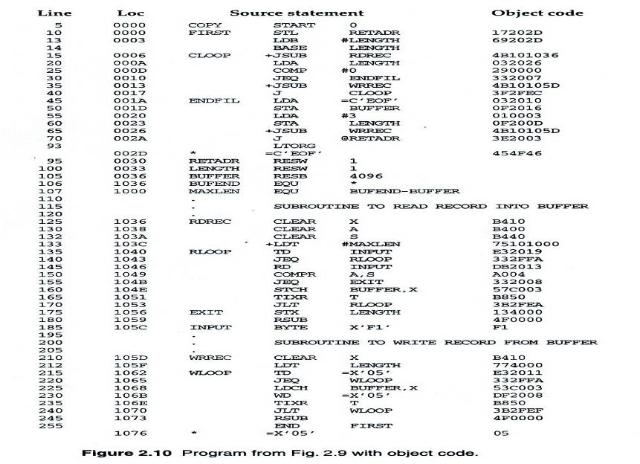

Slide 9
Literals vs. Immediate Operands
Immediate Operands
The operand value is assembled as part of the machine instruction
e.g. 55 0020 LDA #3 010003
Literals
The assembler generates the specified value as a constant at some other memory location
The address of this generated constant is used as target address for the machine instruction.
e.g. 45 001A ENDFIL LDA =C’EOF’ 032010

Slide 10
Literal – Implementation (1/3)
Literal pools
Normally literals are placed into a pool at the end of the program
See Fig (END statement) 255 END FIRST 1076 * =X’05’ 05
In some cases, it is desirable to place literals into a pool at some other location in the object program
Assembler directive LTORG
Reason: keep the literal operand close to the instruction

Slide 11
Literal – Implementation (2/3)
Duplicate literals
e.g. 215 1062 WLOOP TD =X’05’
e.g. 230 106B WD =X’05’
The assemblers should recognize duplicate literals and store only one copy of the specified data value
Same literal used in more than one places in the program

Slide 12
Literal – Implementation (3/3)
LITTAB
Literal name, the operand value and length, the address assigned to the operand
Pass 1
Build LITTAB with literal name, operand value and length, leaving the address unassigned
When LTORG statement is encountered, assign an address to each literal not yet assigned an address
Pass 2
Search LITTAB for each literal operand encountered
Data values specified by the literals are inserted at the appropriate place in the object program
Generate modification record for literals that represent an address in the program

Slide 13
Instruction format and addressing modes

Slide 14
Translation
Register translation
register name (A, X, L, B, S, T, F, PC, SW) and their values (0,1, 2, 3, 4, 5, 6, 8, 9)
preloaded in SYMTAB
Address translation
Most register-memory instructions use program counter relative or base relative addressing
Format 3: 12-bit address field
base-relative: 0~4095
pc-relative: -2048~2047
Format 4: 20-bit address field

Slide 15
Instruction format
Instruction formats
Relative addressing - format 3 (e=0)
Extend the address to 20 bits - format 4 (e=1)
Don’t refer memory at all - formats 1 and 2

Slide 16
Examples
Format 1 (1 Byte)
RSUB (Return to subroutine)
4 C
Format 2 (2 byte)
COMPR A,S
Opcode A S
A 0 0 4
Note : Format 1 and 2 are used for those instruction that do not refer memory at all
0100 1100
1010 0000 0000 0100

Slide 17
Format 3 (3 byte)
LDA #3
6 1 1 1 1 1 1 12
n i x b p e
0 1 0 0 0 3
If n=1 indirect addressing
i=1 immediate addressing
x=1 Indexed addressing
b=1 Base relative addressing
p=1 Program counter relative addressing
000000 | 0 | 1 | 0 | 0 | 0 | 0 | 0000 0000 0011

Slide 18
Format 4 (4 bytes)
+JSUB RDREC (Jump to address 1036)
4 B 1 0 1 0 3 6
Note: Bit ‘e’ is used to distinguish between format 3 and 4.
e=0 means format 3 and e=1 means format 4
010010 | 1 | 1 | 0 | 0 | 0 | 1 | 0000 0001 0000 0011 0110

Slide 19
Addressing modes
Addressing modes refers to the way in which the operand of an instruction is specified.
Addressing modes
Relative addressing modes
Base relative addressing mode
Program counter relative addressing mode
Direct addressing mode
Other addressing modes
Indexed addressing mode
Immediate addressing mode
Indirect addressing mode
Simple addressing mode

Slide 20
Note:
PC-relative or Base-relative addressing: op m
Indirect addressing: op @m
Immediate addressing: op #c
Extended format: +op m
Index addressing: op m,x

Slide 22
Relative addressing mode

Slide 23
Example:
0000 FIRST STL RETADR 17201B
P.C =0003
RETADR=0030
Disp = 30-3 =1B
T.A= PC + Disp
0003+1B=0030

Slide 24
Base relative addressing mode
In PC relative addressing mode , assembler knows the content of P.C
But in base relative addressing mode, programmer must tell the assembler the content of base register using the statement
LDB #LENGTH (say length=0033 so B=0033)
E.g.
160 1046 STCH BUFFER, X 57C003
Address of buffer=0036
B content= 0033
Disp = 36-33 =3

Slide 25
Direct addressing mode
If bits b and p are set to 0,the disp field from the format 3 is taken to be target address
For format 4 instruction, bits b and p are normally set to 0 and target address is taken from the address field of the instruction.
E.g. LDA LENGTH
Immediate addressing
i=1 and n=0,target address itself is used as operand value
No memory reference performed
E.g. LDA #9

Slide 26
Indirect addressing
If bit i=0 and n=1, the word at the location given by target address is fetched. The value contained in this word is then taken as the address of the operand value
E.g. J @RETADR
Simple addressing
If bit i and n are 0 or both 1, the target address is taken as the location of the operand
Indexed Addressing
E.g. STCH BUFFER , X
5 4 1 0 0 0
Effective address= 1000+ content of index register X
0101 01 | 0 0 0 0 0 1 | 0000 0000 0000

Slide 27
Necessity of 2 passes and Forward References
Forward reference is a reference to a label that is defined later in the program.
E.g.
COPY START 1000
1000 FIRST STL RETADR
.
.
.
RETADR RESW 1
.
.
END FIRST

Slide 28
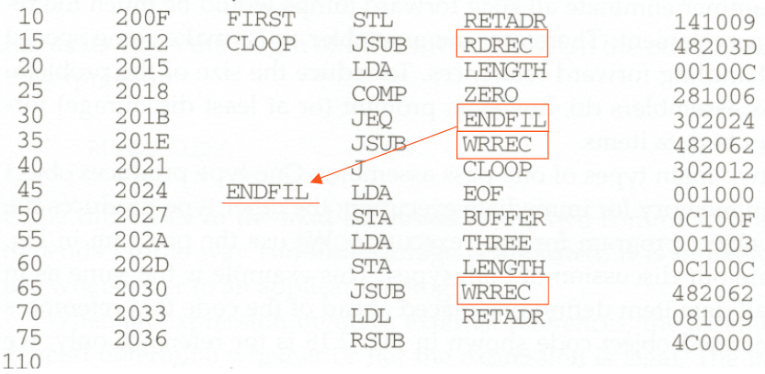

Slide 29
Necessity of two passes
Forward reference is difficult to resolve in single pass
Because of this most assembler make 2 passes over the source program
The first pass scan the source program for label definition and assign address
The second pass perform most of the translation
Note:
Thus we have
2 pass assembler( read twice)
1 pass assembler(Single read)

Slide 30
Data structure used by assembler
OPTAB
SYMTAB
LOCCTR

Slide 31
OPTAB(Operation Code Table)
Content
mnemonic, machine code (instruction format,
length) etc.
Characteristic
static table
Implementation
array or hash table, easy for search , opcode as key
Purpose
Used to check the validity of opcode (pass1)
Convert opcode to machine code (pass2)

Slide 32
SYMTAB (symbol table)
keep track of the types of all symbols defined in the program
Content
label name, value, flag, (type, length) etc.
Characteristic
dynamic table (insert, delete, search)
Implementation
hash table, non-random keys, hashing function
Note:
During pass1, labels are entered to SYMTAB along with address of LOCCTR
During pass2, symbols used as operand are looked up in the table(to get addr)

Slide 33
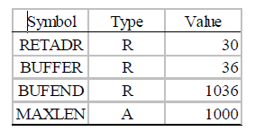
SYMTAB (symbol table)

Slide 34
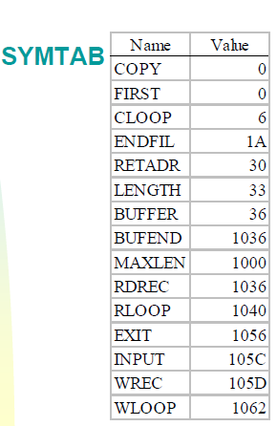

Slide 35
LOCCTR
It is a counter variable that is used to help in the assignment of address
LOCCTR is initialized to the beginning address specified in the START statement.
After each source statement is processed, the length of the assembled instruction or data area to be generated is added to LOCCTR

Slide 36
Assembler output format
Object program contains 3 types of record
Header record
Text record
End record
The header record contains the program name, starting address and length.
The text record contains the translated(i.e. machine code ) instruction and data of the program together with the indication of where these are to be loaded
The end record marks the end of the object program and specifies the address in the program the execution is to begin

Slide 37
Header
Col. 1 H
Col. 2~7 Program name
Col. 8~13 Starting address (hex)
Col. 14-19 Length of object program in bytes (hex)
Text
Col.1 T
Col.2~7 Starting address in this record (hex)
Col. 8~9 Length of object code in this record in bytes (hex)
Col. 10~69 Object code ( 2 columns per byte of object code)
End
Col.1 E
Col.2~7 Address of first executable instruction (hex)
(END program name)

Slide 38
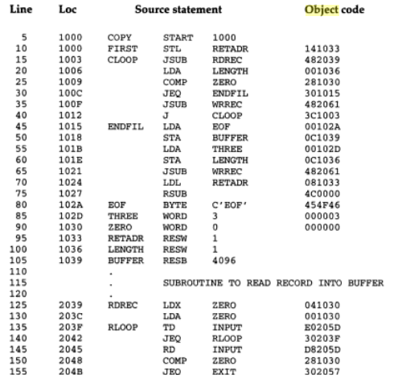

Slide 39
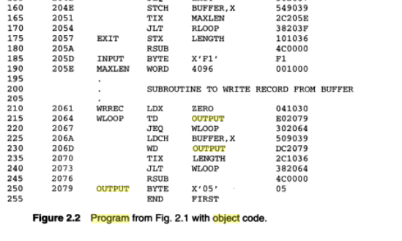

Slide 40
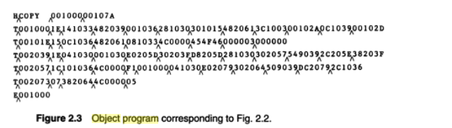
Note: No object code generated for assembler directive like RESW,RESB in the source program

Slide 41
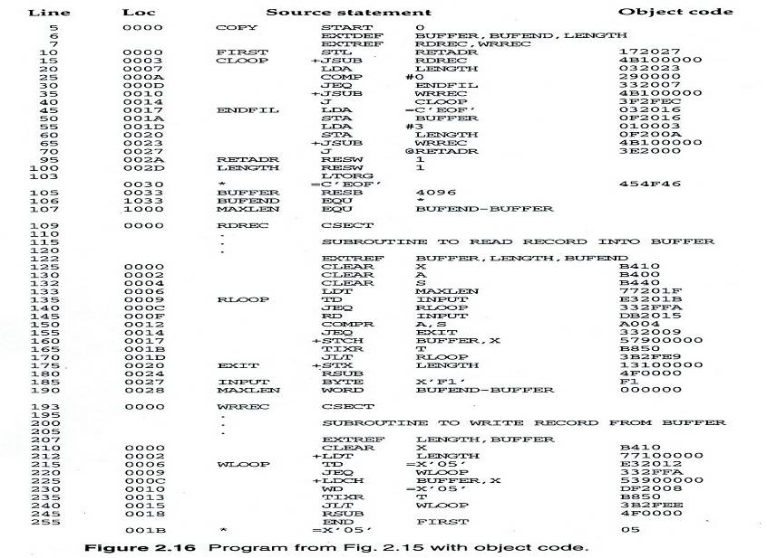

Slide 42
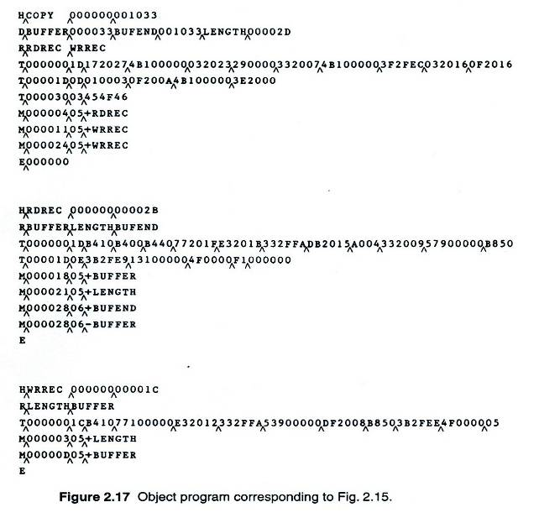
Example 2

Slide 43
2 Pass Assembler
General description of the two pass assembler is given below:
Pass1 (define symbols)
Assign addresses to all statements in the program.
Save the values (addresses) assigned to all labels for use in pass2
Perform some processing of assembler directives
Pass2(Assemble instruction and generate object program)
Assemble instruction (translating operation codes and looking up addresses)
Generate data values defined by BYTE, WORD
Perform processing of assembler directives not done in Pass 1
Write the object program and the assembly listing

Slide 44
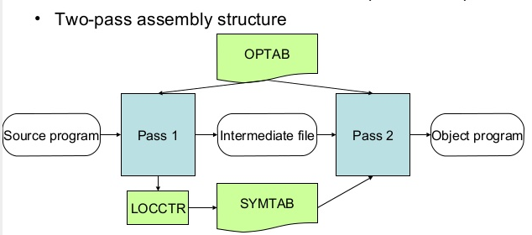

Slide 45
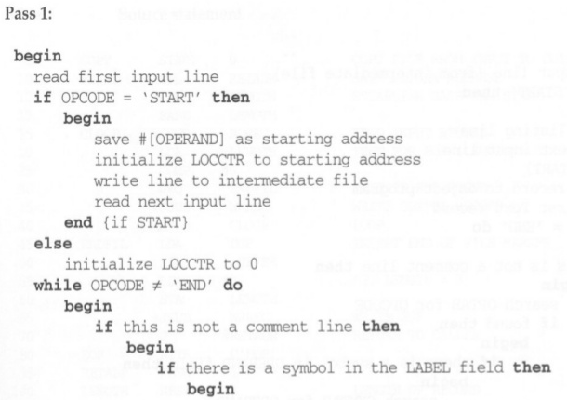
2 pass assembler Algorithm

Slide 46
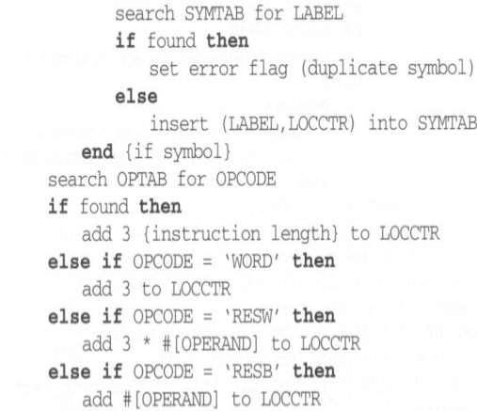

Slide 47
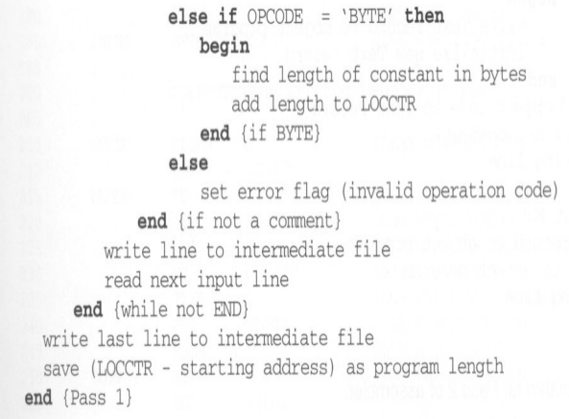

Slide 48
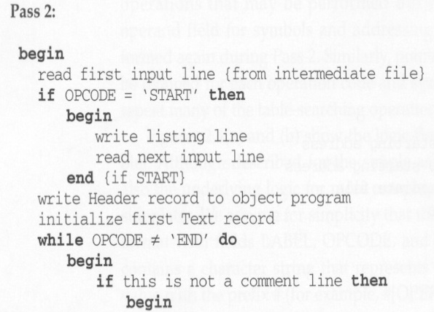

Slide 49
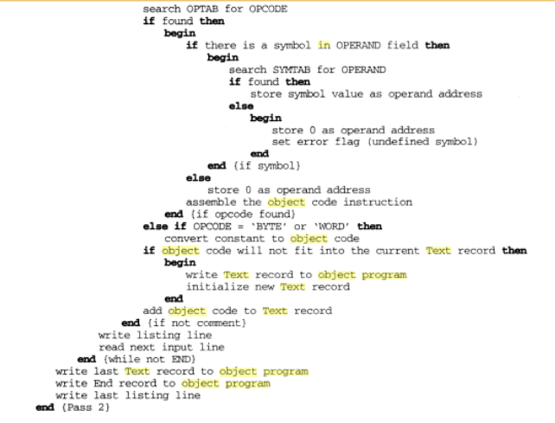
o

Slide 50
One Pass Assembler
There are two main types of one pass assembler:
Load-and-go
Produces object code directly in memory for immediate execution
The other
Produces usual kind of object code for later execution

Slide 51
Load and go assembler
Characteristics
Useful for program development and testing
Avoids the overhead of writing the object program out and reading it back
Both one-pass and two-pass assemblers can be designed as load-and-go.
However one-pass also avoids the over head of an additional pass over the source program
For a load-and-go assembler, the actual address must be known at assembly time, we can use an absolute program

Slide 52
Forward references handling
1. Omit the address translation
2. Insert the symbol into SYMTAB, and mark this symbol undefined
3. The address that refers to the undefined symbol is added to a list of forward references associated with the symbol table entry
4. When the definition for a symbol is encountered, the proper address for the symbol is then inserted into any instructions previous generated according to the forward reference list

Slide 53
At the end of the program
Any SYMTAB entries that are still marked with * indicate undefined symbols
Search SYMTAB for the symbol named in the END statement and jump to this location to begin execution
The actual starting address must be specified at assembly time

Slide 54
Forward reference

Slide 55
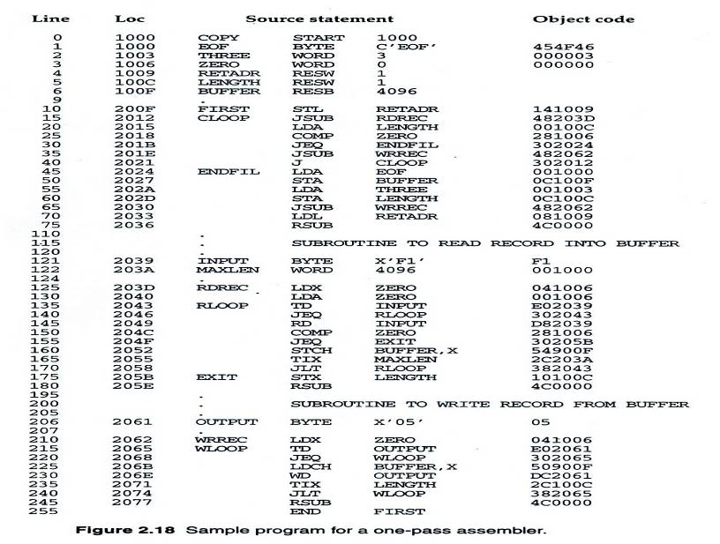

Slide 56
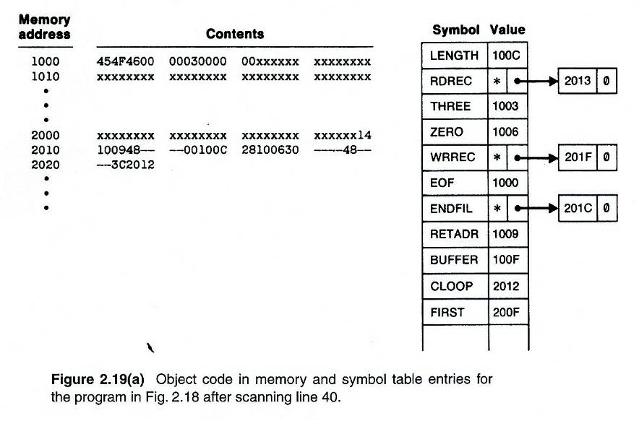

Slide 57
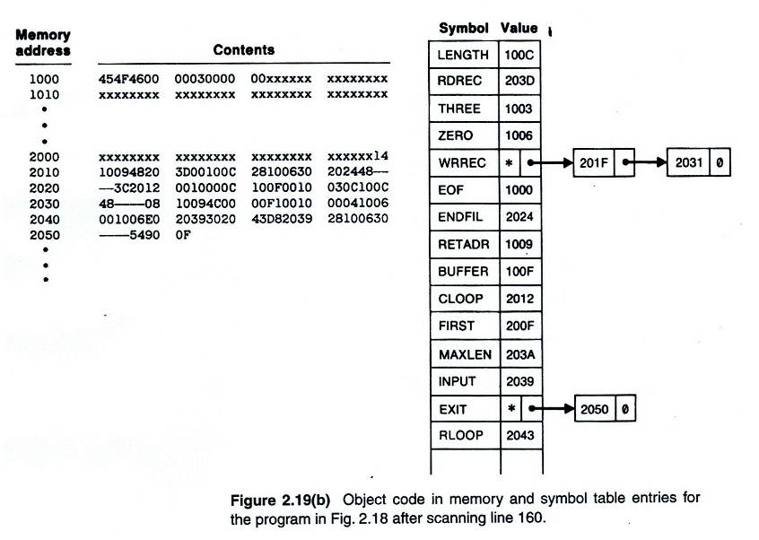

Slide 58
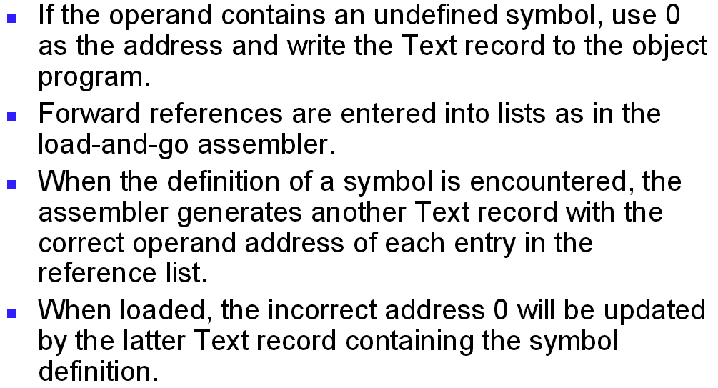
Object code in one pass assembler

Slide 59
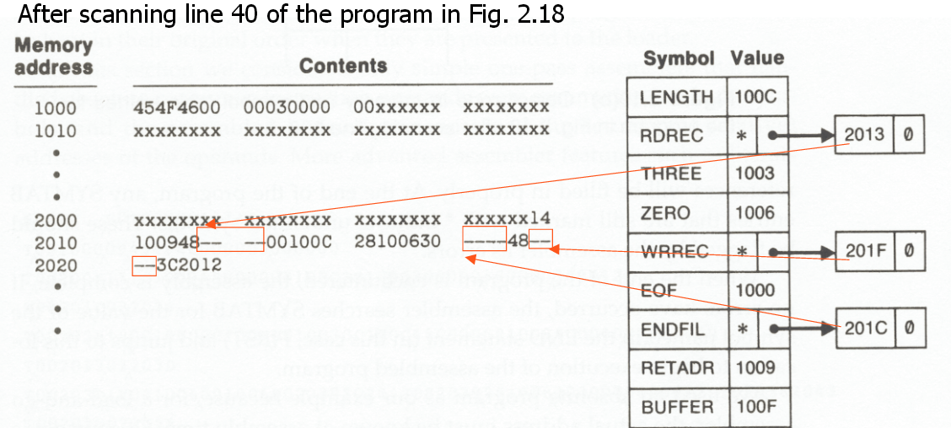

Slide 60
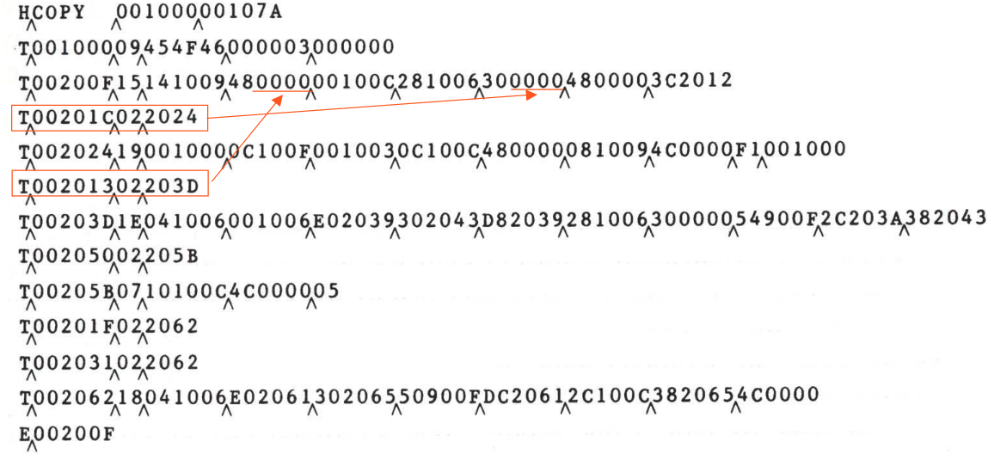
Object code generated by 1 pass assembler

Slide 61
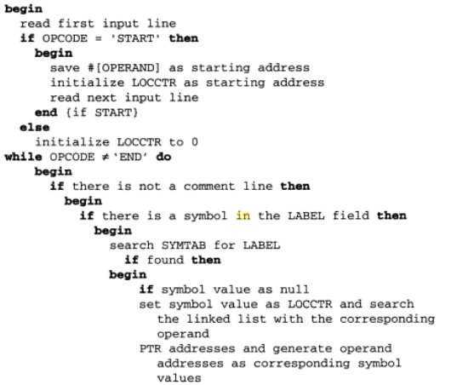
One pass assembler algorithm

Slide 62
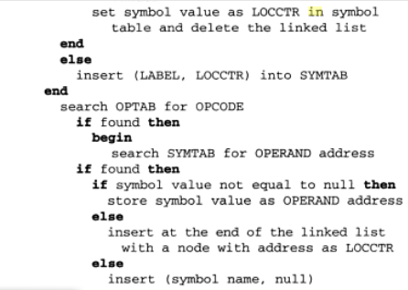

Slide 63
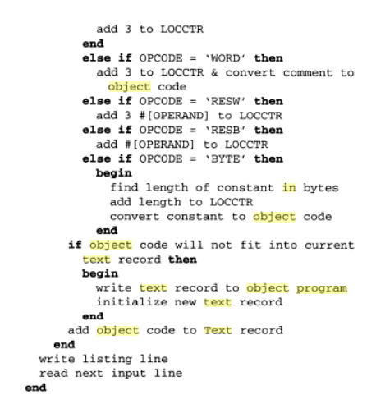


Slide 64
Program block and control section

Slide 65
PROGRAM BLOCK
Program blocks
Feature that allow generated machine instructions and data to appear in object program in a different order from the corresponding source statement
Refer to segments of code that are rearranged within a single object program unit
USE [blockname]
At the beginning, statements are assumed to be part of the unnamed (default) block
If no USE statements are included, the entire program belongs to this single block
Example: Figure 2.11
Each program block may actually contain several separate segments of the source program

Slide 66
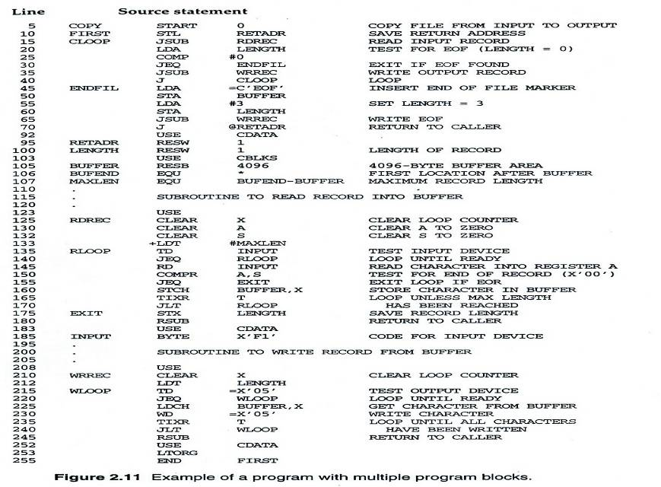

Slide 67
Program Blocks - Implementation
Pass 1
Each program block has a separate location counter
Each label is assigned an address that is relative to the start of the block that contains it
At the end of Pass 1, the latest value of the location counter for each block indicates the length of that block
The assembler can then assign to each block a starting address in the object program
Pass 2
The address of each symbol can be computed by adding the assigned block starting address and the relative address of the symbol to that block

Slide 68
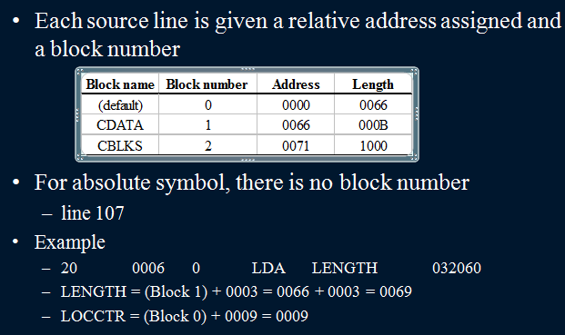

Slide 69
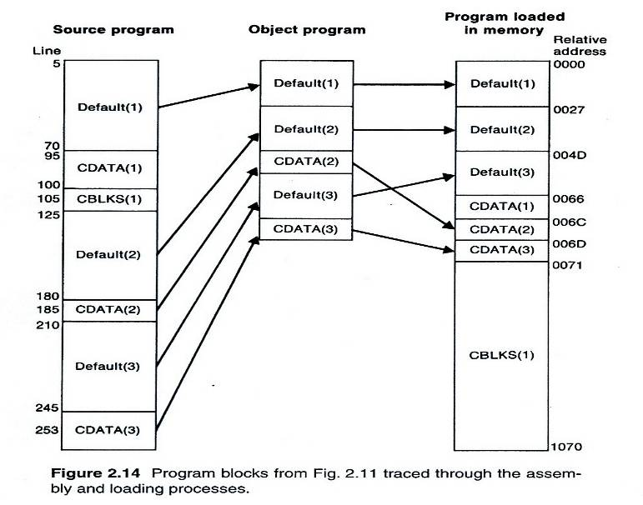

Slide 70
Control Sections and Program Linking
Refers to segments that are translated into independent object program unit.
Each control section can be loaded and relocated independently of the other.
Are most often used for subroutines or other logical subdivisions of a program
The programmer can assemble, load, and manipulate each of these control sections separately
Instruction in one control section may need to refer to instructions or data located in another section
Because of this, there should be some means for linking control sections together

Slide 71
References between control sections are called external references.
The assembler directive CSECT signals the start of new control section.
The assembler establishes a separate location counter (beginning at 0) for each control section.

Slide 72
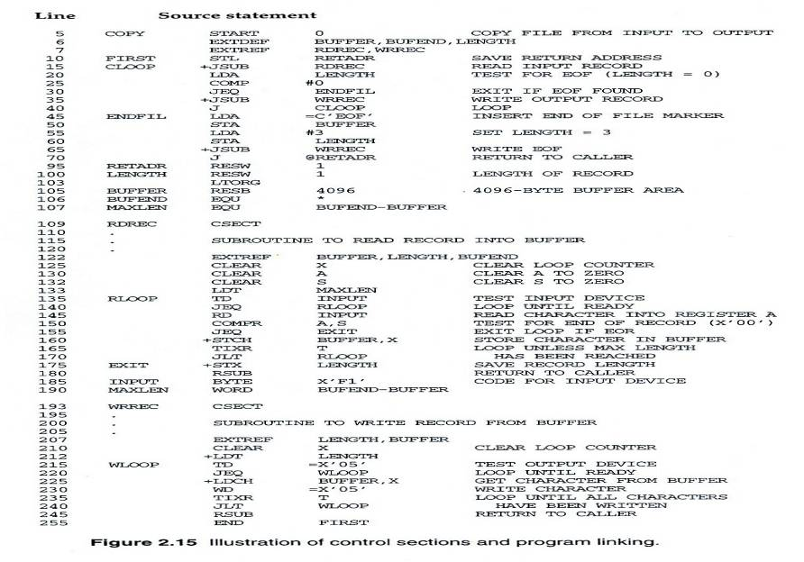

Slide 74
External Definition and References
References between control sections are called external references.
External definition
EXTDEF name [, name]
EXTDEF names symbols that are defined in this control section and may be used by other sections
External reference
EXTREF name [,name]
EXTREF names symbols that are used in this control section and are defined elsewhere
Example EXTREF EXDEF
15 0003 CLOOP +JSUB RDREC 4B100000
160 0017 +STCH BUFFER,X 57900000
190 0028 MAXLEN WORD BUFEND-BUFFER 000000

Slide 75
Implementation
The assembler must include information in the object program that will cause the loader to insert proper values where they are required
Define record
Col. 1 D
Col. 2-7 Name of external symbol defined in this control section
Col. 8-13 Relative address within this control section (hexadecimal)
Col.14-73 Repeat information in Col. 2-13 for other external symbols
Refer record
Col. 1 D
Col. 2-7 Name of external symbol referred to in this control section
Col. 8-73 Name of other external reference symbols

Slide 76
Modification record
Col. 1 M
Col. 2-7 Starting address of the field to be modified (hexadecimal)
Col. 8-9 Length of the field to be modified, in half-bytes (hexadecimal)
Col.11-16 External symbol whose value is to be added to or subtracted from the indicated field
Note: control section name is automatically an external symbol, i.e. it is available for use in Modification records.
Example
M^000004^05+RDREC

Slide 77
Example
4 B
1 0
0 0
0 0
0003
0004
Red digit indicate 5 half byte is to be modified
0005
0006
Modification record of JSUBM(Line 15): M^00004^05

Slide 80
Multi pass assembler
Why Multi pass assembler
ALPHA EQU BETA
BETA EQU DELTA
DELTA EQU 1
Symbol BETA cannot be assigned a value during first pass
Thus ALPHA cannot be evaluated during the second pass
If sequence of definition occur, then forward references cannot be efficiently resolved using two pass assembler so we need multi pass assembler.
Multi pass assembler make as many passes as required to process the definition of symbols.

Slide 81
It is not necessary to make more than two passes over the entire program
Instead , the portion of the program that involves forward references in symbol definition are saved during pass1
Additional passes through this stored definitions are made as assembly progresses.
This process is followed by a normal pass 2
Symbols definitions that involve forward references are stored in symbol table.
The table also indicate which symbols are dependent on the values of others to facilitate symbol evaluation.

Slide 82
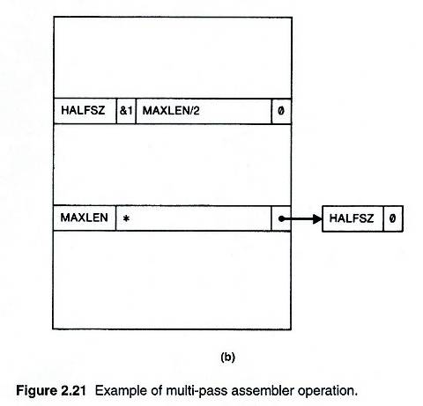
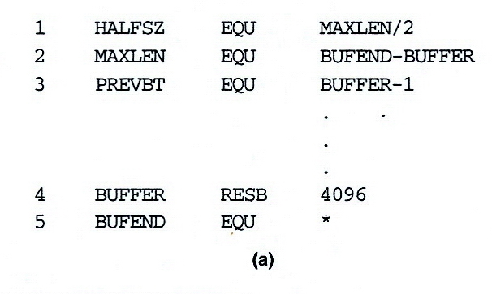
Figure 2.21 (1/5)

Slide 83
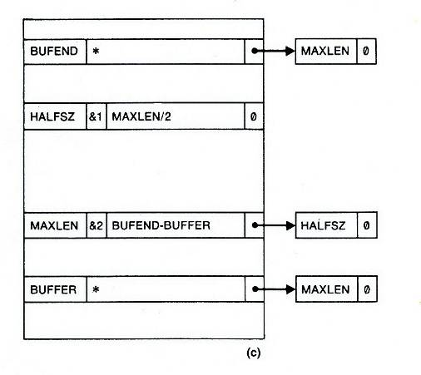
Figure 2.21 (2/5)

Slide 84
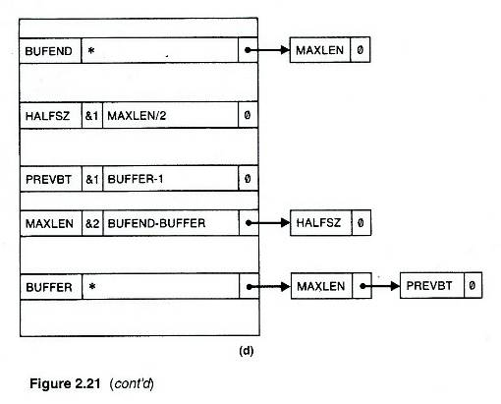
Figure 2.21 (3/5)

Slide 85
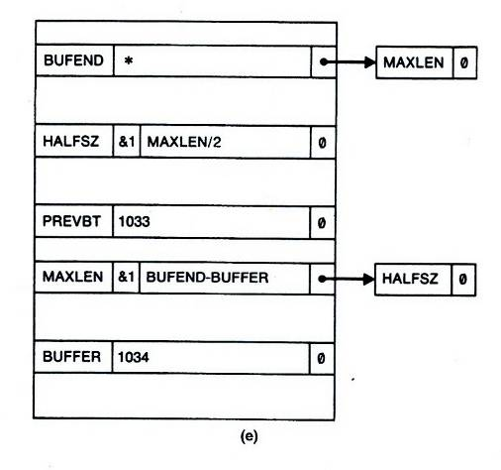
Figure 2.21 (4/5)

Slide 86
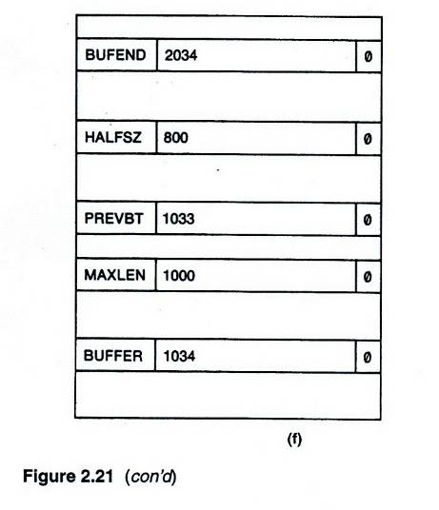
Figure 2.21 (5/5)

Slide 87
Macro Assembler
Macro Assembler perform macro expansion and program assembly simultaneously.
Functions of assembler and macro preprocessor are merged if macros are handled by a macro assembler.
Reduces the number passes over the source program.

Slide 88
Pass structure of macro assembler
3 Pass Structure
Pass 1
Macro definition processing
SYMTAB Construction.
Pass 2
Macro Expansion
Memory allocation and LC processing
Processing Literals
Intermediate code generation
Pass 3
Target code generation.

Slide 89
Pass 2 is large in size, it perform many functions
Since it perform macro expansion as well as pass1 of conventional assembler, all the data structure of the macro preprocessor and the conventional assembler need to exist during this pass.
Pass 3 structure is simplified to give us a 2 pass structure.

Slide 90
2 pass structure
Pass 1
Macro definition processing
Macro expansion
Memory allocation ,LC Processing and SYMTAB construction
Processing of literals
Intermediate code generation
Pass 2
Target code generation

Slide 91
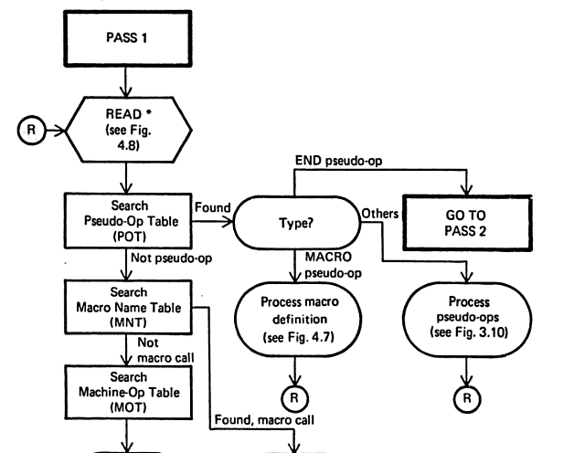
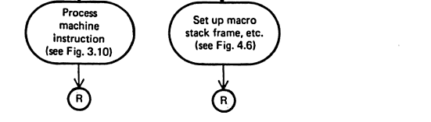

Slide 92
Advantages of Macro Assembler
Many Functions do not have to be implemented twice (e.g. read)
There is less overhead during processing (Functions are combined )
It is not necessary to create intermediate files as output from macro processor and input to assembler
Disadvantages
The combined pass 1 of the assembler and macro preprocessor may be too large program to fit into core of some machine.
The complexity of such program may be more

