Slide 1
MacroProcessor
Lecture 2

Slide 2
Macro
Macro: A set of instructions that is represented in an abbreviated format
A macro is a fragment of code which has been given a name. Whenever the name is used, it is replaced by the contents of the macro. There are two kinds of macros.
A macro instruction is a notational convenience for the programmer
It is a unit of specification for program generation through expansion.
It allows the programmer to write shorthand version of a program (module programming)

Slide 3
A macro consist of a name , a set of formal parameters and a body of code.(Macro Definition)
The use of macro name with a set of actual parameter (Macro call/macro invocation) is replaced by some code generated from its body. This is called macro expansion
Macro Definition
A macro definition is enclosed between a macro header statement and a macro end statement
Typically located at the start of the program

Slide 4
A macro definition consist of :
1. Macro Prototype statement
Declares name of macro and name & kinds of its parameter
2. One or more model statements
Statement from which assembly language statement is generated during expansion
3. Macro preprocessor statements
Used to perform auxiliary function during expansion

Slide 5
Source
STRG MACRO
STA DATA1
STB DATA2
STX DATA3
MEND
.
STRG
.
STRG
.
.
Expanded source
.
.
.
STA DATA1
STB DATA2
STX DATA3
.
STA DATA1
STB DATA2
STX DATA3
.

Slide 6
Source
STRG MACRO &a1, &a2, &a3
STA &a1
STB &a2
STX &a3
MEND
.
STRG DATA1, DATA2, DATA3
.
STRG DATA4, DATA5, DATA6
.
.
Expanded souce
.
.
.
STA DATA1
STB DATA2
STX DATA3
.
STA DATA4
STB DATA5
STX DATA6
.

Slide 7
Macro Processor
The macro processor replaces each macro invocation with the corresponding sequence of statements (Macro expansion)
A macro processor will
Recognize macro definitions
Save the macro definition
Recognize macro calls
Expand macro calls

Slide 8
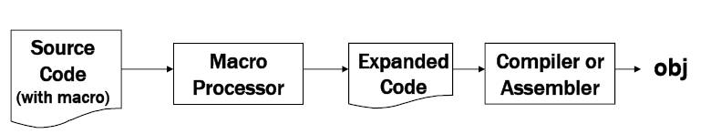

Slide 9
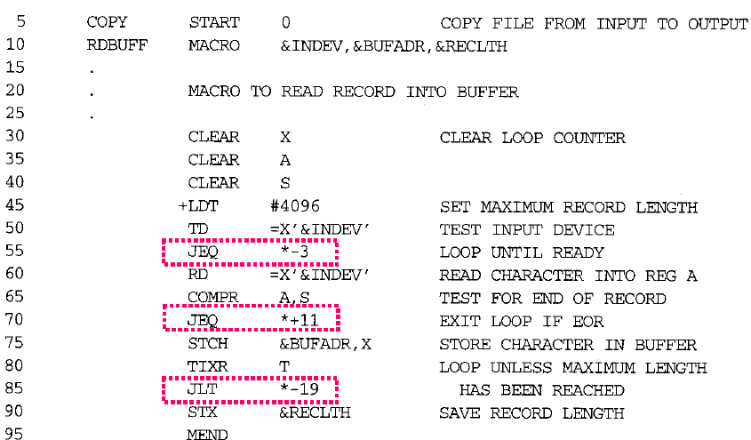
Macro Definition and Invocation

Slide 10
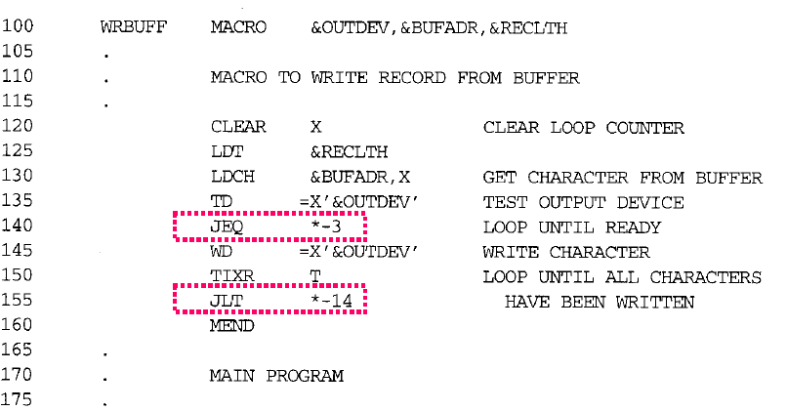

Slide 11
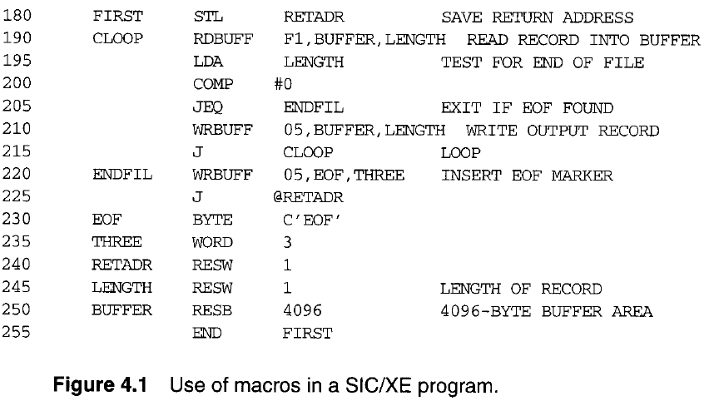

Slide 12
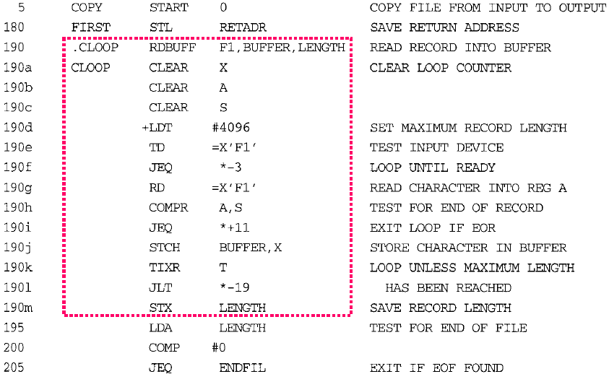
Expanded Program

Slide 13
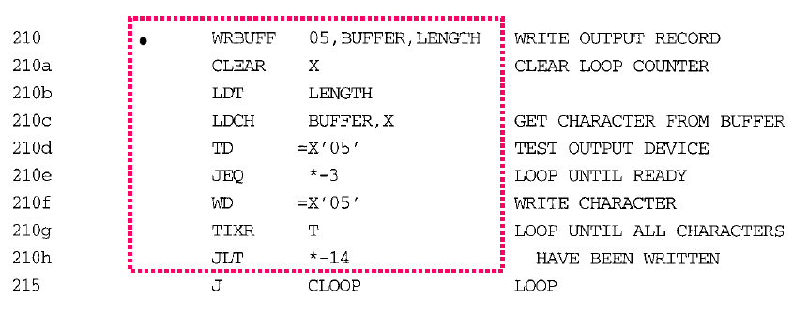

Slide 14
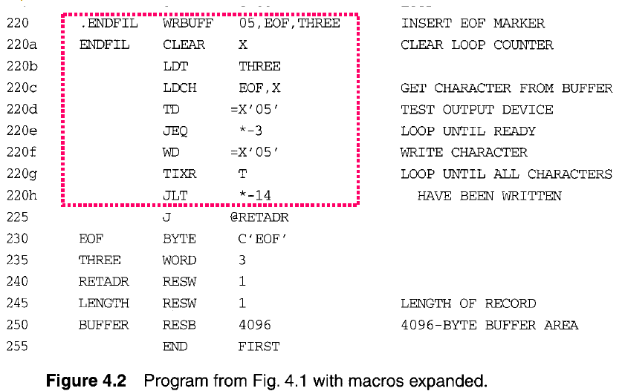

Slide 15
Macro Processor Data structure
Three main data structures are:
1. DEFTAB
2. NAMTAB
3. ARGTAB
DEFTAB
Definition table DEFTAB contains macro prototype and the statement that make up the macro body
Comments lines from definition are not entered
NAMTAB
Macro names are entered
Serve as a index to DEFTAB
Contains pointer to the beginning and end of the definition in DEFTAB

Slide 16
ARGTAB
Used during the expansion of macro invocation
Contains argument list
Arguments from ARGTAB is substituted for corresponding argument in macro body
When a macro invocation statement is recognized, arguments are stored in ARGTAB

Slide 17
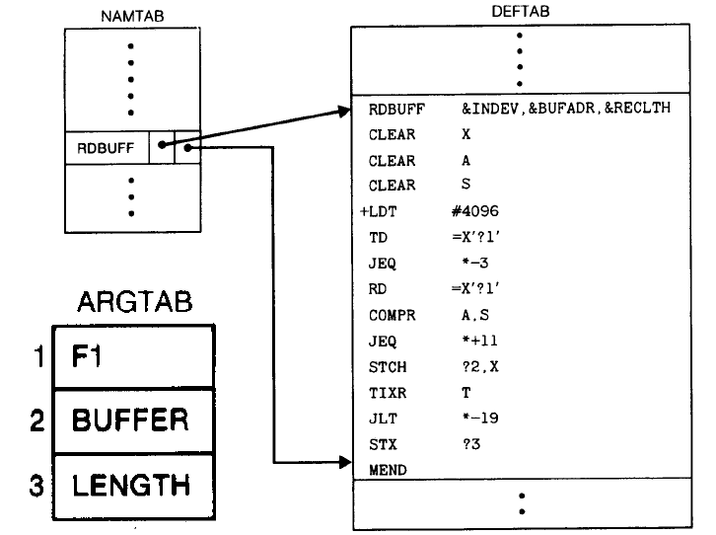

Slide 18
Algorithm for one pass macro processor
Prerequisite
every macro must be defined before it is called
Sub-procedures
macro definition: DEFINE
macro invocation: EXPAND
NOTE
every macro must be defined before it is called
one-pass processor can alternate between macro definition and macro expansion
nested macro definitions may be allowed but nested calls are not

Slide 19
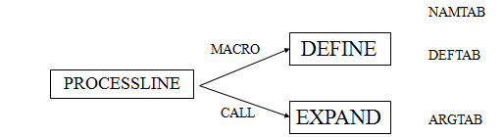

Slide 20
The procedure DEFINE
Called when the beginning of a macro definition is recognized, makes the appropriate entries in DEFTAB and NAMTAB.
DEFINE procedure maintains a counter named LEVEL.
MACROdirective is read, the value of LEVEL is inc. by 1.
MENDdirective is read, the value of LEVEL is dec. by 1.
The procedure EXPAND
Called to set up the argument values in ARGTAB and expand a macro invocation statement.
The procedure GETLINE
Called at several points in the algorithm, gets the next line to be processed.
EXPANDING is set to TRUE or FALSE.

Slide 21
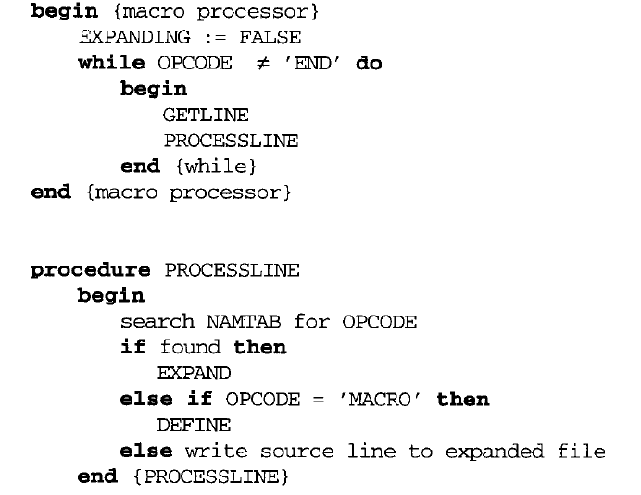

Slide 22
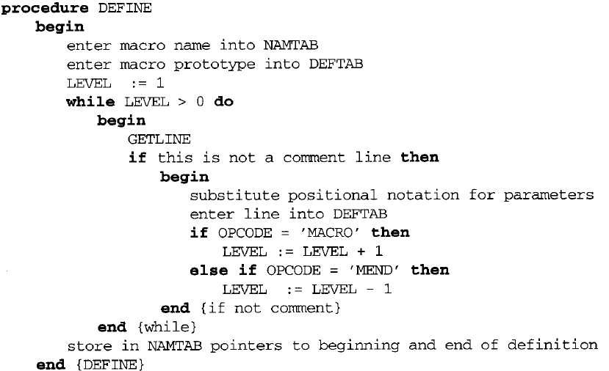

Slide 23
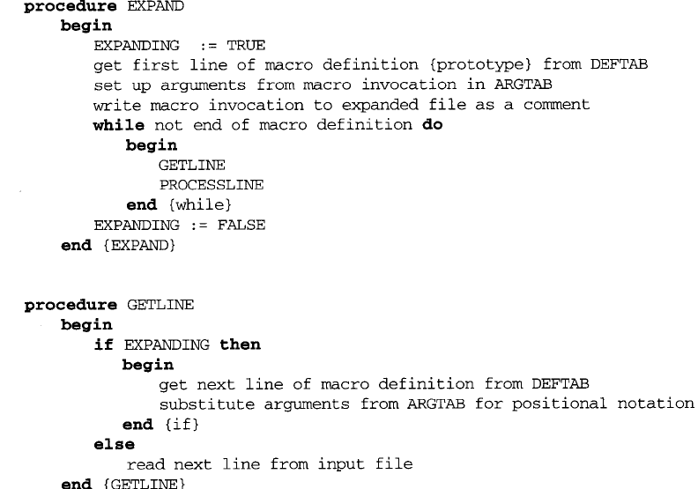

Slide 24
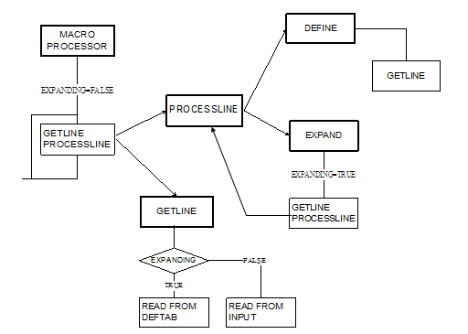

Slide 25
Two-pass macro processor
All macro definitions are processed during the first pass.
All macro invocation statements are expanded during the second pass.
Two-pass macro processor would not allow the body of one macro instruction to contain definitions of other macros.

Slide 26
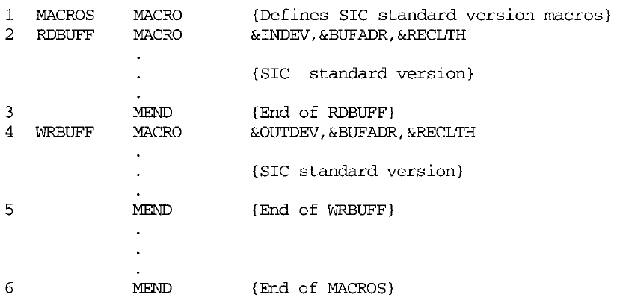
Nested macro definition

Slide 27
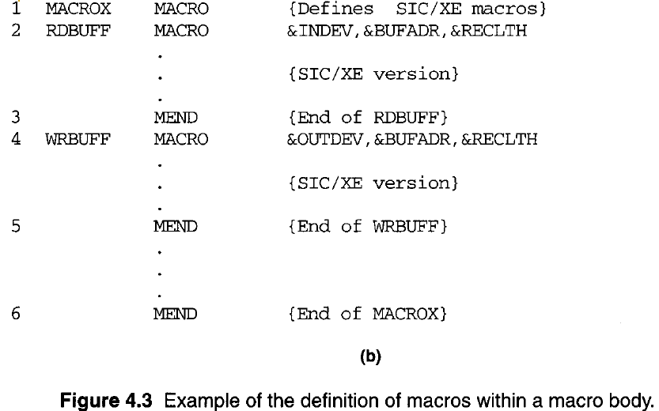

Slide 28
Features of macro processor

Slide 29
1. Concatenation of macro parameters
Most macro processors allow parameters to be concatenated with other character strings.
Pre-concatenation
LDA X&ID1
Post-concatenation
LDA X&ID→1

Slide 30
The beginning of the macro parameter is identified by the starting symbol &;however, the end of the parameter is not marked.
The problem is that the end of the parameter is not marked. Thus X&ID1 may mean “X”+ ID + “1”or “X”+ ID1.
In which the parameter &ID is concatenated after the character string X and before the character string 1.

Slide 31
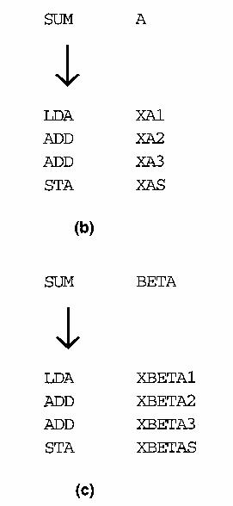
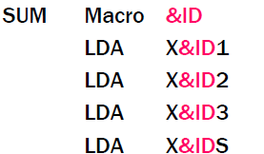

Slide 32
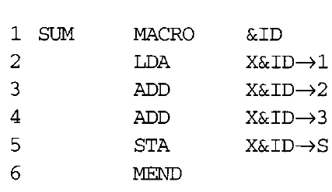
Most macro processors deal with this problem by providing a special concatenation operator (Fig. 4.6).
In SIC or SIC/XE, -> is used

Slide 33
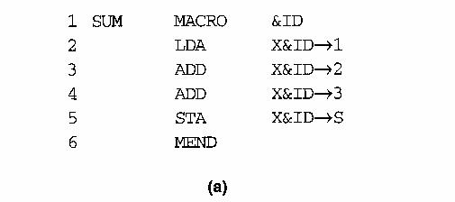

Slide 34
2. Generation of Unique Labels
Example
JEQ *-3
inconvenient, error-prone, difficult to read
Many macro processor avoid these problems by allowing the creation of special types of labels within macro instructions.

Slide 36
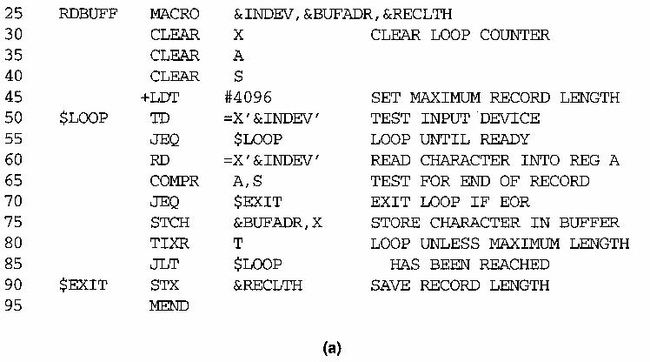

Slide 37
Every time of macro expansion, macro processor replaces $ with $xx where xx is a two character alphanumeric counter where for the four expansion its value is
$AA
$AB
$AC
$AD

Slide 38
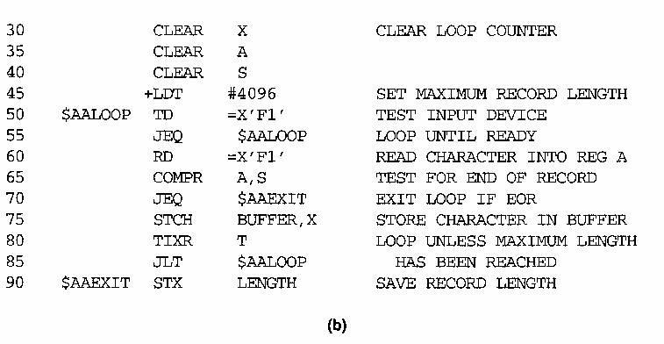
RDBUFF F1, BUFFER, LENGTH

Slide 39
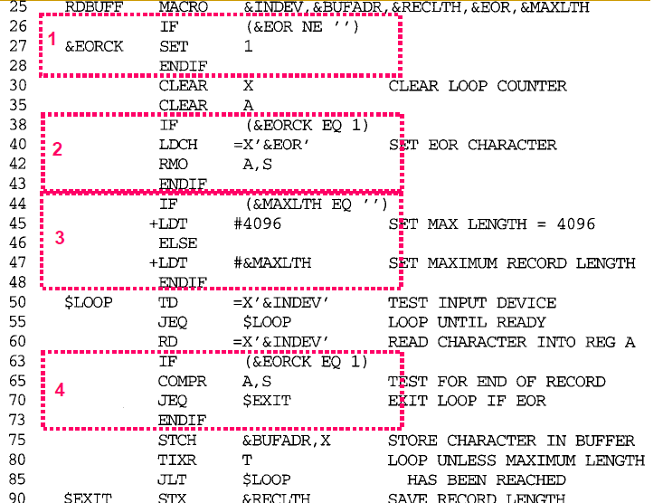
3. Conditional Macro Expansion
Using this facility macro processors can modify the sequence of statements generated for a macro expansion depending on the arguments supplied in the macro invocation.

Slide 40
Add greatly to the power and flexibility of a macro language.
IF-ELSE-ENDIF structure provides a mechanism for either generating or skipping selected statements in the macro body

Slide 41
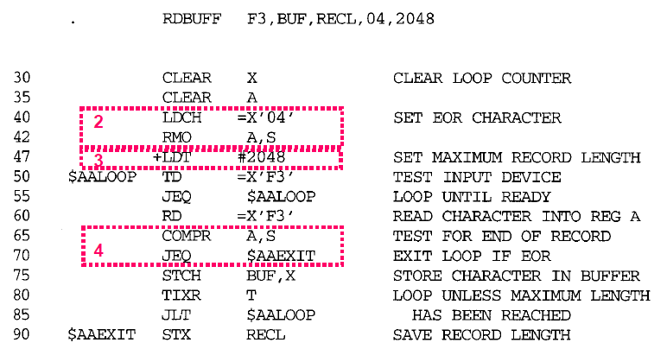
After Expansion

Slide 42
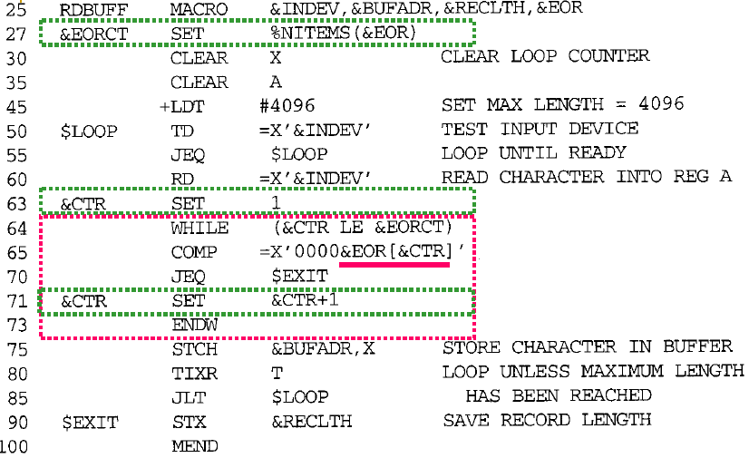
WHILE-ENDW structure

Slide 43
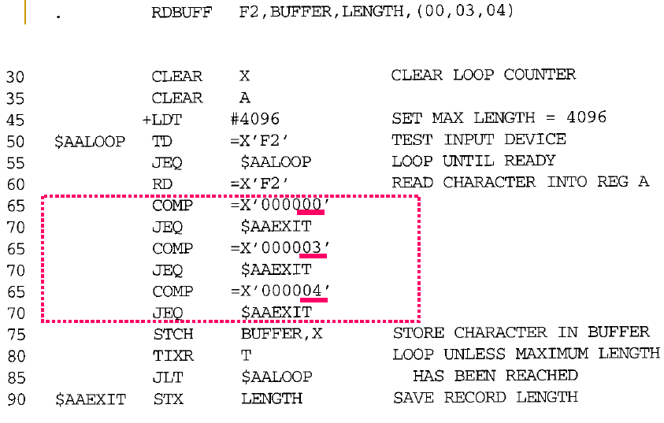
After expansion

Slide 44
4. Keyword Macro Parameters
All macro definitions we have seen positional parameters .
Parameters and arguments are associated with each other according to their positions in macro prototype and macro invocation statement-Positional parameter.
With positional parameter, programmer must carefully specify the arguments in proper order.
Example( When positional parameter are used)
GENER , , DIRECT, , , , , , 3

Slide 45
In keyword parameter specification, each argument value is written with keyword that names the corresponding parameter .
Arguments may appear in any order.
Example
GENER TYPE=DIRECT,CHANNEL=3
Macro invocation are easier to read and much less error prone.

Slide 46
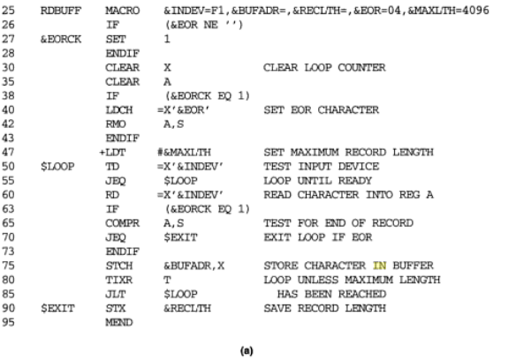

Slide 47
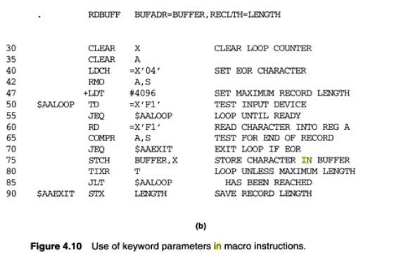

Slide 48
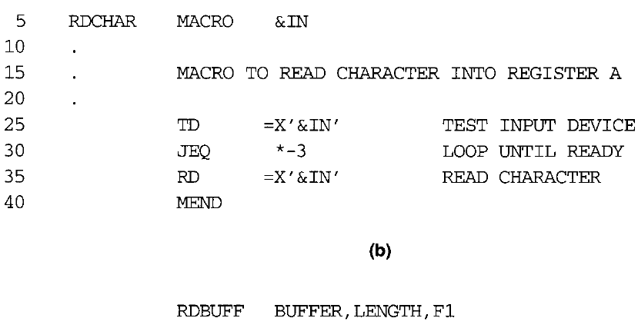
Handling Recursive and Nested macro call

Slide 49
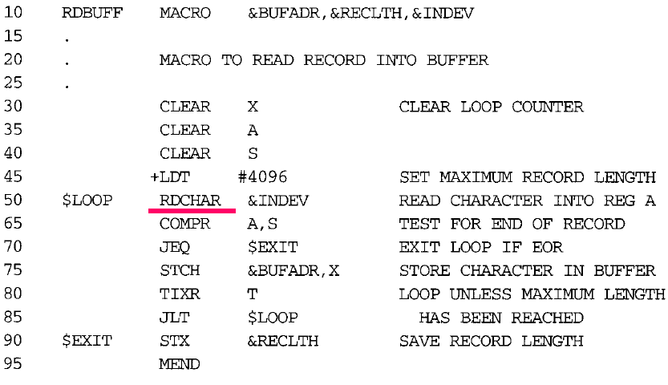

Slide 50
If one pass macro processor algorithm were applied to the macro invocation statement
RDBUFF BUFFER, LENGTH, F1
The procedure EXPAND would be called when the macro was recognized.
The arguments from the macro invocation would be entered into ARGTAB as follows:

Slide 51
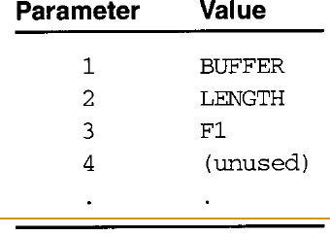

Slide 52
The Boolean variable EXPANDING would be set to TRUE, and expansion of the macro invocation statement would be begin.
The processing would proceed normally until line 50, which contains a statement invoking RDCHAR. At that point, PROCESSLINE would call EXPAND again.
This time, ARGTAB would look like

Slide 53
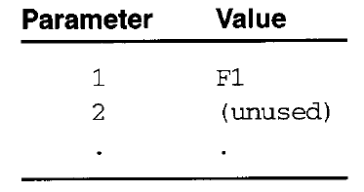

Slide 54
At the end of this expansion, however, a problem would appear. When the end of the definition of RDCHAR was recognized, EXPANDING would be set to FALSE.
Thus the macro processor would “forget” that it had been in middle of expanding a macro when it encountered the RDCHAR statement.
Solution
Use a Stack to save ARGTAB.
These problems are not difficult to solve if the macro processor is written in a programming language that allows recursive call
Use a counter to identify the expansion.

Slide 55
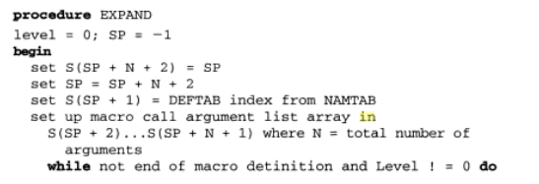

Slide 56
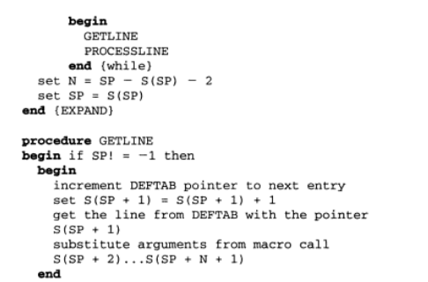

Slide 57
