Slide 1
Debugger

Slide 2
Debugging
Debugging is that activity which is performed after executing a successful test case.
Remember that a successful test case is one that shows that a program does not do what it was designed to do.
Debugging consists of determining the exact nature and location of the suspected error and fixing the error.
Locating the error represents about 95% of the activity

Slide 3
Debugging occurs as a consequence of successful testing. That is, when a test case uncovers an error, debugging is an action that results in the removal of the error.
Debugging is a two-step process that begins when you find an error as a result of a successful test case.
Step 1 is the determination of the exact nature and location of the suspected error within the program.
Step 2 consists of fixing the error.

Slide 4
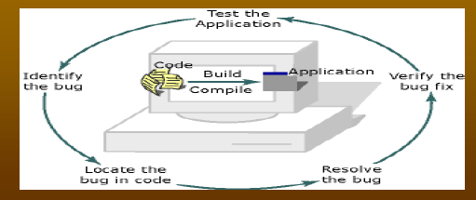

Slide 5
Debugging Process
The debugging process begins with the execution of a test case.
Results are assessed and a lack of correspondence between expected and actual performance is encountered.
In many cases, the non corresponding data are a symptom of an underlying cause as yet hidden.
Debugging attempts to match symptom with cause, thereby leading to error correction

Slide 6
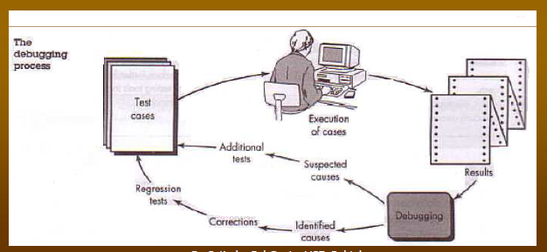

Slide 7
Difference between Testing and Debugging
Testing is the process of executing a program or system with the aim of findings errors or bugs.
Correcting these errors or bugs (found during testing) is debugging.
Testing list out the errors where as debugging localize and correct the error
Bug-A fault in a program, which causes the program to perform in an unintended or unanticipated manner

Slide 8
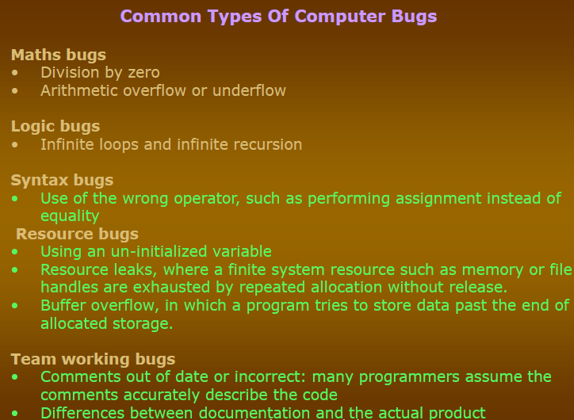

Slide 9
Debugger
An interactive debugging system (IDS) provides programmers with facilities that aid in testing and debugging of programs. Many such systems are available during these days.
Debugging Functions and Capabilities
One important requirement of any IDS is the observation and control of the flow of program execution.
Setting break points – execution is suspended
After execution is suspended, use debugging commands to analyze the progress of the program and to diagnose errors detected.
Execution of the program can then be resumed.
As an alternative , the program can define conditional expression that are continually evaluated during the debugging session. Program execution is suspended when any of these conditions become true.

Slide 10
A Debugging system should also provide functions such as tracing and trace back.
Tracing can be used to track the flow of execution logic and data modifications. The control flow can be traced at different levels of detail – procedure, branch, individual instruction, and so on…
Trace back can show the path by which the current statement in the program was reached. It can also show which statements have modified a given variable or parameter. The statements are displayed rather than as hexadecimal displacements

Slide 11
Program-Display capabilities
A debugger should have good program-display capabilities.
Program being debugged should be displayed completely with statement numbers.
The program may be displayed as originally written or with macro expansion.
It is useful to be able to able to modify and incrementally recompile the program during debugging session
Support for symbolically displaying or modifying the contents of any of the variables and constants in the program
To provide these functions, a debugger should consider the language in which the program being debugged is written.
A single debugger – many programming languages –language independent. (we need a single debugging tool that is applicable to multilingual situation)
Debugging commands should be common across languages

Slide 12
The debugger - a specific programming language – language
dependent.
The debugger must be sensitive to the specific language being debugged so that procedural, arithmetic, and command logic can be coded in the syntax of that language.
The context being used has many different effects on the debugging interaction.
The notation used to specify debugging functions varies according to the language of the program being debugged.
Cobol - MOVE 6.5 TO X
Fortran - X = 6.5
C - X = 6.5

Slide 13
Examples of assignment statements
Similarly, the condition that X be unequal to Z may be expressed as
Cobol - IF X NOT EQUAL TO Z
Fortran - IF ( X.NE.Z)
C - IF ( X <> Z)
Similar differences exist with respect to the form of statement labels, keywords and so on…

Slide 14
Sometimes the language translator itself has debugger interface modules that can respond to the request for debugging by the user.
The source code may be displayed by the debugger in the standard form or as specified by the user or translator.

Slide 15
It is also important that a debugging system be able to deal with optimized code.
Many optimizations like
- Invariant expressions can be removed from loops
- Separate loops can be combined into a single loop
- Redundant expression may be eliminated
Elimination of unnecessary branch instructions
Leads to rearrangement of segments of code in the program. All these optimizations create problems for the debugger, and should be handled carefully.

Slide 16
Relationship with Other Parts of the System
The important requirement for an interactive debugger is that it always be available- interactive debugger should be always active
Must appear as part of the run-time environment and an integral part of the system.
When an error is discovered, immediate debugging must be possible
The debugger must communicate and cooperate with other operating system components such as interactive subsystems.
Debugging is more important at production time than it is at application development time.

Slide 17
The debugger must also exist in a way that is consistent with the security and integrity components of the system.
Use of debugger subjected to normal authorization mechanism and must leave audit trail
The debugger must coordinate its activities with those of existing and future language compilers and interpreters.

Slide 18
Debugging methods
Debugging by brute force
Debugging by induction
Debugging by deduction
Debugging by backtracking
Debugging with test cases

Slide 19
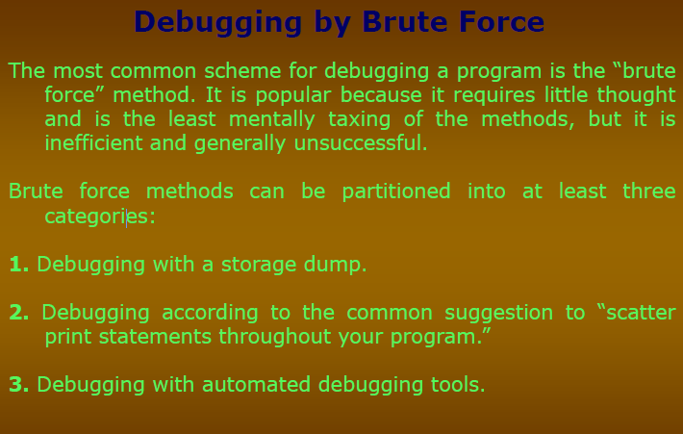

Slide 20
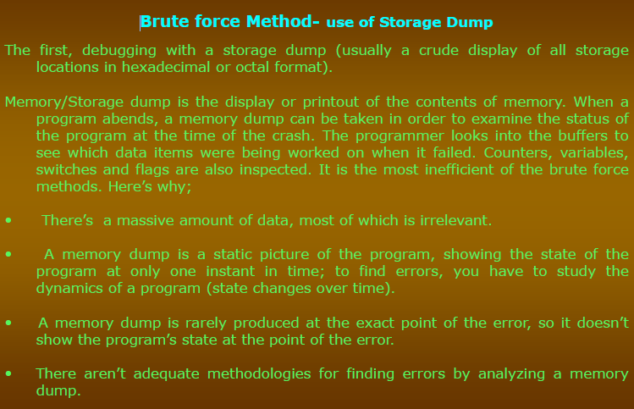

Slide 21
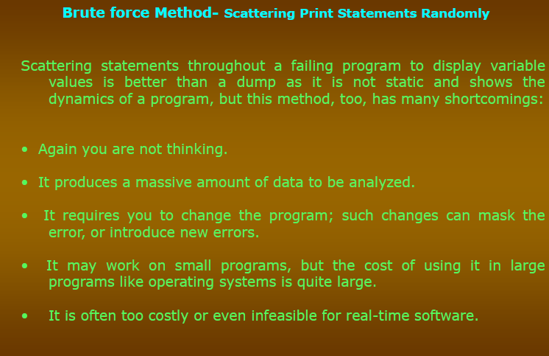

Slide 22
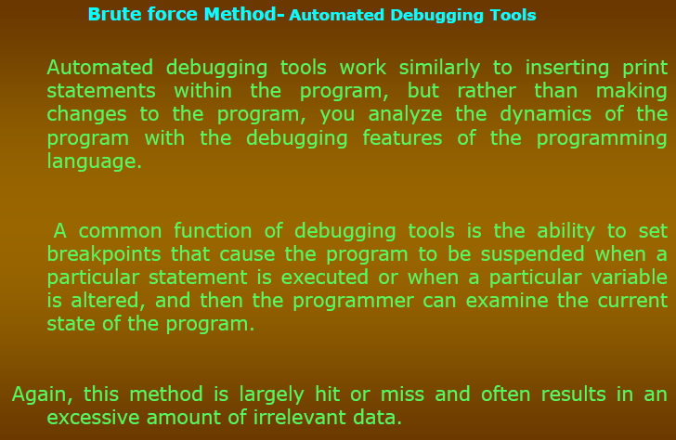

Slide 23
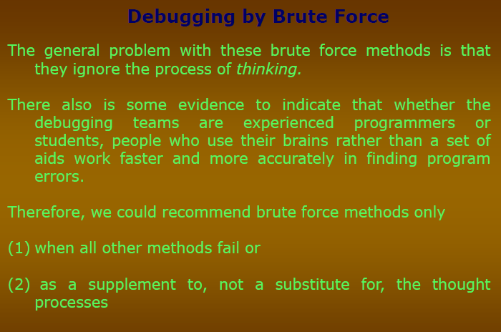

Slide 24
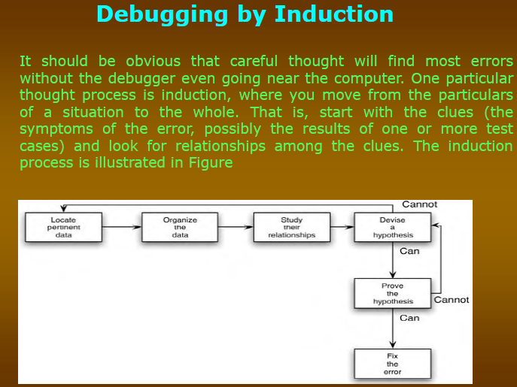

Slide 25
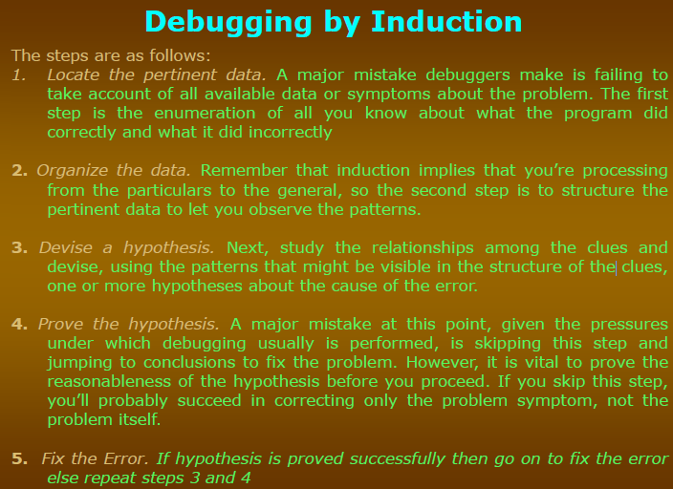

Slide 26
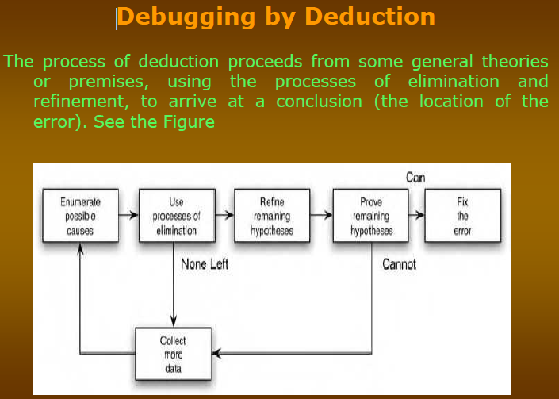

Slide 27
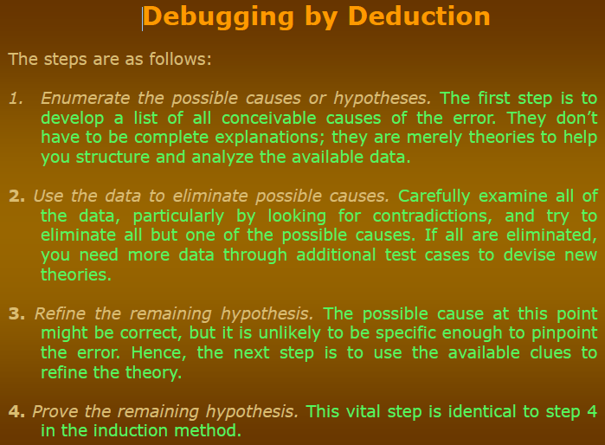

Slide 28
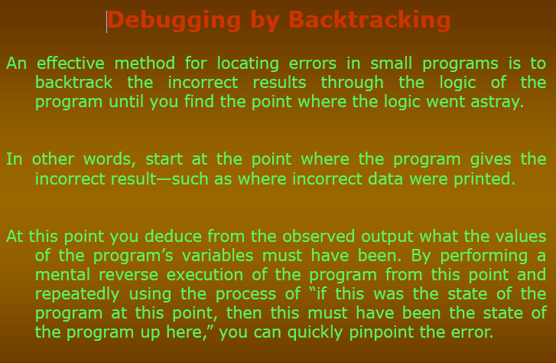

Slide 29
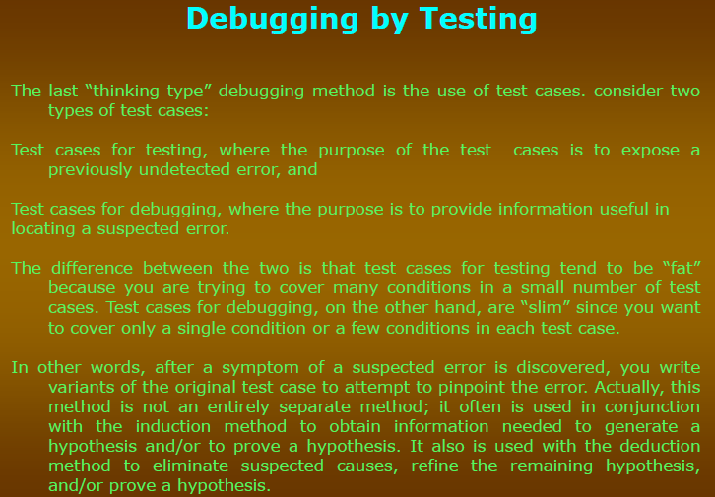

Slide 30


