Slide 1

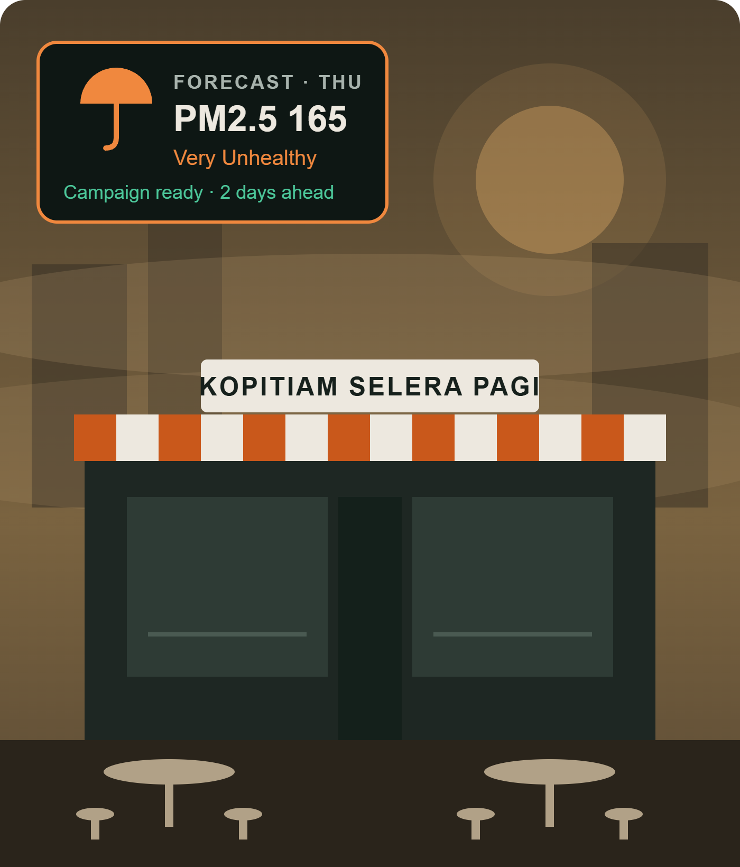
Nobody buys an umbrella after they’re soaked.
sabave.ai
A STORY ABOUT MR TAN’S KOPITIAM
Yet that’s how small shops face the haze. They react once the tables are empty. sabave.ai predicts it, and has the campaign ready two days before.
Guess what?
20–35%
of sales lost by KL and Shah Alam eateries in this month’s haze
And up to RM1 billion of GDP lost across Malaysia every month it stays.
Malay Mail (25 Oct 2026) · MARC Ratings via The Vibes (18 Oct 2026)
SDG 8
SDG 13
Team Nabil The Goat · SDC Hackathon 2026 · Domain 2
Notes:
(~50s) Hi, I’m Nabil from team Nabil The Goat. Let me start with a story. Mr Tan runs a kopitiam in Shah Alam. This October the haze drifted in from my home country, Indonesia. On Monday his tables were full. By Wednesday they were empty, and by the time he thought about a promotion, the week was gone. Nobody buys an umbrella after they’re already soaked, but that’s exactly how small shops deal with the haze: they react after the damage. sabave.ai predicts it, and has the campaign ready two days before. And Mr Tan isn’t alone. [CLICK] Guess what? [CLICK: 20–35% pops] Eateries in KL and Shah Alam lost 20 to 35 percent of their sales during this month’s haze. [CLICK: RM1 billion and sources] And across Malaysia, economists estimate the haze costs up to one billion ringgit of GDP every month it stays. [Next slide]

Slide 2

In the haze, demand moves, and fast
MR TAN’S HAZE WEEK · THE PROBLEM
1 · DAY ONE: THE HAZE RISES
2 · THEN: SPENDING MOVES
3 · EVERY HOUR COUNTS
Customers stop walking in, that same day
14% less
24 h · 81 min
spent in shops when the air turns from clear to unhealthy. People stay close to home and order in instead.
A new Facebook ad can take a day to be approved. A post loses half its views in 81 minutes.
Restaurant visits fall the day pollution rises, and keep falling for a week.
J. Environ. Econ. Manag. (2026), card data, 100 cities
Meta via Social Media Today (2021) · Graffius (2025)
In KL and Shah Alam this month, eateries lost 20–35% of sales.
Sun (2025), 37bn phone-tracked trips · Malay Mail, 25 Oct 2026
RM850
is what Mr Tan loses in one 3-day spell. Most owners just wait: “We just accept it.”
02
Notes:
(~45s) Here’s what happened to Mr Tan, and what the research says happens everywhere. Day one, the haze rises, and customers stop walking in that same day. A study of 37 billion phone-tracked trips found restaurant visits drop the day pollution goes up and keep dropping for a week. Here, eateries in KL and Shah Alam lost 20 to 35 percent of sales this month. Then spending moves: people spend about 14 percent less in shops when the air turns unhealthy, and they order in instead. And it’s fast: a new Facebook ad can take a day to be approved, and a post loses half its views in 81 minutes. For Mr Tan, that’s about 850 ringgit gone in one three-day spell, and most owners told me: we just accept it.

Slide 3
One weather promo costs the owner 90 minutes
WHY MOST DON’T REACT
0
10
25
60
80
90 min
10 min
15 min
35 min
20 min
10 min
Spot the haze
Choose an offer
Design the poster
Write captions
Post it
Check air-quality apps and the news
Which product, what price, what budget
Usually in Canva, often on a phone
In BM and English
Facebook, Instagram, WhatsApp
2.6 h
is what owners who post by hand actually spend per post, so our 90 minutes is conservative
Big chains have marketing teams. A kopitiam has the owner.
Step times: our estimate · 2.6 h = 8.4 h a week ÷ 3.2 posts, owners posting manually (Picmim survey, 200 small businesses, 2026)
03
Notes:
(~25s) Why don’t more of them react? Because reacting is real work. Ten minutes to notice the haze, fifteen to choose an offer, thirty-five to design a poster, twenty to write captions in BM and English, ten to post it. That’s 90 minutes, for an owner who’s also cooking, serving and doing the books. And that’s conservative: a survey of 200 small businesses found owners posting by hand spend 8.4 hours a week on just over three posts, about two and a half hours each. Big chains have marketing teams. A kopitiam has the owner. [If asked: the step times are my own estimate; the survey is of European small businesses, so I use it as a benchmark, not a Malaysian figure. CoSchedule’s survey of 1,597 marketers also found most content takes one to six hours.]

Slide 4
It watches the forecast, so the owner doesn’t have to.
INTRODUCING SABAVE.AI · FROM REACTIVE TO PREDICTIVE
REACTIVE · TODAY
PREDICTIVE · SABAVE.AI
Haze hits → owner notices the empty tables → 90 minutes of work → post goes up after the damage
Forecast alert at T–2 days → campaign built from the Brand Kit → owner approves in minutes → promo live on day one
1 · Forecast
2 · Brand Kit
3 · Rules decide
4 · AI writes
5 · Owner approves
PM2.5 for the shop’s location crosses Unhealthy
Menu, prices, delivery, budget cap
Options, each with a reason and budget
BM and English copy only, never decisions
Published and logged
Shoppers change what they buy before bad weather arrives (Ho et al. 2024) · Forecast: Open-Meteo / Copernicus CAMS · Starting with F&B in the Klang Valley
04
Notes:
(~35s) So I built sabave.ai, from “save” and “brave”. Today, owners are reactive: the haze hits, they notice the empty tables, spend 90 minutes on a post, and it goes up after the damage. sabave.ai is predictive. It watches the PM2.5 forecast for each shop, and two days before the air turns unhealthy, it builds campaign options from the business’s Brand Kit. Rules choose the offer and budget; AI only writes the BM and English copy. The owner approves in minutes, and the promo is live on day one, which matters because shoppers change what they buy before bad weather arrives. Let me show you, live.

Slide 5
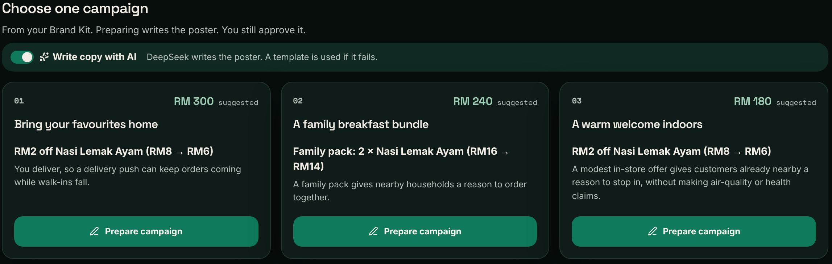
One haze alert, start to finish
LIVE DEMO · 4 MINUTES
1 Automatic alert for Shah Alam
2 Options from the Brand Kit, with reasons
3 AI writes BM and English copy
4 Staff edits and submits
5 Owner rejects one: nothing is published
Live at sabave.web.app: rules pick the options (top), DeepSeek writes the copy and poster (bottom)
6 Owner approves one: published
7 Activity log shows every step
8 A laundromat: same product, new options
Synthetic data · roles and Facebook/Instagram publishing are simulated
05
Notes:
(~4 min) DEMO SCRIPT. Before you start: reset demo data, Kopitiam selected, logged in as Aisyah (Staff). 1 (20s) “This is Mr Tan’s kopitiam. sabave.ai checks the forecast for every business. Here it has flagged unhealthy haze for Shah Alam, days ahead.” If no live alert: press Simulate and say “for the demo I’ll trigger it now”. 2 (30s) “It pulled Mr Tan’s Brand Kit: products, prices, delivery, budget. Rules, not AI, chose these options. Each says why: he delivers, so a delivery push keeps orders coming.” 3 (30s) Prepare campaign on the delivery push. “Only now does AI help: the model writes BM and English copy in his brand voice. It never decides budget or whether to publish.” Point at the poster. 4 (20s) Edit one word of the caption, Submit. “Aisyah is staff. She can draft but cannot publish.” 5 (40s) Switch to Mr Tan (Owner). Prepare a second option, submit, then Reject with a reason. “If the owner says no, nothing goes out. The rejection and the reason are recorded.” 6 (30s) Approve the first draft within budget. “Now it publishes, simulated here, with a post ID.” 7 (30s) Open the Activity Log. “Every step we just did, who, when, and the decision. Written live, not fixed text.” 8 (30s) Switch business to Dobi Ceria. Simulate. “A laundromat that doesn’t deliver. No code change: its Brand Kit gives different options, pickup and wash-and-fold instead. That’s how any SME on Orbyte adopts it.” Back to slides.

Slide 6
Time back for owners, sales kept in the haze
IMPACT · MEASURED IN OUR TEST RUN
Per haze campaign
Baseline
Target
Measured
8
Decent work and economic growth
8.2 productivity through technology · 8.3 growth of micro and small enterprises
Alert to live
~90 min
≤10 min
20 s + review
Days ahead of the haze
0
≥2
1 day (sim)
13
Climate action
Manual steps
7
≤4
4
13.1 resilience and adaptation to climate-related hazards like haze
Banned wording published
unchecked
0
0
Every hour saved goes back into running the shop, and campaigns only run when the forecast says they’re needed: less wasted effort and ad spend.
Baseline: team estimate (benchmark 2.6 h per manual post, Picmim 2026) · Measured: activity-log timestamps, test run 31 Oct 2026 · Lead time from the simulated forecast · Real-SME pilot is next
06
Notes:
(~40s) Here’s what you just watched, in numbers, and why it matters for the SDGs. Mr Tan’s baseline was about 90 minutes per campaign, reacting on the day. In our test run, the system went from alert to live in 20 seconds, so all that’s left is the owner’s review: even at 10 minutes, that’s an 89 percent cut. It took 4 actions instead of 7, and nothing banned can be published. The simulated haze arrived the next day, so that alert was 1 day ahead; with real forecasts covering 5 days, alerts can come up to 4 days early. That’s SDG 8: more productive micro businesses that protect sales instead of cutting staff. And it’s SDG 13, climate action: target 13.1 is about resilience to climate-related hazards, and haze is one Malaysia faces every year. The time saved goes back into the shop, and campaigns only run when they’re needed, so there’s less wasted effort and ad spend. Next, we measure this with real owners in a pilot.

Slide 7
RM100 a month. One haze spell pays for it.
BUSINESS MODEL
THE OWNER’S SIDE · MR TAN
OUR SIDE · PER OUTLET, PER MONTH
Daily sales
RM1,300
Subscription (≈ 32 posters)
RM100.00
× 22% haze dip
RM286 / day
AI copy: 10 campaigns × RM0.03
−RM0.30
× 3-day spell = at risk
RM858
Hosting; weather data is free
−RM1.00
× 15–20% won back
RM129–172
Orbyte revenue share (30%)
−RM30.00
vs RM100 subscription
Paid back
Contribution
RM68.70 (69%)
Dip below the 20–35% eateries reported (Malay Mail, 25 Oct 2026) · Win-back rate and 30% share are assumptions · Every input and source: Appendix A1
07
Notes:
(~40s) Two sides to the money. For the owner: Mr Tan makes about 1,300 ringgit a day. A 22 percent haze dip, which is below what eateries reported, is about 286 a day, so a three-day spell puts about 860 at risk. Win back 15 to 20 percent and that’s 130 to 170 ringgit, more than the 100 ringgit subscription. For us, per outlet per month: 100 ringgit in. About ten campaigns cost 30 sen of AI, hosting about a ringgit, weather data is free. I’ve assumed Orbyte takes 30 percent as the platform. That leaves about 69 ringgit, a 69 percent contribution margin. Every number and its source is in Appendix A1. [If asked: AI cost is about 1,000 input and 500 output tokens per campaign at up to US$2 and US$8 per million tokens. The 15–20% win-back is a pilot hypothesis.]

Slide 8
Start narrow: F&B in the Klang Valley
MARKET AND GO-TO-MARKET
TAM · F&B premises in Malaysia
136,453
HOW WE GET THERE
1
Pilot with 3–5 Klang Valley outlets; measure revenue protected
× RM1,200 a year = RM164m
SAM · Klang Valley (Selangor + KL)
38,474
2
Launch inside Orbyte for SMEs already on the hub, with no cold acquisition
× RM1,200 a year = RM46m
3
Partners: coffee-shop and hawker associations, POS and delivery platforms
SOM · 2% of SAM in 3 years
~770
770 × RM1,200 = RM0.92m a year · built bottom-up, Appendix A2
4
Case studies drive referrals before each haze season
SCALES BY SETUP
Same engine, different Brand Kit: a kopitiam gets a delivery push, a laundromat that doesn’t deliver gets pickup offers. A new business is a setup change, not a rebuild.
DOSM Economic Census 2023 (ref. year 2022): 136,453 F&B premises; Selangor 24,625 + Kuala Lumpur 13,849 · RM1,200 = RM100 × 12 months
08
Notes:
(~40s) We start narrow: F&B. Malaysia has about 136,000 F&B premises according to DOSM, which is roughly 164 million ringgit a year at our price. Our serviceable market is the Klang Valley, about 38,000 outlets, 46 million a year: urban, hit hard by haze, already marketing on Facebook and Instagram. Our three-year target is about 770 outlets, 2 percent of that, or 920k a year. That isn’t a guess at a percentage: it’s built bottom-up from how many outlets a salesperson can sign, plus Orbyte and partner channels, and it’s in Appendix A2. How we get there: first a pilot with three to five outlets to measure revenue protected. Then we launch inside Orbyte, so we sell to SMEs already on the hub instead of paying to acquire each one. Then partners: coffee-shop and hawker associations, and POS and delivery platforms. And pilot case studies drive referrals before each haze season. And it scales by setup, not code: you saw the laundromat get different options from the same engine.

Slide 9
The owner always has the final say
TRUST, RISKS AND NEXT STEPS
BUILT-IN CONTROL
HONEST RISKS → NEXT 3 MONTHS
Approval gate
Server blocks publishing until the Owner approves
Willingness to pay is unproven
M1: pilot with 3–5 Klang Valley outlets, measure revenue protected
Reject
Stops the action and records the reason
Meta API approval takes weeks
Activity log
Who, what, when and why, written live
M2–3: real Meta and WhatsApp publishing; download-and-post meanwhile
AI’s job
Captions only; template fallback if it fails
Forecasts can be wrong
Privacy
Business data only, per PDPA 2010 principles
The owner decides · M2–3: rain and heat signals, a database, results tracking
09
Notes:
(~35s) People stay in control. The approval gate is on the server: staff draft, publishing is blocked until the owner approves, and a rejection stops the action and records why. Every step is logged, AI only writes captions with a template fallback, and we only use business data. I’ll also be honest about what’s unproven. Willingness to pay needs a pilot, so month one is three to five outlets measuring revenue protected. Meta’s API approval takes weeks, so owners can download and post by hand meanwhile. And forecasts can be wrong, which is why the owner always decides. Then rain and heat signals, a proper database and results tracking.

Slide 10
Weather can’t be stopped. Lost sales can.
sabave.ai
Next haze season, Mr Tan won’t wait for the tables to empty. His campaign will be ready two days before the haze arrives.
Live sabave.web.app
Code github.com/Joebilly112/sabaveai
SDG 8
SDG 13
Team Nabil The Goat · SDC Hackathon 2026
Thank you
Notes:
(~20s) Next haze season, Mr Tan won’t wait for his tables to empty. His campaign will be ready two days before the haze arrives. The haze will come back every year. The businesses that know first will keep winning, unless every small business knows first. Weather can’t be stopped. Lost sales can. Thank you.

Slide 11
Appendix
FOR QUESTIONS
A1 Financial assumptions and sources
A4 Architecture
A2 3-year projection
A5 Brand Kit
A3 Why not ChatGPT or Canva?
A6 References
Notes:
Not presented. Jump here during Q&A when a judge asks how a number was built.

Slide 12
Every number, and where it comes from
APPENDIX A1 · FINANCIAL ASSUMPTIONS
Input | Value | Source or reasoning
Price | RM100 / month | Less than one day of Mr Tan’s haze loss (RM286); pilot tests it
Daily sales, Mr Tan | RM1,300 | Illustrative kopitiam at about RM9,000 a week
Haze sales dip | 22% | Below the 20–35% eateries reported (Malay Mail, 25 Oct 2026)
Haze spell | 3 days | Illustrative, one short episode. Losses build for about a week (Sun 2025)
Sales won back | 15–20% | Pilot hypothesis; an air-quality campaign lifted sales 289% (WeatherAds)
AI cost per campaign | RM0.03 | 1,000 in + 500 out tokens at ≤US$2 / ≤US$8 per M, ×RM4.20 = RM0.025
Hosting per outlet | ~RM1 / month | Usage-based Firebase / Cloud Run; weather API is free
Orbyte revenue share | 30% | Assumed, a typical app-marketplace cut. To be agreed with Alpha Red
Outlets (TAM / SAM) | 136,453 / 38,474 | DOSM Census 2023; SAM = Selangor 24,625 + KL 13,849
Outlets one salesperson signs | 48 / year | 20 visits a week × 48 weeks × 5% close rate (assumed)
A1
Notes:
Use when asked “how did you get that number?” Point to the row, read the source. Be clear which ones are assumptions: price acceptance, win-back rate, revenue share and close rate are all things the pilot measures.

Slide 13
Built bottom-up, break-even in year 3
APPENDIX A2 · 3-YEAR PROJECTION
Line | Year 1 | Year 2 | Year 3
Team (mostly sales) | 1 hire | 3 hires | 5 hires
New outlets: salespeople × 48 | +48 | +144 | +240
New outlets: pilot, Orbyte in-app, partners | +2 | +106 | +230
Paying outlets, end of year | 50 | 300 | 770
Revenue (average outlets × RM1,200) | RM30k | RM210k | RM642k
Orbyte share (30%) | −RM9k | −RM63k | −RM193k
AI + hosting (RM1.30 × 12 per outlet) | −RM0.4k | −RM2.7k | −RM8.3k
Team and running costs | −RM60k | −RM180k | −RM360k
Profit / loss | −RM39k | −RM36k | +RM81k
Run-rate revenue, end of year | RM60k | RM360k | RM924k
Average outlets = (start + end) ÷ 2. Hires at RM5,000/month (year 1: RM4,000 + RM12k tools); founder unpaid in year 1. Outlet counts are net of churn. Peak funding need ≈ RM75k.
A2
Notes:
Use when asked about projections or the 2% SOM. 770 outlets is the output of the build, not a target picked first: each salesperson signs about 48 outlets a year, and Orbyte in-app distribution and partners (hawker associations, POS platforms) add the rest from year 2. Year 3 is the first profitable year; total funding needed is about RM75k, which my venture studio can cover.

Slide 14
Today, the owner is the glue
APPENDIX A3 · WHAT OWNERS USE TODAY
Option | What the owner still has to do | Cost
Do nothing | Absorb the lost sales | ~RM850 per spell
Weather app + Canva | Watch forecasts, pick an offer, design, post | ~90 min + skills
ChatGPT | Notice the haze, write prompts, design, post | ~60 min + skills
Marketing agency | Brief them, wait, pay | Too costly for SMEs
sabave.ai | Review and approve, days before the haze | Minutes · RM100/mo
A forecast tells you the weather. A marketing tool posts what you give it. We connect the two for your location, products and budget.
Time estimates are our own
A3
Notes:
Why wouldn’t an owner just use a weather app and Canva, or ChatGPT? They could, but then the owner becomes the glue, and the owner’s time is exactly the problem. ChatGPT is reactive: it waits for you to notice the haze and ask. sabave.ai is predictive: it watches the weather for your location, knows your products and budget, and hands you a ready campaign to approve.

Slide 15
Reusable parts, not a one-off app
APPENDIX A4 · ARCHITECTURE
REACT + VITE WEB APP · EXPRESS API · FIREBASE
WHY IT FITS ORBYTE
Weather signals
Open-Meteo PM2.5 (Copernicus CAMS), pluggable
Reads business profiles from the hub
Works for any SME type, any city
Campaign rules
Deterministic and explainable
Connector reusable by other modules
Copy generator
LLM on the server only, template fallback
New signals plug in without rework
Approval service
Roles, budget and never-say checks
Connector + log
Meta (simulated) · activity log
API keys in server-side secrets · synthetic data · no customer personal data (PDPA)
A4
Notes:
A React web app with an Express API, hosted on Firebase. A pluggable signal engine reads Open-Meteo, deterministic rules decide, an LLM writes copy on the server only with a template fallback, the approval service enforces roles and budgets, and a connector publishes. Keys never reach the frontend; data is synthetic; no customer personal data.

Slide 16
Every campaign sounds like the business
APPENDIX A5 · BRAND KIT
Logo and past poster
Website and ethos
Brand colours are extracted and used on the poster
AI summarises the brand voice; tone chips like “family” or “premium”
Real products and prices
“Never say” list
Offers like “RM2 off Nasi Lemak Ayam”, not placeholders
Blocks banned words and health claims before anything is published
A5
Notes:
The owner sets the Brand Kit up once: logo, a past poster, website, style, real products and prices, and a never-say list. Every campaign uses their colours, voice and actual offers, and nothing banned or health-related gets through.

Slide 17
References
APPENDIX A6
MALAYSIA
HAZE AND CONSUMER BEHAVIOUR
Malay Mail (25 Oct 2026). Eateries in KL and Shah Alam report 20–35% sales drop during haze; takeaway and delivery steady.
Sun (2025). Air pollution and food-service visits, 37bn phone-tracked trips.
The Star (14 Oct 2026). Haze estimated to cost Malaysia RM20–50m a day.
J. Environ. Econ. Manag. (2026). PM2.5 and offline card spending, UnionPay, 100 cities.
DOSM (2023). Economic Census, F&B premises by state, ref. year 2022.
Ho et al. (2024). J. Product & Brand Management: anticipated weather and purchases.
DOSM (2024). MSME Performance: 39.5% of GDP, 48.7% of employment.
Kim & Trusov (2025). Journal of Marketing: pollution and treat purchases.
OWNER TIME
Liu et al. (2021). Kybernetes: air quality, rain and takeaway orders.
Picmim (2026). Survey of 200 small businesses: manual posting 8.4 h a week, 3.2 posts.
PLATFORMS AND DATA
CoSchedule via MarketingProfs (2017). 1,597 marketers: most content takes 1–6 h.
Meta via Social Media Today (2021): ad review usually within 24 h. Graffius (2025): post half-life. WeatherAds: case study. Open-Meteo / Copernicus CAMS.
A6
Notes:
Full reference list. International studies show the mechanism; the Malaysian evidence is news reporting and DOSM data.

