Slide 1
CLIMAHEALTH PREDICT
Ghana knows the weather.
It does not yet know what the weather
is about to do to people.
A climate-health early-warning platform. It turns today's climate into a ranked, explained health warning for the weeks ahead.
GREENRES HACKATHON 2026
Notes:
Open with the one sentence, then stop. Say: every agency in this country already has weather data. Nobody turns it into who gets sick, where, and when. That gap is the whole product.

Slide 2
THE PROBLEM
Climate-driven disease is Ghana's largest health burden.
Ghana is one of the 15 highest-burden malaria countries in the world. Cholera, meningitis and heat illness track the weather just as closely.
AND THE CASES ARRIVE LATE
6.7 million
malaria cases in Ghana in 2024, and 11,635 deaths.
WHO, World Malaria Report 2024
Malaria 2 to 6 weeks
after rainfall and standing water
Cholera 1 to 3 weeks
after flooding and unsafe water
Meningitis 2 to 8 weeks
after dry, dusty harmattan air
That delay is not the problem. It is the opportunity.
It is the only window in which a district can still act before people fall ill. Ghana currently reacts when the cases appear, and the climate data that precedes them is free, public and updated daily.
CLIMAHEALTH PREDICT
02
Notes:
Lead with the number, not the adjective. 6.7 million cases, 11,635 deaths, one year, one country. Then turn it: all of it follows weather we can already see, and it arrives weeks late. That lag is the product.

Slide 3
WHY ANYBODY ACTS
Nobody changes their day for a weather forecast.
Ghana already has weather warnings. People read them and carry on, because rain is not news and a forecast asks nothing of you.
A WEATHER SERVICE SAYS
“Heavy rain expected Thursday.”
Severity: it rains every year
About me: not obviously
To do: nothing is asked
Nothing changes.
CLIMAHEALTH SAYS
“Malaria risk is rising here. Cases in 2 to 6 weeks. Children under five and pregnant women most at risk. Empty standing water tonight.”
Severity: a named disease
About me: my district, my children
To do: one thing, tonight, free
Something to actually do.
We do not warn people about the weather. We warn them about what it is about to do to their children, and give them one thing to do about it.
Protection Motivation Theory: protective action needs severity, personal vulnerability, and a response the person believes they can carry out. Fear on its own produces avoidance, which is why every warning here ends in an action.
CLIMAHEALTH PREDICT
03
Notes:
This is your strongest slide. Read the left column flatly, the right column with weight. Then the line: we do not warn people about the weather, we warn them about what it is about to do to their children. If a judge calls it fear-mongering, the answer is already on the slide: fear without an action backfires, so every warning ends in one thing to do tonight.

Slide 4
THE SOLUTION
ClimaHealth Predict
Reads a district's climate today and says which health risks are rising, why, how long before cases appear, and who is most affected.
FOR THE PUBLIC
Dawuro
Forecast and weather, hazard reporting with a photo, and a daily lesson that pays in NHIS cover.
FOR THE AGENCIES
Command Platform
260 districts ranked and explained, alerts, an incident room, readiness, a view per mandate.
FOR EVERYONE ELSE
USSD and SMS
The same warning on any handset, with no data and no app, because a smartphone is not a requirement.
The brain is a rules engine, not a guess.
Published epidemiological thresholds, evaluated the same way every time. Same inputs, same output, and every warning can name the conditions that caused it. AI never decides risk; it only phrases what the engine already decided, in English or Twi. That is what makes this defensible to a health ministry.
CLIMAHEALTH PREDICT
04
Notes:
Three doors, one engine. Then the bottom line, which is your credibility: deterministic rules from published thresholds, reproducible and explainable. The AI is a translator, not a decider. Say that sentence exactly.

Slide 5
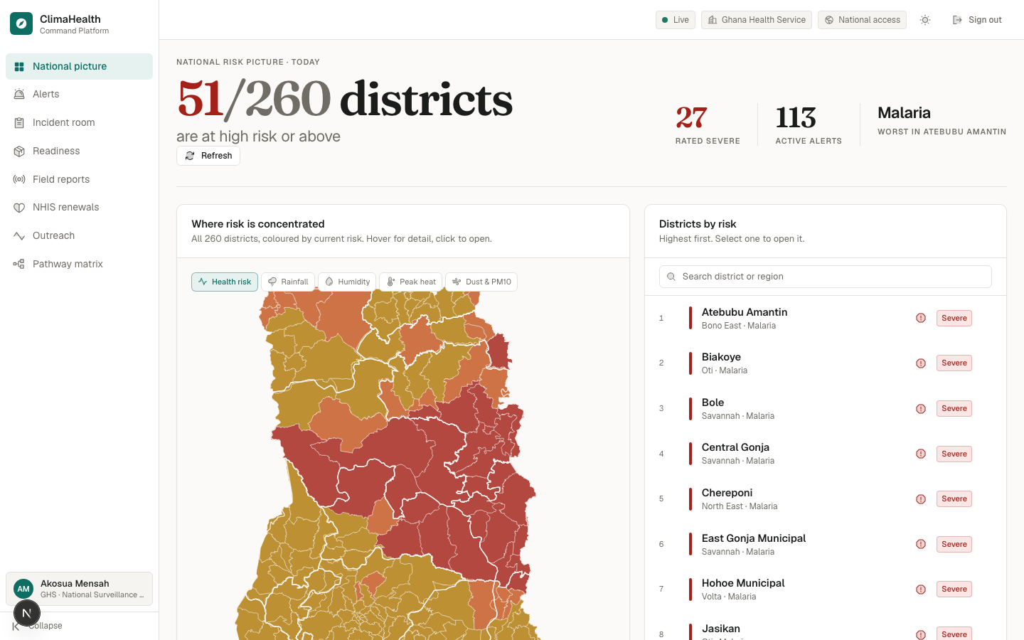
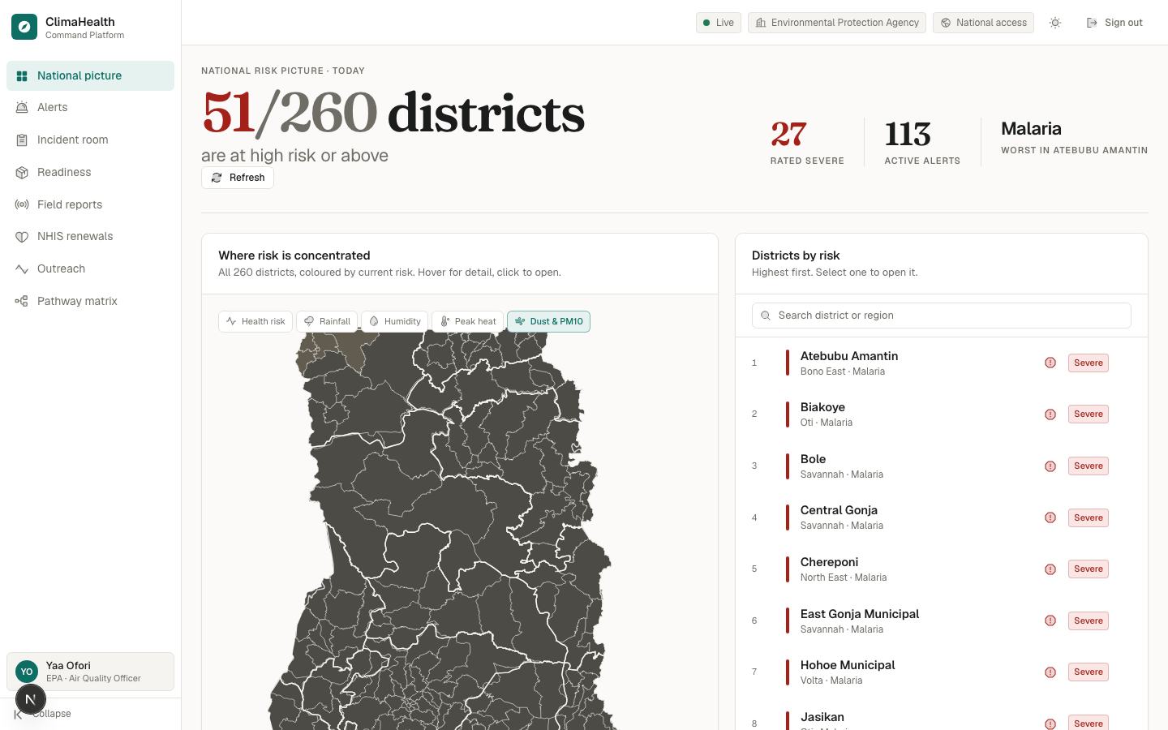
THE AGENCY PLATFORM
260 districts, ranked and explained, every day.
Live engine output, not a mock. Each agency opens on the layer it is responsible for: health risk for GHS, dust and PM10 for EPA, rainfall for NADMO.
Ghana Health Service · 51 of 260 districts at high risk or above
Environmental Protection Agency · dust and PM10 layer active
CLIMAHEALTH PREDICT
05
Notes:
Point at the 51 of 260, then at the map, then at the second screenshot and say: same engine, same districts, different question. An air quality officer should not have to hunt for air quality.

Slide 6
INSTITUTIONAL INTEGRATION
A report is a claim until somebody goes and looks.
Ɔhwɛfoɔ is an on-ground officer role in the platform. Validation and repair are different jobs held by different people, and neither can take the other's step.
01
Citizen reports
photo, location, note
Dawuro app
02
Ɔhwɛfoɔ validates
goes to the site, confirms
25% → 50%
03
Agency works
GHS, NADMO, EPA, Assembly
50% → 75%
04
Resolved
closed with what was done
100%
Every step is written down: who moved it, when, and what they found.
The person who filed the report watches the same bar the officers do. Reporting a hazard into a form that never answers is how people learn not to bother. The agencies do not have to trust the app; they have to trust their own officer.
CLIMAHEALTH PREDICT
06
Notes:
Judges said institutional integration was unproven. This is the answer: a named role, a permission model, an append-only trail, and the citizen sees it close. End on the line about trusting their own officer.

Slide 7
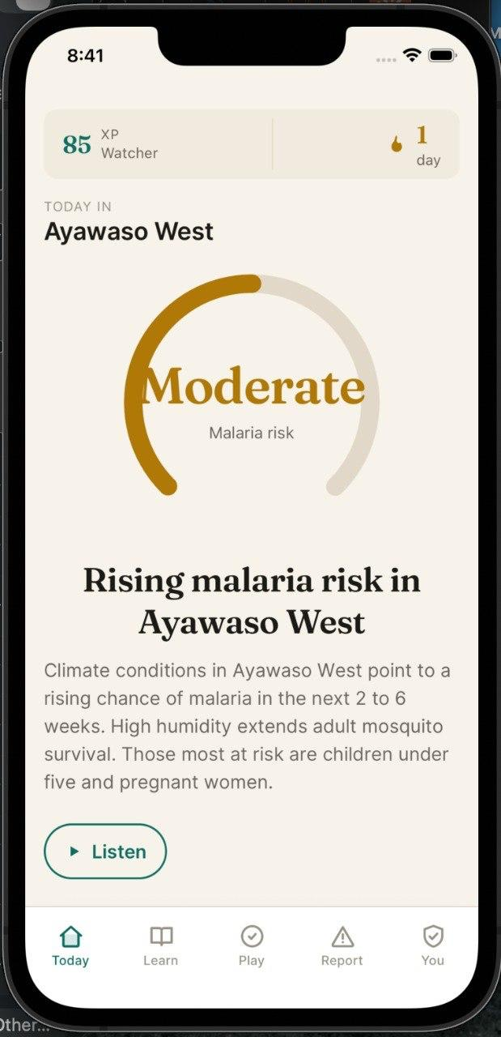
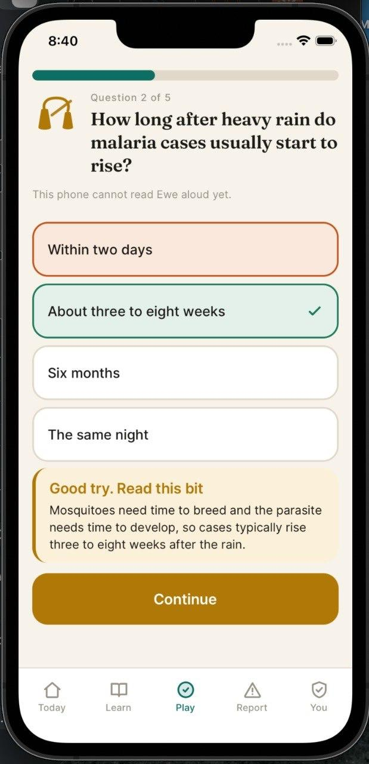
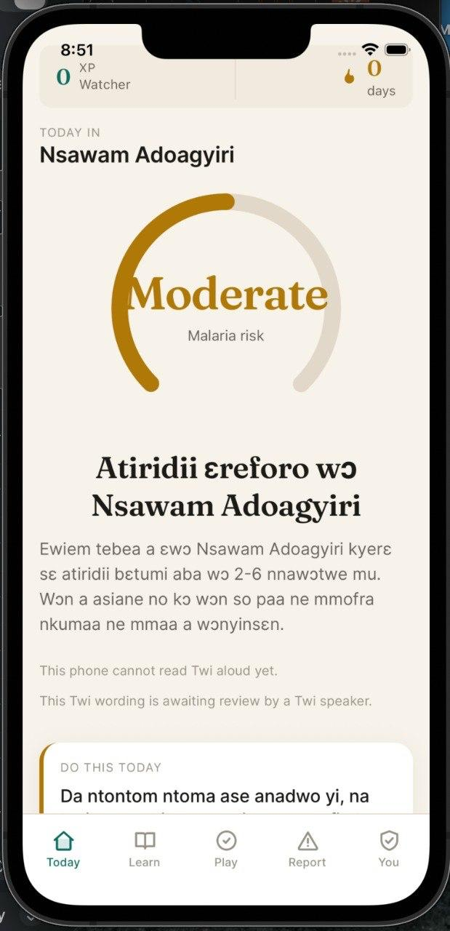
THE APP, AND WHO IT IS FOR
Dawuro
Named after the gong-gong that carried public warnings in Ghana for centuries. The people this must reach are the least likely to own a good phone, read fluently, or speak English at home. Each of those is designed for.
Five languages
English, Twi, Ga, Ewe, Dagbani
Read aloud
Forecasts, lessons and answers can be spoken
Never a wrong voice
No voice for a language, it says so and stays silent
Today's risk
Learn by answering
The same warning in Twi
Age-banded
A child and a grandmother get different wording
Works offline
Last forecast kept; reports queue and send themselves
CLIMAHEALTH PREDICT
07
Notes:
Twenty seconds. Point at the Twi screen last: it tells the reader that their phone cannot read Twi aloud yet and that the wording is awaiting review by a Twi speaker. Nobody else in this room will show a screen admitting its limits.

Slide 8
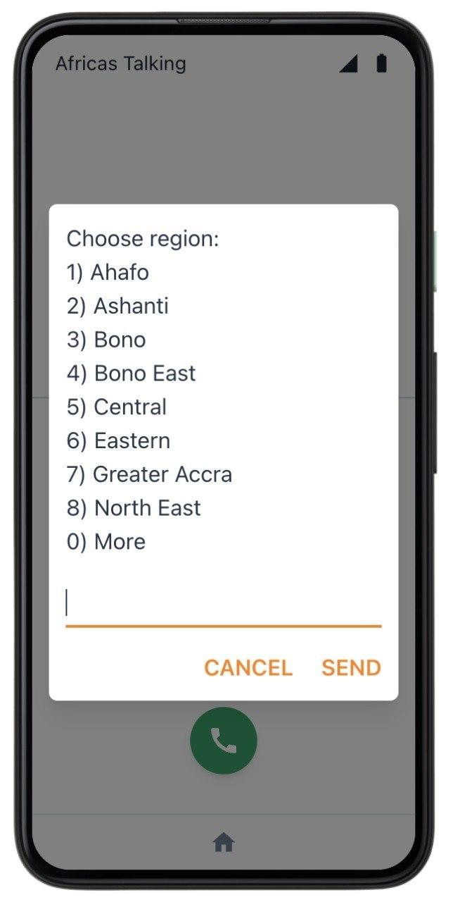
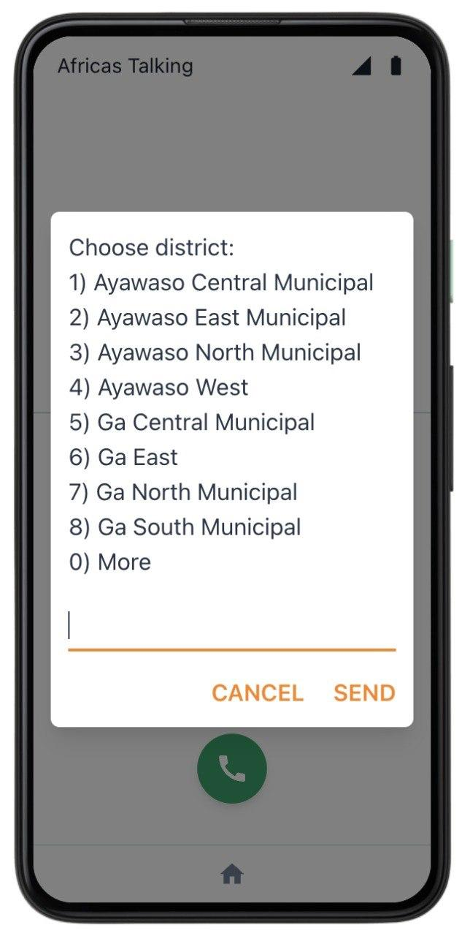
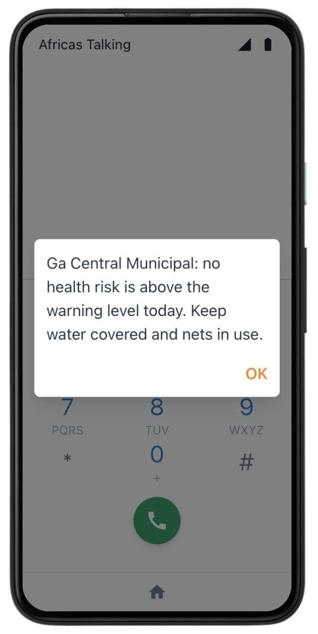
REACH
A smartphone is not a requirement.
Ghana has more mobile connections than people, yet three in ten Ghanaians do not use the internet at all. An app alone never reaches them.
38.3m
mobile connections
69.9%
use the internet
GSMA Intelligence / DataReportal, Digital 2025 Ghana
Choose region
Choose district
Today's warning
Live on Africa's Talking.
Dial the shortcode, choose a language, choose a region, choose a district, get today's warning. No data, no app, no smartphone. SMS pushes the same warning to a district when risk crosses the threshold.
CLIMAHEALTH PREDICT
08
Notes:
Judges flagged USSD and SMS as not implemented. These are real screenshots of a real dial-through on Africa's Talking. Say the three-in-ten number, then point at the last screen: that is the same engine output, on a phone with no internet.

Slide 9
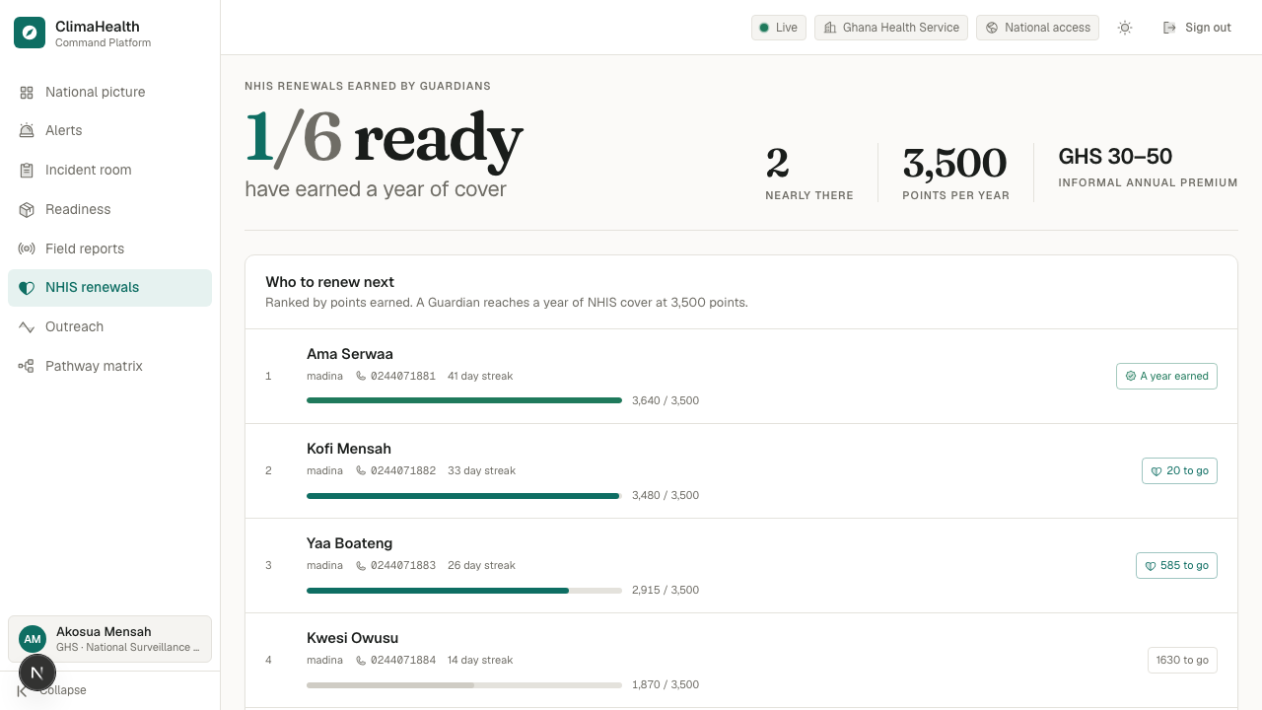
REWARDS THAT ARE FUNDABLE
Points buy health cover, not cash.
3,500 points is one year of NHIS cover. Derived, not chosen: the adult premium runs GHS 7.20 to 48 by income band, about GHS 30 to 50 for informal workers, and we price a point at one pesewa.
No money leaves the platform.
No float to hold, no payout licence, no transfer that cannot be recalled. The platform never says a renewal happened: it records who earned one and hands that to Ghana Health Service, who renew and confirm.
About 44% of Ghanaians hold no active cover.
They are the same people most exposed to climate-driven illness. The reward removes the exact cost that kept them out, which is why they come back tomorrow. The streak forgives a missed day, and wrong answers still earn, so nobody is locked out of health information for getting one wrong.
The renewal queue · GHS only · seeded demonstration Guardians
CLIMAHEALTH PREDICT
09
Notes:
Two answers on one slide. First: cash removed, nothing to fund or regulate. Second, which is the adoption question every judge asks: 44% have no active cover, and the loop pays in exactly the thing they are going without. That is the wedge, not a gimmick.

Slide 10
WHAT YOU ASKED US LAST TIME
Three criticisms, three answers.
Field validation unproven
Ɔhwɛfoɔ: an officer stands where the report was filed and confirms it before any agency spends a truck. Every validation signed and timestamped.
Institutional integration unproven
Reports move through named agency stages with a permission model, and every agency gets a view scoped to its own mandate.
Reward feasibility unproven
Cash removed. Points buy NHIS cover priced against the real premium band, issued by Ghana Health Service, not by us.
WHAT WE ARE ASKING FOR
One district and one season. Give us Madina and a Ghana Health Service link, and we will run the engine against DHIMS2 case records to show how early the warning actually was. It is the only part we cannot build ourselves.
CLIMAHEALTH PREDICT
10
Notes:
Say each criticism out loud before its answer. Judges remember being listened to. Then the ask, and stop talking. Naming the one thing you cannot do alone reads as confidence and gives them something concrete to say yes to.

Slide 11
CLIMAHEALTH PREDICT
The climate signal is already there.
We turn it into a warning
somebody can act on.
260
districts, daily
5
disease pathways
3
ways in
963
tests passing
CLIMAHEALTH PREDICT
11
Notes:
Close on the three lines and stop. Let the numbers sit. Backup slide has every source if they ask where a figure came from.

Slide 12
BACKUP · SOURCES AND LIMITS
Where the numbers come from.
Malaria burden
6.7m cases, 11,635 deaths in Ghana, 2024
WHO, World Malaria Report 2024
NHIS coverage
18.5m active members, about 56% of the population
National Health Insurance Authority, 2025
NHIS premium
GHS 7.20 to 48 a year; GHS 30 to 50 informal
NHIA scheme documentation
Mobile reach
38.3m connections; 69.9% use the internet
GSMA Intelligence / DataReportal 2025
Behaviour change
Severity, vulnerability and a doable action
Protection Motivation Theory, Rogers
Climate data
Daily observations for all 260 districts
Open-Meteo, live in the product
Boundaries
260 district polygons on the map
geoBoundaries, CC BY 4.0
Known limit, stated plainly: the engine has not yet been backtested against DHIMS2 case data. That is the ask, and the one thing between a defensible model and a validated one.
CLIMAHEALTH PREDICT
12
Notes:
Do not present this. It exists so that when a judge asks where a number came from you turn one page and answer. Volunteering the DHIMS2 gap before being asked reads as confident; being caught without it reads as careless.

