Slide 1

REDDIT SHOWDOWN
MAGA vs. Resistance
Joseph Darby
Corporate 2017

Slide 2
1
What’s the problem?

Slide 3

Define the problem
Given the text data of a random post from a binary selection of subreddits, can we predict on which subreddit it was posted?
Subreddit Selection Process
Research topics where classes are hard to differentiate:
Socialism vs. Social Democracy? Trickle-Down Economics vs. Capitalism?
Decided on Political Extremism in the United States:
The_Donald | r/esist
What’s the problem?

Slide 4
2
Gather the Data

Slide 5

Data Gathering
Process
Used requests library to import JSON data
Indexed into child data to target post titles
Created for loop to hit the Reddit API for target titles
Used list comprehensions to isolate and extract post titles and subreddit names
Saved to CSV
Reddi-Trump

Slide 6
3
Data Exploration

Slide 7
Post Distribution
The_Donald
r/esist
997 | 752
1729 total
56.51% baseline

Slide 8
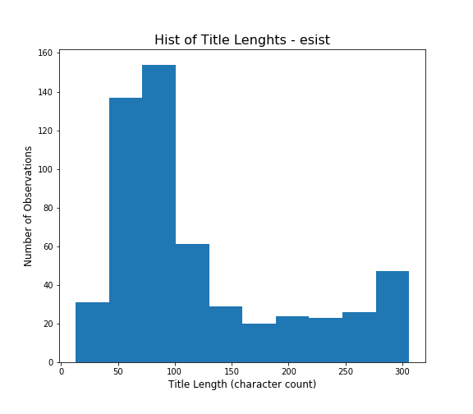
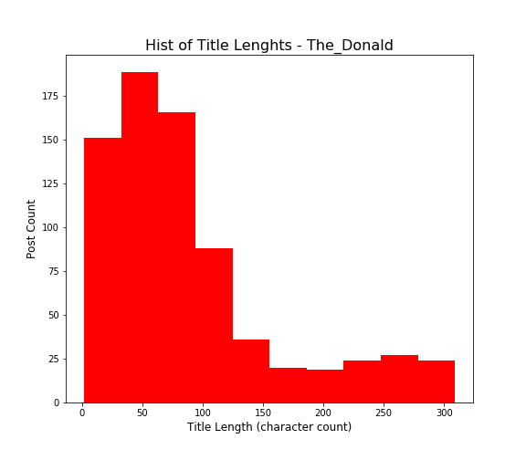
Title Length Distribution

Slide 9
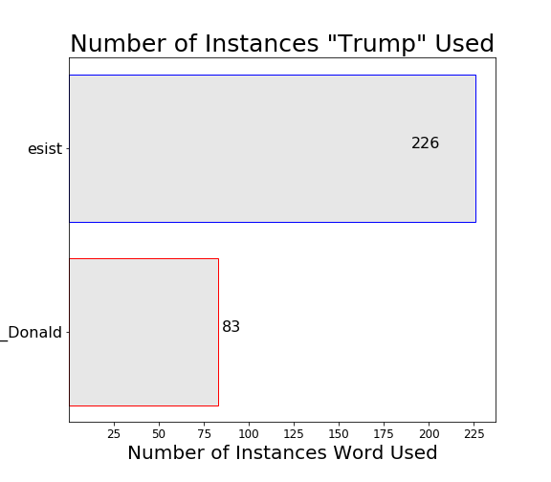
Shared Words
Notes:
Most used word by both subreddits
We can infer that it’s all about Trump
The left complains, while the right defends or complements Trump

Slide 10
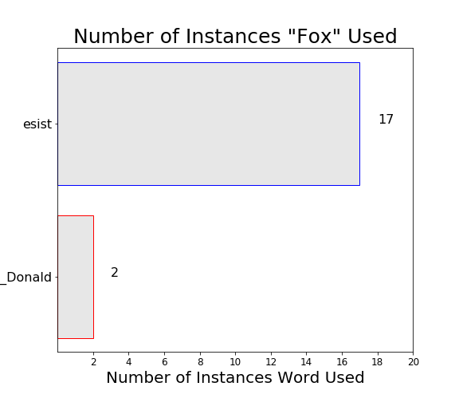
Shared Words
Notes:
News networks that are associated with one side are generally vilified and attacked by the opposing political party
Where one gets their news is an indicator of his or her political leaning

Slide 11
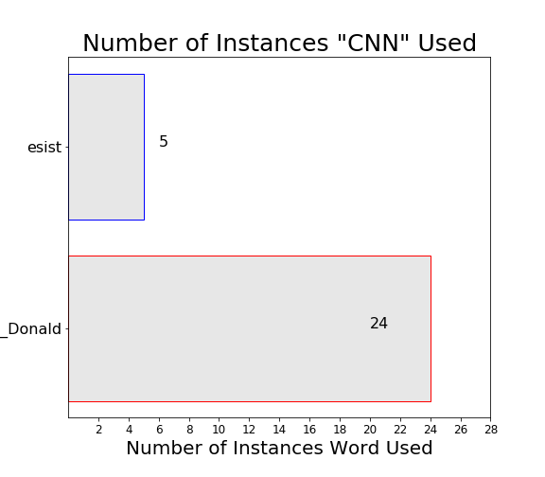
Shared Words
Notes:
News networks that are associated with one side are generally vilified and attacked by the opposing political party
Where one gets their news is an indicator of his or her political leaning

Slide 12
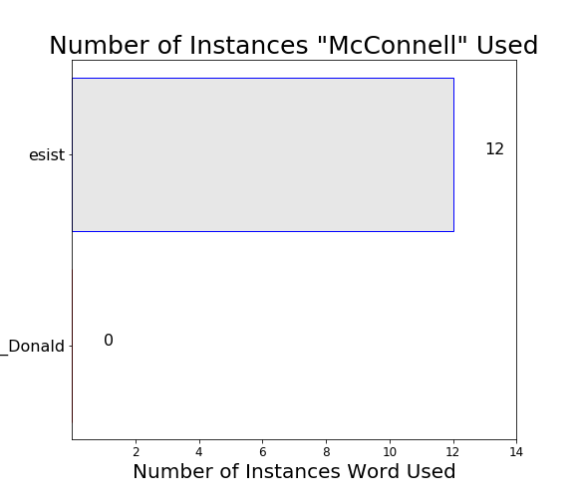
Attack, Attack, Attack!
Notes:
Each side tends to focus on certain representatives of the opposite view point to consistently vilify

Slide 13
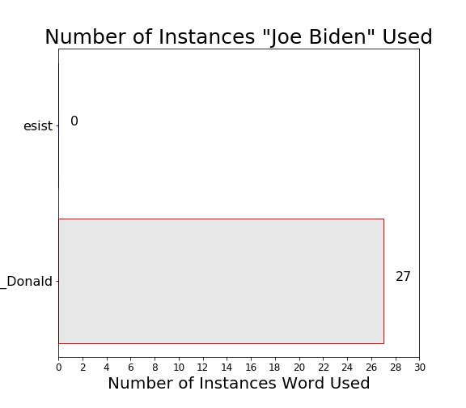
Attack, Attack, Attack!
Notes:
Each side tends to focus on certain representatives of the opposite view point to consistently vilify

Slide 14
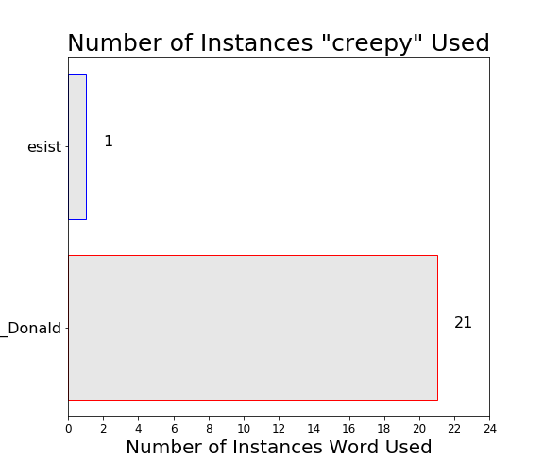
Attack, Attack, Attack!
Notes:
The right has come up with a new nickname for Joe Biden
Creepy Uncle Joe

Slide 15
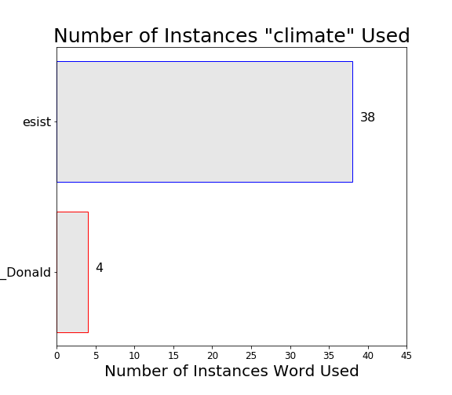
Wedge Issues & Differences
Notes:
There are particular issues that each side defends dearly and simply cannot agree on
They are frequently topics of conversation within the subreddits
“climate change” used by esist: 19 | The_Donald: 3

Slide 16
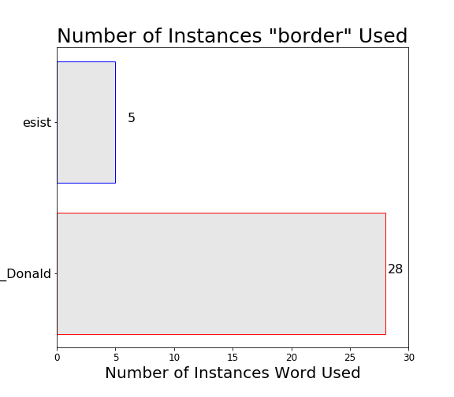
Wedge Issues & Differences
Notes:
Border Security
There are particular issues that each side defends dearly and simply cannot agree on
They are frequently topics of conversation within the subreddits

Slide 17
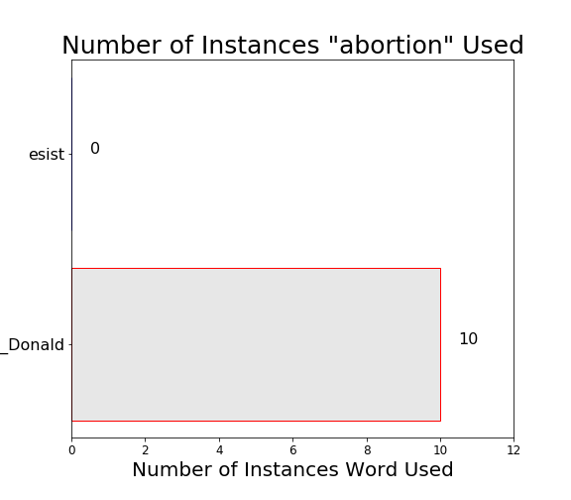
Wedge Issues & Differences
Notes:
Abortion
There are particular issues that each side defends dearly and simply cannot agree on
They are frequently topics of conversation within the subreddits

Slide 18
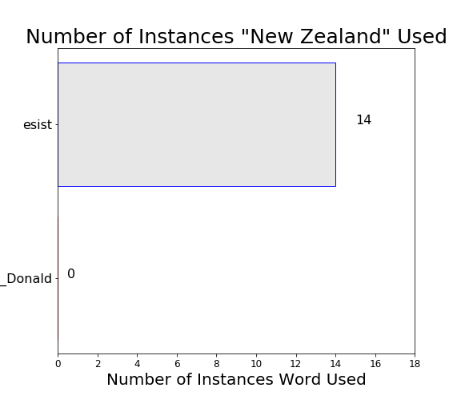
Wedge Issues & Differences
Notes:
Gun Control
The left has capitalized on the recent mass shooting in New Zealand to push the topic

Slide 19
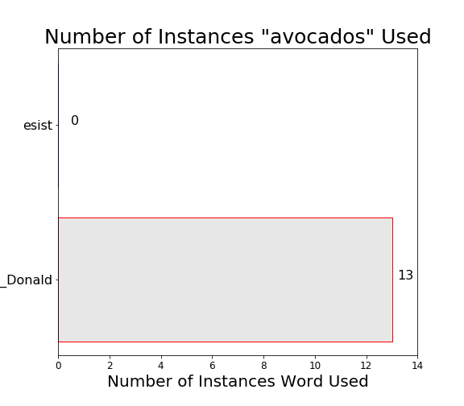
Holy Guacamole!
Notes:
A recent report in USA Today indicated that prices of avocados could rise and supply could dwindle if Trump decides to close the border with Mexico as he has recently tweeted about.

Slide 20
4
Data Modelling

Slide 21
Model Selection & Process
Logistic Regression
Multinomial Naive Bayes
X & y set up & TTS
X & y set up & TTS
Create Pipeline
Create Pipeline
CountVectorizer &
Logistic Regression
CountVectorizer &
MultinomialNB
Set up pipeline parameters
Set up pipeline parameters
GridSearchCV & Score
GridSearchCV & Score
Make Predictions
Make Predictions
Evaluate Confusion Matrix
Evaluate Confusion Matrix

Slide 22
5 | 6
Model Evaluation
&
Answer the Problem

Slide 23
Model Evaluation
Logistic Regression
Multinomial Naive Bayes
GS Best Score: 0.7839
GS Best Score: 0.7879
Training Score: 0.9707
Training Score: 0.9244
Test Score: 0.8176
Test Score: 0.7925
Overfit: 0.1531
Overfit: 0.1322
Baseline: 0.5651
Baseline: 0.5651

Slide 24
Logistic Regression
 | Predicted Negative | Predicted Positive
Actual Negative | 148 | 52
Actual Positive | 27 | 206
TN
FP
FN
TP

Slide 25
Confusion Metrics
Accuracy = 0.8175519630484989
Misclassification = 0.18244803695150116
Sensitivity = 0.8841201716738197
Specificity = 0.74
Precision = 0.7984496124031008

Slide 26
Multinomial Naive Bayes
 | Predicted Negative | Predicted Positive
Actual Negative | 148 | 40
Actual Positive | 50 | 195
TN
FP
FN
TP

Slide 27
Confusion Metrics
Accuracy = 0.792147806004619
Misclassification = 0.2078521939
Sensitivity = 0.7959183673469388
Specificity = 0.7872340425531915
Precision = 0.8297872340425532

Slide 28
In Summary
Trump is largely the topic of conversation
Vilify opposing representatives & news networks
Wedge issues are ingrained and are not up for debate
Yes, we can build an accurate classification model
Can improve through gathering more text (“selftext” field in JSON), Adjust min_df, max_features, new model?

Slide 29
References
Reddit Logo(head)
Reddit Logo (pez)
The Federalist: Creep Uncle Joe
USA Today: Avocados & Trump’s Border Fight

