Slide 1
文本解码原理

Slide 2
文本生成解码
在自然语言处理（NLP）的任务中，模型的原始输出通常是一种概率分布，也就是在词汇表的每个词的概率分布，而我们通常看到的输出是一个句子（系列单词），这个变换过程就是文本生成的解码。
这个过程其实是选择一个最优序列，使得输出序列的条件概率最大，常用方法有贪心搜索（Greedy Search）、束搜索（Beam Search）等，如下图是一个基于贪心搜索的GPT文本生成。

Slide 3
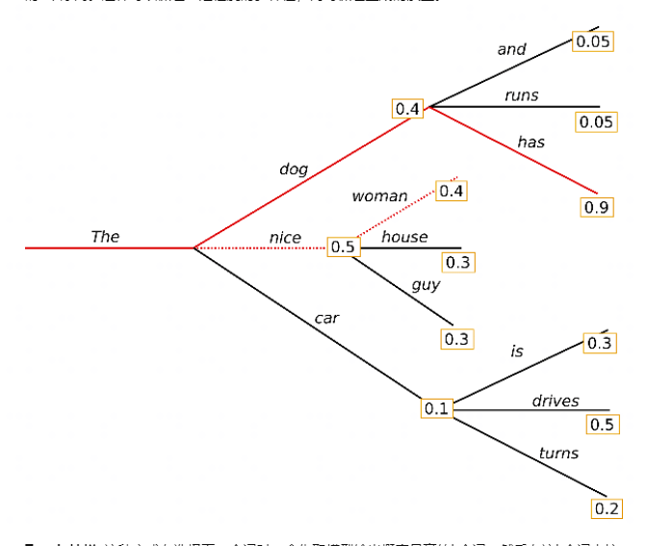
贪心搜索（Greedy Search）
贪心搜索，即每一个时间步都取出一个条件概率最大的输出，再将从开始到当前步的结果作为输入去获得下一个时间步的输出，直到模型给出生成结束的标志。
不过当前的最优不一定全局的最优。如右图：
按照贪心搜索输出序列的条件概率为：
0.5 x 0.4 = 0.2
其实最优的输出序列的条件概率为：
0.4 x 0.9 = 0.36

Slide 4
贪心搜索（Greedy Search）
Greedy Search的另一个问题便是容易产生重复文本。如下图的例子，因为输入数据中有多个“this is a llm course this”的表述，使得在生成中该模板的概率更高。
而完成this is a llm this的生成后，又会因为数据中的this后常接is而再次开始循环。
dataset：
this is a llm course this is interesting.
this is a llm course this is for llm learners.
i am currently studying this course.
prompt：this
output：
this is a llm course this is a llm course this is a llm course ..

Slide 5
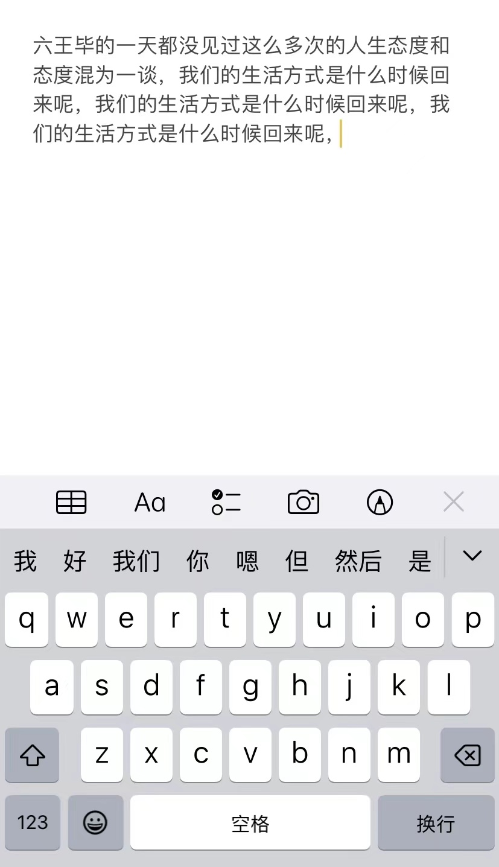
贪心搜索（Greedy Search）
另一个常见的例子是手机的默认输入法。
比如最近很火的“你的手机会背《阿房宫赋》吗”挑战，从“六王毕”开始，一直不断输入默认的第一项。
未有相关语料训练的手机输入法就很容易出现重复文本。

Slide 6
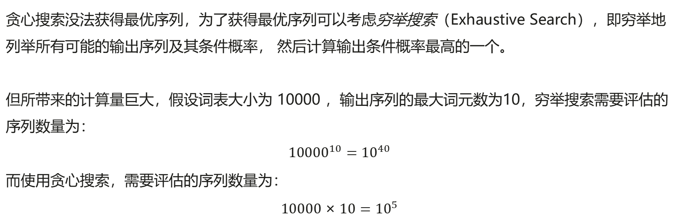
穷举搜索（Exhaustive Search）
贪心搜索没法获得最优序列，为了获得最优序列可以考虑穷举搜索（Exhaustive Search），即穷举地列举所有可能的输出序列及其条件概率， 然后计算输出条件概率最高的一个。
但所带来的计算量巨大，假设词表大小为 10000 ，输出序列的最大词元数为10，穷举搜索需要评估的序列数量为：
$${10000}^{10}={10}^{40}$$
而使用贪心搜索，需要评估的序列数量为：
$$10000×10={10}^{5}$$

Slide 7
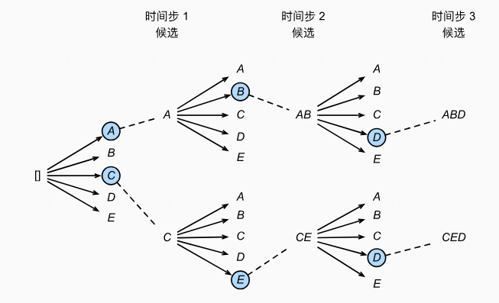
束搜索（Beam Search）
束搜索是在贪心搜索与穷举所搜中进行了平衡，既可以保证生成的质量，又可以使计算量没有那么大。
束搜索在每个时间步保留概率最高的 k 个可能的序列（k 称为束宽）。每次选择新词时，基于这k个序列进行选择，然后保留总体概率最高的k个序列。
束搜索的计算复杂度为v*k*l，其中v为词表大小，k为束宽，l为生成序列长度。可以通过设置束宽的大小灵活控制生成质量和计算量。

Slide 8
束搜索（Beam Search）
如右图所示，假设词表中有5个元素，希望生成长度为3的序列，束宽为2。
第1步：选取目前概率最大的两个元素A和C。
第2步：基于第1步结果A和C分别继续进行生成。
A分支得到5个候选：[AA],[AB],[AC],[AD],[AE]，C也同理得到5个。
然后对10个候选进行统一排名，再保留概率最优的两个，即图中的[AB]和[CE]；
第3步：基于[AB]和[CE]再次分别进行生成，重复第二步的十选二，最终得到[ABD]和[CED]。

Slide 9
束搜索（Beam Search）
不过， 束搜索一般会面临生成文本过于保守或者不自然的问题。
如下面展示的例子，通过束搜索模型会更倾向生成Response B，但我们肯定不希望模型一直在回复’Thank you’或者’I don’t know’这样的safe answer。
Context: Try this cake. I baked it myself.
Response A: That cake tastes great.
Response B: Thank you.

Slide 10
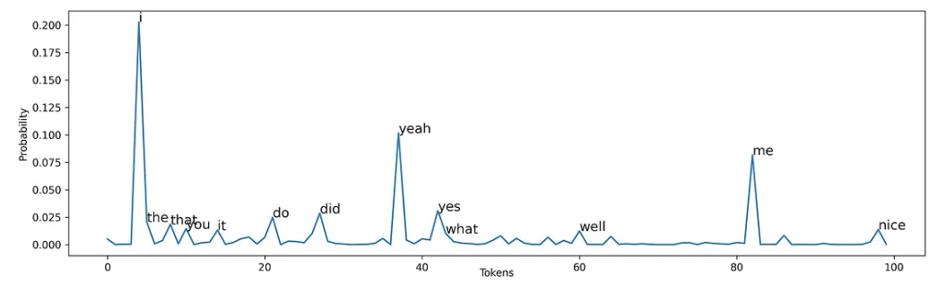
随机采样（Random Sampling）
我们可以通过随机采样增加生成的随机性，避免回复过于通用化。
相比于贪心搜索或者束搜索中的直接选择最优的一个或几个解，随机采样利用了每次解码的概率分布，按照概率随机选择一个单词。
如下图概率分布所示，在生成I love watching movies的第一个token时，也有一定可能选择概率较低的what，well词汇。此方法增加了生成的多样性，但可能导致生成的文本不连贯、无意义。

Slide 11
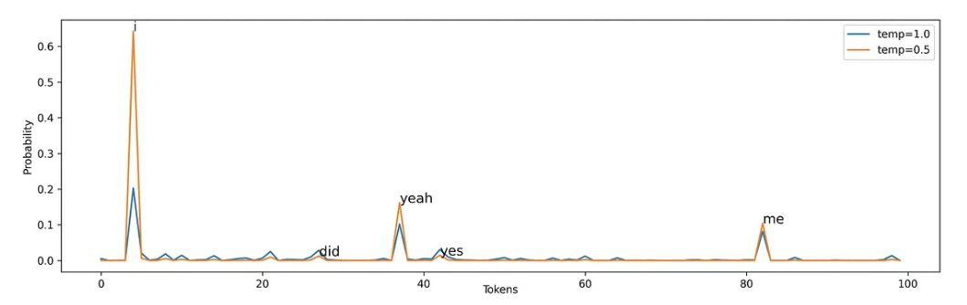
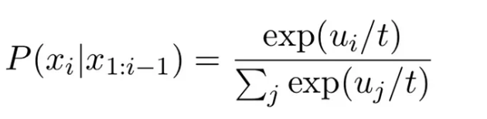
Temperature采样（Temperature Sampling）
Temperature Sampling通过设置参数temperature，控制调整token之间的概率分布。
temperature的取值范围一般是0 < temp ≤ 1，随着temp降低，原本概率高的token对应概率更高，原本概率低的token对应概率更低，模型更具有确定性。
Temperature Sampling计算公式
（温度：t）

Slide 12
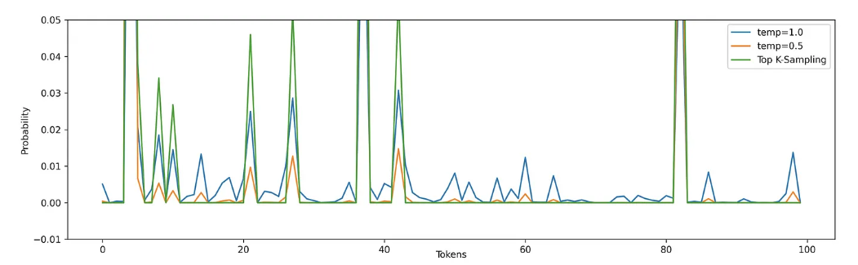
Top-K采样（Top-K Sampling）
Top-K采样是每个时间步只从概率最高的前K个单词中进行随机采样，而不考虑其他低概率的单词，即这些单词的采样概率为0。这样可以避免采样到一些不合适或者不相关的token，同时可以保留一些有趣或有创意的词汇。
Top-K采样和Temperature采样相比模型更加确定，概率小的token根本不会被采样到。缺陷是无法确定k取值是什么时得到的输出序列是最优的。

Slide 13
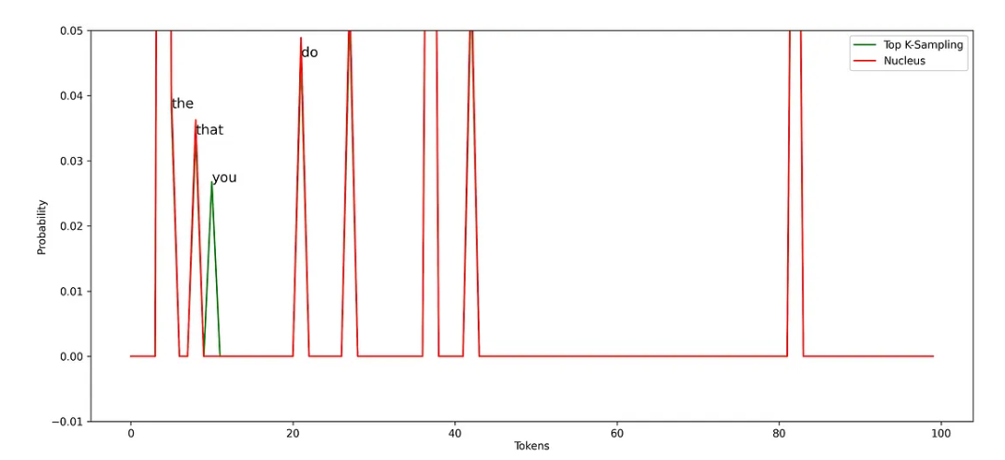
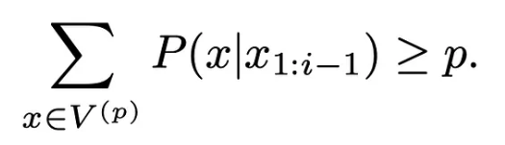
核采样（Nucleus Sampling）
核采样又称为Top-P采样（Top-P Sampling），与Top-K采样类似，但可以对token的候选列表大小进行动态调整。在每步中，仅从累积概率超过某个特定阈值p的最小单词集合中进行随机采样，而不考虑其他低概率的单词。
阈值p一般设置为比较高的值，用于限制低概率token的长尾问题。
Nucleus Sampling计算公式
（阈值：p）

Slide 14
不同解码方式的效果对比
🗣Context:
On days when he woke early, the president liked to have coffee in the oval office. There was something about watching the sky grow lighter and lighter as you sat your pajama'd behind in the most powerful chair in the free world, sipping marine strength coffee, that you just couldn't achieve anywhere else.
🗣Gold:
He was therefore disagreeably surprised to find a man in an understated grey suit sitting in that selfsame chair sipping tea. The president turned around and went looking for his chief of staff.
💰Greedy:
He'd been in the oval office for over a year now, and he'd never been so happy to be there. He'd been in the oval office for almost a year, and he'd never been so happy to be there.
🚦BeamSearch (k=4):
The President was a man of his
word. He was a man of his word. He was a man of his
word. He was a man of his word. He was a man of his
word. He was a man of his word.

Slide 15
不同解码方式的效果对比
🗣Context:
On days when he woke early, the president liked to have coffee in the oval office. There was something about watching the sky grow lighter and lighter as you sat your pajama'd behind in the most powerful chair in the free world, sipping marine strength coffee, that you just couldn't achieve anywhere else.
🗣Gold:
He was therefore disagreeably surprised to find a man in an understated grey suit sitting in that selfsame chair sipping tea. The president turned around and went looking for his chief of staff.
🥄Sampling (t=1.0):
You couldn't be sure if that's what you were really doing, and If you decided to take the day off. The president wanted you to take the day off, but he wanted to maintain a curfew and use his influence wisely.
🇰Top-k Sampling (k=8):
"I'm sorry, sir." "No, it's okay, son," the president said. "I understand." "You're going to have to make a special trip down there to get that kid. He has no idea where he's going."
⚛️Nucleus Sampling (p=0.9):
But that wasn't what drew the president's attention. He'd been seated for maybe a minute when he noticed the other man. What was the guy doing here?

Slide 16
联合采样
通常我们是将Top-K, Top-P, Temperature联合起来使用，顺序为Top-K, Top-P, Temperature。
如下图所示：
🗣I love watching __
moives |  | 66.4%
you |  | 19.9%
what |  | 10.5%
nice |  | 2.7%
... | ... | ...
moives |  | 66.4%
you |  | 19.9%
what |  | 10.5%
moives |  | 66.0%
you |  | 34.0%
Top-K：k = 3
Top-P：p = 0.8
Temperature: t = 0.7

Slide 17
Reference
https://zh-v2.d2l.ai/chapter_recurrent-modern/beam-search.html
https://zhuanlan.zhihu.com/p/43703136/
https://medium.com/@fangkuoyu/a-simple-analysis-of-the-repetition-problem-in-text-generation-c4eb696eb543
https://towardsdatascience.com/decoding-strategies-that-you-need-to-know-for-response-generation-ba95ee0faadc
https://arxiv.org/pdf/2002.02492.pdf
https://zhuanlan.zhihu.com/p/647813179?utm_psn=1708890082965082112

