Slide 1
Group 1: Contact Manager
COP 4331C
Summer 2019

Slide 2

Our Awesome Team
Joseph Hill - Project Manager
Robert Law - Graphical Data/Presentation
Barry Latour - Front End Programmer
Joel Robertson - Front End Programmer
Jacob Haake - Project Lead/Programmer
Miguel Cordero - Graphical Data/Presentation

Slide 3

Contact Manager Goals
The purpose of our project was to create a functional user contact manager
Features include
Login/Create Account
Search Contacts
Add/Delete Contacts
Edit/Update Contacts

Slide 4
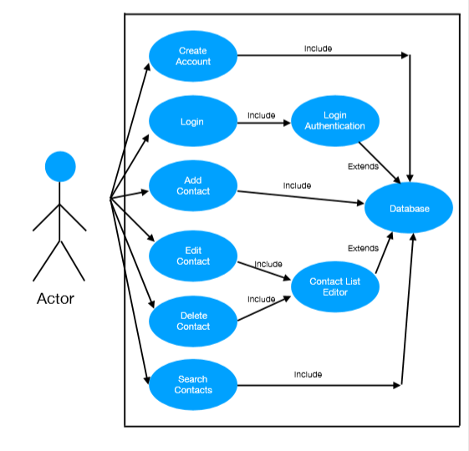
Use Case
Diagram

Slide 5
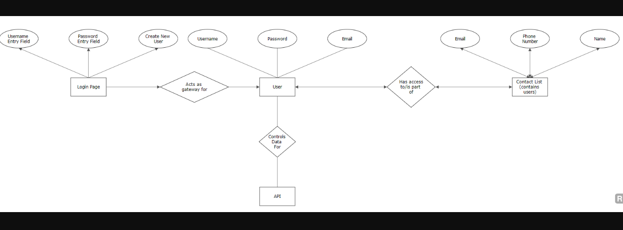
ERD

Slide 6
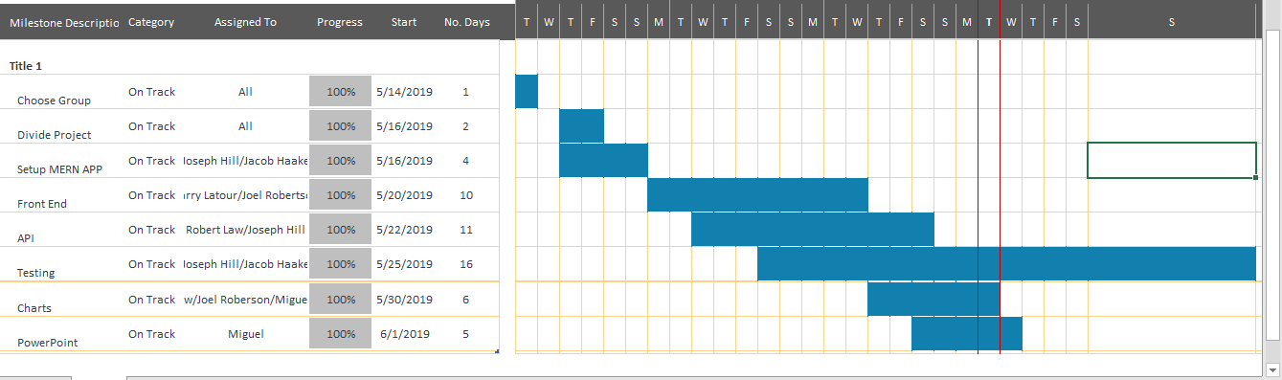
GANTT

Slide 7

Backend and API
MERN Stack
MongoDB
Express
React
Node JS
Mongoose used to connect to MongoDB atlas
Tested with postman

Slide 8
Front-End
Used Bootstrap
Used light colors, very contrasted
all prompts are clearly marked to make easy user interface
Challenges
Connecting frontend to backend presented difficulty
Creating proper call functions for the edit and delete contacts buttons was more time consuming than we initially planned

Slide 9

Team Challenges
As UCF students finding times to meet up is always a challenge at first
Finding a way to balance the workload without stepping on each others toes (small project, not much room for everyone to do anything huge)
Integrating everyone’s work together
MERN was new for most of us, so learning the stack and how to use it was a challenge as well
Login page presented difficulty
Day of Presentation Bug

Slide 10

Road to Success
Research and several software and programming website
Documentation, Blogs, Tutorials
Working with everyone’s strengths
Trial and error

Slide 11
Actions Speak Louder Than Words
http://www.cop4331groupone.com/
May the demo-gods be in our favor

Slide 12

Questions?

