Slide 1
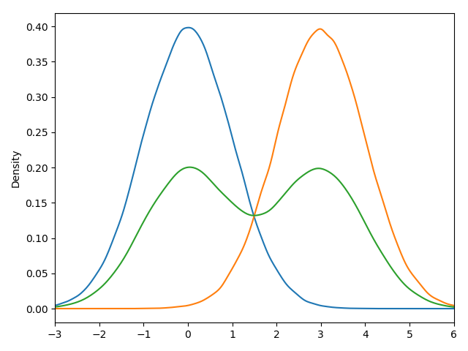
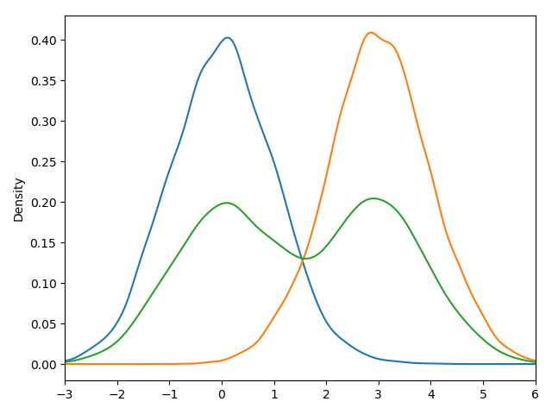
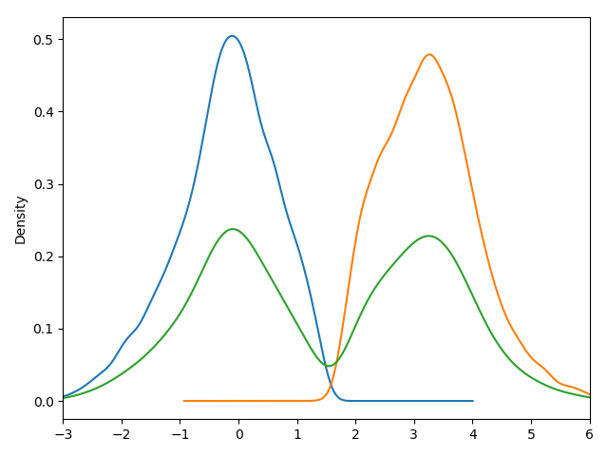
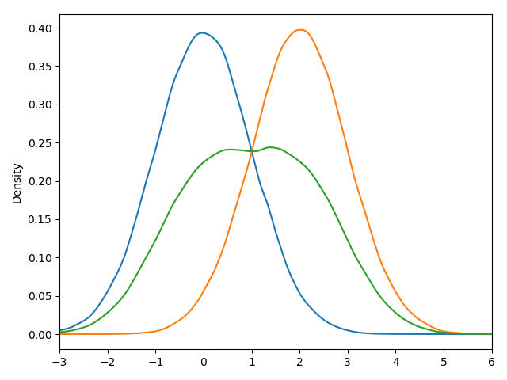
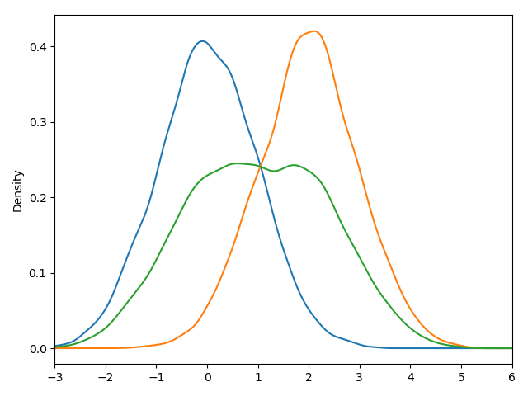
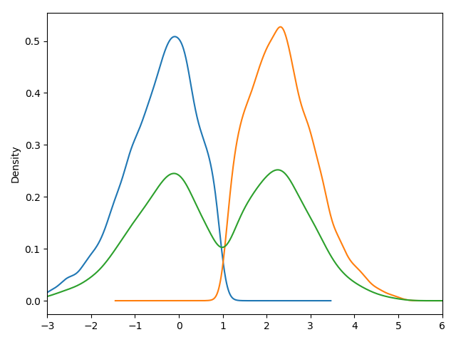
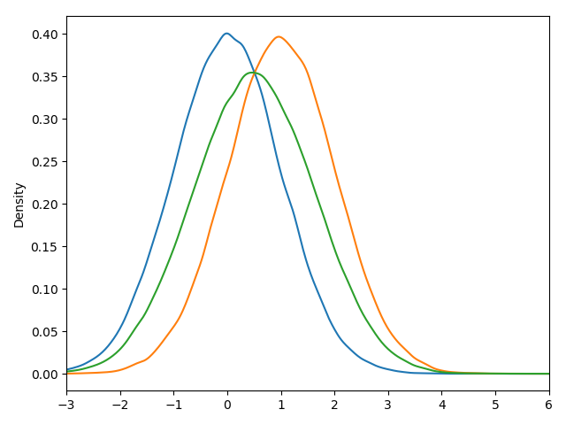

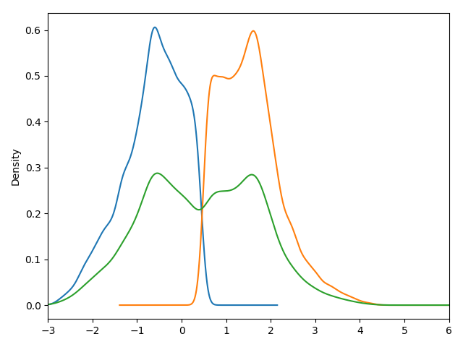



Mixture Gaussian of two Gaussian distribution, the mean of these two Gaussian are $μ_{0}$ and $μ_{1}$ respectively and the $σ=1$ are fixed for both.
Class 0 density
Class 1 density
mixture density
Original
Our method
AC GAN
$$μ_{1}−μ_{0}=3$$
$$μ_{1}−μ_{0}=2$$
$$μ_{1}−μ_{0}=1$$

