Slide 1
Helicopter Flight Dynamics modelling with state-of-the-art dynamic inflow
Final Year Project (FYP)
04/03/2020
Interim presentation
04/03/2020
Ioannis Karatsivoulis- Undergraduate Student, Department of Aeronautics, Imperial College London

Slide 2
Background
Final Year Project (FYP)
04/03/2020
Wake models
CFD
Vortex Wake Models (VWM)
Dynamic wake (inflow)
Free Wake Models (FWM)
Prescribed Wake Models (FWM)
Notes:
Could potentially try the ground effect one→ Although no validation available due to lack of existing flight test data nor the wake model (ground effect is not modelled for ground effect– This is one of the newest version of the wake model).
Have clear understanding of what the model and equations are, where they fit in. Not need to have started/finished coding. Be very clear about the direction/meaning of the project. TALK ABOUT THE CODE (flight dynamics code-introduction in Dr Ribera’s paper). WAHAT IT DOES AND DOES NOT DO. NOT A CFD CODE. HOW THE CODE CAN HAVE DIFFERENT CODES AND MODELS TO CALCULATE THESE VELOCITIES, FROM FREE WAKE TO DYNAMIC INFLOW. EXPLAIN HOW INFLOW FITS IN THERE. SAY ABOUT PROGRESS OF THE MODEL. EXTENDING FLIGHT CONDITIONS CAPTURED THROUGH THE INFLOW MODELS. IDEA: ADD LATER VERSIONS OF CODE. ESPECIALLY THE VORTEX RING STATE; ACCORDING TO DR RIBERAS THESIS. Highlight bits you want people to read.
Feedback: Take the subroutines I have been sent, and start looking at how to the equations in the model correlate with the code. Start to match that and see how it will match your own implementation. See how the commented bit matches any vortex ring corrections. Ensure you understand how the theory matches the 2 sub-routines.

Slide 3
CFD
Final Year Project (FYP)
04/03/2020
Very powerful
Can solve almost anything
✖ Very computationally expensive
✖ Cannot solve turbulence
✖ Grid-dependent solution

Slide 4
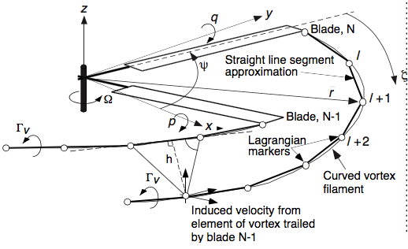
Vortex Wake Models
Final Year Project (FYP)
04/03/2020
Wake modelled as vortex lines
Discretized into lattice of vortex elements:
Straight
Curved
Blobs
Two ways to describe transport of wake vorticity:
Free wake: First principles
Prescribed wake: - Wake filament position specified a priori
- Approximate near-rotor velocity field
Notes:
ADD SOURCE.

Slide 5
Vortex Wake Models
Final Year Project (FYP)
04/03/2020
Once the position and strength of the wake vorticity are calculated, the Biot-Savart law is used to work out the induced velocity field at the rotor, followed by numerical integration
✖ Computationally expensive: High filament number for accurate wake
representation
Notes:
Could potentially try the ground effect one→ Although no validation available due to lack of existing flight test data nor the wake model (ground effect is not modelled for ground effect– This is one of the newest version of the wake model).
Have clear understanding of what the model and equations are, where they fit in. Not need to have started/finished coding. Be very clear about the direction/meaning of the project. TALK ABOUT THE CODE (flight dynamics code-introduction in Dr Ribera’s paper). WAHAT IT DOES AND DOES NOT DO. NOT A CFD CODE. HOW THE CODE CAN HAVE DIFFERENT CODES AND MODELS TO CALCULATE THESE VELOCITIES, FROM FREE WAKE TO DYNAMIC INFLOW. EXPLAIN HOW INFLOW FITS IN THERE. SAY ABOUT PROGRESS OF THE MODEL. EXTENDING FLIGHT CONDITIONS CAPTURED THROUGH THE INFLOW MODELS. IDEA: ADD LATER VERSIONS OF CODE. ESPECIALLY THE VORTEX RING STATE; ACCORDING TO DR RIBERAS THESIS. Highlight bits you want people to read.
Feedback: Take the subroutines I have been sent, and start looking at how to the equations in the model correlate with the code. Start to match that and see how it will match your own implementation. See how the commented bit matches any vortex ring corrections. Ensure you understand how the theory matches the 2 sub-routines.

Slide 6
Dynamic Wake (Inflow) Models
Final Year Project (FYP)
04/03/2020
Momentum (unsteady actuator disk) theory: change in aerodynamic forces across the rotor disk is responsible for creating a certain inflow distribution
Inflow treated as additional Degrees of Freedom
1st order ODE, state-space form

Slide 7
Dynamic Wake (Inflow) Models
Final Year Project (FYP)
04/03/2020
Easily incorporated into flight dynamics codes (FLIGHTLAB, RCAS, HeliUM)
Computationally cheapest model
Potential for real-time simulation
Hierarchical improvement
✖ Linear model=> Problem with capturing non-linear effects
Notes:
Add: Modified/correlated to explain unexplained physical phenomena. Not absolutely based on first principles. Optimum around specific flight conditions

Slide 8
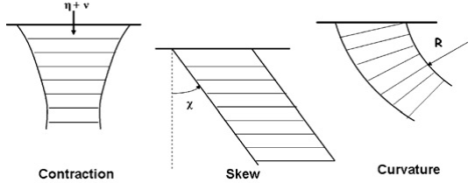
Flight Conditions
Final Year Project (FYP)
04/03/2020
No inflow model is perfect for all conditions
Flight condition ranking (wrt interest):
Descent → Vortex Ring State
Ground effect → Additional lift created
Manoeuvring flight→ Capturing wake skew, curvature and off-axis response
Notes:
Wrt= with respect to
ADD SOURCE

Slide 9
The HeliUM code
Final Year Project (FYP)
04/03/2020
Helicopter Flight Dynamics code
University of Maryland & NASA
Not CFD
Different wake models:
Free-Wake
Dynamic inflow
Accurate but slow=> NO real-time potential
Notes:
Have clear understanding of what the model and equations are, where they fit in. Not need to have started/finished coding. Be very clear about the direction/meaning of the project. TALK ABOUT THE CODE (flight dynamics code-introduction in Dr Ribera’s paper). WAHAT IT DOES AND DOES NOT DO. NOT A CFD CODE. HOW THE CODE CAN HAVE DIFFERENT CODES AND MODELS TO CALCULATE THESE VELOCITIES, FROM FREE WAKE TO DYNAMIC INFLOW. EXPLAIN HOW INFLOW FITS IN THERE. SAY ABOUT PROGRESS OF THE MODEL. EXTENDING FLIGHT CONDITIONS CAPTURED THROUGH THE INFLOW MODELS. IDEA: ADD LATER VERSIONS OF CODE. ESPECIALLY THE VORTEX RING STATE; ACCORDING TO DR RIBERAS THESIS. Highlight bits you want people to read.
Feedback: Take the subroutines I have been sent, and start looking at how to the equations in the model correlate with the code. Start to match that and see how it will match your own implementation. See how the commented bit matches any vortex ring corrections. Ensure you understand how the theory matches the 2 sub-routines.

Slide 10
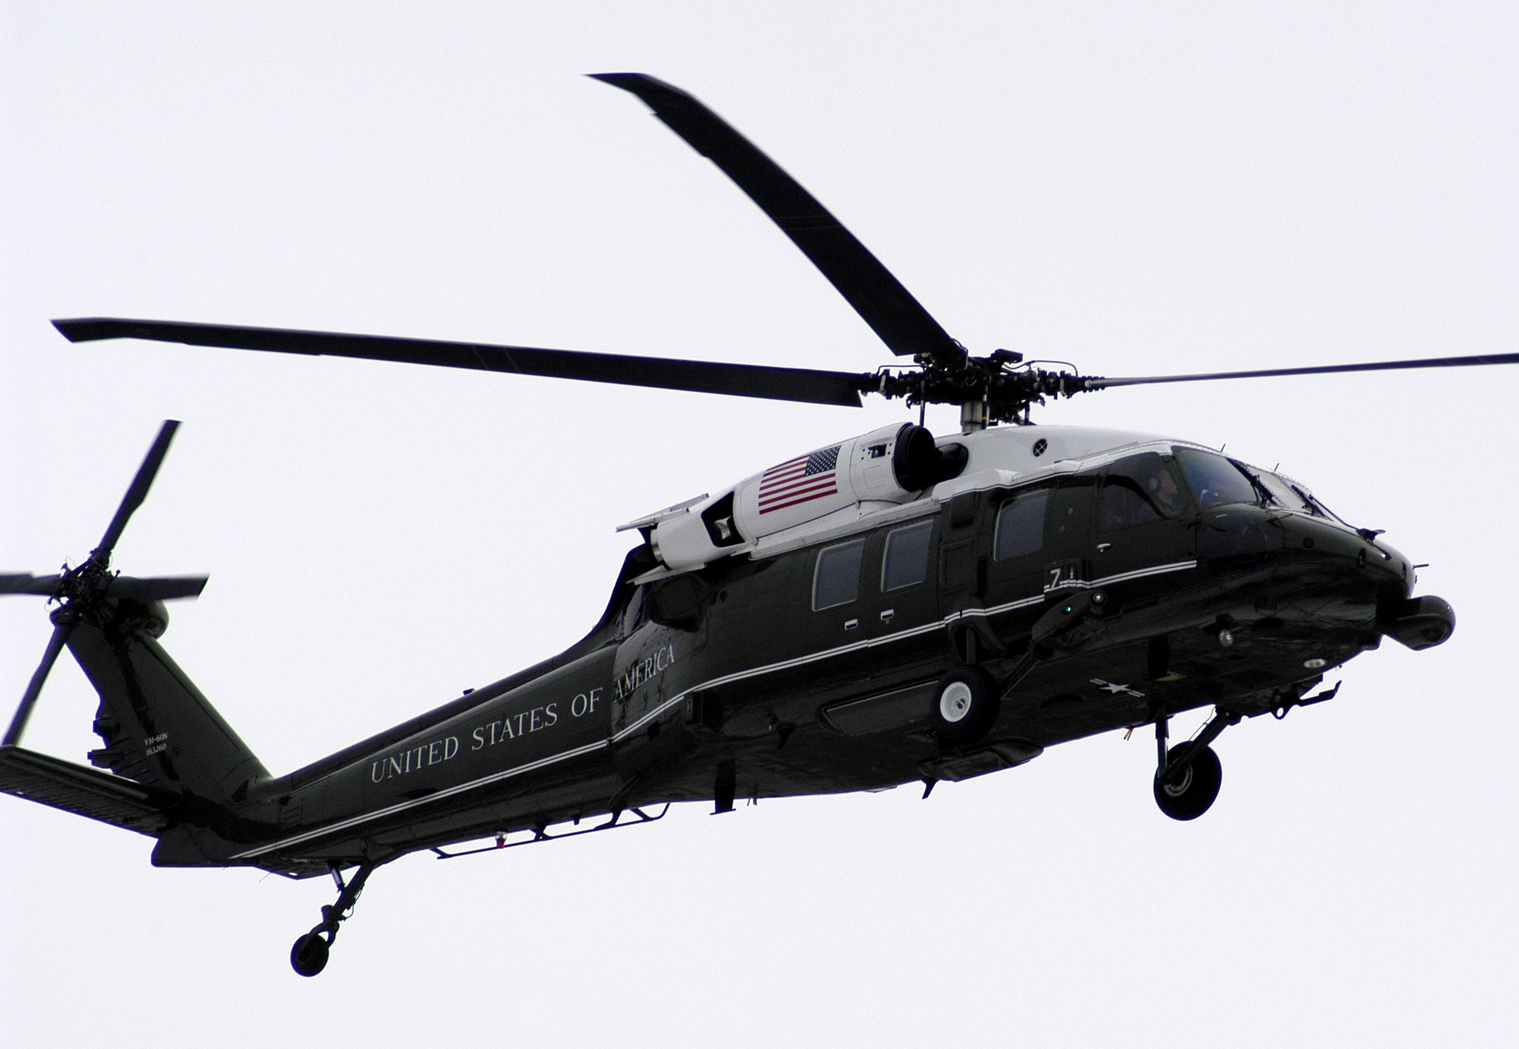
Aims and objectives
Final Year Project (FYP)
04/03/2020
All analyses on the UH-60 Black Hawk
Find inflow model for a not-so-well-modelled condition
Code it inside the HeliUM flight dynamics code
Free wake data validation
Notes:
In the code, there are 2 inflow models, Pitt-Peters and Peters-he, which we are going to be modifying. We’ll be extended the extended models→ capture additional manoeuvres/flight regimes. Already in the code.

Slide 11
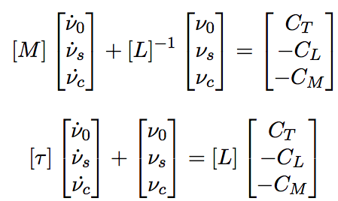

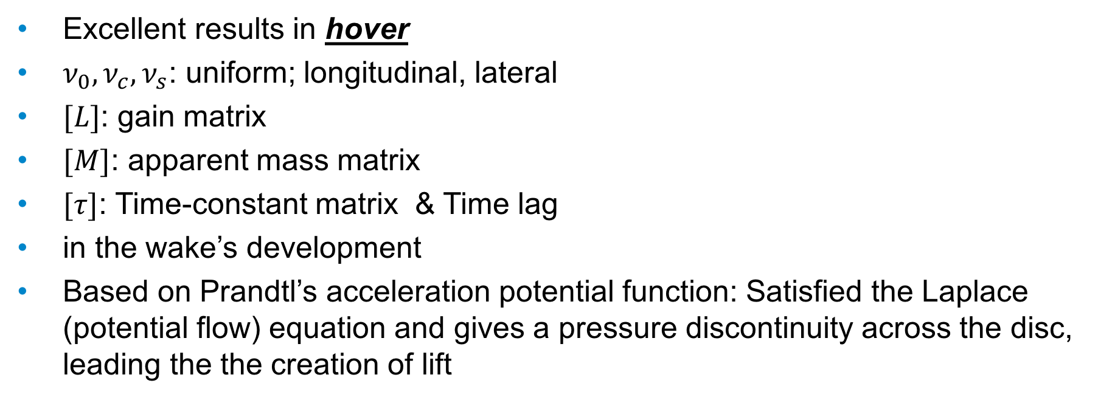
Pitt-Peters (1980)
Final Year Project (FYP)
04/03/2020
Excellent results in hover
$ν_{0},ν_{c},ν_{s}$: uniform; longitudinal, lateral
$[L]$: gain matrix
$[M]$: apparent mass matrix
$[τ]$: Time-constant matrix & Time lag
in the wake’s development
Based on Prandtl’s acceleration potential function: Satisfied the Laplace (potential flow) equation and gives a pressure discontinuity across the disc, leading the the creation of lift
Notes:
Could potentially try the ground effect one→ Although no validation available due to lack of existing flight test data nor the wake model (ground effect is not modelled for ground effect– This is one of the newest version of the wake model).
Have clear understanding of what the model and equations are, where they fit in. Not need to have started/finished coding. Be very clear about the direction/meaning of the project. TALK ABOUT THE CODE (flight dynamics code-introduction in Dr Ribera’s paper). WAHAT IT DOES AND DOES NOT DO. NOT A CFD CODE. HOW THE CODE CAN HAVE DIFFERENT CODES AND MODELS TO CALCULATE THESE VELOCITIES, FROM FREE WAKE TO DYNAMIC INFLOW. EXPLAIN HOW INFLOW FITS IN THERE. SAY ABOUT PROGRESS OF THE MODEL. EXTENDING FLIGHT CONDITIONS CAPTURED THROUGH THE INFLOW MODELS. IDEA: ADD LATER VERSIONS OF CODE. ESPECIALLY THE VORTEX RING STATE; ACCORDING TO DR RIBERAS THESIS. Highlight bits you want people to read.
Feedback: Take the subroutines I have been sent, and start looking at how to the equations in the model correlate with the code. Start to match that and see how it will match your own implementation. See how the commented bit matches any vortex ring corrections. Ensure you understand how the theory matches the 2 sub-routines.

Slide 12
Pitt-Peters (1980)
Final Year Project (FYP)
04/03/2020
✖ Can only go up to 2 harmonics
✖ For each harmonic, only 1 radial shape function used for the induced inflow
Notes:
Sources:
1. He’s PhD thesis: https://search.proquest.com/docview/303711620?pq-origsite=primo

Slide 13
Peters-He (1989)
Final Year Project (FYP)
04/03/2020
Slightly different 1st order ODE
Based on Potential flow functions by Prandtl & Kinner.
Advances made:
Inflow distribution expanded in terms of both harmonic and radial shape functions with undetermined coefficients. This expression can be up to 1000 harmonics
Complete description of radial inflow variation, consistent with, consistent with elastic blade modelling.
Notes:
Sources:
1. He’s PhD thesis: https://search.proquest.com/docview/303711620?pq-origsite=primo
In a helicopter, there is a retreating and advancing disk, which means that the rotor does not produce the same amount of lift for each azimuthal position. Consequently, since (by definition of the induced inflow theory) the inflow is a result of the lift, the blade will nto produce the same amount of inflow at each azimuthal location. As such, the inflow will vary sinusoidally/cosinusoidally

Slide 14
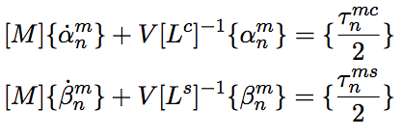

Peters-He (1989)
Final Year Project (FYP)
04/03/2020
Notes:
Sources:
1. He’s PhD thesis: https://search.proquest.com/docview/303711620?pq-origsite=primo
In a helicopter, there is a retreating and advancing disk, which means that the rotor does not produce the same amount of lift for each azimuthal position. Consequently, since (by definition of the induced inflow theory) the inflow is a result of the lift, the blade will nto produce the same amount of inflow at each azimuthal location. As such, the inflow will vary sinusoidally/cosinusoidally

Slide 15
Peters-He (1989)
Final Year Project (FYP)
04/03/2020
Excellent results in hover & forward flight
Good for aeroelastic analysis
More harmonics (up to 1,000) than Pitt-Peters

Slide 16
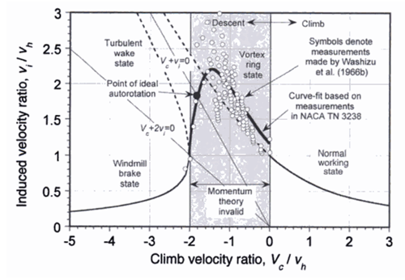
Vortex Ring State (VRS)
Final Year Project (FYP)
04/03/2020
Flight regime: steep descents
Momentum theory breaks down=>
Invalid inflow assumptions=>
Unstable=> Challenge
Tip vortices approach rotor plane
Flapping, possible loss of control
Safety-critical flight condition

Slide 17
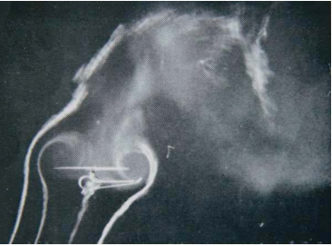
Vortex Ring State (VRS)
Final Year Project (FYP)
04/03/2020
Notes:
ADD SOURCE.
CAN ALSO USE DR RIBERA THESIS’ PICTURES IF YOU WANT TO.

Slide 18
Technical Note: Modification of Mass-Flow Parameter to Allow Smooth Transition between Helicopter and Windmill states (Peters & He, 2006 )
Final Year Project (FYP)
04/03/2020
Modifies the mass flow parameter when transitioning from normal working state to VRS
Free wake data available to compare
Simple Peters-He extension
Clearly maps the VRS boundaries
Implemented using 3 equations

Slide 19
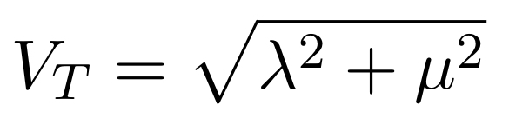
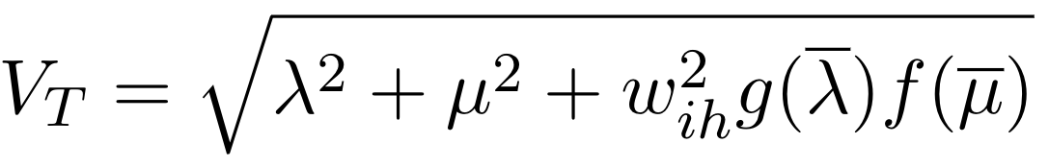
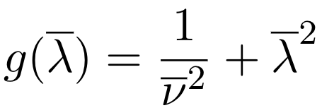

Technical Note: Modification of Mass-Flow Parameter to Allow Smooth Transition between Helicopter and Windmill states (Peters & He, 2006 )
Final Year Project (FYP)
04/03/2020
Notes:
DO NOT EXPLIN THE MATHS IN a lot of detail. Do mention but no too much detail due to time.

Slide 20
Progress
Final Year Project (FYP)
04/03/2020
Reading about helicopter flight dynamics: 9/10
Reading & understanding about Pitt-Peters, Peters-He 10/10
Literature review of inflow models: 9/10
Selecting inflow model(s) to implement: 10/10
Learning FORTRAN: 7/10
Comparing inflow sub-routines to theory: 6/10
Implementing the model: To be Done

Slide 21
Next steps
Final Year Project (FYP)
04/03/2020
Implement the Vortex Ring State inflow model
Produce plots such as the ones by Dr Ribera & Celi
Validate against the free wake data
Notes:
Could potentially try the ground effect one→ Although no validation available due to lack of existing flight test data nor the wake model (ground effect is not modelled for ground effect– This is one of the newest version of the wake model).
Have clear understanding of what the model and equations are, where they fit in. Not need to have started/finished coding. Be very clear about the direction/meaning of the project. TALK ABOUT THE CODE (flight dynamics code-introduction in Dr Ribera’s paper). WAHAT IT DOES AND DOES NOT DO. NOT A CFD CODE. HOW THE CODE CAN HAVE DIFFERENT CODES AND MODELS TO CALCULATE THESE VELOCITIES, FROM FREE WAKE TO DYNAMIC INFLOW. EXPLAIN HOW INFLOW FITS IN THERE. SAY ABOUT PROGRESS OF THE MODEL. EXTENDING FLIGHT CONDITIONS CAPTURED THROUGH THE INFLOW MODELS. IDEA: ADD LATER VERSIONS OF CODE. ESPECIALLY THE VORTEX RING STATE; ACCORDING TO DR RIBERAS THESIS. Highlight bits you want people to read.
Feedback: Take the subroutines I have been sent, and start looking at how to the equations in the model correlate with the code. Start to match that and see how it will match your own implementation. See how the commented bit matches any vortex ring corrections. Ensure you understand how the theory matches the 2 sub-routines.

Slide 22
Timeline
Final Year Project (FYP)
04/03/2020
March | Understanding inflow sub-routines Identifying which sub-routines to change Implementing the Vortex Ring criterion Coding the model(s)
April | Finish coding by mid-April Data analysis Report writing and data interpretation If time- 2nd model implementation
May | Report writing Data interpretation
Notes:
DO NOT SPEND TOO MUCH TIEM ON THIS.

Slide 23
Thank you
Final Year Project (FYP)
04/03/2020
End of Interim presentation
04/03/2020
Ioannis Karatsivoulis- Undergraduate Student, Department of Aeronautics, Imperial College London

