Slide 1


FINAL RESEARCH PRESENTATION · 2026
ForgetBench
Does machine unlearning survive an attack?
RESEARCH TEAM
Bulla Joel Arpith
25WU0103011
Kanchusthambham Jayanth
25WU0103021
Macha Sai Kamal
25WU0103026
Shaik Shahul Parvez
25WU0103036
Damera Sai Sri Ranga Charan
25WU0102048
MENTOR
Prof. Geetha Tripathi
· Woxsen University
Notes:
Good morning. We are presenting ForgetBench, a benchmark and method for machine unlearning. Our question is simple: when a model is told to forget someone's data, does that forgetting survive an attack? Over the next fifteen minutes we show what we built, what we measured, and what we are confirming next.

Slide 2


02
/
THE PROBLEM
A Right on Paper, Not in the Model
DATA SUBJECT
DATABASE
TRAINED MODEL
“Delete my data.”
Row deleted ✓
Still remembers
A lawful erasure request.
The record leaves storage.
Reproduces it from its weights.
EU · 2016
INDIA · 2023
S.D.N.Y. · 2023
N.D. CAL. · 2023
GDPR Art. 17
DPDP Act §12
NYT v. OpenAI
Artists v. Stability AI
Right to erasure
Erasure for data principals
Near-verbatim reproduction
Memorized training works
Notes:
Privacy law gives every person a right to erasure. A company can honour it at the database: the row is deleted. But a model trained on that row has already absorbed it into its weights, and it can still reproduce it. The law and the courts are now pressing on exactly this gap.

Slide 3
03
/
THE PROBLEM
Two Layers, One Word
DATA LAYER
MODEL LAYER
Solved
Not solved
?
Prove the content is gone from the weights
?
Prove it stays gone after further training
?
Do it per request, not per retrain
✓
Delete stored records and logs
✓
Exclude from future training runs
✓
Drop from retrieval indexes
✓
Filter outputs at inference
ForgetBench measures this layer.
Notes:
When people say deletion, they mean two different things. Deleting from storage, training pipelines and indexes is an engineering task that is already solved. Deleting from a trained model, and proving it stays deleted, is not. That second layer is where this project lives.

Slide 4



04
/
THE PROBLEM
Scrubbed Content Comes Back
WE REPRODUCED IT · NPO
forget-set log-prob
STEP 1
Scrub passes the test
Ask directly — the content is gone.
AFTER SCRUB
AFTER 15-STEP ATTACK
−4.87
−0.76
STEP 2
Light fine-tune attack
Fifteen ordinary training steps.
STEP 3
Content resurfaces
It was suppressed, not removed.
NPO scrubs the forget set to −4.87; a 15-step attack brings it back to −0.76.
Consistent with arXiv:2406.13356
Notes:
Approximate unlearning methods look successful on the standard test. But published work shows that a light fine-tune can revive what was scrubbed. We reproduced this ourselves: NPO pushed the forget set down to minus 4.87, and a fifteen-step attack brought it back to minus 0.76. Forgetting that can be undone this cheaply is not forgetting.

Slide 5
05
/
LITERATURE REVIEW
What the Field Has — and What It Misses
2021
2024
2024
2024
SISA
NPO · RMU
Relearning attacks
TOFU · MUSE
Exact unlearning by sharding — retrain only the affected shard.
Preference-loss and representation scrubs at one training pass.
A light fine-tune revives forgotten content.
Standard forget and retain benchmarks.
SCORE ONCE — NEVER AFTER AN ATTACK
EXACT · RETRAIN-SCALE
CHEAP · APPROXIMATE
THE THREAT
Bourtoule et al.
Zhang; Li et al.
arXiv:2406.13356
Maini; Shi et al.
Notes:
Four lines of work frame this project. SISA gives exact unlearning but at retrain-scale cost. NPO and RMU are cheap but approximate. Relearning attacks show that approximate unlearning can be reversed. And the benchmarks, TOFU and MUSE, score forgetting once, never after an attack. That last gap is the one we close.

Slide 6
06
/
RESEARCH GAP
The Cheap-and-Durable Corner Is Empty
COST × DURABILITY
schematic
EXACT
Durable but expensive
EMPTY
Retraining cost scales with the whole corpus.
HRU's target
Full retrain · SISA
durable, expensive
APPROXIMATE
Cheap but fragile
Forgetting collapses under a light attack.
DURABILITY →
NPO · RMU · Gradient ascent
cheap, collapse under attack
THE CORNER
Cheap and durable
No existing method sits here. HRU is built for it.
COST →
Notes:
Plot every method on cost against durability and a pattern appears. Exact methods are durable but expensive. Cheap methods collapse under attack. Nothing sits in the corner that is both cheap and durable. That empty corner is HRU's target.

Slide 7
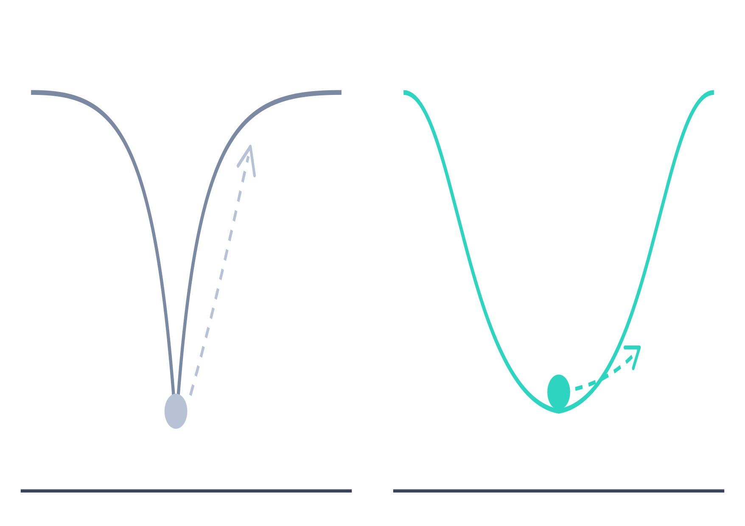


07
/
OUR METHOD
HRU: Forget Into a Flat Minimum
THE HARDENING LOOP
WHERE THE SCRUB LANDS
1
Scrub
Sharpness-aware NPO loss seeks a flat minimum.
2
Probe
Simulate a relearning attack on the model.
3
Harden
Push harder on whatever resurfaces.
Sharp minimum · NPO
Flat minimum · HRU
A small attack step climbs out.
The same step stays inside the basin.
repeat each round
Notes:
HRU changes where the scrub lands. Standard NPO drives the model into a sharp minimum, so a small attack step is enough to climb back out. HRU uses a sharpness-aware NPO loss that seeks a flat basin instead, which a relearning attack cannot easily escape. Around that scrub runs a hardening loop that probes the model with simulated attacks and pushes harder on whatever resurfaces.

Slide 8
08
/
METHODOLOGY
One Harness, Three Arms
12
variants, scored on identical terms
A
BASELINE
B
BASELINE
C
OURS
Exact unlearning
Approximate unlearning
HRU
Full retrain
SISA
NPO
RMU
Gradient ascent
HRU
HRU + sharding
SHARED BY ALL 12
same model
same data
same probes
same seeds
same cost accounting
Notes:
To compare fairly, every method runs through one harness. Arm A is exact unlearning: full retraining and SISA. Arm B is approximate: NPO, RMU and gradient ascent. Arm C is HRU. All twelve variants share the same model, data, probes, seeds and cost accounting, so differences come from the methods, not the setup.

Slide 9
09
/
TOOLS & TECH
Small, Reproducible, Single-GPU
124M
130
1
4
GPT-2 parameters
fictional profiles
Colab T4 GPU
evaluation axes
Small open model, full control.
No real personal data.
Single-GPU by design.
One of them new.
STACK
HuggingFace transformers
PyTorch
Google Colab
AXIS 1
AXIS 2
AXIS 3 · NOVEL
AXIS 4
Forget quality
Retain quality
Durability after attack
Cost
Notes:
We kept the setup deliberately small so anyone can reproduce it. GPT-2 with 124 million parameters, HuggingFace and PyTorch, on one Colab T4 GPU. The forget data is 130 fictional profiles, so no real personal data is ever used. Every method is scored on four axes, and durability after attack is the one we add.

Slide 10
10
/
RESULTS
HRU Holds Its Forgetting Best Under Attack
FORGET-SET LOSS AFTER ATTACK
higher = more durable
HRU
1.31
Gradient ascent
1.09
HRU
NPO
0.76
1.31
Full retrain
0.58
Best of all 12 methods tested — ahead of full retraining.
SISA
0.46
Full retrain: 0.58
RMU
0.45
HRU + sharding
0.42
Selected variants of 12 tested
Notes:
This is our headline result. After the relearning attack, HRU keeps a forget-set loss of 1.31, the highest of all twelve methods we tested. That puts it ahead of gradient ascent at 1.09, NPO at 0.76, and even full retraining at 0.58. Higher means the forgotten data stayed forgotten.

Slide 11
11
/
RESULTS
Not Just Aggressive Forgetting
A · ADJUSTED FOR MODEL IMPACT
B · TRUTH RATIO
+0.20
Does the model still prefer the true answer? 1.0 = clean forgetting.
more durable than predicted from how much HRU changes the model.
1.0 clean
NPO
13.17
//
Full retrain
HRU
1.01
1.29
RANK OF 12
residual durability
1
2
3
4
5
6
7
8
9
10
11
12
over-forgets
HRU · Full retrain
NPO — last
axis broken between 2 and 13
Notes:
A fair objection is that HRU might simply forget harder. Two checks say otherwise. First, after adjusting for how much each method changes the model, HRU is 0.20 more durable than predicted, in the top two of twelve alongside full retraining, while NPO ranks last. Second, its truth ratio is 1.29, close to retraining's 1.01, while NPO over-forgets at 13.17.

Slide 12


12
/
DISCOVERY
Sharding Dilutes Unlearning
Shard 1
scrubbed −4.18
DURABILITY AFTER ATTACK
ENSEMBLE
1.31
Shard 2
untouched
HRU
average
−0.50
Shard 3
untouched
forgetting diluted
0.42
HRU + sharding
Shard 4
untouched
“SISA's averaging assumes the deleted shard has nothing to suppress — approximate unlearning breaks that assumption.”
Notes:
We also found something we did not expect. Combining HRU with SISA-style sharding makes it worse, not better. Only the shard holding the deleted data is scrubbed, to minus 4.18. The other three are untouched, and averaging them pulls the ensemble back to minus 0.50. Durability falls from 1.31 to 0.42. SISA's averaging assumes the deleted shard has nothing left to suppress; approximate unlearning breaks that assumption.

Slide 13
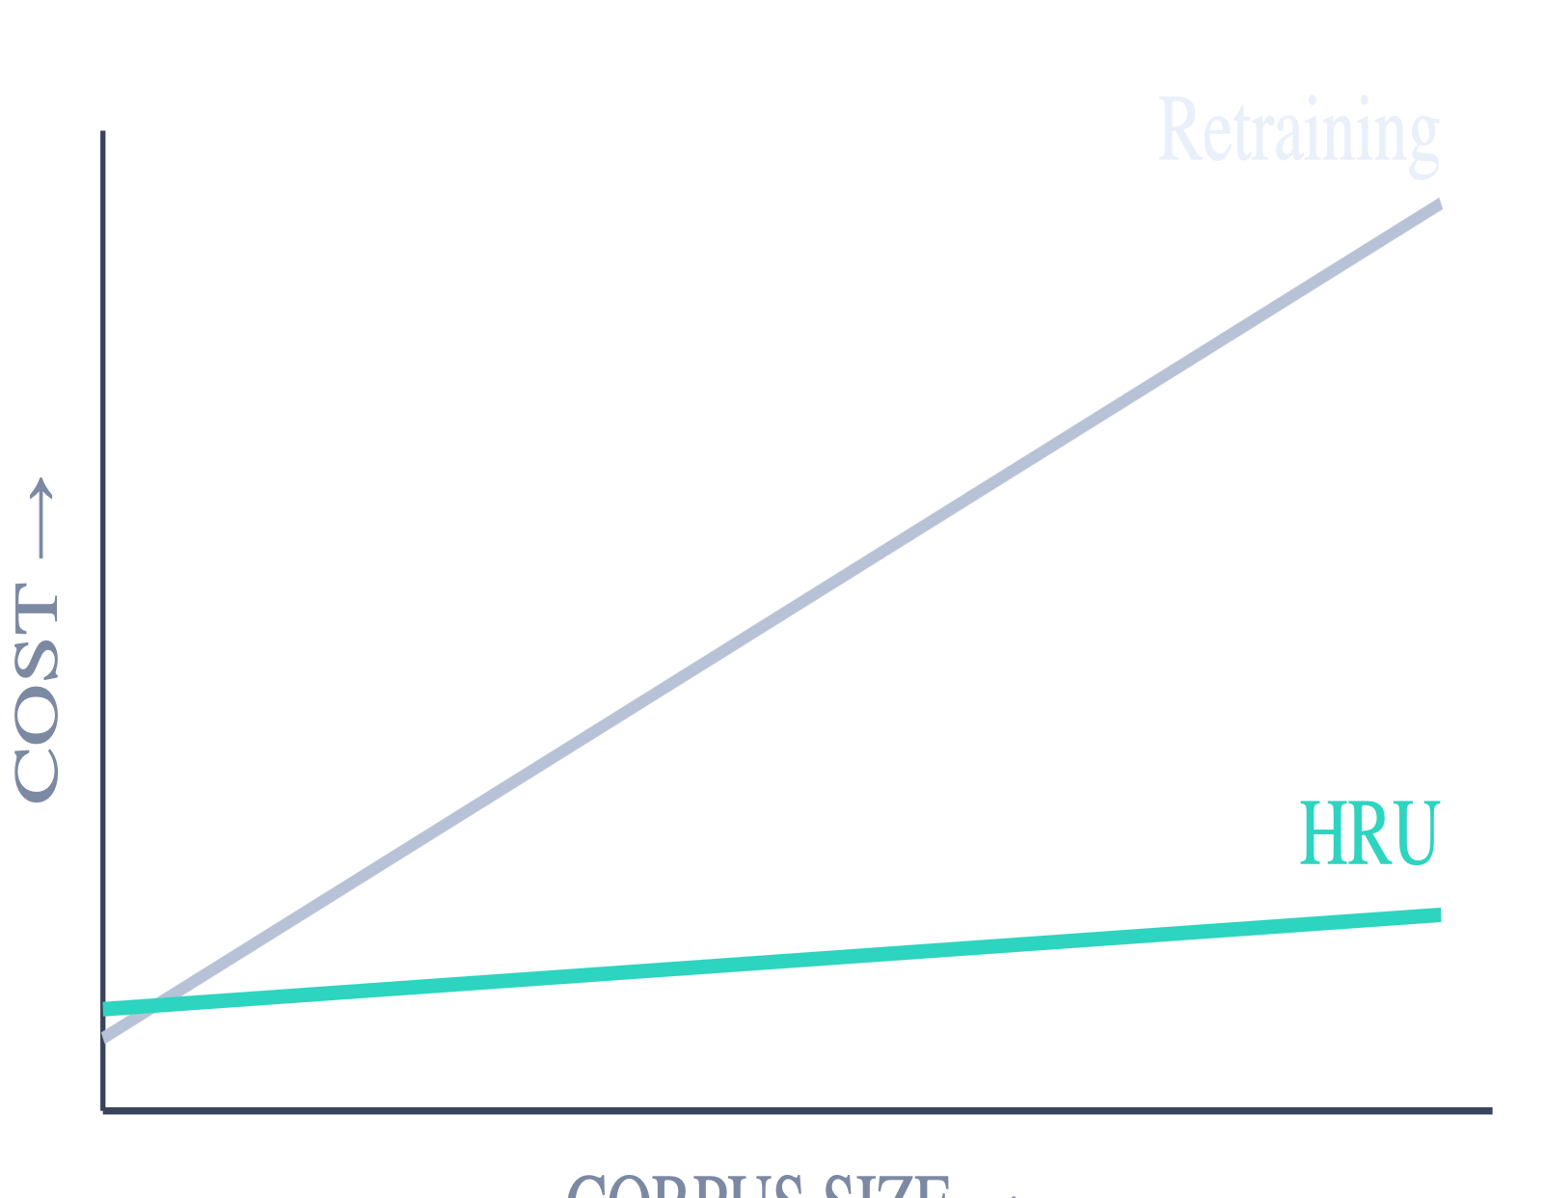
13
/
COST
Cheaper Than Retraining — and Scaling Better
AT DEPLOYMENT SCALE
schematic
MEASURED · OPTIMIZER UPDATES
120
HRU
150
Full retrain
At this scale — GPT-2, 130 profiles.
Retraining
HRU
grows with the entire corpus
grows with the forgotten data only
Notes:
At this scale HRU used 120 optimizer updates, against 150 for full retraining. The more important point is how cost grows. Retraining has to revisit the entire corpus, so it grows with the corpus. HRU only touches the data being forgotten, so its cost grows with the forget set, not with the size of the model's training data.

Slide 14
14
/
VALIDATION PHASE
Confirming the Lead
READY
01
Fact-level metric
Scores the forgotten fact itself, not just the forget-set average.
BUILT · READY TO RUN
~40
READY
02
Full inline reweight loop
Per-example reweighting inside every hardening round.
minutes of GPU time
Experiment built and ready.
READY
Equal-budget test · 3 seeds
03
Against a SAM-NPO control — isolates what the hardening loop adds.
Notes:
Our result is strong, so the next step is to confirm it holds up. We built three checks: a fact-level metric that scores the forgotten fact itself, the full per-example inline reweighting loop, and an equal-budget test over three seeds against a SAM-NPO control, which isolates what the hardening loop adds. The experiment is built and needs about forty minutes of GPU time.

Slide 15
15
/
CONCLUSION
DONE
DONE
READY
ForgetBench harness
Durability comparison · 12 methods
Validation run
Turning the right to be forgotten from a legal claim into a measurable engineering property — one that holds up when someone tries to undo it.
Thank you
Questions?
Prof. Geetha Tripathi
Bulla Joel Arpith
Kanchusthambham Jayanth
Macha Sai Kamal
Shaik Shahul Parvez
Damera Sai Sri Ranga Charan
Woxsen University
Notes:
To close: the ForgetBench harness is done, the durability comparison across twelve methods is done, and the validation run is ready. HRU holds its forgetting better under attack than every method we tested, including full retraining. Our aim is to turn the right to be forgotten into something you can measure, and that holds up when someone tries to undo it. Thank you, we are happy to take questions.

