Slide 1
Cloud Storage

Slide 2
Requirement
Target : Mobile, Tablet, PC
File Upload : 10Gb size limit
Download
Automatic synchronize
Versionable : saving max 10 versions and dealing with conflict
Storage Size : 500GB - DAU : 1million - 50% people upload two files. - Average File Size : 5MB -> Monthly : 1mil *50% * 2 * 5MB * 30days = 150TB

Slide 3







System Design
File History Service
L7
File Upload Service
File Download Service

Slide 4

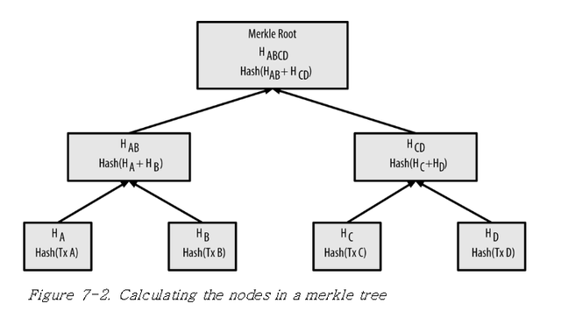
System Design
User
Id, Password, Email
Meta
Id, Name, Size, UserId, Path, Version
Block
Id, MetaId, BlockPath,Hash, status
Version Conflict
Updated Block upload
L7
File Upload Service
Metadata
File Storage
Merkle Tree is better than linear blocks
if the file changes a little and quite often. And making block algorithms should be different for each extension.

Slide 5
System Design
User
Id, Password, Email
Meta
Id, Name, Size, UserId, Path, Version
Block
Id, MetaId, BlockPath,Hash, status
Blocks for synchronize
Full File for Download
L7
File Download Service
Metadata
File Storage

