Slide 1
Keyword Suggestion

Slide 2
Requirement
Target : Mobile, Tablet, PC
Keyword Retrieve, Save, Update
Prefix search
Sorted by frequency each region
Low latency
Scalable
Capacity Planning - DAU : 10million - Each Users search 10 times everyday. - Query Size : 20bytes ( 5bytes * 4words ) - QPS : 10millon * 10times * 4words/24hours/3600sec = 4600 - Max QPS : 9200QPS
Notes:
한 글자씩 request 던지지 말고 0.2초정도 delay 줘서 단어 기준으로 날아갈 수 있게..

Slide 3





System Design
Retrieve
Save
Prefix search each region
Order by priority
Keyword Search Service

Slide 4

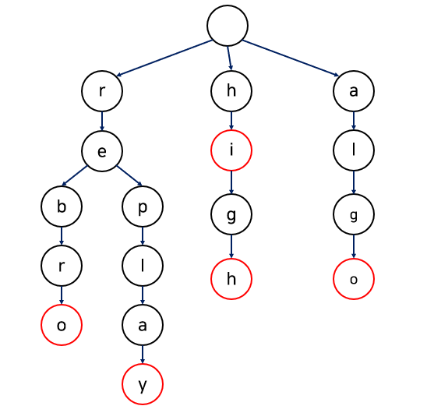

System Design
Alphabet based Sharding (aa-zz)
Cached Data
Cached Data
Cached Data
Retrieve
IDC
Save
Keyword Save Service
Trie Generator
(Batch Job)
Priority = Date*Weight*Frequency
Keyword | Frequency | Date(year) | region
Tree | 1000 | 2021 | US
Tree | 500 | 2022 | CA
Trie | 100 | 2021 | GB
Trie | 800 | 2022 | IS
DB
Notes:
Date에 가중치를 워서 최신 검색된 내용이 우선으로 Suggestion 될 수 있게 하고 Region(idc) 별로 Trie 데이터 분리

