Slide 1
Pineland Music School
Group 38
Riley Hoolahan- Anzah Khan
Joel Michael White- Rafique Mohammed
Panchalee Navarathne

Slide 2

User Stories
Login
Update Details
Instrument Hire
Teacher access
Book lessons
Riley

Slide 3
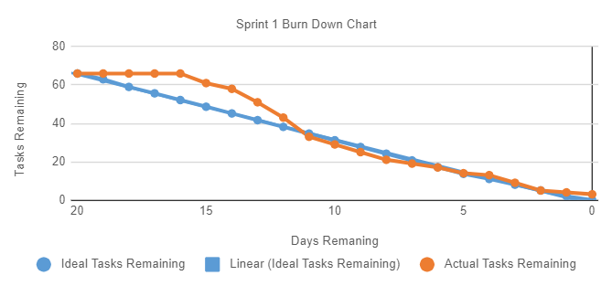
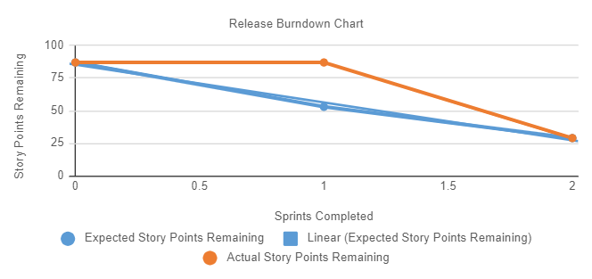
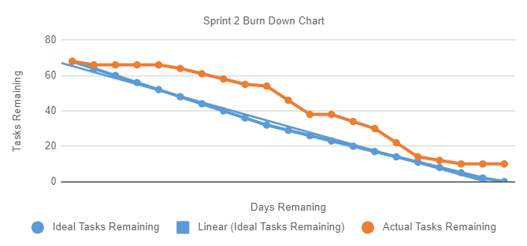
Burndown
Charts
Riley

Slide 4
Velocity
Initial Velocity was set at 34 story points
Due to merging sprint 1 into sprint 2, the velocity was changed to 58 story points for both sprints
This was due to the number of issues we faced at the start of the project, which meant the no stories were fully completed in sprint 1. They were combined into sprint 2.
These issues were:
The progress on the database was restarted many times, due to connection difficulties
Not researching the sprint requirements before starting
Misjudged timings
Riley
Notes:
Not sure if the velocity is quite right, check about the new sprint plan

Slide 5
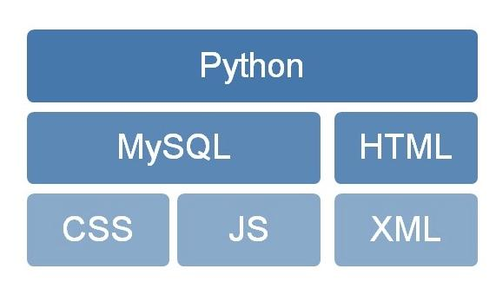
Technology Usage
Joel

Slide 6
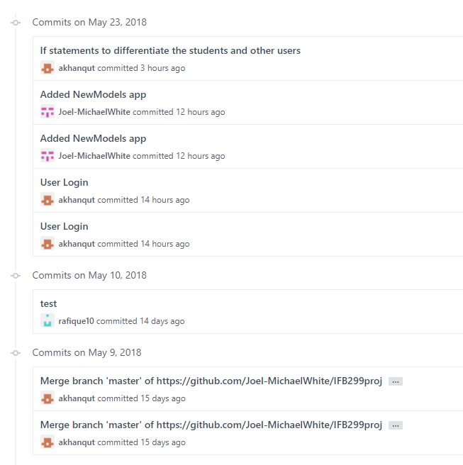
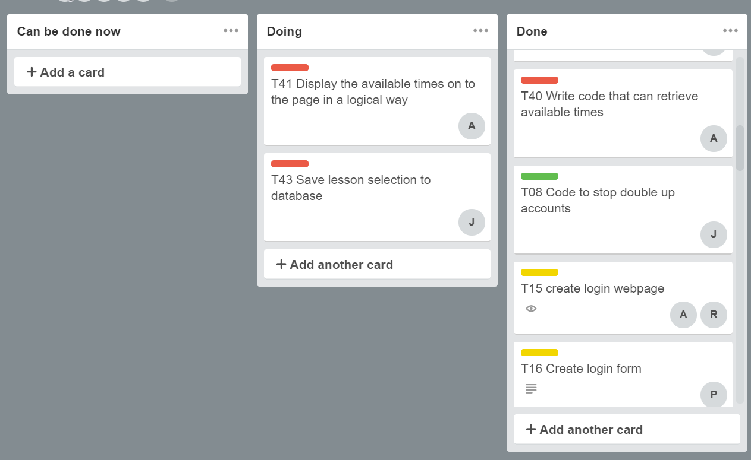
Our Process
Trello was used to track tasks (both website and documentation wise) and the time spent on each task
GitHub was used as version control, as well as allowing
collaboration between developers and clients
Joel

Slide 7
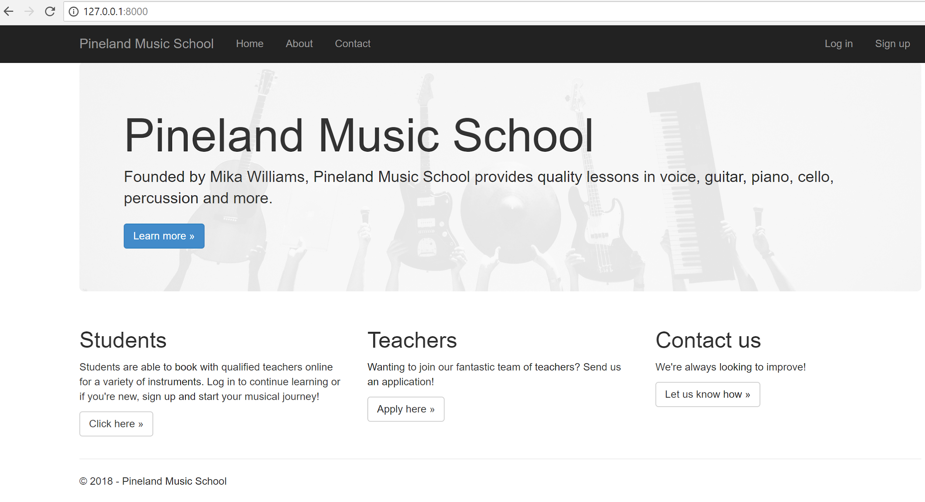
Product Demo
Anzah

Slide 8
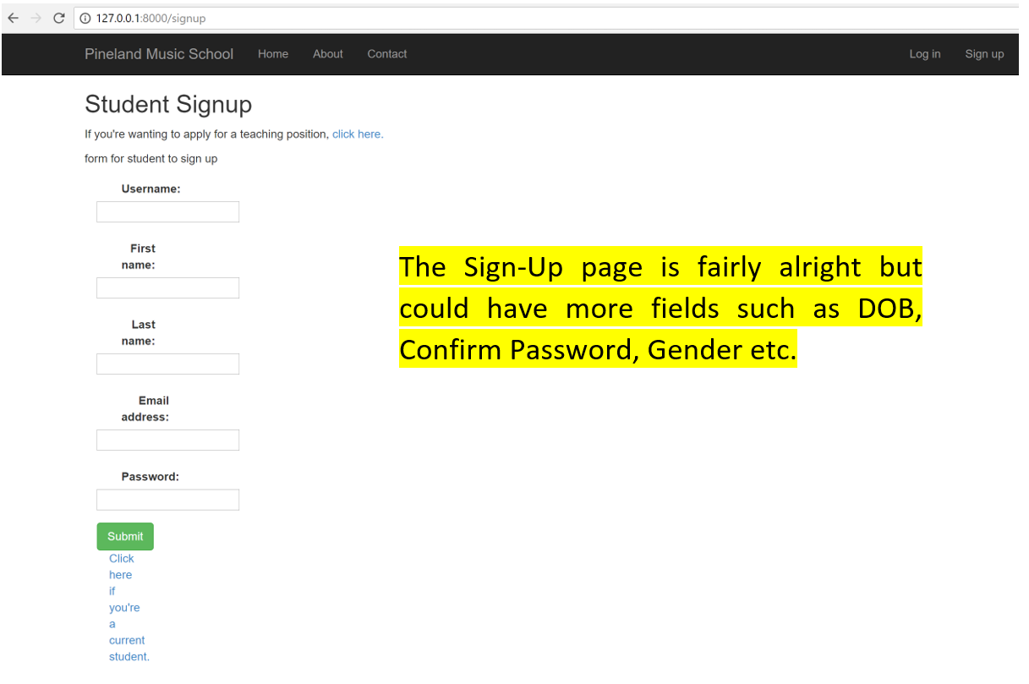
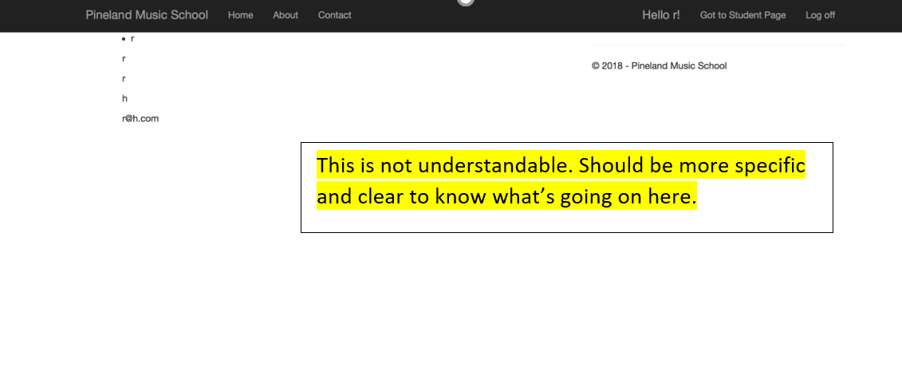
Customer Involvement
Feedback from clients/customer
Rafique

Slide 9
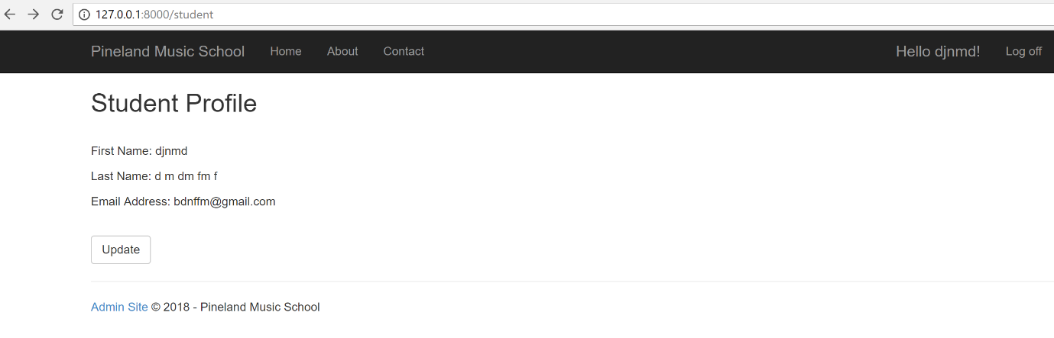
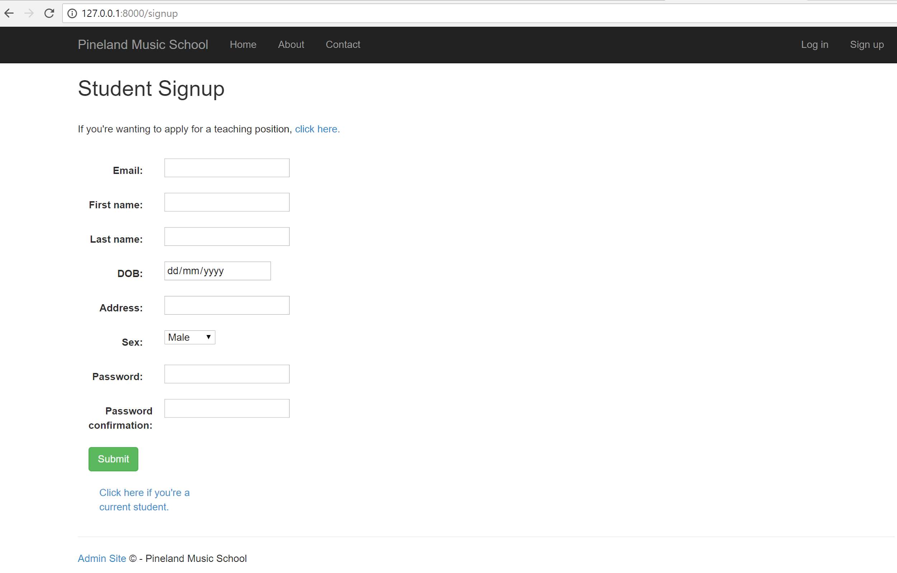
Customer Involvement
Improvements made on the Feedback from clients/customer
Rafique

Slide 10
Testing
Manual Testing of the website has been completed.
Rafique

Slide 11
Moving forward
Improve user experience via testing
Improve functionality
Add additional features such as
Creating a automatic contract between teacher and student
Allowing teachers to set their availability through the website
Panchelle

