Slide 1

Calculator and Text
Editor using HTML
and CSS
Task - 3

Slide 2
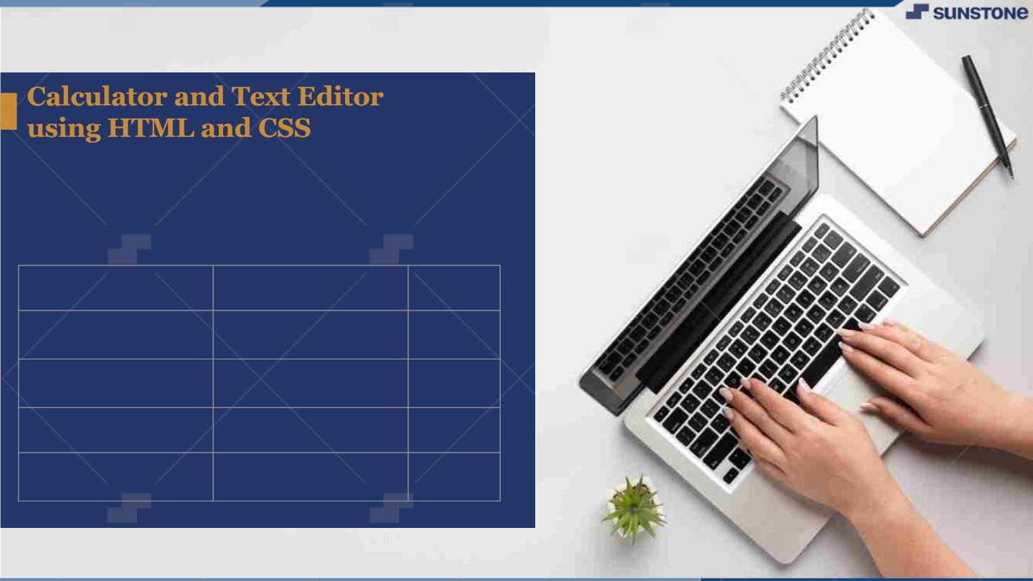
LMS Username
Name
DHANUSHMATI S A55
JOEL JOSEPH A55
MADHUMITHA R A55
PADMAVATHI G A55
Batch
2113a55306
2113a55317
2113a55323
2113a55330

Slide 3
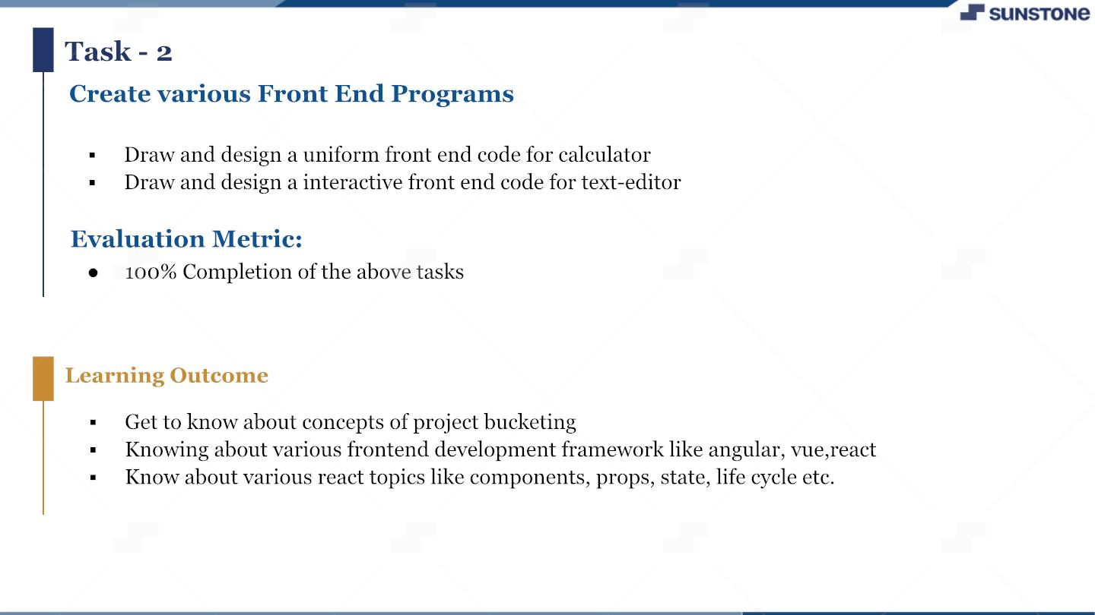

Slide 4

Step-Wise Description
v Define the Purpose
v Choose the Programming Language
v Plan the Layout
v Create HTML Markup
v Style with CSS
v Add JavaScript Functionality
v Test and Debug
v Deploy
v Maintain and Update
Summary of your task
A calculator website is a website that provides users with the ability to perform mathematical
calculations and functions online. To create a calculator website, the purpose must be defined, the
appropriate programming language and CMS chosen, and a plan for layout and design must be
established. The website should be developed with HTML, CSS, and JavaScript, thoroughly tested and
debugged, optimized for search engines, and deployed securely. Regular maintenance and updates are
necessary to keep the website functional and up to date with the latest technologies.

Slide 5

Assessment Parameter
Setup Project for Calculator project
Setup basic structure of text-editor
project
Create a main component with the outer
structure of calculator
Create main component with all
feature buttons
Check-List
Create a button component with on
click handler
Create a json object to store data
for text editor
Create a ` evaluateExpresion`
function to evaluate value
Push both code to github

Slide 6

Submission Github
https://github.com/Joel449-
gif/NM-FSD/tree/main/Task%202

Slide 7


