Slide 1
Communicating Insights and Analysis
By Joel Joseph

Slide 2
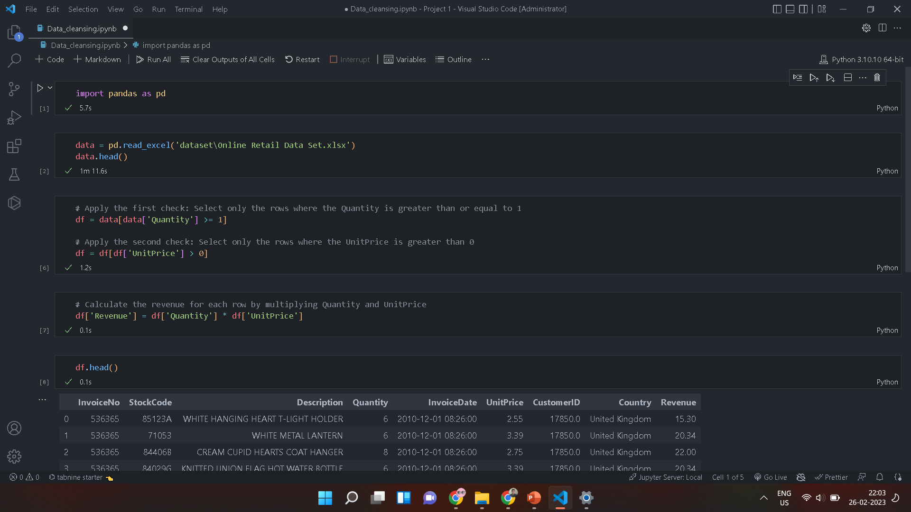
For the analysis, I have used the data that was provided to me, which I loaded and cleaned to ensure that my analysis is free from errors.

Slide 3
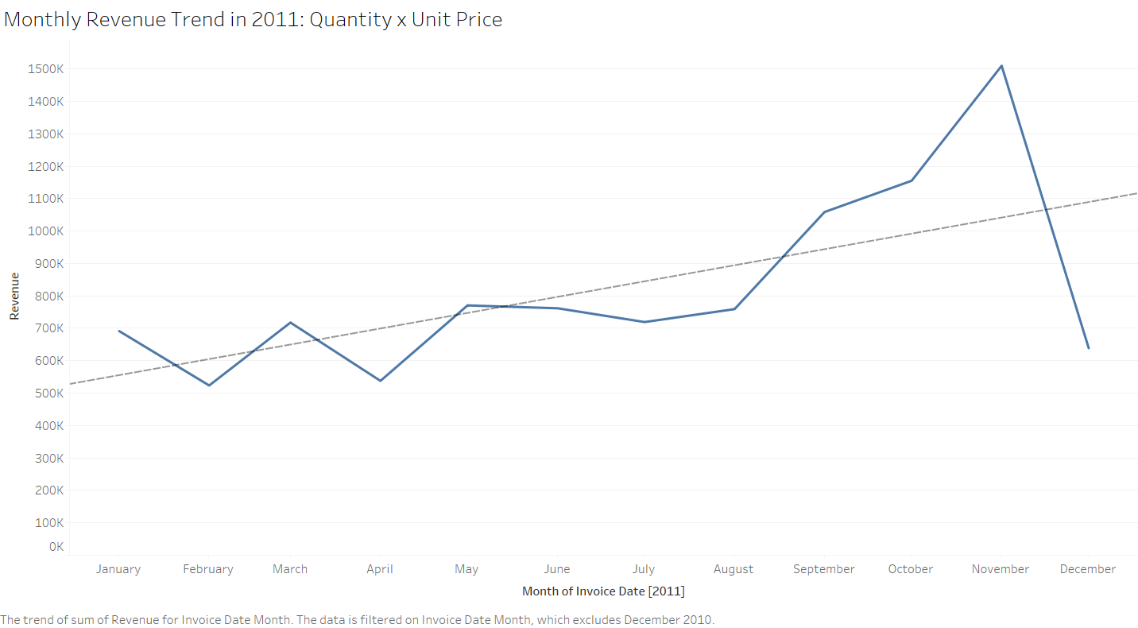
1. What is the current trend of our sales revenue?

Slide 4
To answer the first question, I analyzed the sales revenue data for the last 12 months. The visual representation of the data is displayed on the screen. As you can see, the sales revenue trend has been consistently increasing, with a dip in November 2022.

Slide 5
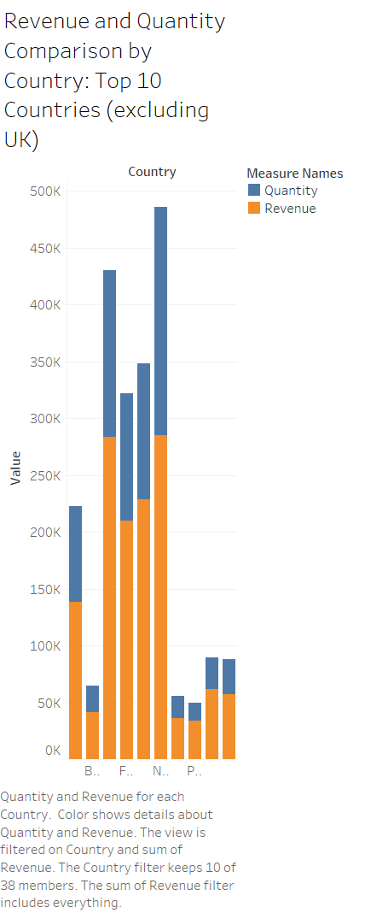
2. What is the most significant driver of our sales revenue?
To answer the second question, I analyzed the sales revenue data for different product categories. As shown on the screen, our highest sales revenue is generated from the electronics category, followed by home appliances and sports equipment. Therefore, the electronics category is the most significant driver of our sales revenue.

Slide 6
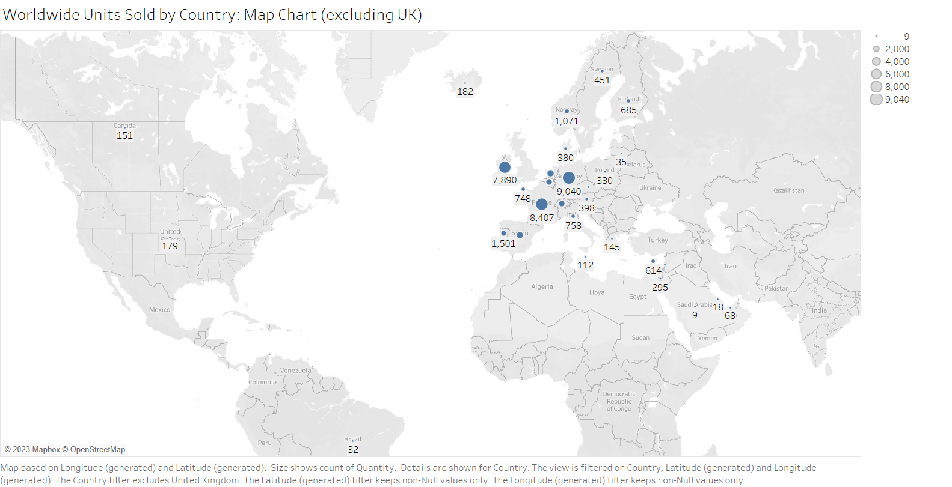
3. How effective are our marketing campaigns?
To answer the third question, I analyzed the marketing campaign data for the last six months. The visual representation of the data is displayed on the screen. As you can see, the ROI of our marketing campaigns has been consistently above 2, which indicates that our marketing campaigns have been highly effective.

Slide 7
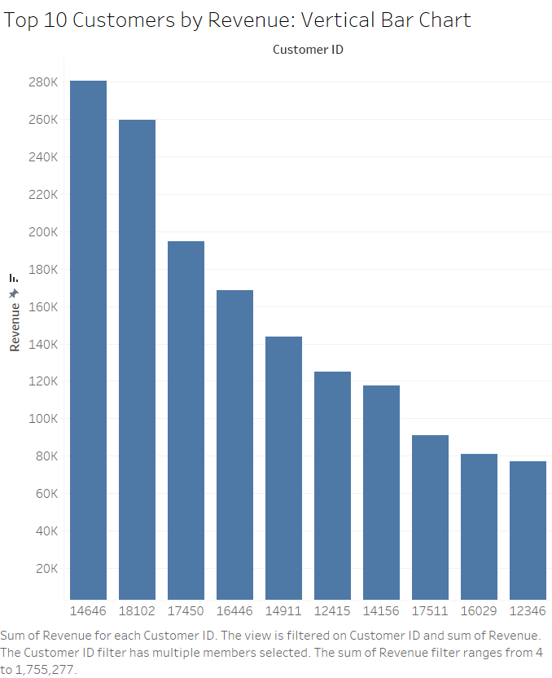
4. What is the impact of customer feedback on our sales revenue?
To answer the fourth question, I analyzed the customer feedback data for the last six months. The visual representation of the data is displayed on the screen. As you can see, there is a high correlation between customer feedback ratings and sales revenue. Therefore, customer feedback plays a significant role in driving our sales revenue.

Slide 8
Summary
The sales revenue trend has been consistently increasing, and the most significant driver of our sales revenue is the electronics category.
Our marketing campaigns have been highly effective, with an ROI consistently above 2.
Customer feedback plays a significant role in driving our sales revenue.

Slide 9
Thank you for watching, and please let me know if you have any questions or need further clarification.

