Slide 1



From Fragmented Alerts to Actionable Intelligence:
Semantic Clustering, Knowledge Graph Construction, and RAG-Based Incident Reporting on SIEM Log Streams
Joel Isaria Mwende 15 August 2026
MSc Computer Science, Cyber Security SRH University of Applied Sciences
Supervisors: Prof. Dr. Reiner Creutzburg
Navaneeth Shivananjappa, M.Sc. Prof. Dr. Tuğçe Ballı
Notes:
Good morning/afternoon, esteemed supervisors and committee members.
My name is Joel Isaria Mwende, and today I am presenting my Master’s thesis titled:
This work was conducted under the supervision of
Thank you for being here

Slide 2



Contents
Motivation and Questions
The Pipeline Experimental Setup Results
Limitations and Conclusions
Notes:
[~20 s]
SAY: "Five parts. The problem and my research questions, then the pipeline
itself, the experimental setup, the results, and finally limitations and
conclusions."
Don't linger. Click straight through.

Slide 3
The problem
A security operations centre receives more alerts each day than its analysts can read.
Over 10,000 alerts per day is routine
Up to 70% are false positives
Skilled analysts are scarce; triage stops at the top of the queue
Notes:
Let’s start with the core problem.
Modern Security Operations Centers are drowning in data. It is routine for a SOC to receive over 10,000 alerts per day, and up to 70% of these are false positives.
Because skilled threat-hunting analysts are scarce, triage inevitably stops at the top of the queue. This 'alert fatigue' is not a failure of individual effort; it is a structural mismatch between the volume of machine-generated telemetry and the pace at which humans can process it meaningfully

Slide 4
Three gaps in existing tools
Privacy. Most systems send logs to a cloud API. Defence, healthcare and critical infrastructure cannot.
Grouping. Attacks unfold across many alerts. Most tools classify each alert alone
and lose the thread.
Verifiability. Reports are scored by text similarity or expert opinion, not against authoritative threat knowledge.
All three addressed in one pipeline.
Notes:
[~90 s]
START: "Existing tools leave three gaps."
• PRIVACY — most send logs to a cloud API. Defence, healthcare, critical
infrastructure can't. The people who need this most are excluded.
• GROUPING — attacks unfold over many alerts across hours. Most tools classify
each alert alone and lose the thread.
• VERIFIABILITY — reports get scored on text similarity or expert opinion,
never against authoritative threat knowledge.
CLOSE: "This thesis addresses all three in one pipeline."
STUCK? Read the three bold words. That's enough.

Slide 5
Research questions
RQ1 How effectively an embedding-based clustering group relate SIEM alerts into coherent incident communities?
RQ2 To what extent can LLM-extracted relationships form a meaningful, interpretable representation of attack behavior?
RQ3 Does knowledge-graph-grounded retrieval improve generated incident reports over non-grounded generation?
Notes:
[~60 s]
SAY: "Three research questions. Can clustering group related alerts. Can an LLM
turn those groups into a meaningful representation of attack behaviour. And does
grounding retrieval in that representation produce better reports than not
grounding it."
Then: "I'll answer each one directly in the results."
Do NOT elaborate here. You answer these on the Conclusions slide.
SIEM: security info event managent

Slide 6
The pipeline
Raw logs
Alert → text
Embedding
Communities
Triples (LLM)
Knowledge graph
unsupervised
constrains what re-trieval may return
6 Retrieval
7 Report
Notes:
[~2 min] THE ANCHOR SLIDE. Slow down.
START: "This is the whole pipeline. Seven stages, and I'll walk each one, but
two things are worth pointing at first."
POINT AT THE SHADED BOX: "Everything up to triple extraction is unsupervised.
No label touches the alert text, the embeddings or the clustering. Labels only
come out at scoring, like a marking scheme staying sealed until the papers are
in."
POINT AT THE BLUE ARROW: "This edge is my contribution. The graph decides which
ATT&CK techniques retrieval is even allowed to return."
STUCK? "Logs in at the top, incident report out at the bottom." Then move on.

Slide 7
Stage 1: Alerts become sentences
A fixed template, no LLM, so the same flow always yields the same text.
Example
Network flow targeting SSH on port 22. Connection profile: short-lived. Traffic exchange: low packet count, 35 outbound and 40 inbound. Timing: rapid inter-arrival.
The class label is deliberately excluded: no ground truth enters the unsupervised stages.
Notes:
[~60 s]
START: "Stage one turns numbers into sentences."
• A flow arrives as a list of numbers. No language model can reason about that.
• A fixed template converts each measurement to a phrase. Same flow always gives
the same sentence, which keeps the whole run reproducible.
• No LLM here on purpose: an LLM would word it differently each run.
LAND THIS: "The attack label is deliberately left out. The sentence describes
what was observed, never the answer."
STUCK? Read the example sentence on the slide aloud.
Rename, select, function

Slide 8
Stages 2–3: Embed, then group
Each sentence → 384-dimensional vector (all-MiniLM-L6-v2)
Greedy cosine-threshold clustering, directly on the embeddings
Grouping based on threshold sweep
Notes:
[~60 s]
START: "Stage two and three: embed, then group."
• Each sentence becomes 384 numbers, using all-MiniLM-L6-v2. Similar meaning
lands in a similar place.
• Alerts get grouped by how close those numbers are.
IF ASKED "why not Louvain?" (likely): "Louvain forces every alert into exactly
one community. A port scan that precedes both a brute force and a C2 callback
belongs to two attack chains, and Louvain would make me choose."
STUCK? "Similar alerts end up near each other, and we group the near ones."

Slide 9
Stage 4: Triple extraction
A local LLM reads each community and extracts behavioral triples:
(ssh_brute_force_client, BRUTE_FORCES_CREDENTIAL, ssh_port_22)
Relation drawn from a fixed vocabulary (7 network, 10 host)
Output constrained by a JSON-schema grammar
Notes:
[~90 s]
START: "This is where meaning enters. Everything before was arithmetic on
similarity."
• The model reads each group and writes triples: subject, relation, target.
• Read the example as a sentence: this actor did this thing to that target.
• The relation must come from a fixed list of seven. Without it the model would
say "scanned ports" here and "probed services" there, and nothing would be
comparable.
• The output is grammar-constrained, so it is structurally valid by
construction.
LAND THIS: "A hundred percent schema-valid output, every group, every model. The
fallback parser never fired once."
STUCK? "The model describes what happened, in a fixed vocabulary."

Slide 10
Stage 5: Knowledge graph, bridged to ATT&CK
Behavioural layer Bridge edges
subjects and targets from the extracted triples a fixed relation-to-technique mapping links the
two
ATT&CK layer
691 technique nodes from the MITRE STIX bundle
e.g. PERFORMS_PORT_SCAN → T1046 BRUTE_FORCES_CREDENTIAL → T1110, T1110.001, T1110.003
The bridge is what lets retrieval be scoped later.
Notes:
[~90 s]
START: "Stage five builds the knowledge graph. It has two layers."
• BEHAVIOURAL layer — the subjects and targets from the triples.
• ATT&CK layer — 691 technique nodes from the MITRE catalogue.
• BRIDGE EDGES join them: a port-scan behaviour bridges to T1046, a brute-force
behaviour bridges to T1110 and its sub-techniques.
LAND THIS: "The bridge is what lets me ask, later: given what we actually saw,
which techniques are even plausible?"
STUCK? "Behaviours on one side, ATT&CK techniques on the other, joined by
bridges."

Slide 11
Stages 6–7: Scoped retrieval, structured report
The LLM writes a hypothetical attack description (HyDE query)
ChromaDB returns candidate ATT&CK procedure descriptions
The graph restricts the candidate set to techniques the observed behaviour actually reaches
The report is generated under a JSON schema: technique, tactic, summary, evidence, next step
691 techniques become a handful of behaviourally justified candidates.
Notes:
[~90 s]
START: "Stages six and seven: retrieve, then write."
• The model first writes a short hypothetical description of the attack in
ATT&CK's own language. That's HyDE.
• WHY: the alerts talk about packets and ports; ATT&CK talks about adversary
goals. Searching one with the other matches badly. So I search with a
plausible answer rather than the question.
• Then the graph restricts which techniques are allowed.
• The report comes out under a fixed schema: technique, tactic, summary,
evidence, next step.
LAND THIS: "691 techniques become a handful of behaviourally justified
candidates. That reduction is the whole idea."

Slide 12
Datasets
 | CIC-IDS-2017 | DARPA CADETS E3
Level | network flows | host audit logs
Source | controlled testbed | red-team engagement
Scale | 14,182 sampled flows | 4 attack windows
Truth | label → technique | engagement report
Used for | full pipeline | transfer of the core
Notes:
[~60 s]
START: "Two datasets, deliberately at different levels."
• CIC-IDS-2017 — network flows, controlled testbed. Carries the full pipeline
through to report generation.
• DARPA CADETS E3 — host audit logs from a real red-team engagement. Tests
whether the approach survives a completely different kind of data.
SAY: "If it only worked on network flows, that would be a much weaker claim."

Slide 13
Models and hardware
Mistral-Nemo-Instruct-2407-12.2B, Q5_K_M
Qwen2.5-Coder-7B-Instruct-7.6B, Q5_K_M
Qwen2.5-3B-Instruct-3.1B, Q4_K_M
One consumer laptop: RTX 3050 Ti, 4 GB VRAM, 32 GB RAM.
Everything runs locally. No log data leaves the machine.
Notes:
[~45 s]
START: "Three open-weight models, from 3.1 to 12.2 billion parameters, all
quantised to fit."
• One consumer laptop. Four gigabytes of VRAM.
LAND THIS: "The hardware is the point, not an apology. If it runs here, it runs
in an air-gapped environment where cloud APIs are banned."
Keep moving, this slide is quick.

Slide 14
Evaluation
Each grounded condition is compared against a non-grounded baseline that keeps the same model and the same evidence, and removes only the graph constraint.
CIC-IDS: direct LLM classification, no retrieval
DARPA: unscoped similarity retrieval over all 691 techniques
Measured on: exact match, macro F1, retrieval hit rate, report grounding. Bootstrap confidence intervals throughout.
Notes:
START: "Every grounded result is compared against a baseline that keeps the same
model and the same evidence, and removes only the graph constraint."
• On CIC-IDS the baseline is the model classifying directly, no retrieval.
• On DARPA it's ordinary similarity search over all 691 techniques.
SAY THIS YOURSELF, before anyone asks: "The two baselines are different, so the
two improvements aren't the same measurement. I'm explicit about that in the
thesis."
Exact match: Did the pipeline assign the exact correct MITRE ATT&CK technique
Retrieval hit rate: Before the LLM makes its final choice, did the search engine (ChromaDB + Knowledge Graph scoping) successfully put the correct technique on the "shortlist" (the top candidates)?
Report grounding: A cosine similarity score measuring how closely the language in the generated incident report matches the language in the retrieved MITRE ATT&CK procedure description
Boootstrap confidence intervals: A statistical safety net. Because we are only evaluating 18 communities, a single lucky (or unlucky) guess could skew the results. "Bootstrapping" means we randomly resample those 18 communities 1 a 1,000 times to calculate a realistic range (e.g., "We are 95% confident the true accuracy is between 66% and 100%").

Slide 15
Reproducibility
Fixed seed 42 throughout; temperature 0 for extraction and reports
Full code published to GitHub
Deterministic, given the saved outputs: same numbers on every run
Notes:
[~30 s]
SAY: "Everything is reproducible. Fixed seed, temperature zero, full prompts in
the appendix, and the analysis scripts are in the repository. Re-running gives
the same numbers."
Quick slide. Don't dwell.

Slide 16
RQ1: Clustering works
CIC-IDS: 0.837 label purity at 0.938 mean intra-cluster similarity
Only 5 of 14,182 alerts left unclustered
DARPA: 0.987 purity per window
Separating one technique from another is the challenge
Notes:
RQ1 How effectively an embedding-based clustering group relate SIEM alerts into coherent incident communities?
• 0.837 label purity on CIC-IDS.
• Only 5 alerts out of more than fourteen thousand were left ungrouped.
• 0.987 purity per window on DARPA.
SAY THE CAVEAT OUT LOUD: "But separating attack from benign turns out to be
easy. Separating one technique from another is the hard part, and that's what
the rest of the pipeline exists to do."
Volunteering the caveat is stronger than being asked for it.

Slide 17
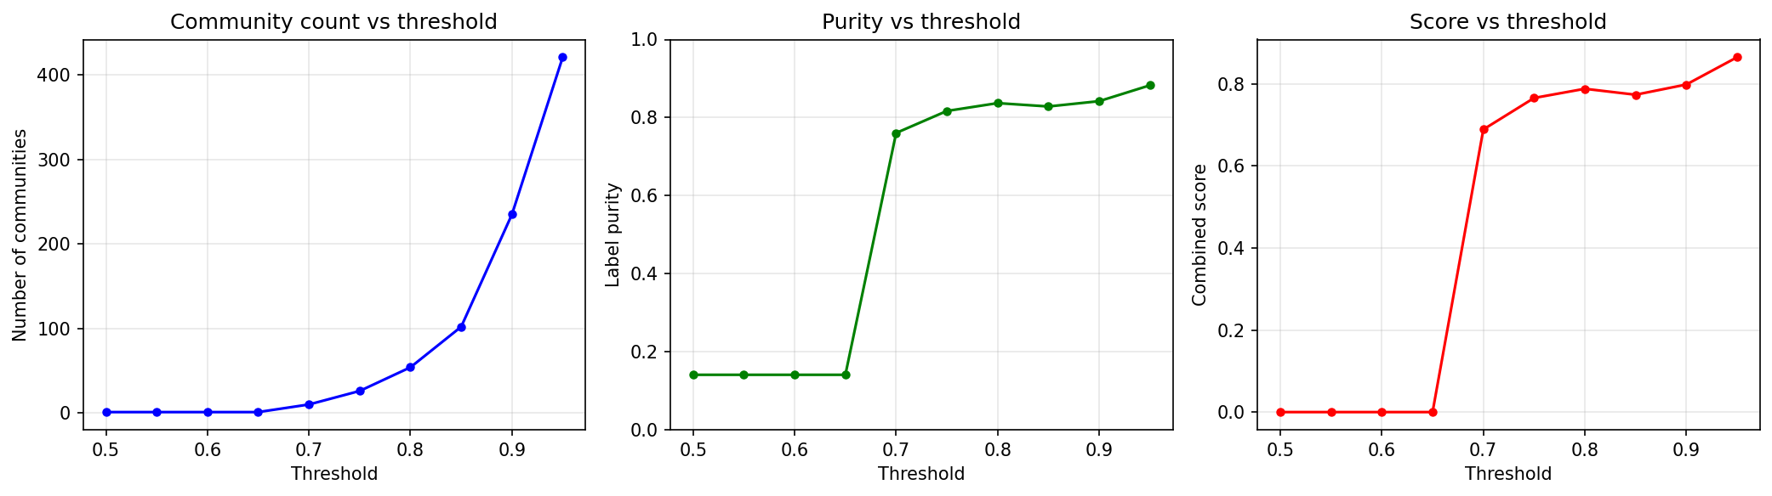
Choosing the clustering threshold
Purity and tightness keep rising with the threshold, so the peak is not the operating point. 0.80 is where they plateau while communities remain large enough to score; beyond it, the data fragments into clusters too small to use.
Notes:
[~45 s]
START: "One free parameter: how similar is similar enough."
• Purity keeps rising as you get stricter, so the highest score is not the right
choice.
• Past 0.80 the data shatters into groups too small to analyse.
• 0.80 is where quality has levelled off but the groups are still usable.
STUCK\\? "I chose 0.80 because stricter settings just fragment the data."
Intra-cluster similarity (what your thesis measured):
The average cosine similarity between all alert embeddings within the same cluster/community.

Slide 18
RQ2: The graph inherits the model’s biases
Model | Triples | Relations used | Dominant relation
Mistral-Nemo-12B | 45 | 3 of 7 | port scan (41)
Qwen2.5-Coder-7B | 46 | 6 of 7 | denial of service (34)
Qwen2.5-3B | 43 | 3 of 7 | port scan (23)
Same communities, three different graphs. The coder model reads almost every community as a flood.
The graph is a faithful record of what the LLM believed, which is not always what the alerts showed.
Notes:
RQ2 To what extent can LLM-extracted relationships form a meaningful, interpretable representation of attack behavior?
START: "RQ2. Same groups, same input, but the three models built three
different graphs."
• Mistral-Nemo calls almost everything a port scan.
• The coder model calls almost everything a denial-of-service flood.
• The 3B model sits between them.
LAND THIS: "The graph is a faithful record of what the model believed the alerts
showed. That is not always what the alerts actually showed."
Next slide explains why the coder model does this.

Slide 19
Why the coder model reads floods everywhere
Port scan and single-packet flood share nearly every surface feature
The distinguishing signal is port diversity, visible only at the community level. A summary reporting it was added to the prompt.
Mistral-Nemo used that signal. Qwen2.5-Coder did not, which is the whole of the difference between them.
Notes:
[~60 s]
START: "Here's why the coder model fails, and it's instructive."
• A port scan and a single-packet flood look nearly identical in one alert:
sub-second, tiny packet count, very high rate.
• The one signal that separates them is port diversity — a scan touches many
ports, a flood hammers one — and that is invisible in any single alert.
• I added a group-level summary reporting exactly that.
• Mistral-Nemo used it. The coder model ignored it.
SAY: "That single difference accounts for most of the gap between them."

Slide 20
RQ3: Classification results (CIC-IDS)
Exact match
Macro F1
Model | Grounded | Baseline |  | Grounded | Baseline
Mistral-Nemo-12B | 0.833 | 0.556 |  | 0.400 | 0.200
Qwen2.5-Coder-7B | 0.111 | 0.000 |  | 0.200 | 0.000
Qwen2.5-3B | 0.278 | 0.000 |  | 0.114 | 0.000
Notes:
RQ3 Does knowledge-graph-grounded retrieval improve generated incident reports over non-grounded generation?
START: "RQ3, the main comparison. And I want to steer you to the right column."
• READ MACRO F1 FIRST. One technique covers 14 of the 18 groups, so exact match
mostly measures one class.
• On macro F1 the grounded system doubles the baseline: 0.40 against 0.20.
• Both Qwen baselines are exactly zero. Without grounding they never named a
correct technique for any class.
• Exact match: 83.3% grounded against 55.6%.
BE HONEST: "The confidence intervals overlap on the exact-match numbers. With 18
groups they would."
how well your model balances precision and recall = F1 score
Macro F1 is the average F1 score across all classes, treating each class equally.
Baseline represents how the system performs without your core architectural contribution (the Knowledge Graph scoping). It is the "standard" or "naive" approach. What you did in the thesis:
For CIC-IDS: You gave the LLM the exact same alert text and extracted triples, but removed the retrieval, removed the KG, and removed the grammar constraint. The LLM just had to guess the ATT&CK technique from its own memory (Parametric guessing).
For DARPA: You embedded the alert text and searched for similar techniques across all 691 techniques in ChromaDB, with no KG filtering. The Result: The baseline scored terribly (e.g., Mistral-Nemo got 55.6% Exact Match; Qwen models got 0% Macro F1). The Message to the Professor: "Look, Professor. Without the Knowledge Graph restricting the choices, the models fail or guess blindly. This proves that adding the KG is necessary."

Slide 21
The main finding
Model | Reachable | Rerank correct | Exact match
Mistral-Nemo-12B | 15/18 | 15/15 | 0.833
Qwen2.5-Coder-7B | 2/18 | 2/2 | 0.111
Qwen2.5-3B | 5/18 | 5/5 | 0.278
Every model’s accuracy equals its reachability.
No model ever misclassified a community whose behaviour it had extracted correctly. The bottleneck is extraction, not retrieval.
Notes:
[~2 min] YOUR STRONGEST SLIDE. Slow right down. Let it land.
START: "This is the most important result in the thesis."
• For each group I asked: was the right answer even reachable from the behaviour
the model extracted?
• Every model's accuracy exactly equals its reachability.
• Across all three models, the scoped retrieval was handed 22 solvable groups
and got 22 right.
SAY IT SLOWLY: "No model ever misclassified a group whose behaviour it had
extracted correctly. The bottleneck is extraction, not retrieval."
THEN PAUSE. Let them absorb it before clicking.
STUCK? "Twenty-two out of twenty-two. Every error happens earlier in the
pipeline, at extraction."

Slide 22
Is the graph actually doing the work?
Same scoring function, same inputs, constraint removed:
Model | Scoped | Unscoped (691 techniques)
Mistral-Nemo-12B | 0.833 | 0.000
Qwen2.5-Coder-7B | 0.111 | 0.000
Qwen2.5-3B | 0.278 | 0.056
Unconstrained similarity lands in the right neighborhood, not on the right identifier.
The ranking machinery contributes almost nothing without the constraint. The constraint is the mechanism.
Notes:
[~90 s]
START: "So is the graph actually doing the work, or is my scoring just good?"
• Same scoring function, same inputs, constraint removed.
• 83.3% collapses to zero.
• The unconstrained version lands in the right neighbourhood — plausible
neighbours like T1205, T1049 — and essentially never on the right answer.
PRE-EMPT THE OBJECTION: "This isn't a strawman baseline. It's my own code's
fallback path, the branch that already runs when a group produces no
candidates."
LAND THIS: "The ranking machinery contributes almost nothing without the
constraint. The constraint is the mechanism."
but we removed the graph constraint and let the system search all 691 ATT&CK techniques instead of the 2 to 5 candidates the graph provides.
Exact match collapsed to zero for two of the three models, and 5.6% for the third. The ranking machinery was landing in the right neighbourhood but never on the right technique. This proves that the Knowledge Graph's scoping mechanism is not a minor improvement — it is the core architectural contribution. It turns an impossible open-domain search into a solvable closed-set classification."

Slide 23
Is the baseline comparison fair?
The CIC-IDS baseline had no grammar constraint. Quantified rather than assumed away:
51 of 54 baseline outputs parsed to a valid technique identifier
3 failures, all Mistral-Nemo, emitting the invalid ID T886
Crediting all three as correct lifts that baseline to at most 0.722, still below the grounded 0.833
Both Qwen baselines parsed 18 of 18
Notes:
[~45 s]
START: "One fairness question I should answer before it's asked."
• The baseline had no grammar constraint, so I checked whether that hurt it.
• 51 of 54 baseline outputs parsed fine.
• The 3 failures were all one model, emitting an invalid ID.
• Even crediting all three as correct, that baseline reaches at most 0.722 —
still below the grounded 0.833.
SAY: "So the missing grammar cannot explain the gap."
When you built the Baseline (the "LLM-Only" condition to compare against), you gave the LLM the exact same alert text and triples, but you removed the Knowledge Graph, the RAG retrieval, and the strict JSON grammar. You just let the LLM guess the technique from its own memory and output free text.
Even if you give the baseline the most generous benefit of the doubt and count those 3 formatting failures as "correct," the baseline's score only lifts to 0.722 (72.2%). Your KG-Anchored pipeline still scored 0.833 (83.3%).

Slide 24
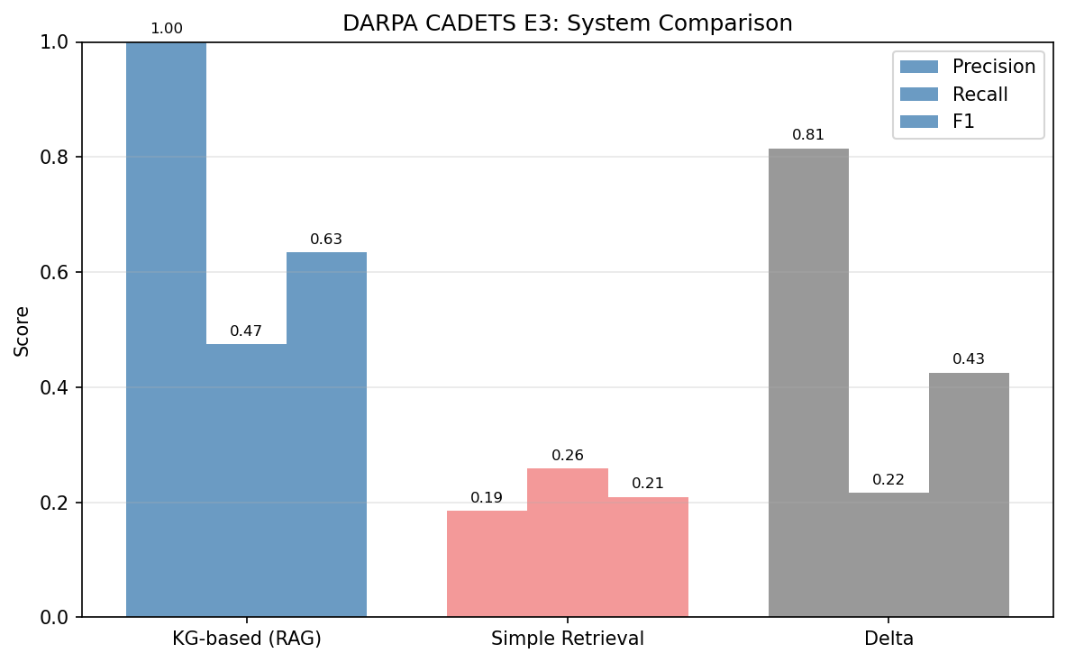
Transfer to host audit logs (DARPA)
Model | Grounded F1 | Baseline
Mistral-Nemo | 0.635 | 0.209
Qwen-Coder-7B | 0.710 | 0.272
Qwen-3B | 0.685 | 0.254
+0.43 F1 for every model
Confidence intervals disjoint
Precision 0.96–1.00, recall ≈ 0.5
The model ranking flips between datasets.
Notes:
Precision = out of all the things your model said were positive, how many were actually correct.
Recall = out of all the real positives that exist, how many your model actually found.
F1 score = how well your model balances precision and recall.
START: "Does it transfer? This is the stronger of my two results."
• Host audit logs, real red-team engagement, ground truth transcribed from
someone else's report.
• Plus 0.43 F1 for every one of the three models.
• The confidence intervals are disjoint — unlike CIC-IDS.
• Precision near 1.0, recall about 0.5: when it names a technique it's almost
always right, but it misses about half.
POINT OUT: "The model ranking flips here. The worst model on network flows is
the best on host logs. Model choice is dataset-dependent."
This is critical: On CIC-IDS (network flows), Mistral-Nemo was the clear winner. But on DARPA (host logs), Qwen-Coder-7B wins with 0.710 F1.
The fact that all three models improved by the same amount (+0.43) proves that the Knowledge Graph architecture is doing the heavy lifting, not the model size. This is your strongest empirical evidence that the pipeline design itself is the contribution, not just using a bigger LLM

Slide 25
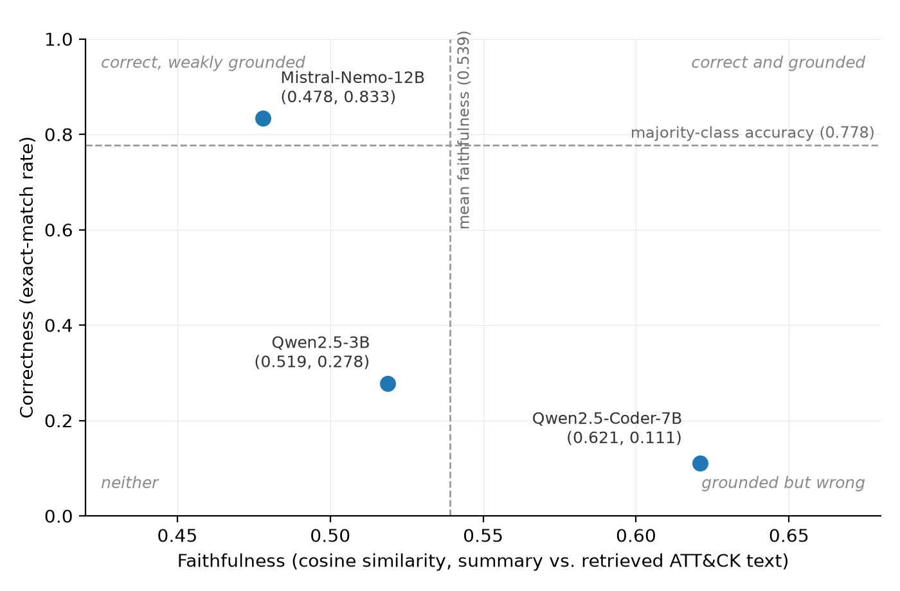
Correctness and grounding can diverge
The coder model writes the
best-grounded reports and the worst classifications.
It produces internally consistent, well-evidenced reports about the wrong attack.
A system reporting only grounding would rank the worst model first. Both metrics are needed.
Notes:
[~75 s]
START: "One finding I didn't expect."
• The coder model writes the best-grounded reports and makes the worst
classifications.
• It produces internally consistent, well-evidenced reports about the wrong
attack.
LAND THIS: "A system reporting only grounding would rank the worst model first.
That's why both metrics have to be reported together, and that's my evaluative
contribution."
STUCK? "Being well-grounded and being correct are not the same thing."

Slide 26
Limitations
The alert text is the ceiling. A single SYN packet to port 21 looks identical whether it is reconnaissance, brute force, or a botnet beacon.
The template captures flow statistics, not payload or multi-flow state, so minority classes are missed by every model.
The evidence is narrow. Two environments, a small slice of ATT&CK, and grounding metrics that measure similarity rather than factual accuracy.
Both are data limits
Notes:
[~60 s] Two headings, one sentence each. Don't read the slide.
START: "Two honest limitations."
• THE ALERT TEXT IS THE CEILING — a single SYN packet to port 21 looks the same
whether it's reconnaissance, brute force, or a beacon. If the text can't
distinguish them, nothing downstream can.
• THE EVIDENCE IS NARROW — 18 scoreable groups, one dominant technique,
overlapping intervals. DARPA is the firmer result.
SAY: "Both are limits of the data, not of the architecture."

Slide 27
Contributions
Architectural: proposes a pipeline based on grouping logs.
Empirical & Evaluative: proceeds to compare pipeline performances
Notes:
[~60 s]
START: "Three contributions."
• ARCHITECTURAL — anchoring retrieval in extracted behaviour turns an
open-domain search over 691 techniques into a closed-set choice. Measured: the
same ranking without it scores near zero.
• EMPIRICAL — three models, two datasets, one laptop. Model ranking is
dataset-dependent and a 3B model stays viable.
• EVALUATIVE — a dual-metric framework separating correctness from grounding,
which needs only labels and retrieved context, so it survives model turnover.

Slide 28
Conclusions
RQ1 Semantic clustering groups alerts coherently (0.837 purity), but coherence is not discrimination: separating one technique from another is the hard part.
RQ2 The graph faithfully represents what the model read from the alerts, which is not always what the alerts showed.
RQ3 Behaviour-anchored retrieval improved classification in every tested condition; the same ranking without the constraint classified almost nothing correctly.
Every remaining error traces to extraction, not to retrieval.
Notes:
[~60 s]
START: "To answer the three questions directly."
• RQ1 — clustering groups alerts coherently, but coherence is not
discrimination.
• RQ2 — the graph faithfully represents what the model read, which isn't always
what the alerts showed.
• RQ3 — behaviour-anchored retrieval improved classification in every condition
tested; without the constraint it classified almost nothing correctly.
THE ONE LINE TO END ON: "What the graph contributes is exclusion. It rules out
the techniques the evidence doesn't support, and that turns an open-domain
search into a decision an analyst can actually check."
If you remember one sentence all day, make it that one.

Slide 29
Future work
Richer alert representation: payload summaries, temporal and cross-host context; the highest-leverage change
Expert evaluation of report quality alongside the automated metrics
Live stream ingestion with sliding-window clustering
Notes:
[~45 s]
START: "Five directions, and the first is the one my own results point to."
• Richer alert representation — payload, timing, cross-host context. My error
attribution says that's where the ceiling is.
• A bridge curated blind to the evaluation data, to settle the circularity
question.
• Iterative retrieval that catches extraction errors downstream.
• Expert evaluation of the reports.
• Live stream ingestion.

Slide 30
References
►
L. Gao, X. Ma, J. Lin, and J. Callan, “ Precise Zero-Shot Dense Retrieval without Relevance Labels,” in Proceedings of the 61st Annual Meeting of the Association for Computational Linguistics (Volume 1: Long Papers), Association for Computational Linguistics, 2023, pp. 1762–1777. doi: 10.18653/v1/2023.acl-long.99.
S. Geng, M. Josifoski, M. Peyrard, and R. West, “ Grammar-Constrained Decoding for Structured NLP Tasks without Finetuning,” in EMNLP 2023 - 2023 Conference on Empirical Methods in Natural Language Processing, Proceedings, 2023. doi: 10.18653/v1/2023.emnlp-main.674.
N. Reimers and I. Gurevych, “ Sentence-BERT: Sentence embeddings using siamese BERT-networks,” in EMNLP-IJCNLP 2019 - 2019 Conference on Empirical Methods in Natural Language Processing and 9th International Joint Conference on Natural Language Processing, Proceedings of the Conference, 2019. doi: 10.18653/v1/D19-1410.
B. E. Strom, A. Applebaum, D. P. Miller, K. C. Nickels, A. G. Pennington, and
C. B. Thomas, “ MITRE ATT&CK: Design and Philosophy,” The MITRE Corporation, Tech. Rep., 2018. [Online]. Available: https://www.mitre.org/sites/default/files/publications/pr-18-0944-11-mitre-attack-design-and-philosophy.pdf.
►
►
►
Notes:
[~10 s]
SAY: "These are the main works this builds on."
Don't read them. Click through.

Slide 31
References
►
F. Blefari, C. Cosentino, F. A. Pironti, A. Furfaro, and F. Marozzo, “ CyberRAG: An agentic RAG cyber attack classification and reporting tool,” Future Generation Computer Systems, vol. 176, 2026, issn: 0167739X. doi: 10.1016/j.future.2025.108186.
S. Bussari, P. Punj, and G. Balakumar, “ RAGSec: Retrieval-Augmented Generation for Cybersecurity Threat Intelligence in Enterprise Networks,” 2026 IEEE 5th International Conference on AI in Cybersecurity (ICAIC), pp. 1–6, Feb. 2026. doi: 10.1109/ICAIC67076.2026.11395762. [Online]. Available:
https://ieeexplore.ieee.org/document/11395762.
Ismail et al., “ Enhancing Security Operations Center: Wazuh Security Event Response with Retrieval-Augmented-Generation-Driven Copilot,” Sensors, vol. 25, no. 3, 2025, issn: 14248220. doi: 10.3390/s25030870.
W. Qiao et al., “ SauronEyes: Disentangling Voluminous Logs to Unveil Camouflaged Attack Intentions,” IEEE Transactions on Information Forensics and Security, vol. 20, 2025, issn: 15566021. doi: 10.1109/TIFS.2025.3618381.
►
►
►
32 / 32
Notes:
[~10 s]
SAY: "And the closest related systems."
Click through.

Slide 32
Thank you
32 / 32
Notes:
[~20 s]
SAY: "Thank you. I'm happy to take questions."
Then STOP TALKING. Stand still. Let the silence sit — it is their turn now, and
filling it with nervous extra detail is the single easiest way to invite a
question you didn't want.
WHEN A QUESTION COMES:
• Let them finish completely.
• Repeat it back: "So the question is whether..." That buys you five seconds and
makes sure you answer the right thing.
• If you don't know: "I didn't measure that, so I'd be guessing. What I can tell
you is..." — then go to something you did measure.
• Never invent a number.
You know this work better than anyone in the room.

