Slide 1

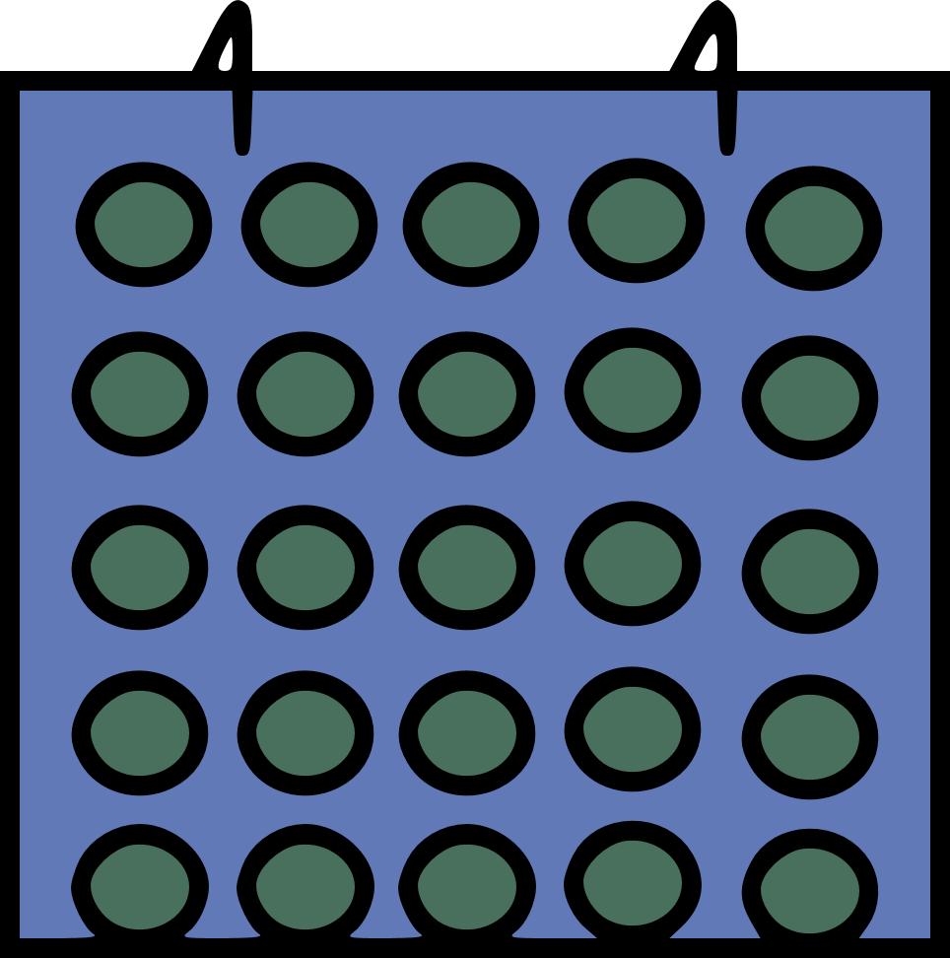
Your Calendar
Project by
Joel Aalto
Daniel Smolen

Slide 2

The main idea
Calendar App in Kotlin
Save and events
Title, description
Start – end time and date
Show Location Map API
Show the current weather on the location

Slide 3
The main idea
Create a widget, which shows events
Account creation (every user owns his events)
Set Meetings on weekly repeat
(Connect Accounts to share events)

Slide 4
General
Firebase Auth and Realtime Database
Used Material Calendar View (A Material design back port of Android's CalendarView)
Geocoder for location
Google Maps API to show on the map
Openweathermap API

Slide 5
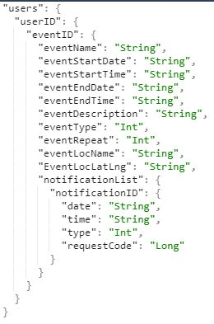
Database

Slide 6
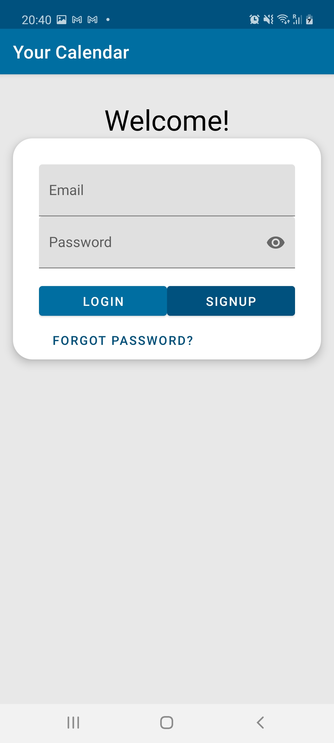
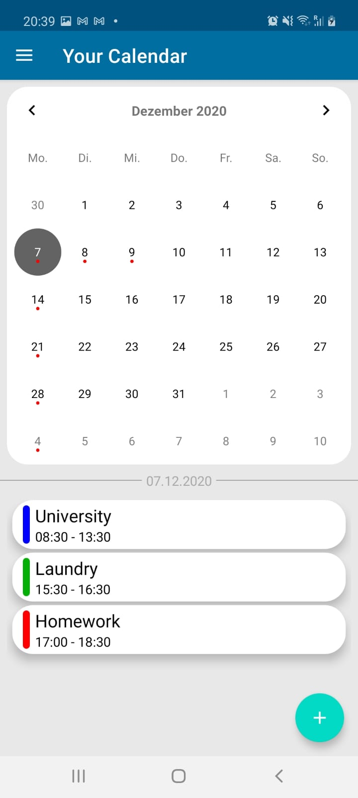
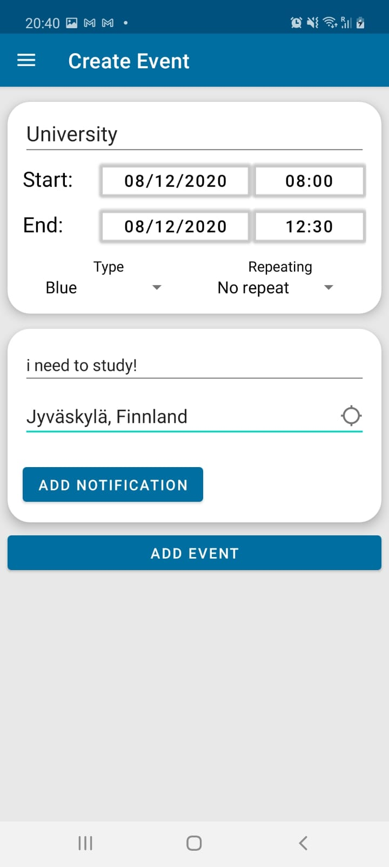
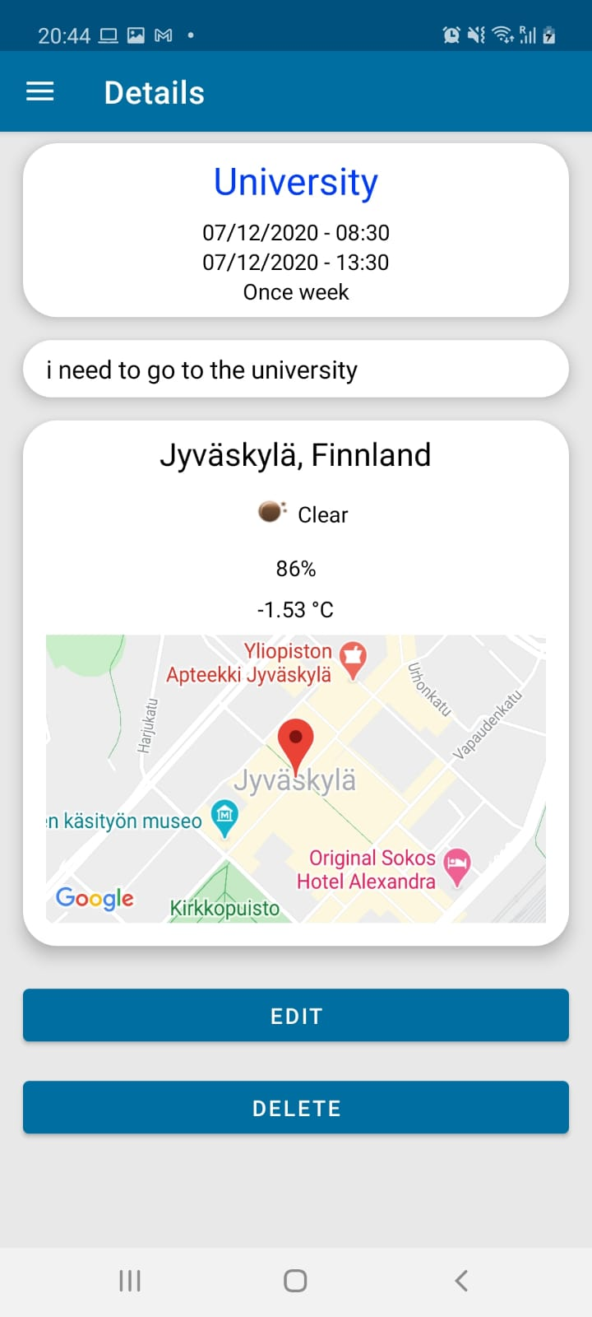
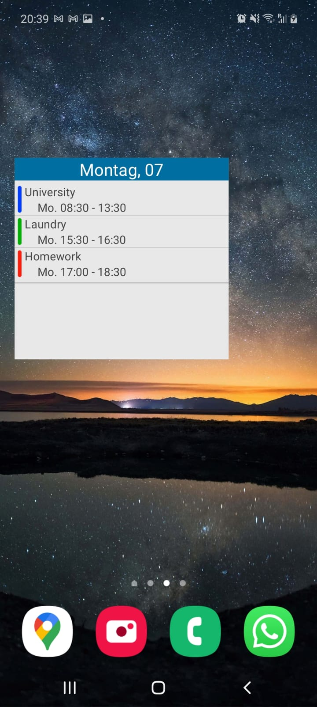
Your Calendar App

Slide 7
Thank you for listening!

