Slide 1
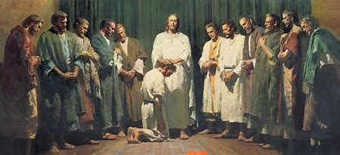
"Truly I say to you, my disciples, the key to spreading your work across the nations is learning GitHub. For it is through commits and pushes that your creations shall endure for eternity." — Jesus, AD 33

Slide 2
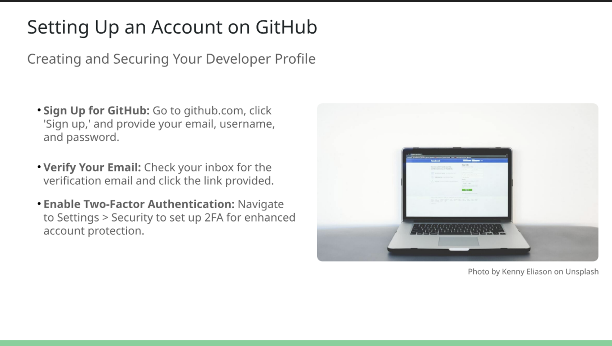

Slide 3
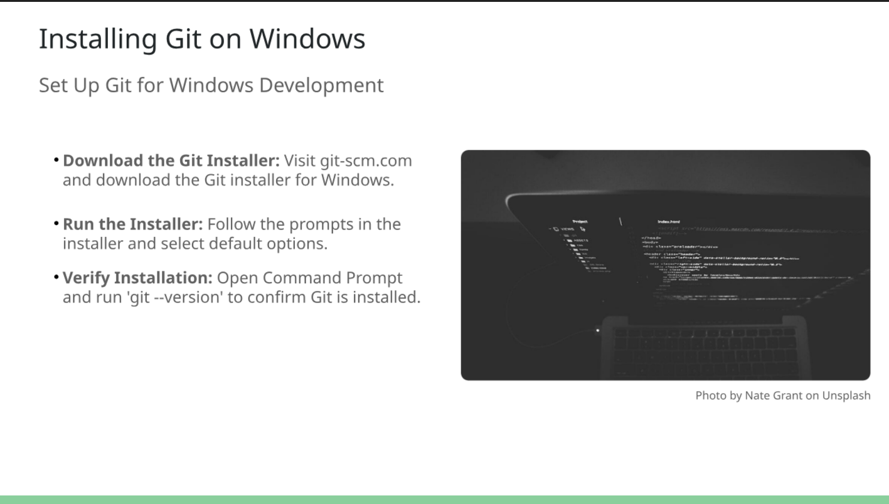

Slide 4
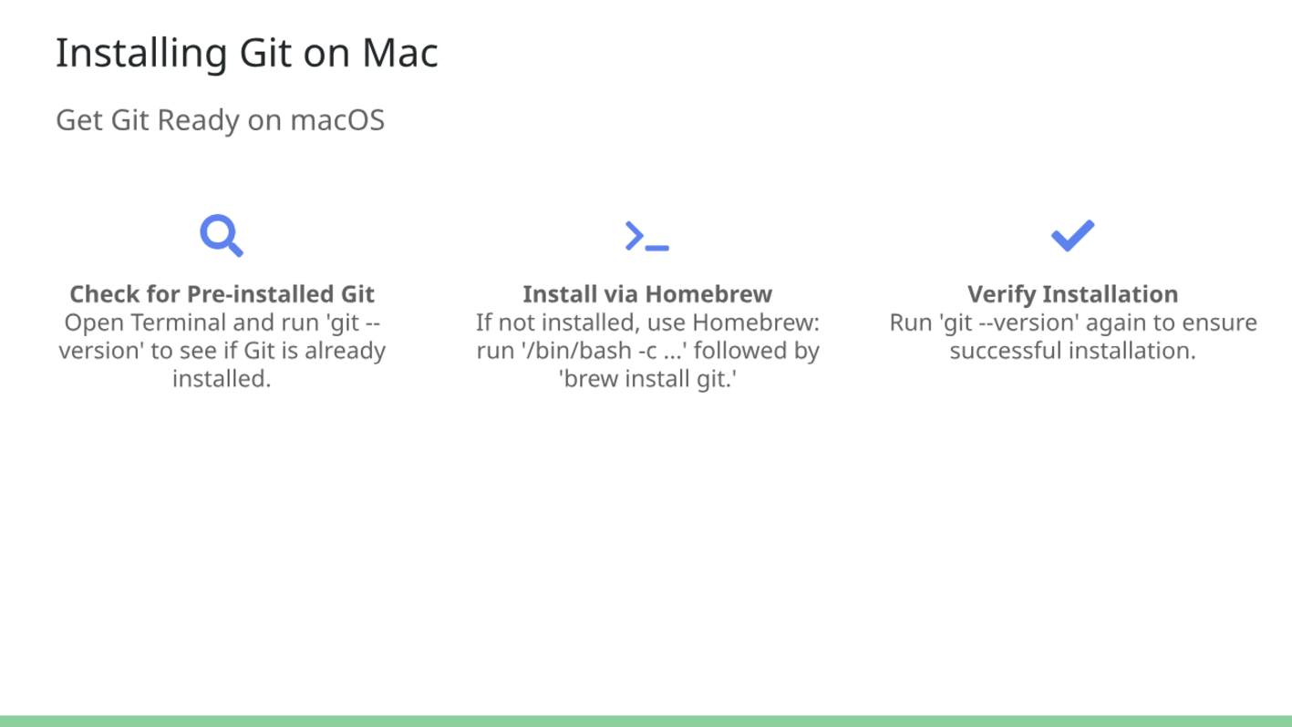

Slide 5

Introduction to Git and GitHub
What is Git?
Version control system that tracks code changes.
Snapshot – Save Point in Video Game
Open Source – Free To Use
Distributed -Helps collaborate with others and manage project versions.
90-95% Of Professional Development Teams Use Git And Github As Their Version Control System

Slide 6

Introduction to Git and GitHub
What is GitHub?
Took Git, Put On A Server & Connescted It To The Internet.
Makes It Easy To Connect To A Git Repo And Share Code With Others.
Git Has No Security Built In
Enterprises Want To Control Who Sees Their Code (Authentication Services.
Pull Requests – Makes Sure A Senior Sees Changes Before Allowing Changes To Go To Main Branch
Microsoft Purchased GitHub in 2018 9B

Slide 7
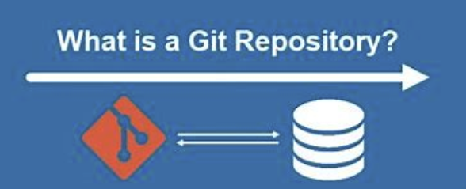
Maintains The History Of Your Commits
Have To Have One For Every Project You Are Working On
Keeps Track Of Branches (Experiments W/ Code
Keeps Track Of Remote Repositories (Local To Remote In Cloud)
Gives You Everything Needed To Connect To A GitHub Account

Slide 8

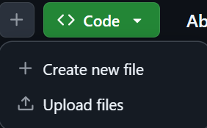










Create A Git Repository / New File (Through GitHub)
Login To Github (github.com)
Click New
Give Name
Check Public
Add README file
License (For Companies)
Create Repository
Create A New File (+)
Name Your File (.txt .py .cpp)
Type Something In txt Box
Commit Changes
Insert Commit Message (First Commit)
Click Commit Changes
Go Home
Click Project
Look At History

Slide 9




Get Files/Code From GitHub To Your Local Machine (pt 1)
Go Home (Three Tab Top Left Corner)
Open Project
Click Code Dropdown (URL Points To Your Repository)
Copy The URL
Git Clone – Now We Can Take A Copy Of That Repository & Bring It Over To Our Local Machine

Slide 10
Configure Git Through PowerShell
The 1st time you run git on your computer you need to tell it who you are.
Email
Name
Tells your boss who made the changes
git config –global user.email “yourGetHubEmail.com”
git config –global user.name “yourName”
Open PowerShell

Slide 11




Get Files/Code From GitHub To Your Local Machine (pt 2) (Windows PowerShell)
Open Windows Powershell (start button)
Ls -List The Files In Our current Directory
mkdir “_repos” - Create A New Directory (Store all Repos Here in C)
ls -Check For Our File In The Current Working Directory
cd _repos -Change Current Working Directory To _repos
git clone https:/pasteURL
ls -See New Project Listed
Open File Explorer, Locate _repo And See Our txt File Opens

Slide 12



Add Files (With Windows Powershell)
Navigate To Your Repo In PowerShell
New-item “Bravo.txt” -Create A New Text File
ls -See The New File Listed
Right Now Git Doesn’t Know This Is A File You Want It To Pay Attention Too
If Our Text Document Was Just Notes That’s Fine
If You Want Git To Know To Pay Attention To It We Have To Tell Git To Add It To Our Index
git add Charles.txt - To Add It To Our Index So Git Knows This Is Something We Want To Commit Later
Git status -Shows Us Changes That Git Knows To Keep Track Of And Commit Later.

Slide 13
Commit Changes(Windows Powershell)
1. Commit Our Changes And New Files To Be Added To GitHub
git commit –m “ Second Commit” (-m means message)
2. Show Our History
git log –-all –-decorate –-oneline --graph (special formatted way to show history)
Head->main – Locally i have these changes, but Github doesn’t know about them yet. (see in github)
3. git push - pushes our new files and changes up to github (see in github)
Your first commit through git might require authorization (sign in and continue)

Slide 14
Create A New File On Local Machine (2nd)
new-item “Charlie.txt” (Create New Text File)
git add . (Adds All Changes / New Files to Index)
git commit –m “third commit” (Commit To Push)
git push (Push Changes To GitHub)

Slide 15
Git Pull
Copies files from the server to your workspace.
Keeps your repository up to date with changes
Performs 2 steps: (git fetch) (git merge)
Git fetch – downloads changes (without adding them to file system)
Git merge – merges those files onto your file system.

Slide 16
Clone This Entire Presentation With Cheat Sheet
Clone This Repository To Your Repos
https://github.com/JoelAbbott/git-githubPresentation.git

