Slide 1

XENALYTICS
Stock Price Prediction Analysis
By- Hatim Talwara and Joel Alphonso

Slide 2

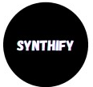
Our CHOICE OF COMPANIES TO INVEST IN
SYNTHIFY
NEXUS
QUANTUMIZE

Slide 3
SYNTHIFY
NEWS, CHARTS AND OUR ANALYSIS

Slide 4
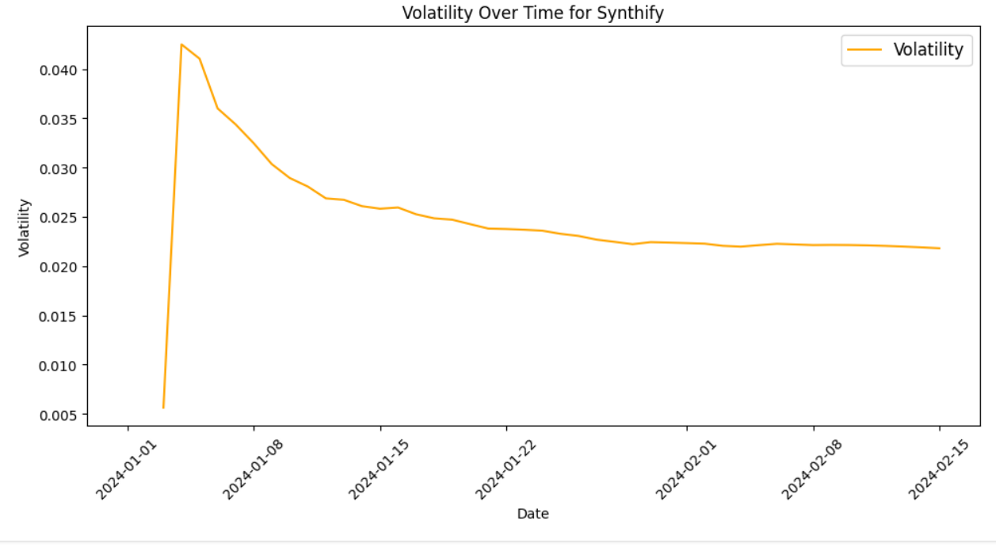
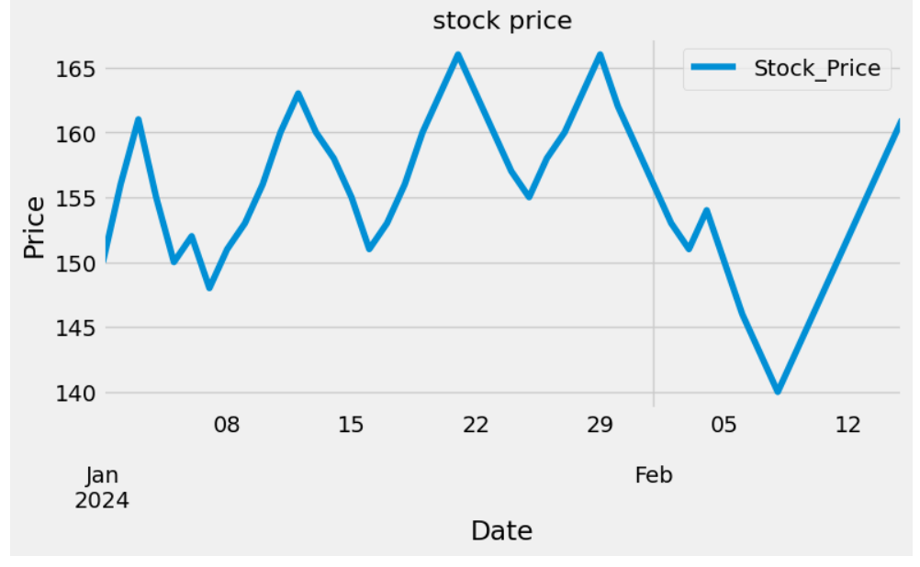
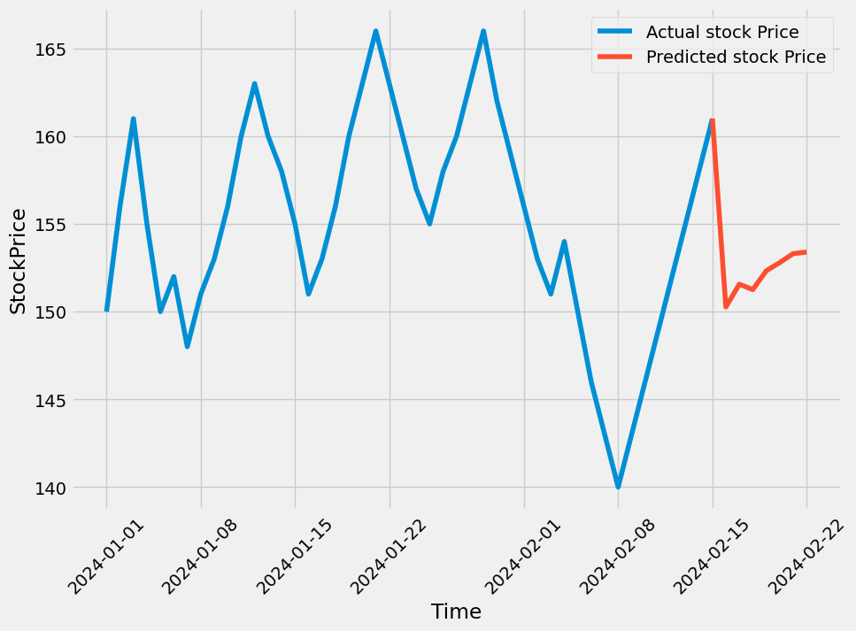
OUR PREDICTIVE ANALYSIS
SYNTHIFY has been top choice as the company’s stock price graph indicates its stock price always lies in between $ 140 to $165 and no negative news surrounds it which indicates its stability in the market

Slide 5
NEXUS
NEWS,CHARTS & OUR ANALYSIS

Slide 6
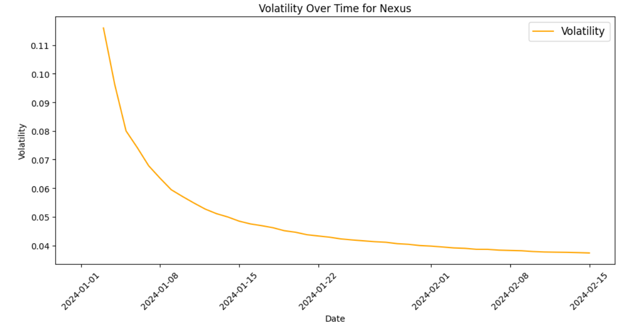
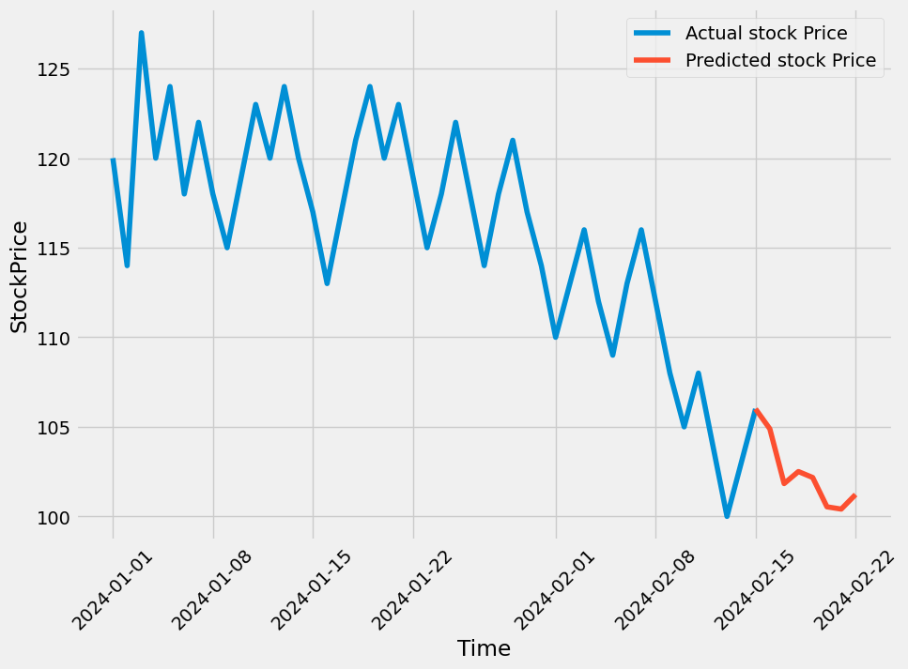
OUR PREDICTIVE ANALYSIS
NEWS:
Nexus Wins Prestigious Industry Award for Innovation.
ANALYSIS:
NEXUS comes next in our list as it recently won prestigious innovator award and its stock price also fluctuates between $100 and $125 and likely will increase in the upcoming days

Slide 7
QUANTUMIZE
NEWS,CHARTS & ANALYSIS

Slide 8
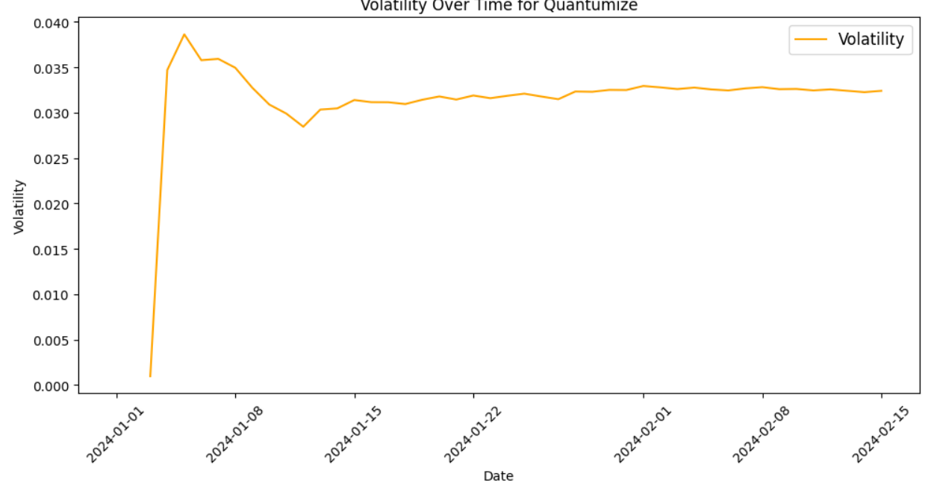
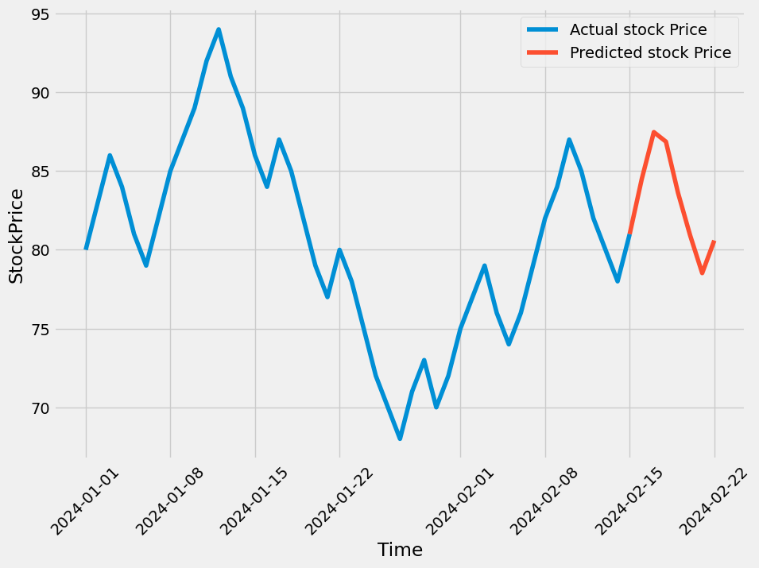
OUR PREDICTIVE ANALYSIS
NEWS:
Quantumize Leads in Renewable Energy Solutions - Promising Future Ahead for Eco-Conscious Investors!
ANALYSIS:
QUANTUMIZE is our final recommendation as it has been leading in renewable energy space and since its stock have larger fluctuations between $68 to $94 we will carefully place our investment budget in sight

Slide 9
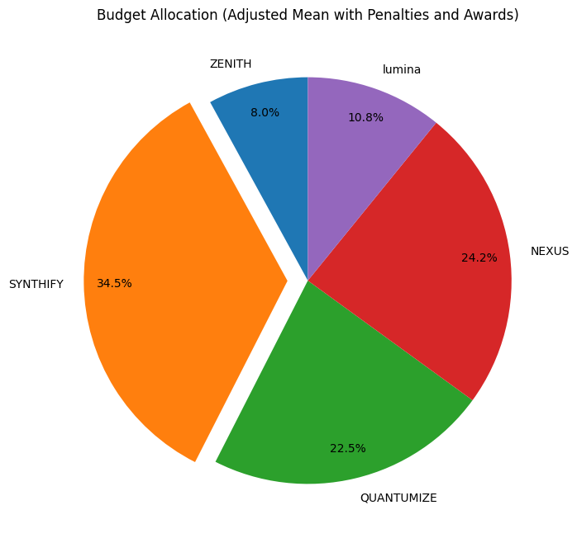
Investment strategy #1
Budget Allocation: (Adjusted Mean with Penalties and Awards)

Slide 10
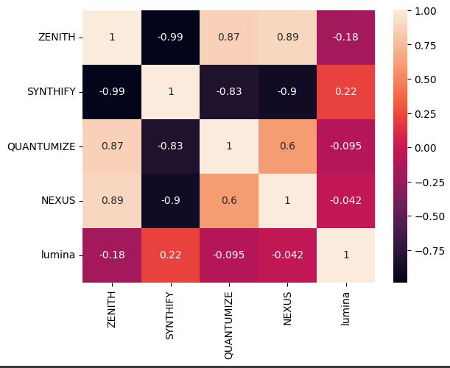
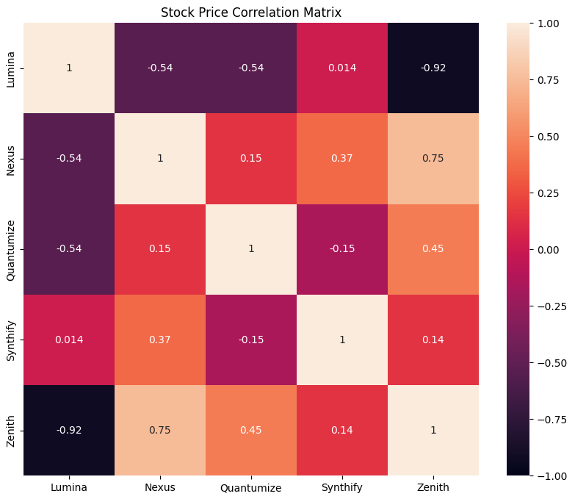
Investment STRATEGY #2
PREDICTED VALUES HEATMAP
STOCK PRICES HEATMAP

Slide 11

Thank you

