Slide 1
Scenario
Banking System
“ABC-BANK-India” – is a bank which provides banking services to it’s customers, it is spread across country having more than 500 branches. It uses software product to serve customers and it uses it to automate creating different type of accounts services like Savings account and PF (provident fund account). The customer can deposit, withdraw or transfer money from one account to another account. The application is used by bank itself and customers. Write a Java program to simulate customer transaction on bank accounts.

Slide 2
Scenario
Consider a Syndicate Bank provides “SyndCard” a DebitCard for his customers. The customer uses DebitCard for cash transactions and cash available in his account. The available cash can be considered as balance associated with card. The customer swipe card for transactions of a certain amount, he is allowed to change the pin and display debited amount and balance. Write a Java program to simulate the customer using DebitCard.

Slide 3
UML: Class diagrams
Modeling is an Essential Part of large software projects, and helpful to medium and even small projects as well
Modeling is the designing of software applications before coding.
Modeling is the way to visualize your design and check it against requirements before you start to code.
A model is not the real world but merely a human construct to help us better understand real world systems. In general all models have an information input, an information processor, and an output of expected results.

Slide 4
What can you Model with UML?
UML 2.0 defines thirteen types of diagrams, divided into three categories: Six diagram types represent static application structure; three represent general types of behavior; and four represent different aspects of interactions:
Structure Diagrams include the Class Diagram, Object Diagram, Component Diagram, Composite Structure Diagram, Package Diagram, and Deployment Diagram.
Behavior Diagrams include the Use Case Diagram (used by some methodologies during requirements gathering); Activity Diagram, and State Machine Diagram.
Interaction Diagrams, all derived from the more general Behavior Diagram, include the Sequence Diagram Communication Diagram, Timing Diagram, and Interaction Overview Diagram.

Slide 5
Overview
The class diagram is a static diagram.
It represents the static view of an application
The class diagram describes the attributes and operations of a class and also the constraints imposed on the system
UML diagrams can be mapped directly with object oriented languages.
The class diagram shows a collection of classes, interfaces, associations, collaborations and constraints.
UML class diagrams show the classes of the system, their inter-relationships, and the operations and attributes of the classes. Class diagrams are typically used, although not all at once, to:
Explore domain concepts in the form of a domain model
Analyze requirements in the form of a conceptual/analysis model
Depict the detailed design of object-oriented or object-based software

Slide 6
Purpose
The purpose of the class diagram can be summarized as:
Analysis and design of the static view of an application.
Describe responsibilities of a system.
Base for component and deployment diagrams.

Slide 7
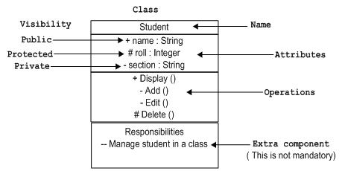
How to draw class diagrams
UML class is represented by the diagram shown below. The diagram is divided into four parts.
The top section is used to name the class.
The second one is used to show the attributes of the class.
The third section is used to describe the operations performed by the class.
The fourth section is optional to show any additional components.

Slide 8
Guidelines to draw class diagrams
Use Common Terminology for Names
Prefer Complete Singular Nouns for Class Names
Name Operations with a Strong Verb
Name Attributes With a Domain-Based Noun
Never Show Classes With Just Two Compartments
Include an Ellipsis ( . . . ) At The End of Incomplete Lists
List Static Operations/Attributes Before Instance Operations/Attributes
List Operations/Attributes in Decreasing Visibility
For Parameters That Are Objects, Only List Their Type
Develop Consistent Method Signatures

Slide 9
Guidelines……………..
Indicate Exceptions In An Operation's Property String. Exceptions can be indicated with a UML property string, an example of which is shown below.
+ findAllInstances(): Vector {exceptions=NetworkFailure, DatabaseError}

Slide 10
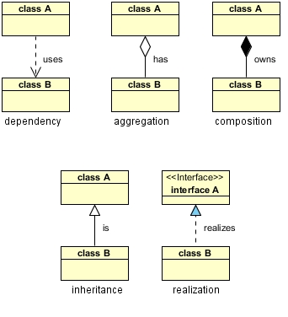
UML Class Diagram Relationships, Aggregation, Composition
There are five key relationships between classes in a UML class diagram

Slide 11

Association
An association represents a family of links
A binary association (with two ends) is normally represented as a line
An association can link any number of classes.
An association can be named, and the ends of an association can be adorned with role names, ownership indicators, multiplicity, visibility, and other properties.
Association represents the static relationship shared among the objects of two classes.

Slide 12
Association Types: Aggregation/ Composition
Aggregation
Aggregation is a variant of the "has a" association relationship; aggregation is more specific than association.
Aggregation can occur when a class is a collection or container of other classes
However, the contained classes do not have a strong lifecycle dependency on the container.
The contents of the container are not automatically destroyed when the container is.
In UML, it is graphically represented as a hollow diamond shape on the containing class with a single line that connects it to the contained class

Slide 13

Composition
Composition is a stronger variant of the "has a" association relationship; composition is more specific than aggregation.
Composition usually has a strong lifecycle dependency between instances of the container class and instances of the contained class
If the container is destroyed, normally every instance that it contains is destroyed as well
The UML graphical representation of a composition relationship is a filled diamond shape on the containing class.

Slide 14
The above relationships are read as follows:
Dependency : class A uses class B
Aggregation : class A has a class B
Composition : class A owns a class B
Inheritance : class B is a Class A (or class A is extended by class B)
Realization : class B realizes Class A (or class A is realized by class B)
RELATIONSHIPS Composition
is very similar to the aggregation relationship, with the only difference being its key purpose of emphasizing the dependence of the contained class to the life cycle of the container class. That is, the contained class will be obliterate (destroy) when the container class is destroyed. For example, a shoulder bag’s side pocket will also cease to exist once the shoulder bag is destroyed. To depict a composition relationship in a UML diagram, use a directional line connecting the two classes, with a filled diamond shape adjacent to the container class and the directional arrow to the contained class.

Slide 15
Identify Relationships
Person --🡪 Mobile
Mobile -🡪 Sim
CellPhone 🡪 Processor
Car🡪 CarEngine
Student 🡪 Course
CellPhone 🡪 RearCamera
CellPhone 🡪 Memory
Customer 🡪 BankAccount

