Slide 1
Chapter 3: Inheritance

Slide 2
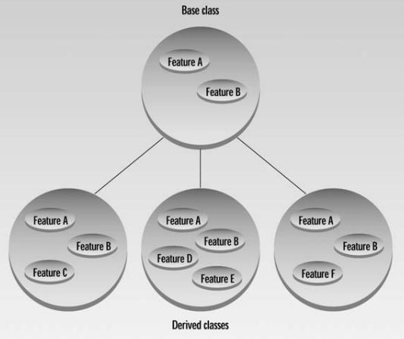
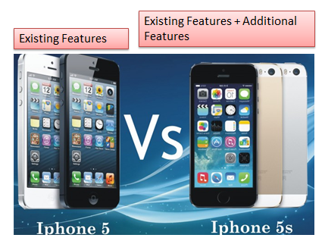
Characteristics of Object-Oriented Languages
Inheritance and Reusability

Slide 3
Student administration world
?

Slide 4
Student Administration world: OO - World
Person ( firstName, lastName)
Teacher -> what are properties?
Student -> what are properties?
Course (courseCode, courseTitle, grade, isa1,isa2,activity)
How these classes can be organized?
Person
Teacher
Student

Slide 5
Student enroll for courses and Teacher teaches courses
Person
Teacher
Student
Course

Slide 6
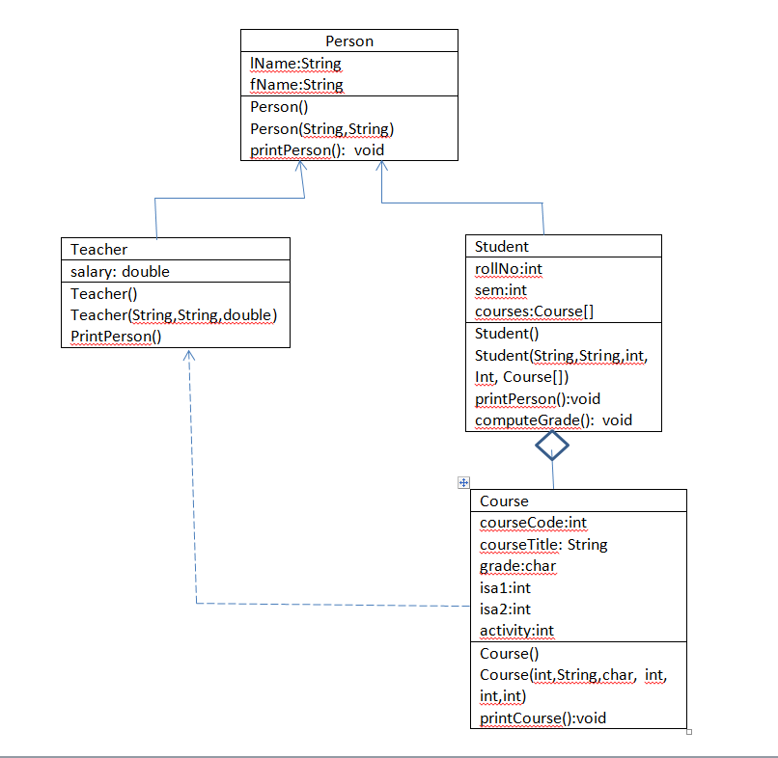

Slide 7
Scenario
Consider the Bank Account of type Savings account, current account and money can be debited or credited to bank accounts. The number of transactions is limited to 5 on the savings accounts, if it exceeds a penalty has to be imposed and the penalty amount has to be automatically debited from account. The details of the bank accounts shall be printed. Identify base class and derived classes, attributes and functions in a class hierarchy. Write a class diagram and CPP program to simulate the scenario.

Slide 8
List of objects
BankAccount
SavingsAccount (interest paid)
CurrentAccount (no interest, no penalty, any number of transactions)
Data members:
Account number
Account balance
Rate of interest
Penalty amount
Number of transactions
Functions
debitAccount(double amt)
creditAccount(double amt)
payInterest()
printAccount()

