Slide 1
Spring Boot
Department of Computer Science and Engineering

Slide 2
Spring boot: Overview
Spring Boot is a framework built on top of the Spring Framework that simplifies the development of Java-based applications, especially web and microservices.
Spring Boot eliminates a lot of manual configuration required in traditional Spring applications.
It helps developers quickly create standalone, production-ready applications with minimal setup.

Slide 3
Key Features
Auto-configuration: Automatically configures your application based on dependencies.
Standalone apps: Runs using an embedded server like Apache Tomcat or Jetty (no need to deploy separately).
Starter dependencies: Predefined dependency sets (e.g., spring-boot-starter-web).
No XML configuration: Uses annotations instead of complex XML files.
Production-ready: Includes monitoring and metrics via Actuator.

Slide 4
Why use Spring Boot?
Faster development
Less boilerplate code
Easy integration with databases and APIs
Ideal for microservices architecture
Typical Use Cases
Web applications
REST(Representational State Transfer API) APIs
Communicate using HTTP methods
Microservices
Enterprise applications

Slide 5
Simple Flow
Add dependencies
Write main class with @SpringBootApplication
Create controllers/services
Run the app → starts embedded server automatically
Note: Spring Boot makes Java development faster, simpler, and more efficient by handling most of the setup for you.

Slide 6
Spring Boot – Key Features
Spring Boot, built on the Spring Framework, provides several features that simplify Java application development:
1. Auto-Configuration
Automatically configures your application based on the libraries (dependencies) you include. This reduces manual setup.
2. Starter Dependencies
Provides ready-made dependency packages like spring-boot-starter-web, so you don’t need to manage individual libraries.

Slide 7
3. Embedded Servers
Includes built-in servers like Apache Tomcat, Jetty, and Undertow, allowing applications to run independently without external deployment.
4. No XML Configuration
Uses annotations and Java-based configuration instead of complex XML files, making code cleaner and easier to maintain
5. Production-Ready Features
Includes tools like Actuator for monitoring, health checks, and metrics.

Slide 8
6. Easy Integration
Works smoothly with databases, messaging systems, and other frameworks.
7. Microservices Support
Well-suited for building scalable microservices architectures.
Spring Boot reduces configuration effort, speeds up development, and helps build robust, production-ready applications quickly.

Slide 9
Core components of Spring Boot Architecture
1. Spring Boot Application Layer
This is the entry point of the application.
Contains the main class annotated with @SpringBootApplication
Starts the application using SpringApplication.run()
Bootstraps all configurations and components

Slide 10
2. Auto-Configuration Layer
Automatically configures beans based on dependencies present in the project
Reduces manual configuration effort
Example: If a web dependency is added, it auto-configures a web server like Apache Tomcat
3. Starter Dependencies
Predefined dependency sets (e.g., spring-boot-starter-web, spring-boot-starter-data-jpa)
Simplifies dependency management

Slide 11
4. Embedded Server
Runs applications using built-in servers such as Apache Tomcat, Jetty, or Undertow
Eliminates the need for external deployment
5. Spring MVC Layer (Web Layer)
Handles HTTP requests and responses
Uses controllers (@Controller, @RestController)
Implements REST APIs and web applications

Slide 12
6. Business Logic Layer (Service Layer)
Contains application logic
Uses @Service annotation
Acts as a bridge between controller and data layers
7. Data Access Layer (Repository Layer)
Interacts with the database
Uses Spring Data (e.g., JPA repositories)
Handles CRUD operations

Slide 13
8. Database Layer
Stores application data
Can use SQL or NoSQL databases (MySQL, MongoDB, etc.)

Slide 14
Flow of Execution
Client sends request
Controller receives request
Service processes business logic
Repository interacts with database
Response is sent back to client
Simple Diagram (Conceptual)
Client → Controller → Service → Repository → Database ↑ Auto-Configuration + Embedded Server

Slide 15
In short: Spring Boot architecture is layered, modular, and automated, helping developers build scalable and maintainable applications with minimal configuration.

Slide 16
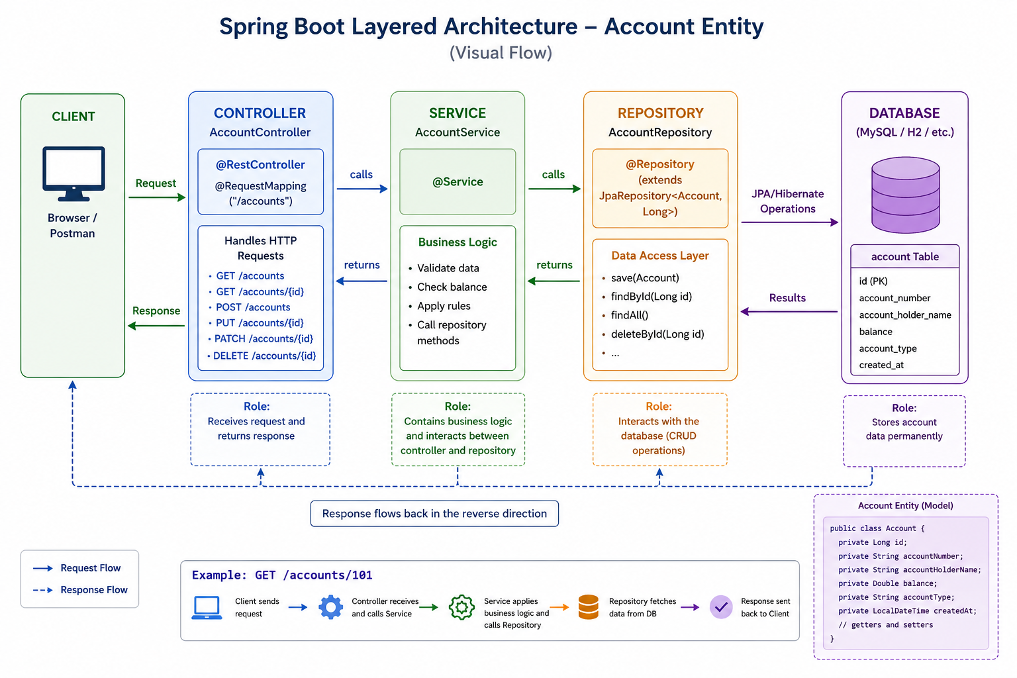
Spring Boot Layered Architecture

Slide 17
Flow:
Client sends request
Controller handles request
Service processes logic
Repository interacts with database
Response is returned to client
Auto-configuration and embedded server run in the background

Slide 18
Setting Up a Spring Boot
1. Go to Spring Initializer
Use Spring Initializer
It generates a ready-to-use Spring Boot project.
Select:
Project: Maven
Language: Java
Spring Boot: Latest version
Group: com.example
Artifact: demo

Slide 19
2. Add Dependencies
Choose based on your need:
Spring Web → for web applications
Spring Data JPA → for database
MySQL Driver → if using MySQL
3. Download & Open Project
Extract the ZIP file
Open in IntelliJ IDEA or Eclipse IDE

Slide 20
4. Project Structure
Important files:
DemoApplication.java → Main class
pom.xml → Dependencies
application.properties → Configuration

Slide 21
5. Main Class Example
@SpringBootApplication public class DemoApplication { public static void main(String[] args) { SpringApplication.run(DemoApplication.class, args); } }

Slide 22
6. Create a Simple Controller
@RestController public class HelloController { @GetMapping("/") public String hello() { return "Hello Spring Boot!"; } }

Slide 23
7. Run the Application
Run the main class
It starts embedded server like Apache Tomcat
8. Test in Browser
Open:
http://localhost:8080/ 👉 Output: Hello Spring Boot!

Slide 24
RESTful API
A RESTful API (Representational State Transfer API) is a way for different systems to communicate over the web using standard HTTP methods
It follows the principles of REST architecture to make communication simple, scalable, and stateless
A RESTful API treats everything as a resource (like users, products, orders), and each resource is identified by a URL.
Example:
/users /products /orders

Slide 25
HTTP Methods Used
REST APIs use standard HTTP methods:
GET → Retrieve data
POST → Create new data
PUT → Update existing data
DELETE → Remove data
Example:
GET /users → Get all users POST /users → Create user PUT /users/1 → Update user DELETE /users/1 → Delete user

Slide 26
Key Characteristics
1. Stateless
Each request is independent. The server does not store client state.
2. Client-Server Architecture
Client and server are separate, improving flexibility.
3. Uniform Interface
Uses standard conventions (URLs + HTTP methods).
4. Resource-Based
Everything is treated as a resource.

Slide 27
5. Data Format
Usually uses JSON for data exchange.
Example Response (JSON)
{ "id": 1, "name": "John" }

Slide 28
Why Use RESTful APIs?
Simple and easy to understand
Scalable and lightweight
Works with any platform (web, mobile)
Widely used in modern applications

Slide 29
In Spring Boot
REST APIs are created using:
@RestController
@GetMapping, @PostMapping, etc.
A RESTful API is a standard way to build web services where clients interact with resources using HTTP methods in a stateless manner.

