Slide 1
Circle Master (PP10)
Joel Branham - Project 1 For CS331

Slide 2
Project Hierarchy
Model
View/Controller
Circle Manager
Circle Frame
Circle Model
Circle Model
Circle Canvas
Circle Model
Circle Model
Circle Model

Slide 3
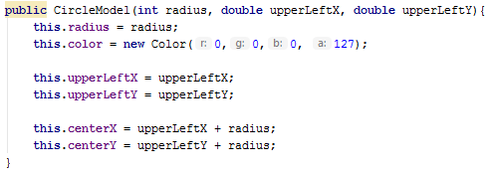
CircleModel
Every circle knows its radius, color, coordinates of center, and coordinates of the upper-left point of a square encompassing the circle (used for drawing the circle) and can get and set them
Circle’s x and y center calculated based on upper-left coordinates and radius

Slide 4
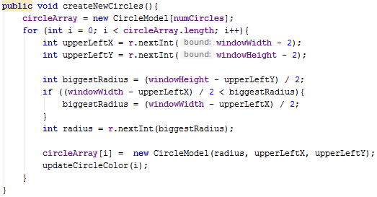
CircleManager
Manages Array of CircleModel
Circle Creation Process

Slide 5
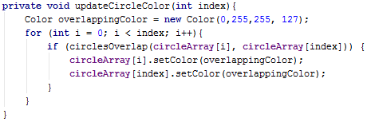
CircleManager Continued
Every circle’s color is based on location of every other circle

Slide 6
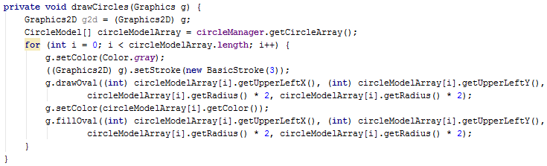

CircleCanvas
JPanel on which circles are drawn

Slide 7
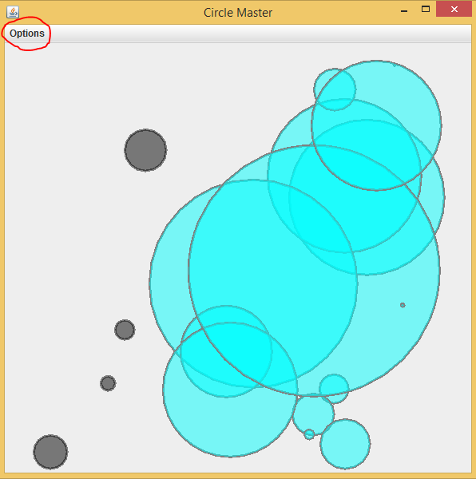
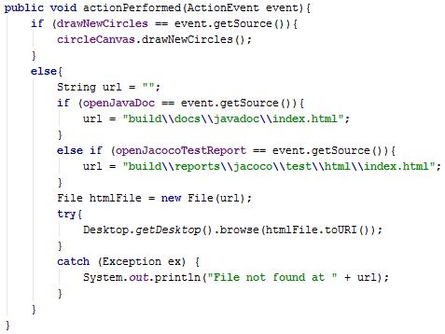
CircleFrame
Handles interaction with user and displays CircleCanvas

Slide 8

Running the application
Args – Number of circles, height of window, width of window

Slide 9
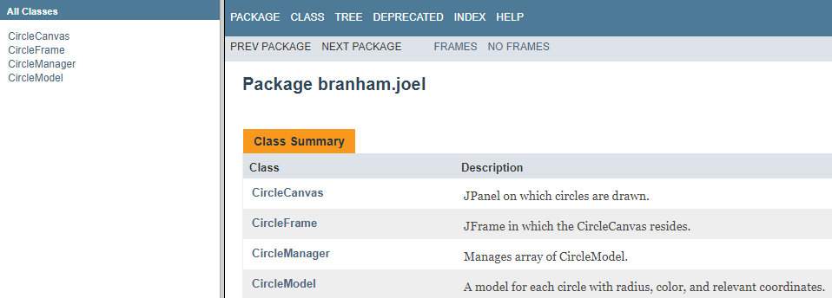
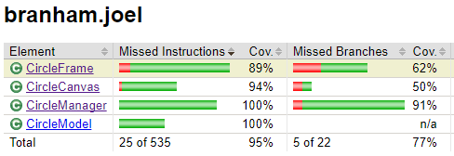
Features
Draw New Circles
Documentation generated by JavaDocs
Unit Test Coverage report generated by Jacoco

