Slide 1
Image-Component Labeler
By Joel Branham

Slide 2
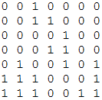
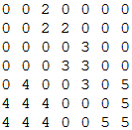
Prompt
Given an NxN Matrix filled with 1’s or 0’s, number unique components (starting from 2)
Adjacent 1’s are of same component

Slide 3
Class Hierarchy
Model
View/Controller
Grid
Main
Square
Queue
Panel

Slide 4
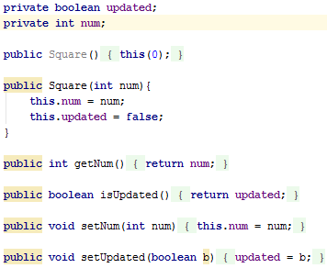
Square.java
Each Square in the Grid keeps track of its number and whether or not is has been updated

Slide 5
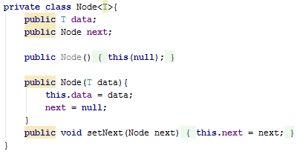
Queue.java
Used to store locations of components
Contains private Node class that holds data and maintains the connection to another Node if one exists

Slide 6
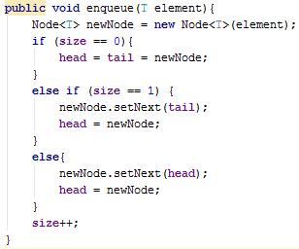
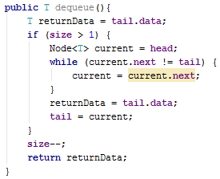
Queue Cont.
Features standard enqueue and dequeue methods utilizing Node class

Slide 7
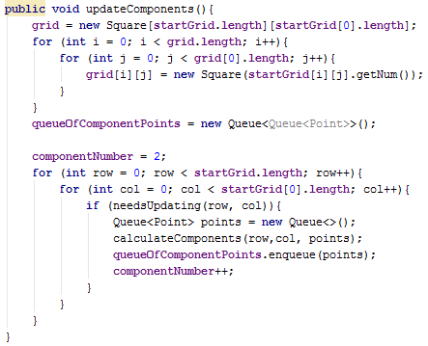
Grid.java
Component number starts at 2
If any square in the grid needs updating (its number does not equal 0 and it has not been updated), calculateComponents() is called for that square
Points for each component stored in Queue
Queue of Queues stores Queues for all components

Slide 8
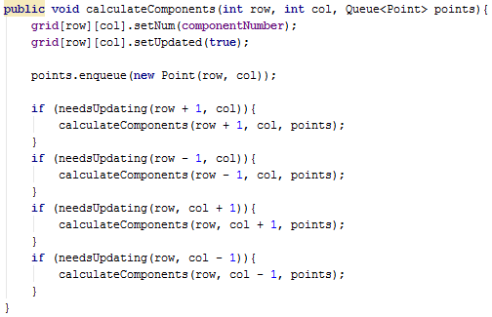
Grid.java Cont.
Ensures all adjacent 1’s are labeled with same component number
Flips isUpdated flag for checked Square so that it is not checked again
calculateComponents() is a recursive function
Base case is that a square has no surrounding squares that need to be updated

Slide 9
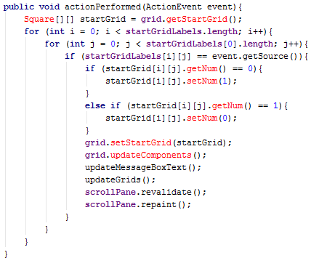
Panel.java
Called when a square is clicked
Square’s starting number is toggled (from 0 to 1 or 1 to 0) and then the output grid is generated through grid.updateComponents()

Slide 10
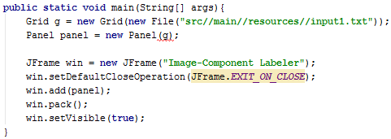
Main.java
Grid is passed input file
Panel is passed Grid object
Window (Jframe) is created and made visible

Slide 11
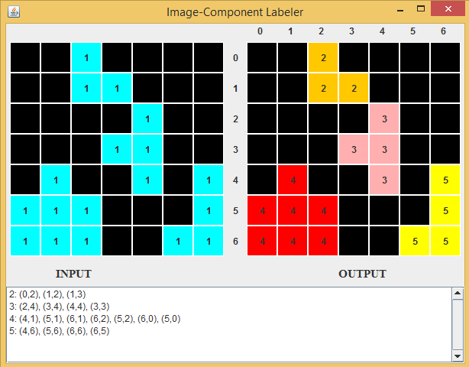
Application
Can click square on input grid to generate new output
Points for each component shown at bottom of screen

