Slide 1

Nba statistics
Which statistics matter most?
Joel C / 26 January

Slide 2

Key basketball statistics
Field goal percentage (FG%)
Free throw percentage (FT%)
3 Point percentage (3FG%)
Points per game (PPG)
Assists per game (APG)
Rebounds per game (RBG)

Slide 3
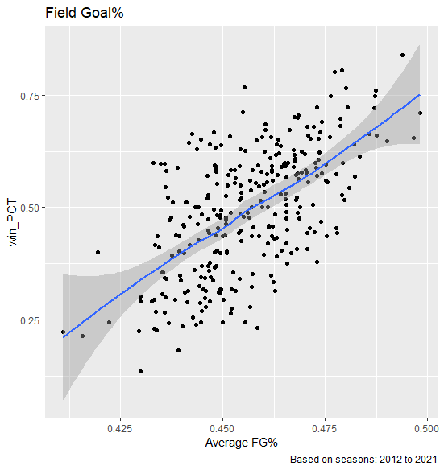
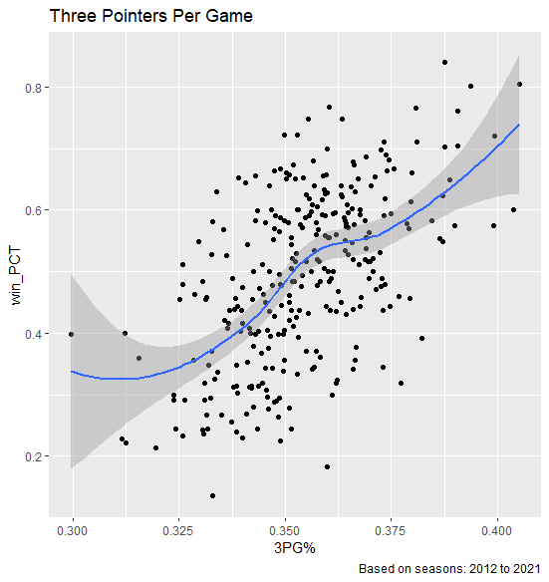
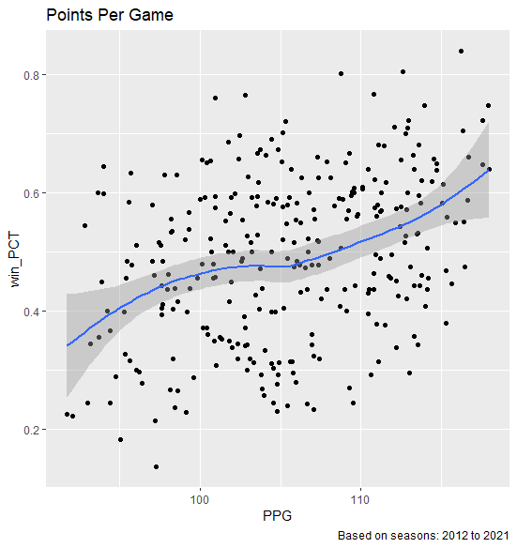
How do they correlate with wins?
Stats that had a strong correlation to wins were:
FG%
FG3%
PPG
Notes:
FG% had the strongest correlation to win% followed by FG3 and PPG
AST, REB and FT did not contribute strongly to wins

Slide 4

Analysis process
Gather Data
Verified sources are credible
Validate data
Create Sample
2012 to 2021 Season
Win percentage greater than 70%
Analyse Key statistics
Field Goal%
Points Per Game
3 Point Field Goal%
Recommendations
Which statistics should team owners and general managers focus on
What type of players to recruit and develop
Notes:
Data from: Kaggle (Nathan Lauga)
Win% = Total wins/total games

Slide 5
Top 10 teams by win%
Rank | TEAM | Season win% | Rating
 |  |  | FG | FT | FG3 | AST | REB | PTS
1 | Warriors2016 | 84% | 100 | 84 | 97 | 100 | 71 | 97
2 | Warriors2015 | 81% | 94 | 39 | 100 | 99 | 80 | 84
3 | Warriors2014 | 80% | 92 | 35 | 99 | 96 | 67 | 66
4 | Rockets2017 | 77% | 50 | 69 | 66 | 19 | 41 | 75
5 | Spurs2015 | 77% | 96 | 94 | 95 | 68 | 43 | 35
6 | Heat2012 | 76% | 99 | 43 | 98 | 41 | 1 | 27
7 | Suns2021 | 75% | 98 | 91 | 72 | 97 | 72 | 92
8 | Bucks2019 | 75% | 92 | 18 | 54 | 89 | 100 | 100
9 | Bucks2018 | 72% | 88 | 48 | 50 | 91 | 100 | 100
10 | Lakers2019 | 72% | 96 | 14 | 41 | 85 | 80 | 87
Note: Data based on 2012 to 2021 NBA season
Notes:
Rating based on percentage of total sample. (E.g. Rating of 97 indicates the team is in top 3% of the stats category)
Note that majority of teams had high FG and FG3

Slide 6
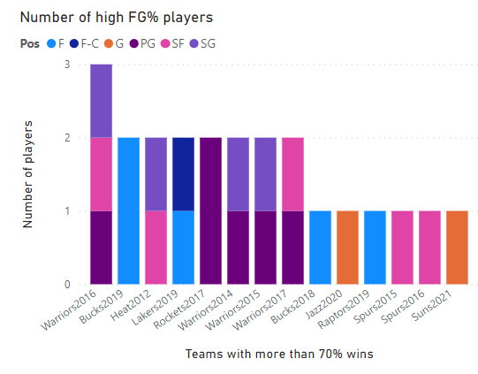
Let’s take a closer look: field goal%
High win percentage teams all had at 1-3 players with:
At least 20 points per game; and
field goal percentage greater than 50%
No strong position bias for high FG% players
Guard positions appeared slightly more efficient than forwards
There was no centres that matched the criteria

Slide 7
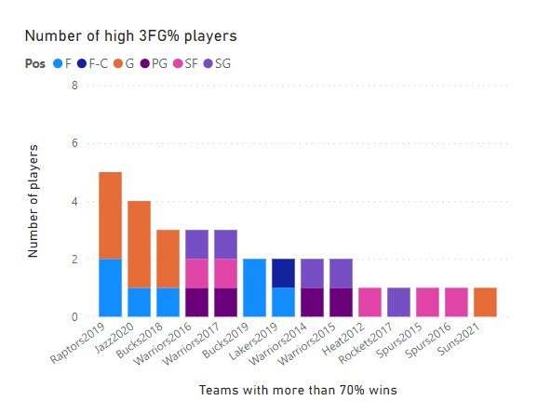
Let’s take a closer look: 3-Point field goal%
High win% teams all had 1-4 players with:
At least 15 points per game
3-point field goal percentage greater than 30%
Gaurds are more efficient 3 point shooters than forwards

Slide 8
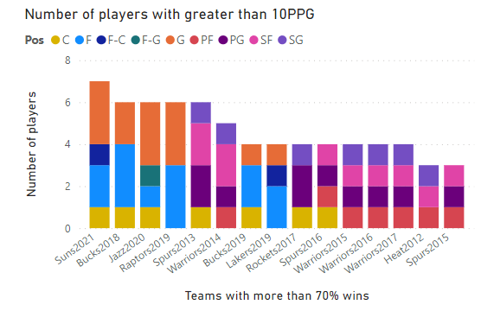
Let’s take a closer look: Points per game
On average high win% teams need at least 5 players that have greater than 10 PPG
Forwards have more scorers than guards
Top teams have strong role players at the forward position

Slide 9

Key takeaways & recommendations
Winning teams have:
Strong back courts
Efficient 3-point shooters
Dominant role players at the forward position
Recommendations:
Build around guard players that can shoot 3 pointers efficiently
Focus on developing role players at the forward position

