Slide 1
Respuesta al impulso
Convolución
Filtro FIR

Slide 2


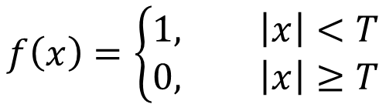



Respuesta al impulso
$$f\left(x\right)=\left\{\begin{aligned}1, \left|x\right|<T \\ &0, \left|x\right|≥T\end{aligned}\right.$$
$$f\left(t\right)$$
$$1$$
$$−\frac{T}{2}$$
$$\frac{T}{2}$$
$$t$$
8

Slide 3

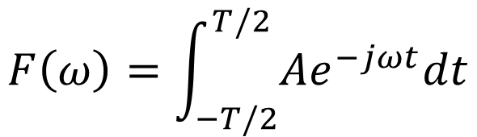
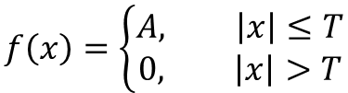
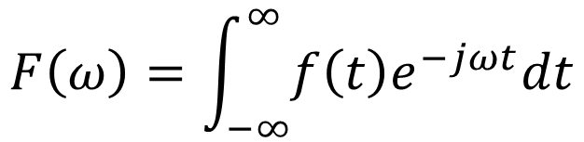


Respuesta al impulso
$$f\left(x\right)=\left\{\begin{aligned}A, \left|x\right|≤T \\ &0, \left|x\right|>T\end{aligned}\right.$$
$$F\left(ω\right)=\int_{−∞}^{∞}{f\left(t\right)e^{−jωt}dt}$$
$$f\left(t\right)$$
$$F\left(ω\right)=\int_{−T/2}^{T/2}{Ae^{−jωt}dt}$$
$$A$$
$$v=−jωt$$
$$−\frac{T}{2}$$
$$\frac{T}{2}$$
$$t$$
$$dv=−jωdt$$
8

Slide 4


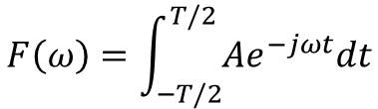
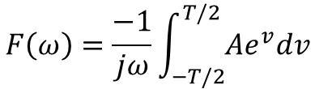
Respuesta al impulso
$$f\left(x\right)=\left\{\begin{aligned}A, \left|x\right|≤T \\ &0, \left|x\right|>T\end{aligned}\right.$$
$$F\left(ω\right)=\int_{−T/2}^{T/2}{Ae^{−jωt}dt}$$
$$F\left(ω\right)=\frac{−1}{jω}\int_{−T/2}^{T/2}{Ae^{v}dv}$$
$$f\left(t\right)$$
$$A$$
$$v=−jωt$$
$$dv=−jωdt$$
$$−\frac{T}{2}$$
$$\frac{T}{2}$$
$$t$$
8

Slide 5
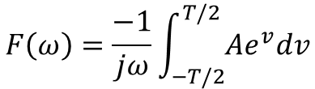


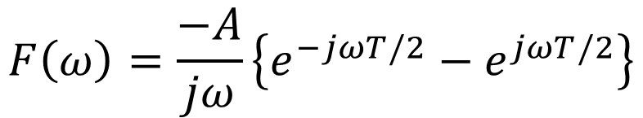
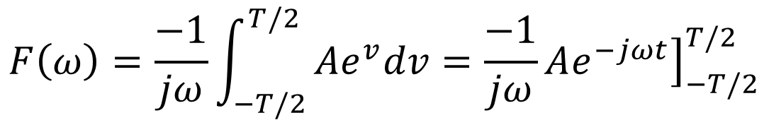
Respuesta al impulso
$$f\left(x\right)=\left\{\begin{aligned}A, \left|x\right|≤T \\ &0, \left|x\right|>T\end{aligned}\right.$$
$$F\left(ω\right)=\frac{−1}{jω}\int_{−T/2}^{T/2}{Ae^{v}dv}$$
$$v=−jωt$$
$$f\left(t\right)$$
$$dv=−jωdt$$
$$A$$
$$F\left(ω\right)=\frac{−1}{jω}\int_{−T/2}^{T/2}{Ae^{v}dv=\frac{−1}{jω}A{\left.e^{−jωt}\right]}_{−T/2}^{T/2}}$$
$$−\frac{T}{2}$$
$$\frac{T}{2}$$
$$t$$
$$F\left(ω\right)=\frac{−A}{jω}\left\{e^{−jωT/2}−e^{jωT/2}\right\}$$
8

Slide 6
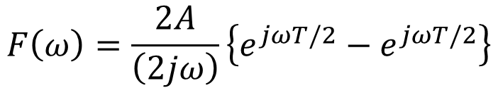
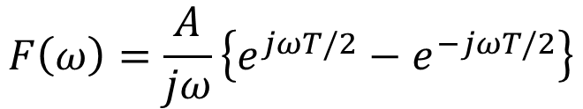
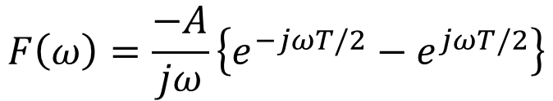
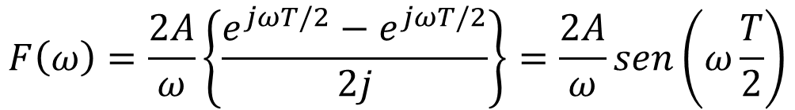
Respuesta al impulso
$$F\left(ω\right)=\frac{−A}{jω}\left\{e^{−jωT/2}−e^{jωT/2}\right\}$$
$$f\left(x\right)=\left\{\begin{aligned}A, \left|x\right|≤T \\ &0, \left|x\right|>T\end{aligned}\right.$$
$$F\left(ω\right)=\frac{A}{jω}\left\{e^{jωT/2}−e^{−jωT/2}\right\}$$
$$f\left(t\right)$$
$$F\left(ω\right)=\frac{2A}{\left(2jω\right)}\left\{e^{jωT/2}−e^{jωT/2}\right\}$$
$$A$$
$$−\frac{T}{2}$$
$$\frac{T}{2}$$
$$t$$
$$F\left(ω\right)=\frac{2A}{ω}\left\{\frac{e^{jωT/2}−e^{jωT/2}}{2j}\right\}=\frac{2A}{ω}sen\left(ω\frac{T}{2}\right)$$
8

Slide 7
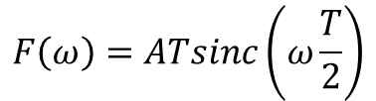
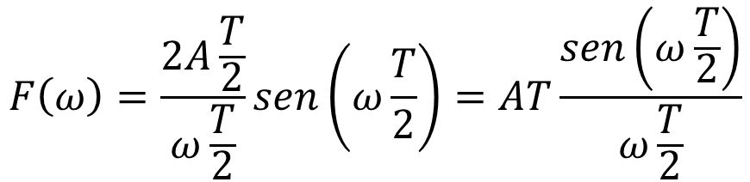
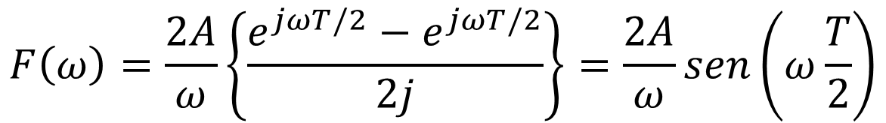
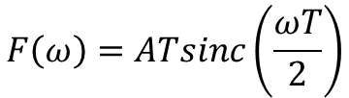
Respuesta al impulso
$$f\left(x\right)=\left\{\begin{aligned}A, \left|x\right|≤T \\ &0, \left|x\right|>T\end{aligned}\right.$$
$$F\left(ω\right)=\frac{2A}{ω}\left\{\frac{e^{jωT/2}−e^{jωT/2}}{2j}\right\}=\frac{2A}{ω}sen\left(ω\frac{T}{2}\right)$$
$$f\left(t\right)$$
$$F\left(ω\right)=\frac{2A\frac{T}{2}}{ω\frac{T}{2}}sen\left(ω\frac{T}{2}\right)=AT\frac{sen\left(ω\frac{T}{2}\right)}{ω\frac{T}{2}}$$
$$A$$
$$F\left(ω\right)=ATsinc\left(ω\frac{T}{2}\right)$$
$$−\frac{T}{2}$$
$$\frac{T}{2}$$
$$t$$
$$F\left(ω\right)=ATsinc\left(\frac{ωT}{2}\right)$$
8

Slide 8
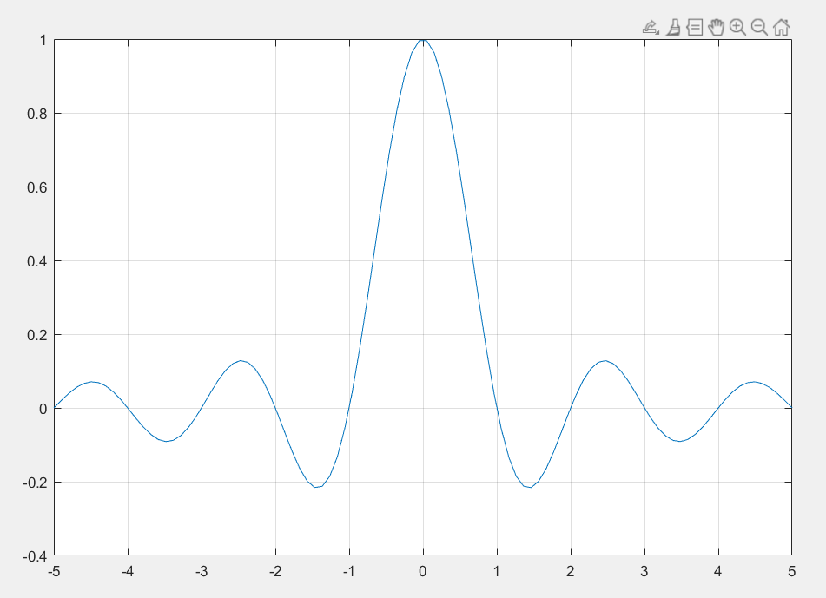
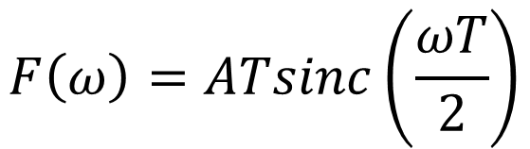
Respuesta al impulso
$$F\left(ω\right)=ATsinc\left(\frac{ωT}{2}\right)$$
$$f\left(x\right)=\left\{\begin{aligned}A, \left|x\right|≤T \\ &0, \left|x\right|>T\end{aligned}\right.$$
$$f\left(t\right)$$
$$A$$
$$−\frac{T}{2}$$
$$\frac{T}{2}$$
$$t$$
8

Slide 9
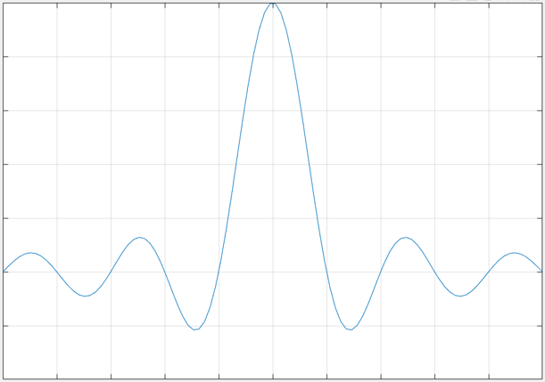
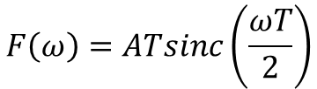
Respuesta al impulso
$$F\left(ω\right)=ATsinc\left(\frac{ωT}{2}\right)$$
$$f\left(x\right)=\left\{\begin{aligned}A, \left|x\right|≤T \\ &0, \left|x\right|>T\end{aligned}\right.$$
$$f\left(t\right)$$
$$A$$
$$−\frac{T}{2}$$
$$\frac{T}{2}$$
$$t$$
8

Slide 10
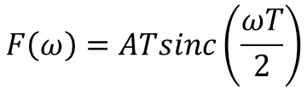
Respuesta al impulso
$$F\left(ω\right)=ATsinc\left(\frac{ωT}{2}\right)$$
Es la función de transferencia de los filtros pasabajos ya que suprime o atenúa frecuencias laterales
[8], [9]

Slide 11
Convolución
Convolución lineal
Un sistema en tiempo discreto LTI queda completamente caracterizado por su respuesta al impulso
Dada la respuesta al impulso de un sistema LTI, es posible calcular su salida para una entrada arbitraria
El impulso queda descrito con la notación $δ\left(n\right)$
La respuesta al impulso se describe con la notación $h\left(n\right)$

Slide 12
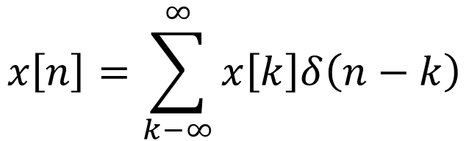

Convolución
Convolución lineal
En la práctica una señal $x\left[n\right]$ queda expresada como la suma ponderada y retardada de los impulsos como sigue
$$x\left[n\right]=\sum_{k−∞}^{∞}{x\left[k\right]δ\left(n−k\right)}$$
Los valores de la señal $x\left[k\right]$ son los pesos de $δ\left(n−k\right)$

Slide 13
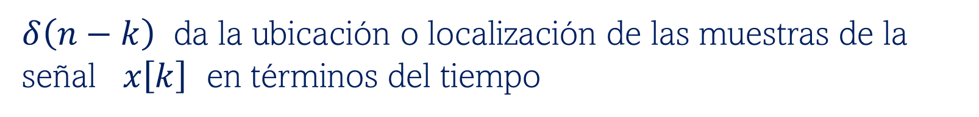
Convolución
Convolución lineal
En la práctica una señal $x\left[n\right]$ queda expresada como la suma ponderada y retardada de los impulsos como sigue
$$x\left[n\right]=\sum_{k−∞}^{∞}{x\left[k\right]δ\left(n−k\right)}$$
$δ\left(n−k\right)$ da la ubicación o localización de las muestras de la señal $x\left[k\right]$ en términos del tiempo

Slide 14
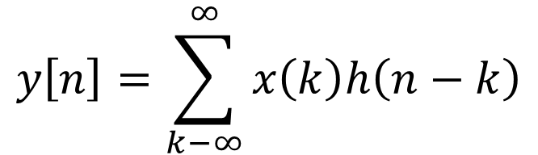
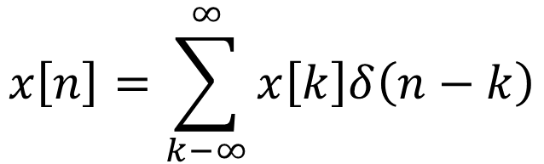
Convolución
Convolución lineal
$$x\left[n\right]=\sum_{k−∞}^{∞}{x\left[k\right]δ\left(n−k\right)}$$
Aplicando la operación de transformación sobre la serie, la salida es:
$$y\left[n\right]=\sum_{k−∞}^{∞}{x\left(k\right)h\left(n−k\right)}$$
Es posible por la propiedad de linealidad

Slide 15
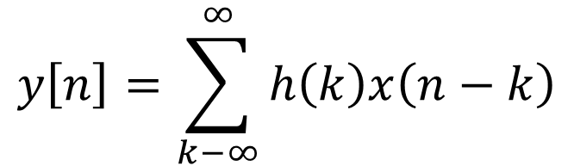
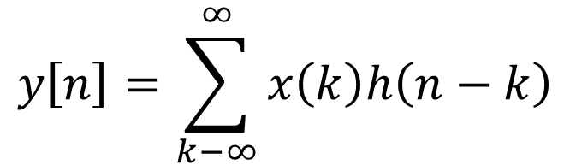
Convolución
Convolución lineal
$$y\left[n\right]=\sum_{k−∞}^{∞}{x\left(k\right)h\left(n−k\right)}$$
Y es referida como la suma de convolución
Como es un sistema LTI tiene la versión alternativa siguiente
$$y\left[n\right]=\sum_{k−∞}^{∞}{h\left(k\right)x\left(n−k\right)}$$

Slide 16
Convolución
Convolución lineal
Métodos o procedimientos para calcular la convolución
I).- Forma directa
II).- Tabla de convolución
III).- Forma LTI
IV).- Forma matricial
V).- Forma invertir y desplazar
VI).- Forma sumar por bloques
[5] page 121

Slide 17
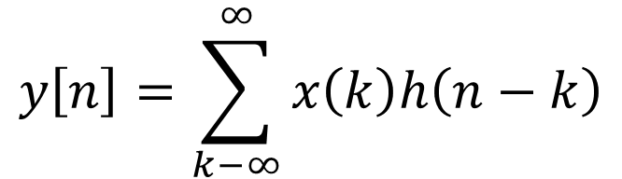
Convolución
Convolución lineal
Forma invertir y deslizar
$$y\left[n\right]=\sum_{k−∞}^{∞}{x\left(k\right)h\left(n−k\right)}$$
El procedimiento para calcular esta expresión se sugiere como sigue

Slide 18
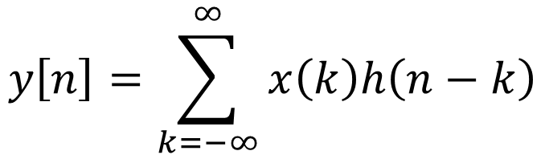

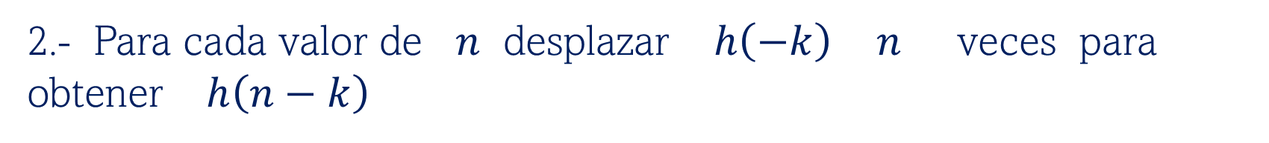
Forma invertir y deslizar
Convolución
Convolución lineal
$$y\left[n\right]=\sum_{k=−∞}^{∞}{x\left(k\right)h\left(n−k\right)}$$
1.- Obtener la reflexión en el tiempo (Time-Reversal) de la respuesta al impulso $h\left(−k\right)$
2.- Para cada valor de $n$ desplazar $h\left(−k\right)$ $n$ veces para obtener $h\left(n−k\right)$

Slide 19
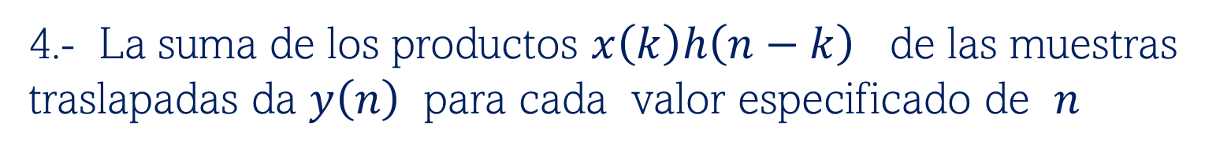
Forma invertir y deslizar
Convolución
Convolución lineal
$$y\left[n\right]=\sum_{k−∞}^{∞}{x\left(k\right)h\left(n−k\right)}$$
3.- Multiplicar el traslape de las muestras $x\left(k\right)$ y $h\left(n−k\right)$
4.- La suma de los productos $x\left(k\right)h\left(n−k\right)$ de las muestras traslapadas da $y\left(n\right)$ para cada valor especificado de $n$

Slide 20
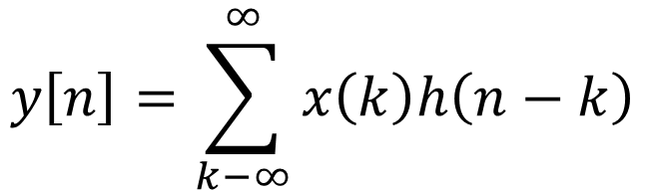
Forma invertir y deslizar
Convolución
Convolución lineal
$$y\left[n\right]=\sum_{k−∞}^{∞}{x\left(k\right)h\left(n−k\right)}$$
5.- Las muestras de $x\left(n\right)$ son ordenadas desde $n=0, 1, 2, ⋯, N−1$
6.- Los impulsos son ordenados inicialmente de la misma forma que $x\left(n\right)$

Slide 21
















Forma invertir y deslizar
Convolución
Convolución lineal
$$x\left[n\right]$$
$$0$$
$$1$$
$$2$$
$$3$$
$$4$$
$$5$$
$$6$$
$$δ\left[n\right]$$
$$0$$
$$1$$
$$2$$
$$3$$
$$4$$
$$5$$
$$6$$

Slide 22







Forma invertir y deslizar
Convolución
Convolución lineal
$$x\left[n\right]$$
$$0$$
$$1$$
$$2$$
$$3$$
$$4$$
$$5$$
$$6$$
$$δ\left[n\right]$$
$$−6$$
$$−5$$
$$−4$$
$$−3$$
$$−2$$
$$−1$$
$$0$$

Slide 23

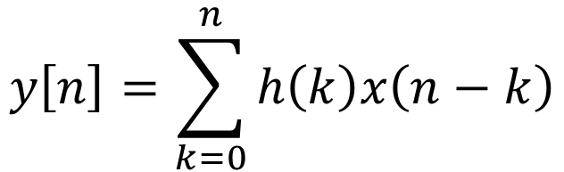
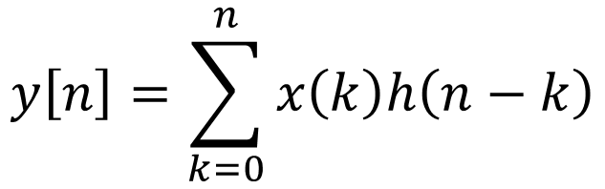
Forma invertir y deslizar
Convolución
$$y\left[n\right]=\sum_{k=0}^{n}{x\left(k\right)h\left(n−k\right)}$$
Convolución lineal
$$x\left[n\right]$$
$$y\left[n\right]=\sum_{k=0}^{n}{h\left(k\right)x\left(n−k\right)}$$
$$0$$
$$1$$
$$2$$
$$3$$
$$4$$
$$5$$
$$6$$
$$δ\left[n\right]$$
$$−6$$
$$−5$$
$$−4$$
$$−3$$
$$−2$$
$$−1$$
$$0$$

Slide 24





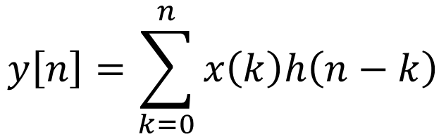











Forma invertir y deslizar
Convolución
$$y\left[n\right]=\sum_{k=0}^{n}{x\left(k\right)h\left(n−k\right)}$$
$$2$$
Convolución lineal
$$1.5$$
$$x\left[n\right]$$
$$0.9$$
$$1$$
$$0.7$$
$$0.4$$
$$0.2$$
$$y\left[n\right]=\sum_{k=0}^{n}{h\left(k\right)x\left(n−k\right)}$$
$$0$$
$$1$$
$$2$$
$$3$$
$$4$$
$$5$$
$$6$$
$$δ\left[n\right]$$
$$1.2$$
$$1.3$$
$$0.7$$
$$1$$
$$0.5$$
$$0.5$$
$$0.2$$
$$−6$$
$$−5$$
$$−4$$
$$−3$$
$$−2$$
$$−1$$
$$0$$

Slide 25
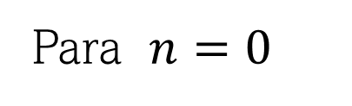
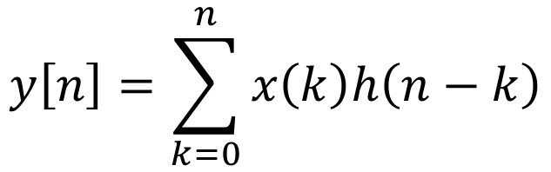


Forma invertir y deslizar
Convolución
$$y\left[n\right]=\sum_{k=0}^{n}{x\left(k\right)h\left(n−k\right)}$$
$$2$$
Convolución lineal
$$1.5$$
$$x\left[n\right]$$
$$0.9$$
$$1$$
$$0.7$$
$$0.4$$
$$0.2$$
$$y\left[n\right]=\sum_{k=0}^{n}{h\left(k\right)x\left(n−k\right)}$$
$$0$$
$$1$$
$$2$$
$$3$$
$$4$$
$$5$$
$$6$$
Para $n=0$
$$δ\left[n\right]$$
$$y\left(0\right)=h\left(0\right)x\left(0\right)$$
$$1.2$$
$$1.3$$
$$0.7$$
$$1$$
$$0.5$$
$$0.5$$
$$y\left(0\right)=\left(1\right)\left(0.7\right)=0.7$$
$$0.2$$
$$−6$$
$$−5$$
$$−4$$
$$−3$$
$$−2$$
$$−1$$
$$0$$

Slide 26


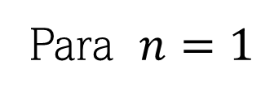









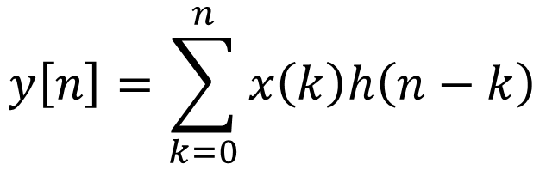
Convolución
$$y\left[n\right]=\sum_{k=0}^{n}{x\left(k\right)h\left(n−k\right)}$$
$$2$$
Convolución lineal
$$1.5$$
$$x\left[n\right]$$
$$0.9$$
$$1$$
$$0.7$$
$$0.4$$
$$0.2$$
$$y\left[n\right]=\sum_{k=0}^{n}{h\left(k\right)x\left(n−k\right)}$$
Para $n=1$
$$0$$
$$1$$
$$2$$
$$3$$
$$4$$
$$5$$
$$6$$
$$y\left(1\right)=h\left(0\right)x\left(1−0\right)+h\left(1\right)x\left(1−1\right)$$
$$δ\left[n\right]$$
$$1.2$$
$$1.3$$
$$y\left(1\right)=h\left(0\right)x\left(1\right)+h\left(1\right)x\left(0\right)$$
$$0.7$$
$$1$$
$$0.5$$
$$0.5$$
$$y\left(1\right)=\left(0.5\right)\left(1\right)+\left(1\right)\left(0.7\right)=1.2$$
$$0.2$$
$$−5$$
$$−4$$
$$−3$$
$$−2$$
$$−1$$
$$0$$
$$1$$

Slide 27


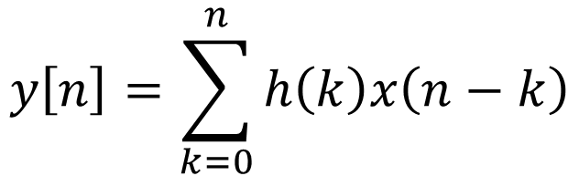




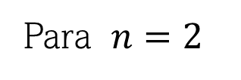









Forma invertir y deslizar
Convolución
$$2$$
Convolución lineal
$$1.5$$
$$x\left[n\right]$$
$$0.9$$
$$1$$
$$0.7$$
$$0.4$$
$$y\left[n\right]=\sum_{k=0}^{n}{h\left(k\right)x\left(n−k\right)}$$
$$0.2$$
Para $n=2$
$$0$$
$$1$$
$$2$$
$$3$$
$$4$$
$$5$$
$$6$$
Y$\left(2\right)=h\left(0\right)x\left(2−0\right)+h\left(1\right)x\left(2−1\right)+h\left(2\right)x\left(2−2\right)$
$$δ\left[n\right]$$
$$1.2$$
$$1.3$$
$$0.7$$
$$1$$
$$0.5$$
$$0.5$$
$$0.2$$
$$−4$$
$$−3$$
$$−2$$
$$−1$$
$$0$$
$$1$$
$$2$$

Slide 28
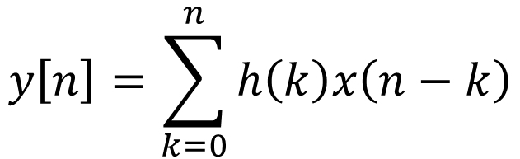
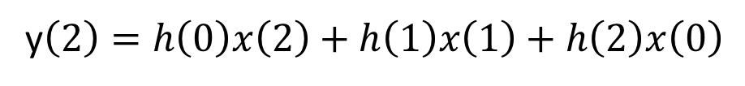
Forma invertir y deslizar
Convolución
$$2$$
Convolución lineal
$$1.5$$
$$x\left[n\right]$$
$$0.9$$
$$1$$
$$0.7$$
$$0.4$$
$$0.2$$
$$y\left[n\right]=\sum_{k=0}^{n}{h\left(k\right)x\left(n−k\right)}$$
Para $n=2$
$$0$$
$$1$$
$$2$$
$$3$$
$$4$$
$$5$$
$$6$$
y$\left(2\right)=h\left(0\right)x\left(2−0\right)+h\left(1\right)x\left(2−1\right)+h\left(2\right)x\left(2−2\right)$
y$\left(2\right)=h\left(0\right)x\left(2\right)+h\left(1\right)x\left(1\right)+h\left(2\right)x\left(0\right)$
y$\left(2\right)=\left(1.3\right)\left(1.5\right)+\left(0.5\right)\left(1\right)+\left(1\right)\left(0.7\right)=3.15$

Slide 29

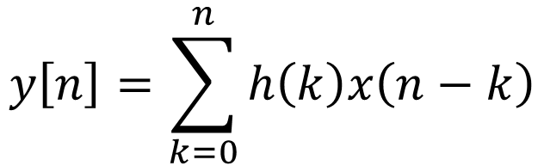



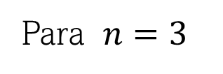




Forma invertir y deslizar
Convolución
$$2$$
Convolución lineal
$$1.5$$
$$x\left[n\right]$$
$$0.9$$
$$1$$
$$0.7$$
$$0.4$$
$$0.2$$
$$y\left[n\right]=\sum_{k=0}^{n}{h\left(k\right)x\left(n−k\right)}$$
Para $n=3$
$$0$$
$$1$$
$$2$$
$$3$$
$$4$$
$$5$$
$$6$$
$$Y\left(3\right)=h\left(0\right)x\left(3−0\right)+h\left(1\right)x\left(3−1\right)+h\left(2\right)x\left(3−2\right)+h\left(3\right)x(3−3)$$
$$δ\left[n\right]$$
$$1.2$$
$$1.3$$
$$0.7$$
$$1$$
$$0.5$$
$$0.5$$
$$0.2$$
$$−3$$
$$−2$$
$$−1$$
$$0$$
$$1$$
$$2$$
$$3$$

Slide 30
Forma invertir y deslizar
Convolución
$$2$$
Convolución lineal
$$1.5$$
$$x\left[n\right]$$
$$0.9$$
$$1$$
$$0.7$$
$$0.4$$
$$0.2$$
$$y\left[n\right]=\sum_{k=0}^{n}{h\left(k\right)x\left(n−k\right)}$$
Para $n=3$
$$0$$
$$1$$
$$2$$
$$3$$
$$4$$
$$5$$
$$6$$
$$Y\left(3\right)=h\left(0\right)x\left(3−0\right)+h\left(1\right)x\left(3−1\right)+h\left(2\right)x\left(3−2\right)+h\left(3\right)x(3−3)$$
$$Y\left(3\right)=h\left(0\right)x\left(3\right)+h\left(1\right)x\left(2\right)+h\left(2\right)x\left(1\right)+h\left(3\right)x(0)$$
$$Y\left(3\right)=\left(0.2\right)\left(2\right)+\left(1.3\right)\left(1.5\right)+\left(0.5\right)\left(1\right)+\left(1\right)\left(0.7\right)=3.55$$

Slide 31

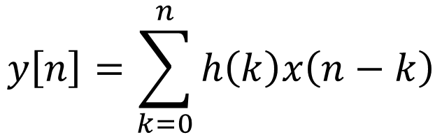



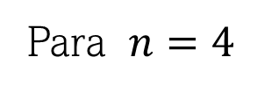




Forma invertir y deslizar
Convolución
$$2$$
Convolución lineal
$$1.5$$
$$x\left[n\right]$$
$$0.9$$
$$1$$
$$y\left[n\right]=\sum_{k=0}^{n}{h\left(k\right)x\left(n−k\right)}$$
$$0.7$$
$$0.4$$
$$0.2$$
Para $n=4$
$$0$$
$$1$$
$$2$$
$$3$$
$$4$$
$$5$$
$$6$$
$$Y\left(4\right)=h\left(0\right)x\left(4−0\right)+h\left(1\right)x\left(4−1\right)+h\left(2\right)x\left(4−2\right)+h\left(3\right)x\left(4−3\right)+h\left(4\right)x(4−4)$$
$$δ\left[n\right]$$
$$1.2$$
$$1.3$$
$$0.7$$
$$1$$
$$0.5$$
$$0.5$$
$$0.2$$
$$−2$$
$$−1$$
$$0$$
$$1$$
$$2$$
$$3$$
$$4$$

Slide 32
Forma invertir y deslizar
Convolución
$$2$$
Convolución lineal
$$1.5$$
$$x\left[n\right]$$
$$0.9$$
$$1$$
$$0.7$$
$$0.4$$
$$0.2$$
$$y\left[n\right]=\sum_{k=0}^{n}{h\left(k\right)x\left(n−k\right)}$$
Para $n=4$
$$0$$
$$1$$
$$2$$
$$3$$
$$4$$
$$5$$
$$6$$
$$Y\left(4\right)=h\left(0\right)x\left(4−0\right)+h\left(1\right)x\left(4−1\right)+h\left(2\right)x\left(4−2\right)+h\left(3\right)x\left(4−3\right)+h\left(4\right)x(4−4)$$
$$Y\left(4\right)=h\left(0\right)x\left(4\right)+h\left(1\right)x\left(3\right)+h\left(2\right)x\left(2\right)+h\left(3\right)x\left(1\right)+h\left(4\right)x(0)$$
$$Y\left(4\right)=\left(0.7\right)\left(0.4\right)+\left(0.2\right)\left(2\right)+\left(1.3\right)\left(1.5\right)+\left(0.5\right)\left(1\right)+\left(1\right)\left(0.7\right)=3.83$$

Slide 33




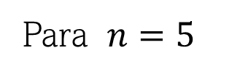




Forma invertir y deslizar
Convolución
$$2$$
Convolución lineal
$$1.5$$
$$x\left[n\right]$$
$$0.9$$
$$1$$
$$y\left[n\right]=\sum_{k=0}^{n}{h\left(k\right)x\left(n−k\right)}$$
$$0.7$$
$$0.4$$
$$0.2$$
Para $n=5$
$$0$$
$$1$$
$$2$$
$$3$$
$$4$$
$$5$$
$$6$$
$$Y\left(5\right)=h\left(0\right)x\left(5−0\right)+h\left(1\right)x\left(5−1\right)+h\left(2\right)x\left(5−2\right)+h\left(3\right)x\left(5−3\right)+h\left(4\right)x\left(5−4\right)+h\left(5\right)x(5−5)$$
$$δ\left[n\right]$$
$$1.2$$
$$1.3$$
$$0.7$$
$$1$$
$$0.5$$
$$0.5$$
$$0.2$$
$$−1$$
$$0$$
$$1$$
$$2$$
$$3$$
$$4$$
$$5$$

Slide 34
Forma invertir y deslizar
Convolución
$$2$$
Convolución lineal
$$1.5$$
$$x\left[n\right]$$
$$0.9$$
$$1$$
$$0.7$$
$$0.4$$
$$0.2$$
$$y\left[n\right]=\sum_{k=0}^{n}{h\left(k\right)x\left(n−k\right)}$$
Para $n=4$
$$0$$
$$1$$
$$2$$
$$3$$
$$4$$
$$5$$
$$6$$
$$Y\left(5\right)=h\left(0\right)x\left(5−0\right)+h\left(1\right)x\left(5−1\right)+h\left(2\right)x\left(5−2\right)+h\left(3\right)x\left(5−3\right)+h\left(4\right)x\left(5−4\right)+h\left(5\right)x(5−5)$$
$$Y\left(5\right)=h\left(0\right)x\left(5\right)+h\left(1\right)x\left(4\right)+h\left(2\right)x\left(3\right)+h\left(3\right)x\left(2\right)+h\left(4\right)x\left(1\right)+h\left(5\right)x(0)$$
$$Y\left(5\right)=\left(1.2\right)\left(0.2\right)+\left(0.7\right)\left(0.4\right)+\left(0.2\right)\left(2\right)+\left(1.3\right)\left(1.5\right)+\left(0.5\right)\left(1\right)+\left(1\right)\left(0.7\right)=4.07$$

Slide 35




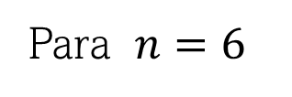




Forma invertir y deslizar
Convolución
$$2$$
Convolución lineal
$$1.5$$
$$x\left[n\right]$$
$$0.9$$
$$1$$
$$y\left[n\right]=\sum_{k=0}^{n}{h\left(k\right)x\left(n−k\right)}$$
$$0.7$$
$$0.4$$
$$0.2$$
Para $n=6$
$$0$$
$$1$$
$$2$$
$$3$$
$$4$$
$$5$$
$$6$$
$$Y\left(6\right)=h\left(0\right)x\left(6−0\right)+h\left(1\right)x\left(6−1\right)+h\left(2\right)x\left(6−2\right)+h\left(3\right)x\left(6−3\right)+h\left(4\right)x\left(6−4\right)+h\left(5\right)x\left(6−5\right)+h\left(6\right)x(6−6)$$
$$δ\left[n\right]$$
$$1.2$$
$$1.3$$
$$0.7$$
$$1$$
$$0.5$$
$$0.5$$
$$0.2$$
$$0$$
$$1$$
$$2$$
$$3$$
$$4$$
$$5$$
$$6$$

Slide 36
Forma invertir y deslizar
Convolución
$$2$$
Convolución lineal
$$1.5$$
$$x\left[n\right]$$
$$0.9$$
$$1$$
$$0.7$$
$$0.4$$
$$0.2$$
$$y\left[n\right]=\sum_{k=0}^{n}{h\left(k\right)x\left(n−k\right)}$$
Para $n=6$
$$0$$
$$1$$
$$2$$
$$3$$
$$4$$
$$5$$
$$6$$
$$Y\left(6\right)=h\left(0\right)x\left(6−0\right)+h\left(1\right)x\left(6−1\right)+h\left(2\right)x\left(6−2\right)+h\left(3\right)x\left(6−3\right)+h\left(4\right)x\left(6−4\right)+h\left(5\right)x\left(6−5\right)+h\left(6\right)x(6−6)$$
$$Y\left(6\right)=h\left(0\right)x\left(6\right)+h\left(1\right)x\left(5\right)+h\left(2\right)x\left(4\right)+h\left(3\right)x\left(3\right)+h\left(4\right)x\left(2\right)+h\left(5\right)x\left(1\right)+h\left(6\right)x(0)$$
$$Y\left(6\right)=\left(0.5\right)\left(0.9\right)+\left(1.2\right)\left(0.2\right)+\left(0.7\right)\left(0.4\right)+\left(0.2\right)\left(2\right)+\left(1.3\right)\left(1.5\right)+\left(0.5\right)\left(1\right)+\left(1\right)\left(0.7\right)=4.52$$

