Slide 1
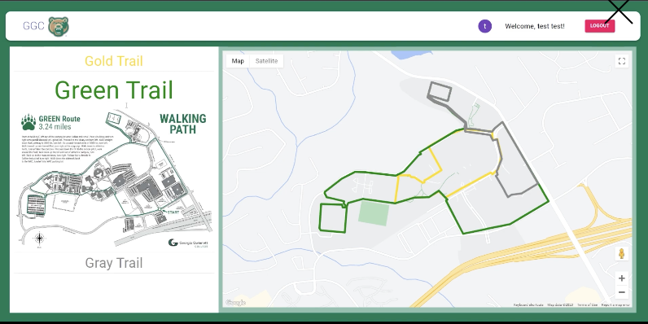
Walking Trail App
The W.A.L.K.E.R.S:
Khales R, Greg S, Drew K, Rahul B

Slide 2
Client's Vision
Our clients' main goal is to promote physical/nutritional health
This app should serve as a tool to expand its users' knowledge base on all thing's health
On a smaller scale, this app will be implemented throughout GGC's existing walking trail
Down the road after successful implementation of the app in GGC, this app will be used by Gwinnett County Parks & Rec.
Implementation of this app in Gwinnett County parks will allow the app to aid a larger population in physical education and nutritional health

Slide 3
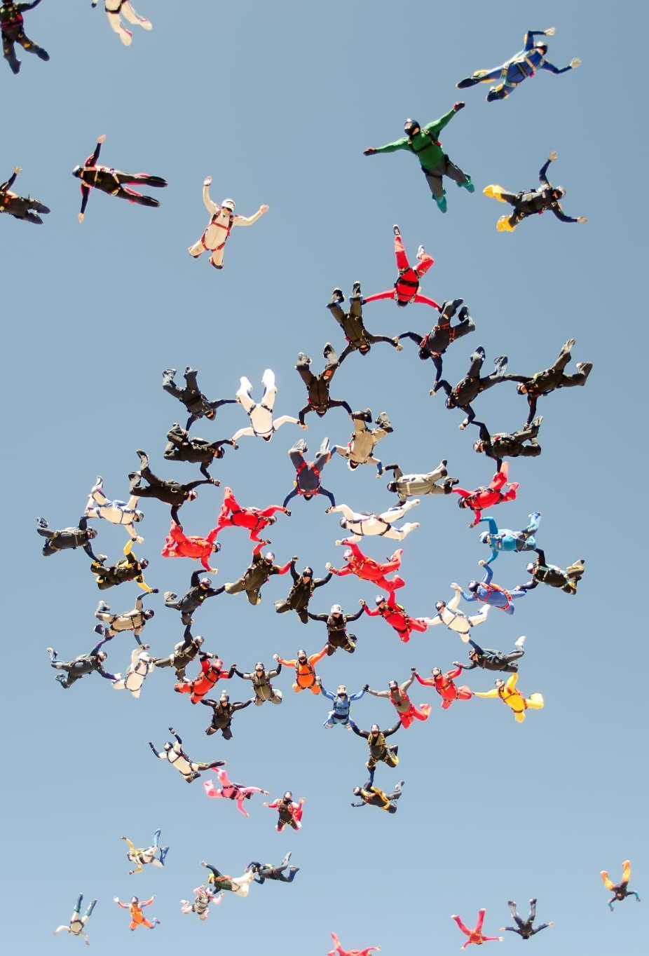
Our Teams' Skills and Goals
Khales
skills: Attention to detail, Team Leadership, Strategic Planning
goals: Strengthen my leadership qualities in relation to software engineering and build confidence in my technical skills
Greg
skills: Leadership, Creative and Curious Mindset, Communication
goals: Gain more understanding of Technologies and applications used in the field
Drew
skills: Efficiency, Communication, Time-Management
goals: To always be learning and implementing what I learn in the workplace
Rahul
skills: Problem-Solving, Organizing documents
goals: Improve my coding skills, and create new helpful software

Slide 4
Requirements
Implements information around the trail
Build a QR code system for user to scan and find useful information about the trail.
Prompt the user to scan QR code to retrieve information.
Add new trails alone the route
Enable users to create an account and log in/out

Slide 5
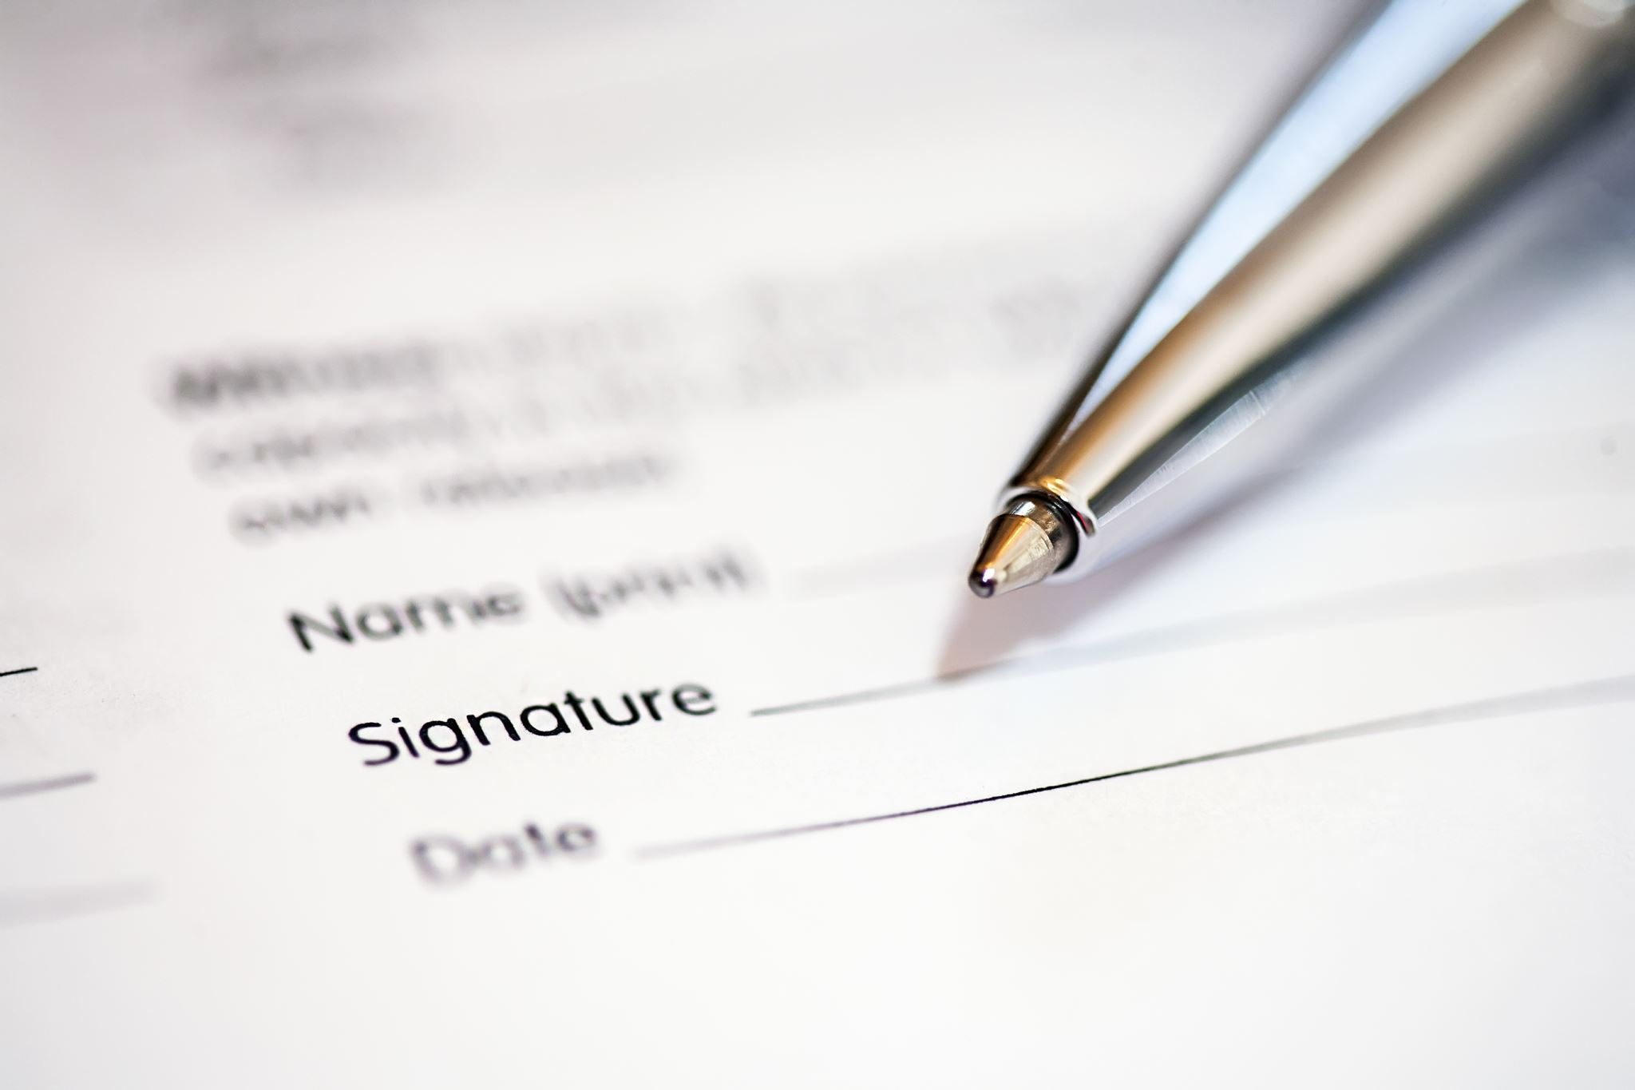
Requirements => User Stories
User Story | Student wants to access the GGC map
Priority 1 | User should visit the map site, enter his/her credentials, and will be able access the map
Estimates | Log in with credentials Validate log in Map access

Slide 6
Requirements => User Stories pt.2
User Story 2 | Faculty wants to know more information about the C Building
Priority 2 | User needs to log in with credential, access the map, click on the C building to access the information
Estimates | Log in with credentials Validate log in Map access Click on a location Access information on the particular location

Slide 7

Semester at a Glance
Mockup (UI & First Iteration):
Aug 22 – Sep 07
Functional (Connect DB & Services to UI):
Sep 08 – Oct 10
Final (Finalize Code & Testing):
Oct 10 – Nov 28
Reflect (Celebrate end of Project):
Nov 28 –

Slide 8
Code Architecture
Technologies for the web application:
React - Front-End
GitHub
Mongo
Node - Back-End
Passport
Google Map Api
Express

Slide 9
Diagram
Node
Passport
View
MongoDB

Slide 10
More about application
Platforms – PC and MACs on Web Browsers(Chrome, IE, Safari), Android & iOS
Language – HTML, CSS, JavaScript
Framework – Bootstrap, ASP.NET (Visual Studio Code)

Slide 11
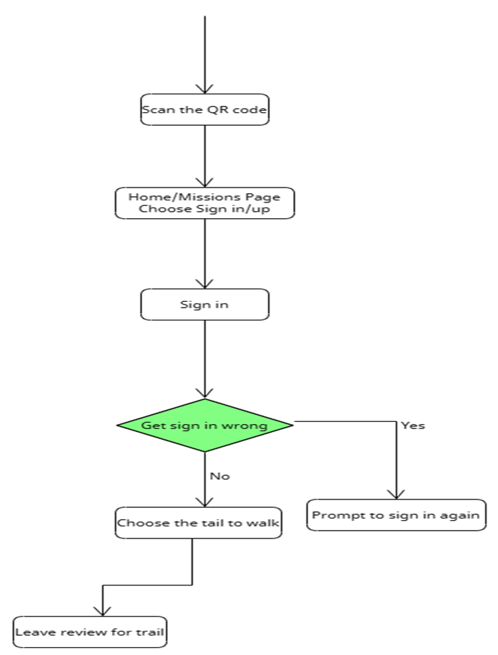
Activity Diagram

Slide 12
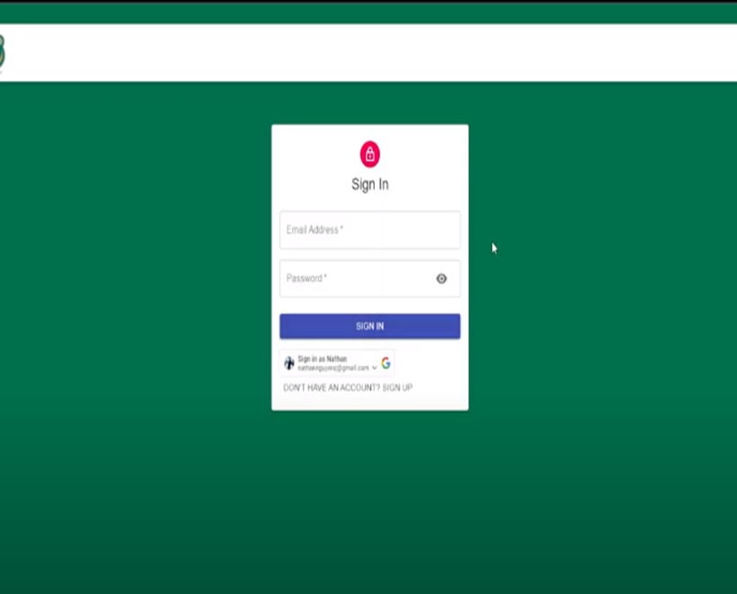
Sign In/Up

Slide 13
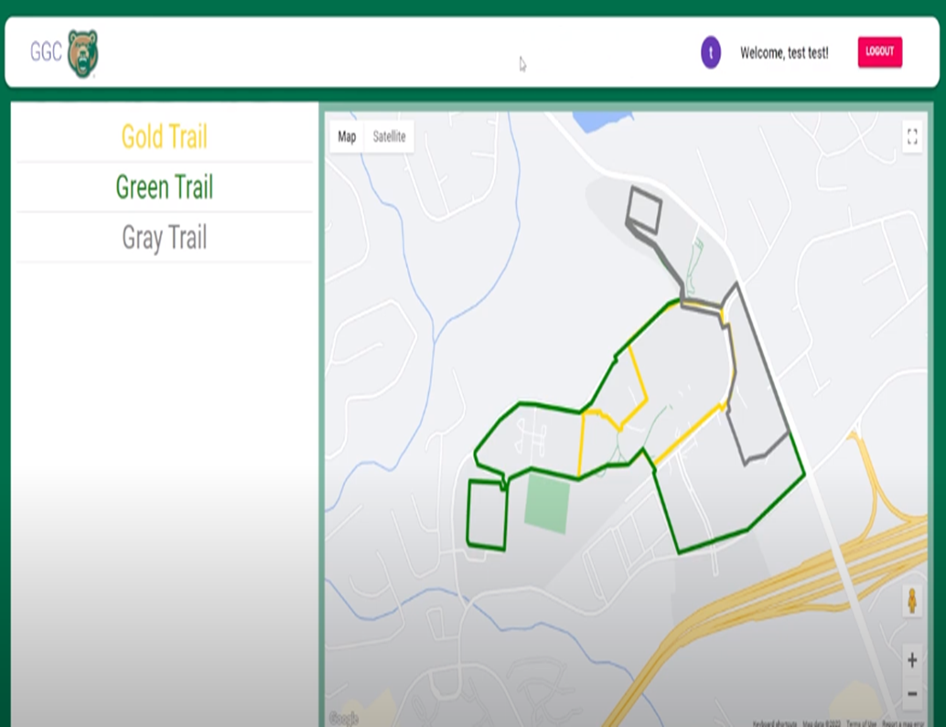
Trail Options For User

Slide 14
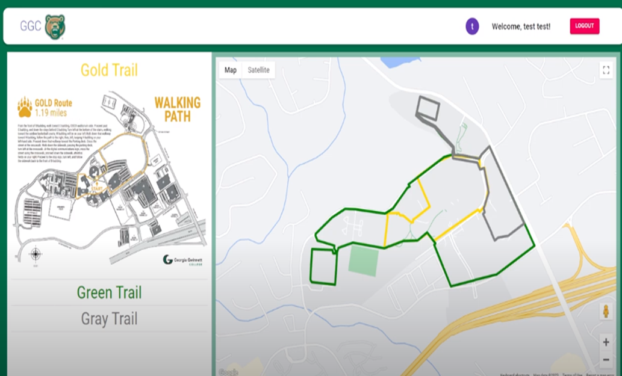
Map Details

Slide 15
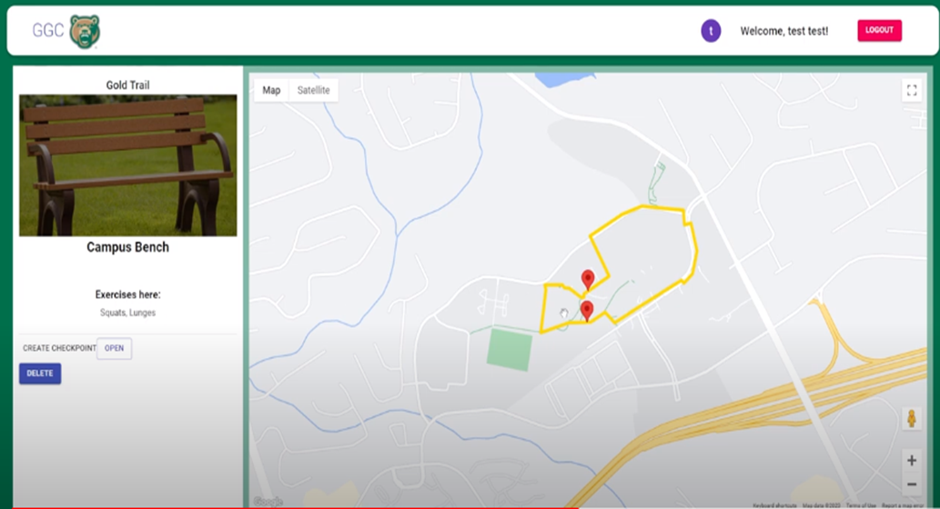
Exercises

Slide 16
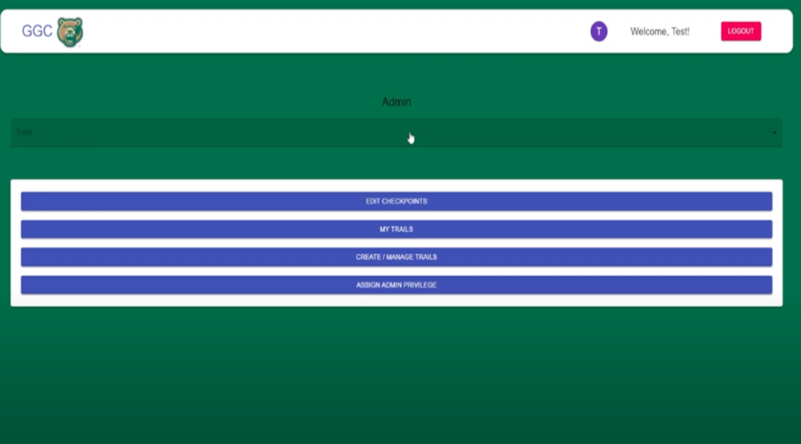
Admin Page

Slide 17

Future Direction
Add Videos
Create QR Codes
Update Homepage
Ratings for App

