Slide 1
Logo

Slide 2

Joel Fong

Slide 3
Version 1
< / >
Joel Fong

Slide 4
Favicon
< / >
< / >
Joel Fong

Slide 5
Version 2
< / >
Joel Fong

Slide 6
Carousel

Slide 7


Slide 8


Slide 9
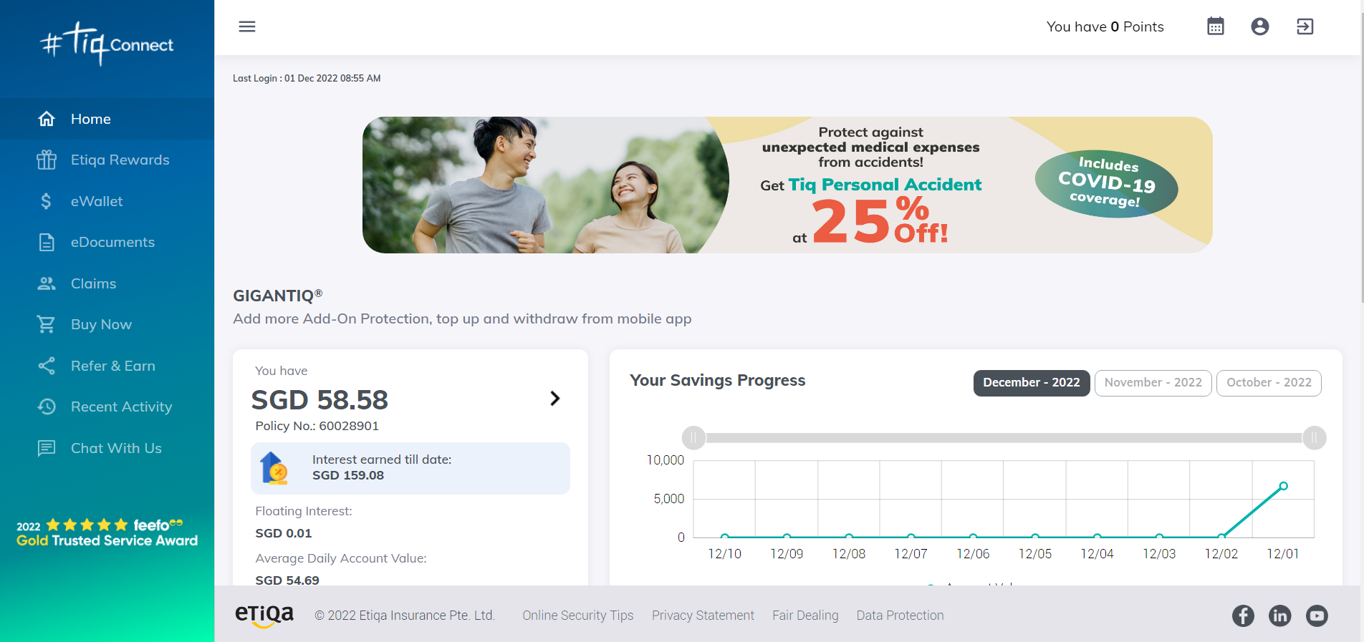

Slide 10
Look & Feel

Slide 11
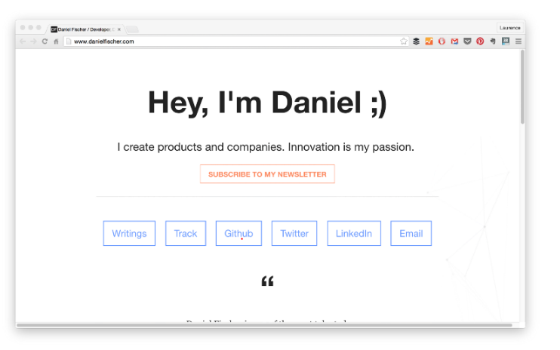

Slide 12
https://www.freecodecamp.org/news/15-web-developer-portfolios-to-inspire-you-137fb1743cae/
https://activetheory.net/home
https://mattfarley.ca/
https://www.danielfischer.com/
https://caferati.me/portfolio?ref=hackernoon.com
https://hackernoon.com/21-best-developer-portfolio-examples-p61j31wi
https://colorhunt.co/palette/00abb33c4048b2b2b2eaeaea

