Slide 1













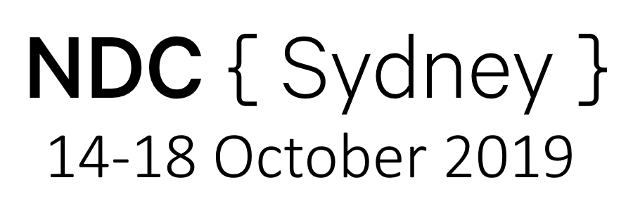

COFFEE BY
WIFI BY
CHILDCARE BY

Slide 2





 | joel@joelgallagher.com
 | @joelgall
 | linkedin.com/in/joelgallagher/
 | https://github.com/JoelGallagher/TimeTravelWithSqlServer

Slide 3
Time Travel with SQL Server
Joel Gallagher

Slide 4


Temporal Tables
Azure SQL
SQL Server 2016 +

Slide 5

What are Temporal Tables?

Slide 6

Temporal Tables != Temporary Tables

Slide 7
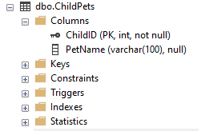
Standard Table
ChildPets
ChildID | PetName
1 | Max
2 | Fido

Slide 8
Temporal Tables
ChildPets
ChildID | PetName | From | To
1 | Max | 1/1/2019 | 31/12/9999
2 | Fido | 1/4/2019 | 31/12/9999

Slide 9
Temporal Tables
ChildPets
ChildPets_History
ChildID | PetName | From | To
1 | Max | 1/1/2019 | 31/12/9999
2 | Fido | 1/4/2019 | 31/12/9999
ChildID | PetName | From | To
1 | Buffy | 1/1/2010 | 1/1/2011
1 | Draco | 1/1/2011 | 1/6/2012
1 | Zack | 3/8/2015 | 12/7/2016
2 | Scruffy | 1/2/2013 | 3/9/2016
2 | Ruffy | 3/9/2016 | 1/4/2019
1 | Jackie | 12/7/2016 | 1/1/2019

Slide 10
Temporal Tables
ChildPets
ChildPets_History
ChildID | PetName | From | To
1 | Max | 1/1/2019 | 31/12/9999
2 | Fido | 1/4/2019 | 31/12/9999
ChildID | PetName | From | To
1 | Buffy | 1/1/2010 | 1/1/2011
1 | Draco | 1/1/2011 | 1/6/2012
1 | Zack | 3/8/2015 | 12/7/2016
2 | Scruffy | 1/2/2013 | 3/9/2016
2 | Ruffy | 3/9/2016 | 1/4/2019
1 | Jackie | 12/7/2016 | 1/1/2019

Slide 11
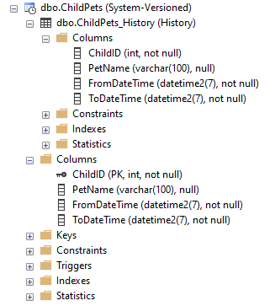
Temporal Tables
ChildPets
ChildPets_History
ChildID | PetName
1 | Max
2 | Fido
ChildID | PetsName | From | To
1 | Buffy | 1/1/2010 | 1/1/2011
1 | Draco | 1/1/2011 | 1/6/2012
1 | Zack | 3/8/2015 | 12/7/2016
2 | Scruffy | 1/2/2013 | 3/9/2016
2 | Ruffy | 3/9/2016 | 1/4/2019
1 | Jackie | 12/7/2016 | 1/1/2019

Slide 12
Why use Temporal Tables?

Slide 13

Why?
Standard Tables
Lose historical data
ChildID | PetName
1 | Max
2 | Fido

Slide 14
Why?
Standard Tables
Lose historical data
Accidental modifications (no rollback)
ChildID | PetName
1 | Max
2 | Fido

Slide 15
Why?
Standard Tables
Lose historical data
Accidental modifications (no rollback)
Hard to report Analytics & Insights
ChildID | PetName
1 | Max
2 | Fido

Slide 16
Why?
Temporal Tables
ChildID | PetName | From | To
1 | Max | 1/1/2019 | 31/12/9999
2 | Fido | 1/4/2019 | 31/12/9999
Point in Time query
ChildID | PetName | From | To
1 | Buffy | 1/1/2010 | 1/1/2011
1 | Draco | 1/1/2011 | 1/6/2012
1 | Zack | 3/8/2015 | 12/7/2016
2 | Scruffy | 1/2/2013 | 3/9/2016
2 | Ruffy | 3/9/2016 | 1/4/2019
1 | Jackie | 12/7/2016 | 1/1/2019

Slide 17
Why?
Temporal Tables
ChildID | PetName | From | To
1 | Max | 1/1/2019 | 31/12/9999
2 | Fido | 1/4/2019 | 31/12/9999
Point in Time query
Insights
ChildID | PetName | From | To
1 | Buffy | 1/1/2010 | 1/1/2011
1 | Draco | 1/1/2011 | 1/6/2012
1 | Zack | 3/8/2015 | 12/7/2016
2 | Scruffy | 1/2/2013 | 3/9/2016
2 | Ruffy | 3/9/2016 | 1/4/2019
1 | Jackie | 12/7/2016 | 1/1/2019

Slide 18
Why?
Temporal Tables
ChildID | PetName | From | To
1 | Max | 1/1/2019 | 31/12/9999
2 | Fido | 1/4/2019 | 31/12/9999
Point in Time query
Insights
Disaster Recovery
ChildID | PetName | From | To
1 | Buffy | 1/1/2010 | 1/1/2011
1 | Draco | 1/1/2011 | 1/6/2012
1 | Zack | 3/8/2015 | 12/7/2016
2 | Scruffy | 1/2/2013 | 3/9/2016
2 | Ruffy | 3/9/2016 | 1/4/2019
1 | Jackie | 12/7/2016 | 1/1/2019

Slide 19
Why?
Temporal Tables
ChildID | PetName | From | To
1 | Max | 1/1/2019 | 31/12/9999
2 | Fido | 1/4/2019 | 31/12/9999
Point in Time query
Insights
Disaster Recovery
Audit requirements
ChildID | PetName | From | To
1 | Buffy | 1/1/2010 | 1/1/2011
1 | Draco | 1/1/2011 | 1/6/2012
1 | Zack | 3/8/2015 | 12/7/2016
2 | Scruffy | 1/2/2013 | 3/9/2016
2 | Ruffy | 3/9/2016 | 1/4/2019
1 | Jackie | 12/7/2016 | 1/1/2019

Slide 20
How to use Temporal Tables?

Slide 21
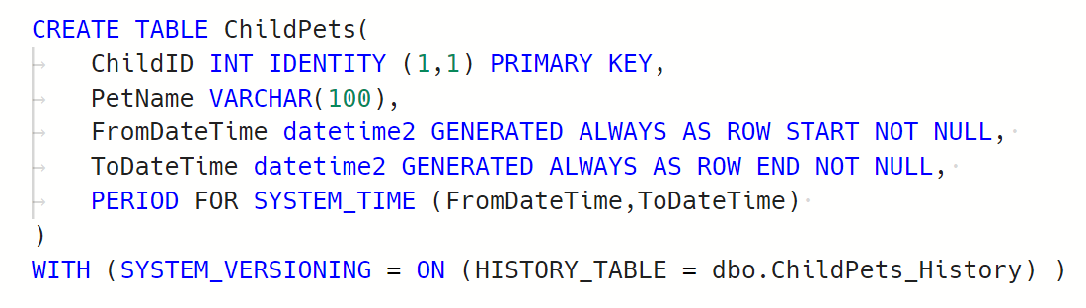
How?

Slide 22
How?

Slide 23
How?

Slide 24
When?
Notes:
Introduce HOS dataset, reasons for choosing,
UK US AUS

Slide 25
When?
Syntax | Description
ALL | Every Row in main & history
AS OF <dt> | Data at this exact point in time
FROM <dt> TO <dt> | Data active at ANY POINT within the date range. Excludes records starting on upper END date
BETWEEN <dt> AND <dt> | As with FROM, but includes records starting on upper END date.
CONTAINED IN (<dt>, <dt>) | All records that began and ended within the date range

Slide 26

When?
Temporal Insights

Slide 27
Where can I run Temporal Tables?
Notes:
2016, Azure
Introduce Travel dataset
Azure Stretch Hybrid

Slide 28


Where?

Slide 29
Where?
Azure Stretch
Travel
Travel History
Travel History
On Prem

Slide 30

CONSIDERATIONS

Slide 31
CONSIDERATIONS
Data Privacy

Slide 32
CONSIDERATIONS
Data Privacy
Joins between Temporal & Non-Temporal tables

Slide 33
CONSIDERATIONS
Data Privacy
Joins between Temporal & Non-Temporal tables
Azure Stretch reliant on network connectivity

Slide 34
CONSIDERATIONS
Tables with Binary, Text, Image will get BIG!

Slide 35
CONSIDERATIONS
Tables with Binary, Text, Image will get BIG!
No Checks, P|F keys on History table

Slide 36
CONSIDERATIONS
Tables with Binary, Text, Image will get BIG!
No Checks, P|F keys on History table
No Indexed Views using Temporal Tables

Slide 37
CONSIDERATIONS
Tables with Binary, Text, Image will get BIG!
No Checks, P|F keys on History table
No Indexed Views using Temporal Tables
https://docs.microsoft.com/en-us/sql/relational-databases/tables/temporal-table-considerations-and-limitations

Slide 38




Alternatives
Notes:
Oracle = FLASH QUERY Postgres = Extension required

Slide 39
SUMMARY
What
Where
When
How
Why
Who

Slide 40
SUMMARY
What
Temporal Table: A regular table with a corresponding _History table tracking all historic changes

Slide 41
SUMMARY
Why
Query data for given points in time
Analytics & Insights
Disaster Recovery
Audit requirements

Slide 42
SUMMARY
How
Add DateFrom / DateTo to main table.
Turn on SystemVersioning

Slide 43
SUMMARY
When
Syntax
ALL
AS OF <dt>
FROM <dt> TO <dt>
BETWEEN <dt> AND <dt>
CONTAINED IN (<dt>, <dt>)

Slide 44
SUMMARY
Where

Slide 45

SUMMARY
Who
 | joel@joelgallagher.com
 | @joelgall
 | linkedin.com/in/joelgallagher/
 | https://github.com/JoelGallagher/TimeTravelWithSqlServer

