Slide 1
Time Travel with SQL Server
Joel Gallagher

Slide 2





 | joel@joelgallagher.com
 | @joelgall
 | linkedin.com/in/joelgallagher/
 | https://github.com/JoelGallagher/TimeTravelWithSqlServer

Slide 3


Temporal Tables
Azure SQL
SQL Server 2016 +

Slide 4

What are Temporal Tables?

Slide 5

Temporal Tables != Temporary Tables

Slide 6
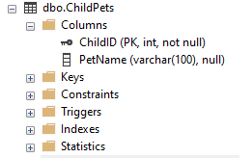
Standard Table
ChildPets
ChildID | PetName
1 | Max
2 | Fido

Slide 7
Temporal Tables
ChildPets
ChildPets_History
ChildID | PetName | From | To
1 | Max | 1/1/2019 | 31/12/9999
2 | Fido | 1/4/2019 | 31/12/9999
ChildID | PetName | From | To
1 | Buffy | 1/1/2010 | 1/1/2011
1 | Draco | 1/1/2011 | 1/6/2012
1 |  | 1/6/2012 | 3/8/2015
1 | Zack | 3/8/2015 | 12/7/2016
2 | Scruffy | 1/2/2013 | 3/9/2016
2 | Ruffy | 3/9/2016 | 1/4/2019
1 | Jackie | 12/7/2016 | 1/1/2019

Slide 8
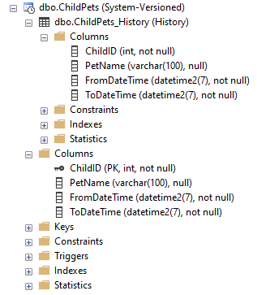
Temporal Tables
ChildPets
ChildPets_History
ChildID | PetName
1 | Max
2 | Fido
ChildID | PetsName | From | To
1 | Buffy | 1/1/2010 | 1/1/2011
1 | Draco | 1/1/2011 | 1/6/2012
1 |  | 1/6/2012 | 3/8/2015
1 | Zack | 3/8/2015 | 12/7/2016
2 | Scruffy | 1/2/2013 | 3/9/2016
2 | Ruffy | 3/9/2016 | 1/4/2019
1 | Jackie | 12/7/2016 | 1/1/2019

Slide 9
Why use Temporal Tables?

Slide 10

Why?
Standard Tables
Lose historical data
ChildID | PetName
1 | Max
2 | Fido

Slide 11
Why?
Standard Tables
Lose historical data
Accidental modifications (no rollback)
ChildID | PetName
1 | Max
2 | Fido

Slide 12
Why?
Standard Tables
Lose historical data
Accidental modifications (no rollback)
Hard to report Analytics & Insights
ChildID | PetName
1 | Max
2 | Fido

Slide 13
Why?
Temporal Tables
ChildID | PetName | From | To
1 | Max | 1/1/2019 | 31/12/9999
2 | Fido | 1/4/2019 | 31/12/9999
Point in Time query
ChildID | PetName | From | To
1 | Buffy | 1/1/2010 | 1/1/2011
1 | Draco | 1/1/2011 | 1/6/2012
1 |  | 1/6/2012 | 3/8/2015
1 | Zack | 3/8/2015 | 12/7/2016
2 | Scruffy | 1/2/2013 | 3/9/2016
2 | Ruffy | 3/9/2016 | 1/4/2019
1 | Jackie | 12/7/2016 | 1/1/2019

Slide 14
Why?
Temporal Tables
ChildID | PetName | From | To
1 | Max | 1/1/2019 | 31/12/9999
2 | Fido | 1/4/2019 | 31/12/9999
Point in Time query
Insights
ChildID | PetName | From | To
1 | Buffy | 1/1/2010 | 1/1/2011
1 | Draco | 1/1/2011 | 1/6/2012
1 |  | 1/6/2012 | 3/8/2015
1 | Zack | 3/8/2015 | 12/7/2016
2 | Scruffy | 1/2/2013 | 3/9/2016
2 | Ruffy | 3/9/2016 | 1/4/2019
1 | Jackie | 12/7/2016 | 1/1/2019

Slide 15
Why?
Temporal Tables
ChildID | PetName | From | To
1 | Max | 1/1/2019 | 31/12/9999
2 | Fido | 1/4/2019 | 31/12/9999
Point in Time query
Insights
Disaster Recovery
ChildID | PetName | From | To
1 | Buffy | 1/1/2010 | 1/1/2011
1 | Draco | 1/1/2011 | 1/6/2012
1 |  | 1/6/2012 | 3/8/2015
1 | Zack | 3/8/2015 | 12/7/2016
2 | Scruffy | 1/2/2013 | 3/9/2016
2 | Ruffy | 3/9/2016 | 1/4/2019
1 | Jackie | 12/7/2016 | 1/1/2019

Slide 16
Why?
Temporal Tables
ChildID | PetName | From | To
1 | Max | 1/1/2019 | 31/12/9999
2 | Fido | 1/4/2019 | 31/12/9999
Point in Time query
Insights
Disaster Recovery
Audit requirements
ChildID | PetName | From | To
1 | Buffy | 1/1/2010 | 1/1/2011
1 | Draco | 1/1/2011 | 1/6/2012
1 |  | 1/6/2012 | 3/8/2015
1 | Zack | 3/8/2015 | 12/7/2016
2 | Scruffy | 1/2/2013 | 3/9/2016
2 | Ruffy | 3/9/2016 | 1/4/2019
1 | Jackie | 12/7/2016 | 1/1/2019

Slide 17
How to use Temporal Tables?

Slide 18
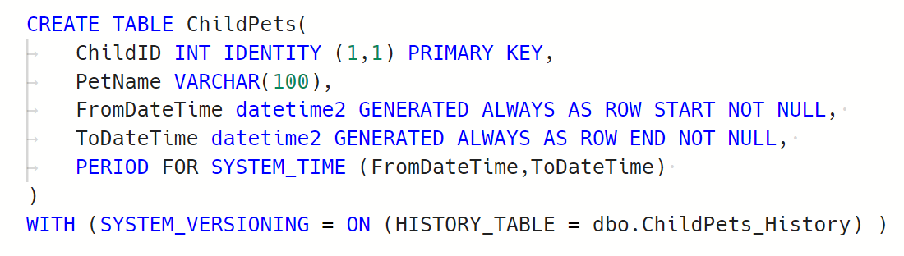
How?

Slide 19
How?

Slide 20
How?

Slide 21

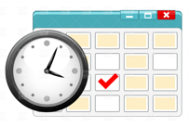


How?
Main
Main
History

Slide 22
When?

Slide 23
When?
Syntax | Description
ALL | Every Row in history
AS OF <dt> | Data at this exact point in time
FROM <dt> TO <dt> | Data active at ANY POINT within the date range. Excludes extremes
BETWEEN <dt> AND <dt> | As with FROM, but includes records starting on upper END date.
CONTAINED IN (<dt>, <dt>) | All records that began and ended within the date range

Slide 24
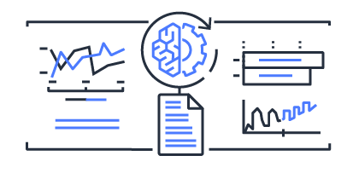
When?
Temporal Insights

Slide 25
Where can I run Temporal Tables?

Slide 26


Where?

Slide 27
Where?
Azure Stretch
Travel
Travel History
Travel History
On Prem

Slide 28

CONSIDERATIONS
Data Privacy

Slide 29
CONSIDERATIONS
Data Privacy
Joins between Temporal & Non-Temporal tables

Slide 30
CONSIDERATIONS
Data Privacy
Joins between Temporal & Non-Temporal tables
Azure Stretch reliant on network connectivity

Slide 31
CONSIDERATIONS
Tables with Binary, Text, Image will get BIG!

Slide 32
CONSIDERATIONS
Tables with Binary, Text, Image will get BIG!
No Checks, P|F keys on History table

Slide 33
CONSIDERATIONS
Tables with Binary, Text, Image will get BIG!
No Checks, P|F keys on History table
No Indexed Views using Temporal Tables

Slide 34
CONSIDERATIONS
Tables with Binary, Text, Image will get BIG!
No Checks, P|F keys on History table
No Indexed Views using Temporal Tables
https://docs.microsoft.com/en-us/sql/relational-databases/tables/temporal-table-considerations-and-limitations

Slide 35




Alternatives

Slide 36
SUMMARY
What
Where
When
How
Why
Who

Slide 37
SUMMARY
What
Temporal Table: A regular table with a corresponding _History table tracking all historic changes

Slide 38
SUMMARY
Why
Query data for given points in time
Analytics & Insights
Disaster Recovery
Audit requirements

Slide 39
SUMMARY
How
Add DateFrom / DateTo to main table.
Turn on SystemVersioning

Slide 40
SUMMARY
When
Syntax
ALL
AS OF <dt>
FROM <dt> TO <dt>
BETWEEN <dt> AND <dt>
CONTAINED IN (<dt>, <dt>)

Slide 41
SUMMARY
Where

Slide 42

SUMMARY
Who
 | joel@joelgallagher.com
 | @joelgall
 | linkedin.com/in/joelgallagher/
 | https://github.com/JoelGallagher/TimeTravelWithSqlServer

Slide 43

Questions

