Slide 1

Cody Curtis, Bailey Malone, Joel Hough,
James Murdock, John Wells
Team Exception:

Slide 2
The Future:
Revolutionary technique for player interactions
State-of-the-art network communications
Immersive, ever-expanding world

Slide 3
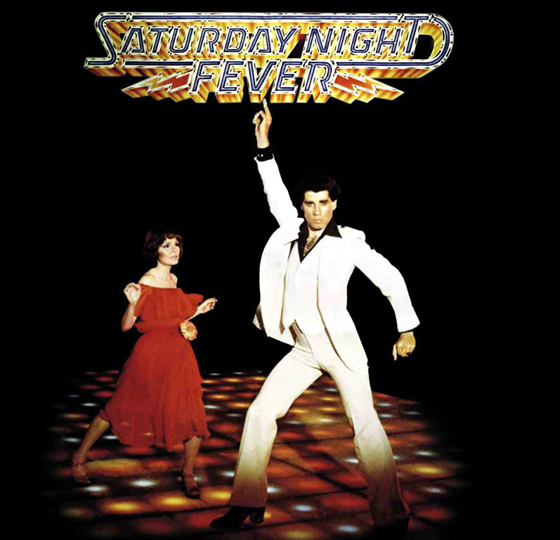
…If it were 1970

Slide 4
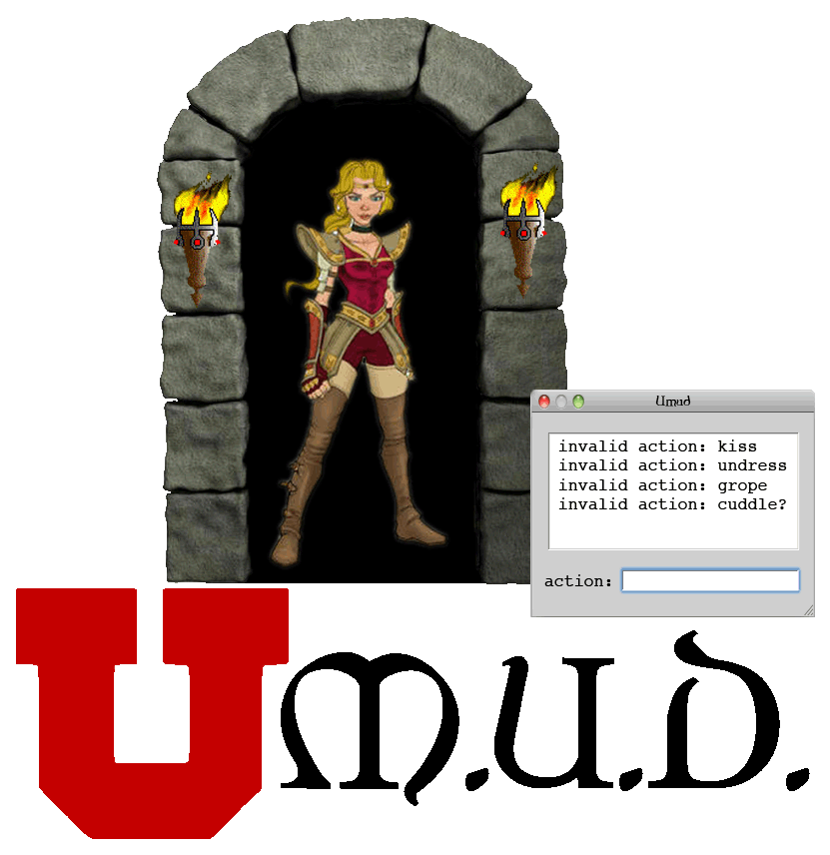
Team Exception

Slide 5
uMUD - Overview
Lua concepts and philosophy
Network interface
Game design
Fever dreams and Parsing

Slide 6
Lua – Concepts
What is Lua?
Why use Lua?
  Lightweight and Fast
  Hot patching
  Extensible
  It’s not C

Slide 7
Network Interface
C++ Async POSIX sockets (OG)
Single-threaded
User authentication - SQLite
Source control – Git
  Live Hotfixes
Notes:
Enter Bailey

Slide 8
uMUD Bot
One-to-many async socket proxy
Embedded into IRC
Allows access to uMUD from anywhere
Notes:
Connects to IRC with one socket, routes to several sockets depending on which user talks to it.

Slide 9
Pure Creation
Philosophy
Designer-friendly ‘World’ format
Dynamic additions to uMUD
Automatic association
Notes:
When we decided to do a MUD, it evolved from this concept of a single game hosted on a server to an idea of an extensible platform for any MUD.
Taking this idea, we decided to implement a world building function. The World Builder is the realization of this concept. Using a set of Lua functions, a designer can create a Lua-friendly table file and place all of the desired game elements into that file.
The world builder reads through this, and creates things and their associations based on how these tables are nested.
Associations in uMUD are extremely diverse, but the simplest example would be the ability to place a particular instance of an item into a room or other container.
The flexibility of Lua allows all of this to be done during runtime, so if a MUDerator implements a new list of features in the game, the players in the game won’t experience any downtime.

Slide 10
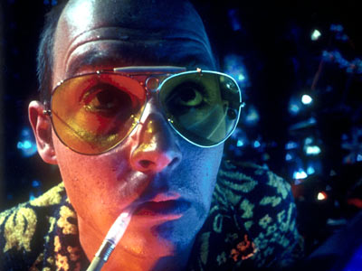
Bartle’s Fever Dream
The first MUD – 1978
Richard Bartle – Co-Creator
  His idea
  ‘Atom’ concept
  Hierarchies

Slide 11
Binding and Parsing
Binders and Parsers and the wonders that ensue.

Slide 12
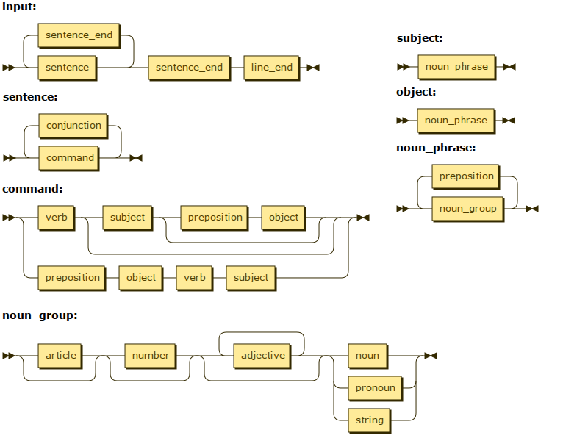

Slide 13
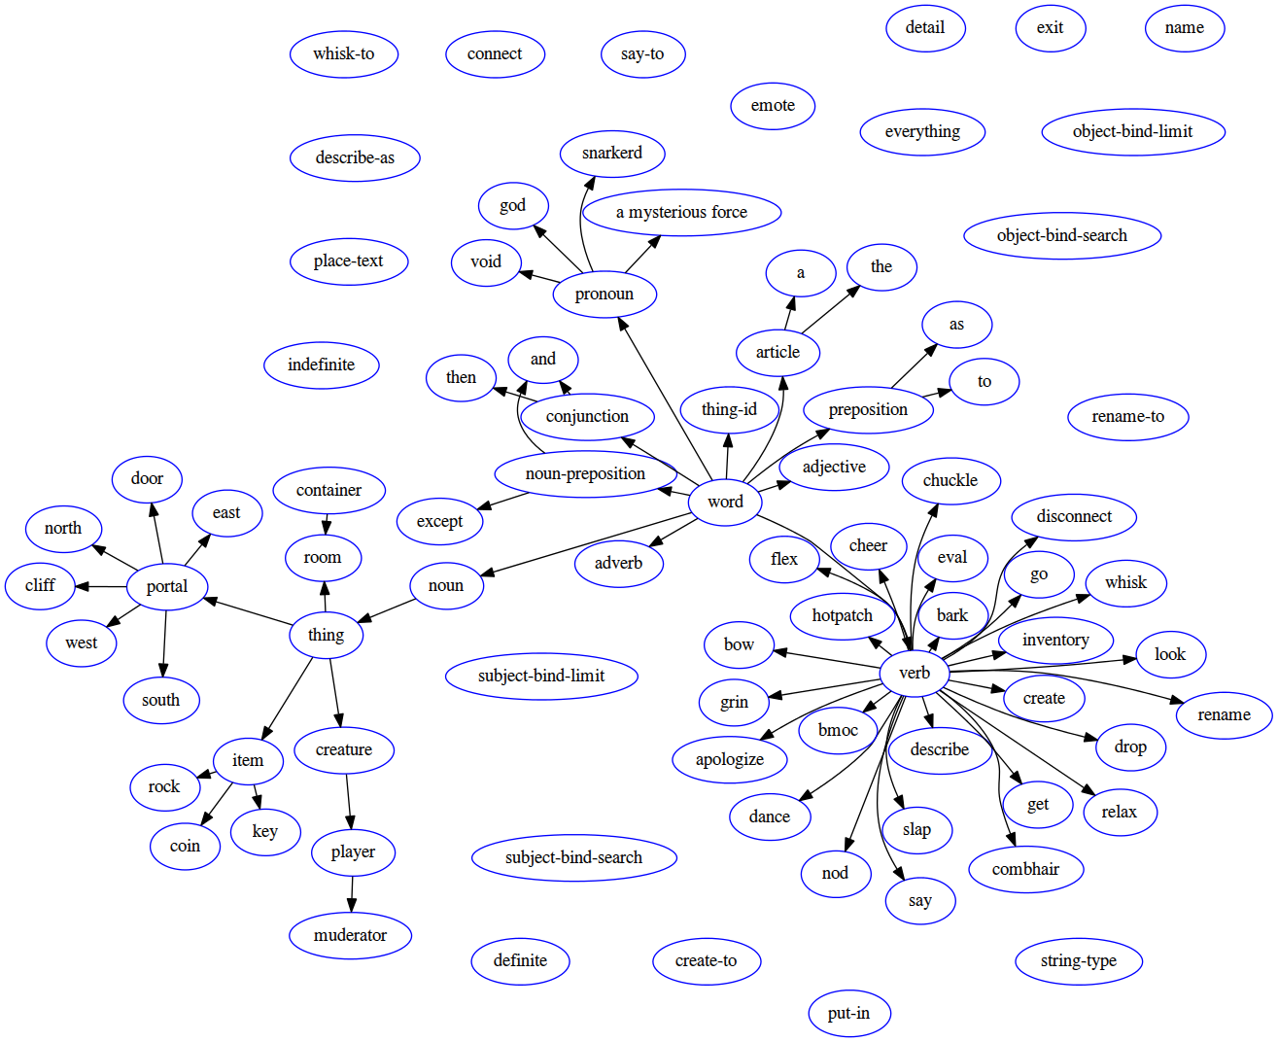

Slide 14
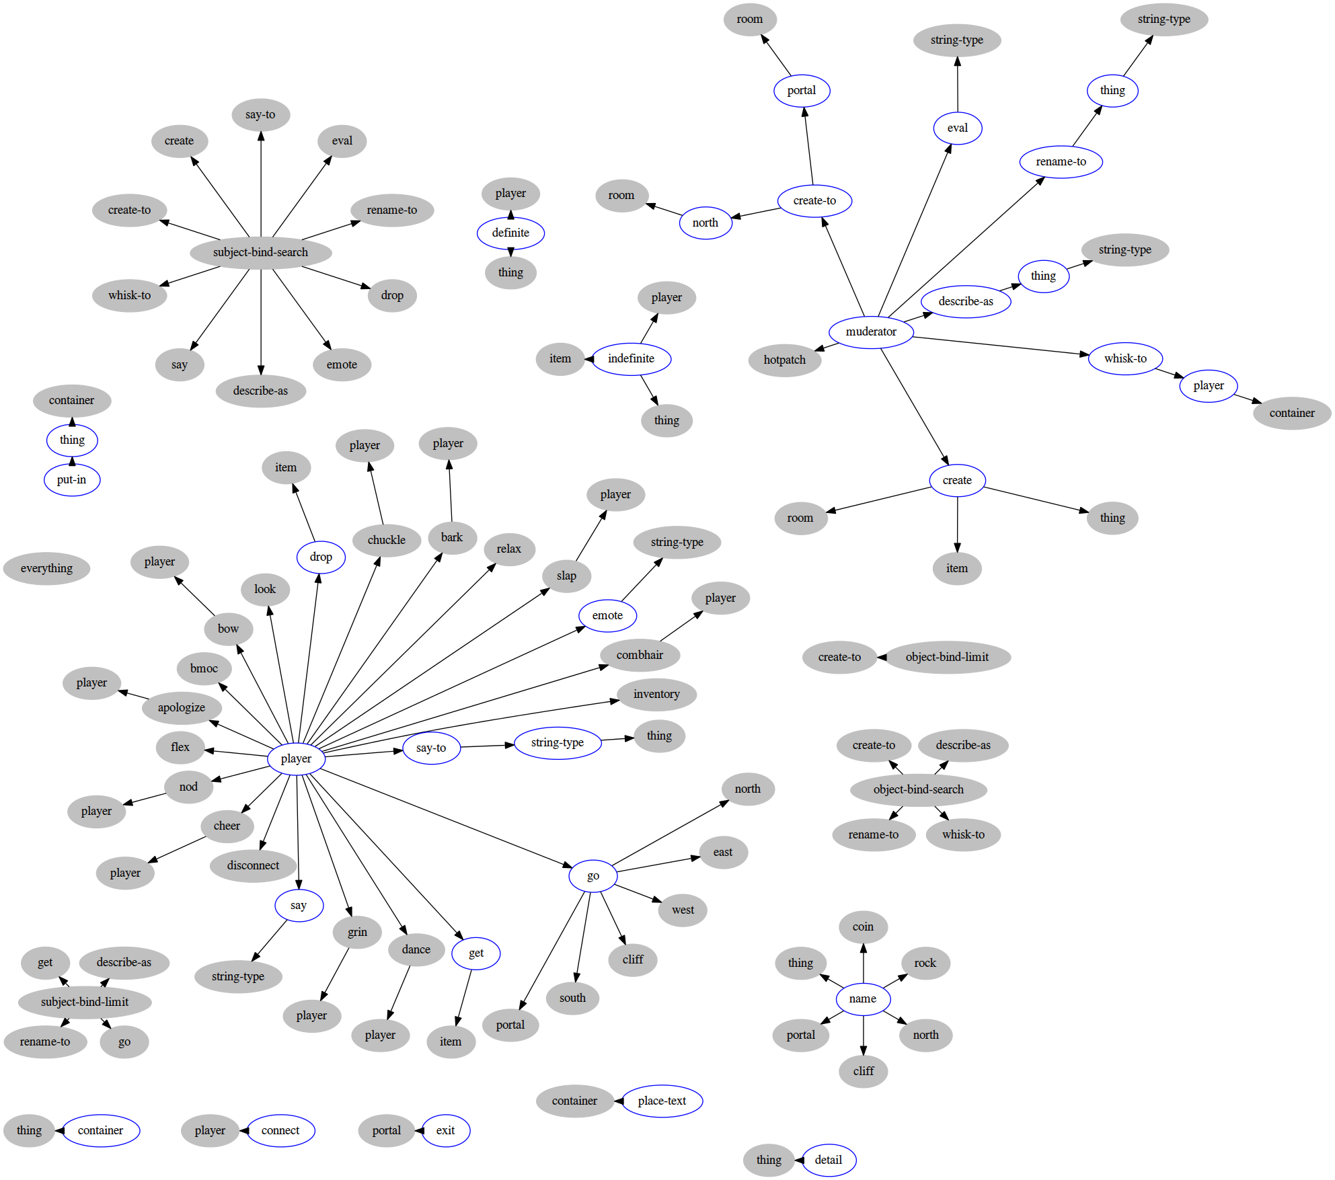

Slide 15
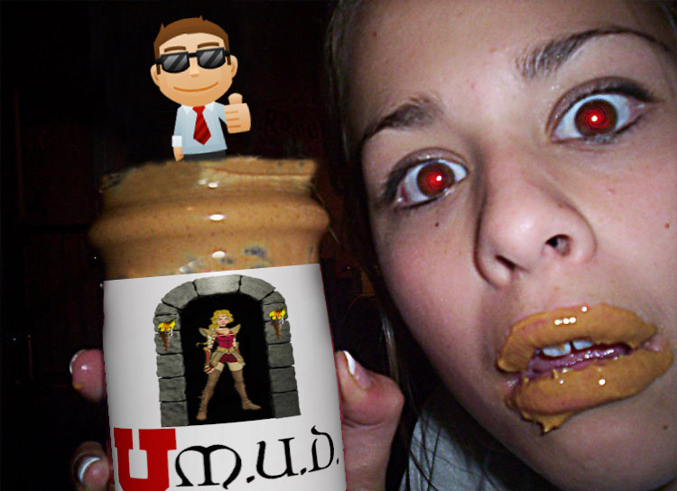
Questions?

