Slide 1

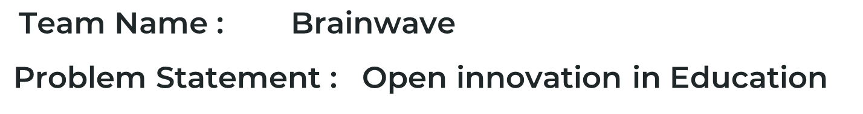

Slide 2
A FRESH APPROACH TO THE CONCEPT
A NEUROLOGICAL CONDITION CALLED DYSLEXIA IMPAIRS A PERSON'S CAPACITY FOR READING, WRITING, AND SPELLING. IT AFFECTS HOW THE BRAIN INTERPRETS LANGUAGE, MAKING IT CHALLENGING FOR THOSE WITH DYSLEXIA TO UNDERSTAND
WRITTEN CONTENT. BETWEEN 5% AND 20% OF INDIANS SUFFER WITH DYSLEXIA, WITH URBAN REGIONS HAVING A HIGHER PREVALENCE OF THE CONDITION. THIS INDICATES THAT MILLIONS OF INDIAN SCHOOL CHILDREN EXPERIENCE READING AND COMPREHENSION PROBLEMS AS A RESULT OF THIS DISORDER. THE CREATION OF SOLUTIONS LIKE OUR PRODUCT DYSLEXIFY, A MACHINE LEARNING INITIATIVE INTENDED TO HELP PEOPLE WITH DYSLEXIA IMPROVE THEIR READING AND COMPREHENSION SKILLS, HAS BEEN MADE POSSIBLE BY TECHNOLOGICAL DEVELOPMENTS USING INTEL’S ONEAPI.

Slide 3
WHAT WE OFFER
FEATURES WE OFFER SUCH AS
3D MODEL WITH AR INTERFACE USING ONEAPI RENDERING TOOLKIT
IMAGE TO SPEECH RECOGNITION, TEXT TO SPEECH RECOGNITION, USING SYCL
ML DRIVEN SUGGESTION OF BOOKS ,USING DAAL4PY
AI POWERED DOCUMENT ASSISTANT,USING GPU STRENGTH
THROUGH THE USE OF 3D MODELS ALONG WITH AUGMENTED REALITY, EDUCATIONAL INSTITUTIONS CAN PROVIDE STUDENTS WITH AN INTERACTIVE LEARNING EXPERIENCE.. DYSLEXIFY HAS THE POTENTIAL TO SIGNIFICANTLY IMPROVE THE LIVES OF STUDENTS IN INDIA AND AROUND THE WORLD AND WILL HAVE A MAJOR IMPACT IN EDUCATION SECTOR .

Slide 4
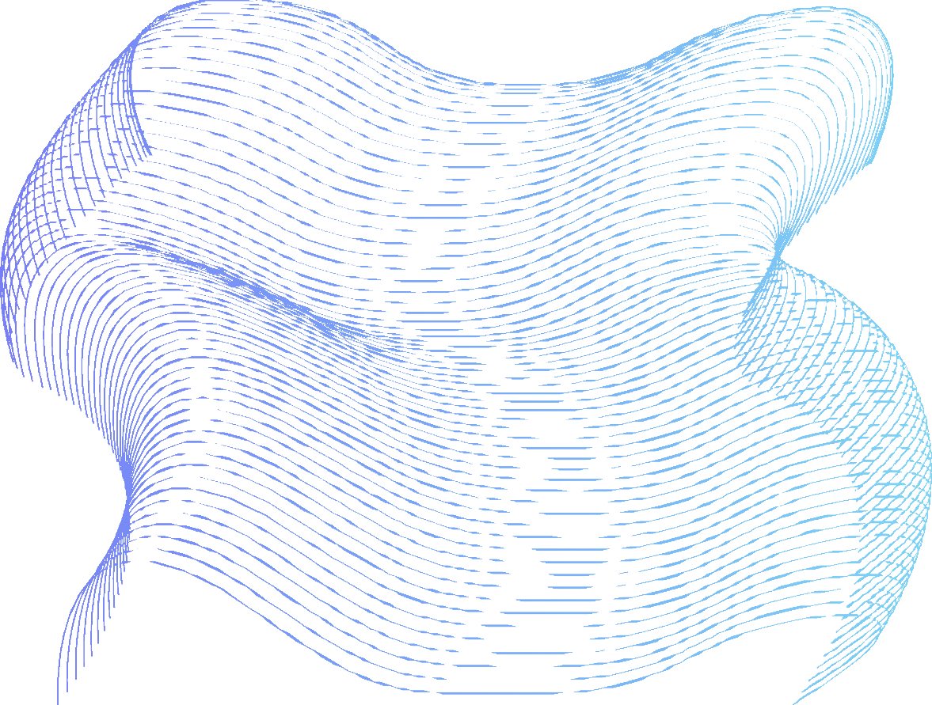
ADD ON FEATURES
SOME INTERESTING FEATURES
Javascript extention:Which have the features such as dyslexic font,reading ruler,spacing adjust,line height adjust.
Reading Tools:Provides with stories and rhymes,podacst and much more.
Lexi Virtual Assistant :Interactive virtual assistant for our webpage

Slide 5





3D MODEL WITH AR INTERFACE
Bringing 3D models into the learning process and utilizing an augmented reality interface, students can visualize complex concepts, objects, in a more interactive and engaging manner. This technology enables students to manipulate and explore virtual objects, enhancing their understanding and retention of the subject matter.
How we did!
The oneAPI Rendering Toolkit is used to create 3D models,
which are then hosted on a WebAR platform for easy accessibility.
The models are converted into the glTF format and uploaded to the chosen platform.
Users can view and interact with the models through web browsers on
various devices, without the need for specialized applications or high-end hardware.
This combination of powerful rendering tools powered by intel oneAPI
and WebAR technology provides a seamless experience for individuals to explore and engage with captivating in augmented reality.

Slide 6



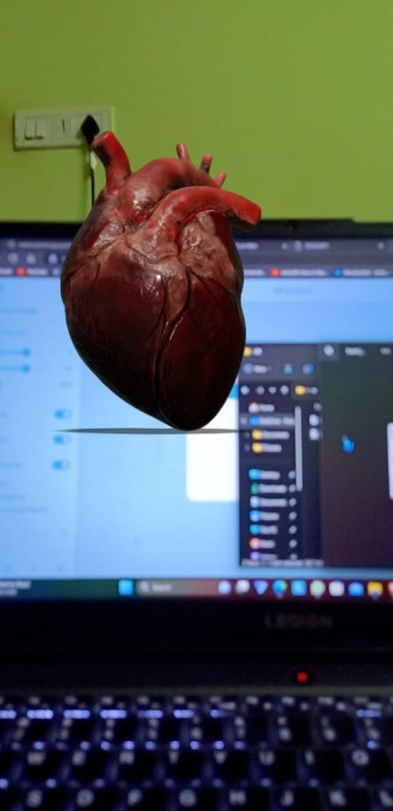
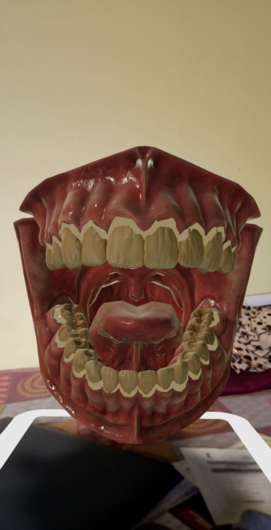
3D MODEL WITH AR INTERFACE

Slide 7

IMAGE TO TEXT TO SPEECH RECOGNITION
This feature enables students to capture images of text, such as medical prescription or text on whiteboards, and convert them into speech. It can assist students with visual impairments or those who prefer auditory learning, making educational content more accessible.
How we did!
Create SYCL kernels using the DPC++ programming model provided by the Intel oneAPI Toolkit.
Compile the SYCL DPC++ code using the DPC++ compiler provided by the Intel oneAPI Toolkit.
Use ctypes to create a Python wrapper for the compiled C++ code.
Import the Python wrapper into your Flask application.
Use the wrapper to call the SYCL DPC++ functions for image processing and speech conversion.

Slide 8

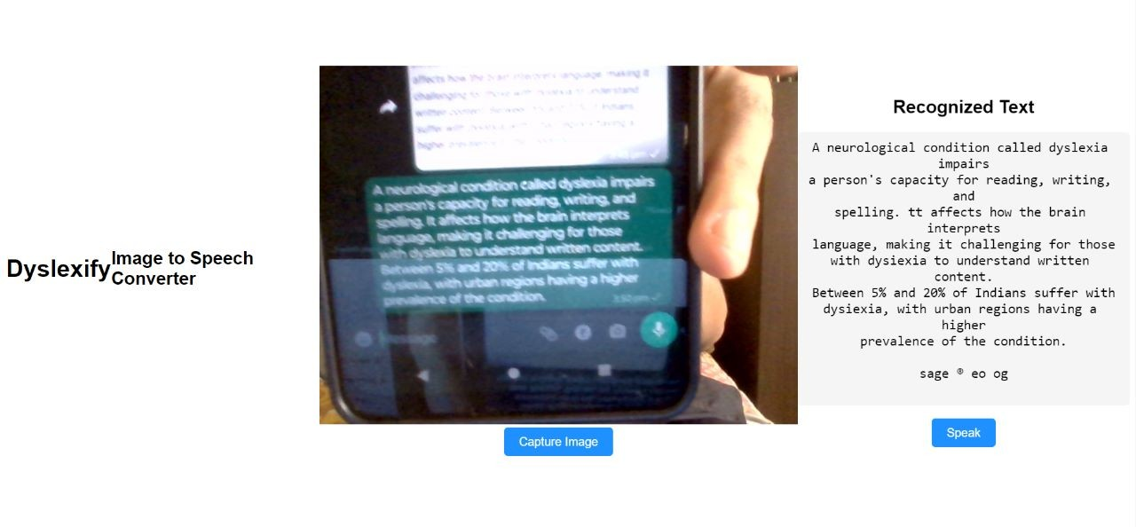
IMAGE TO TEXT TO SPEECH RECOGNITION

Slide 9

ML DRIVEN SUGGESTION OF BOOKS
With This feature , you can bid farewell to the overwhelming task of choosing your next read.
The system analyzes your reading history, genre preferences, favorite authors,
you will be able to choose what to read next by selecting the book which you already selected. It shows similar kind of suggestions.
How we did!
The daal4py is used here.The main purpose of using daal4py in the project is to leverage the optimized implementations of algorithms provided by oneDAL.
The oneAPI Data Analytics Library (oneDAL) and its Python wrapper, daal4py, are used for computing cosine similarity between vectors.

Slide 10


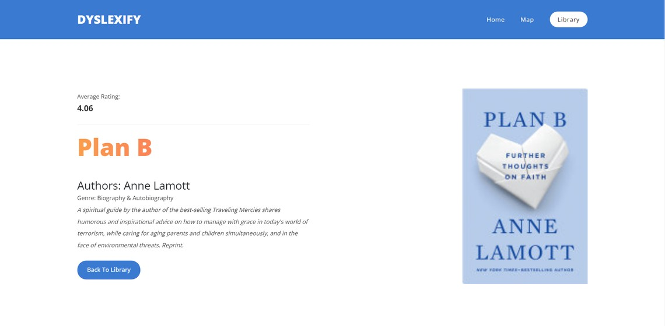
ML DRIVEN SUGGESTION OF BOOKS

Slide 11
AI POWERED DOCUMENT ASSISTANT
This is feature advanced AI-powered document assistant that revolutionizes the way you search and extract information from PDFs. It eliminates the need for manual searching and scrolling through lengthy documents by leveraging the power of GPT-3.5 and Intel oneApi. With PDFGPT, you can effortlessly ask questions and receive instant answers, allowing for efficient and hassle-free document exploration.
How we did!
Imports the SYCL context from the daal4py.onea pi module
.This module provides SYCL functionality for GPU acceleration.
This flexibility allows you to take advantage of the specific strengths of GPUs while maintaining portability across different hardware architectures.
It is a game-changing tool for researchers, students, and professionals, providing a seamless and effective solution for working with PDF documents.

Slide 12
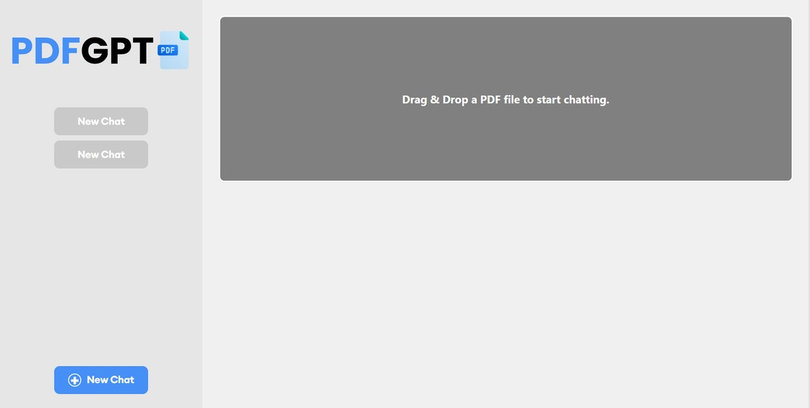
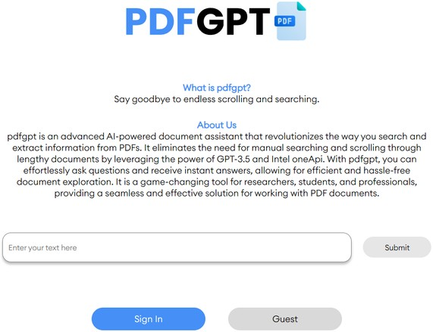
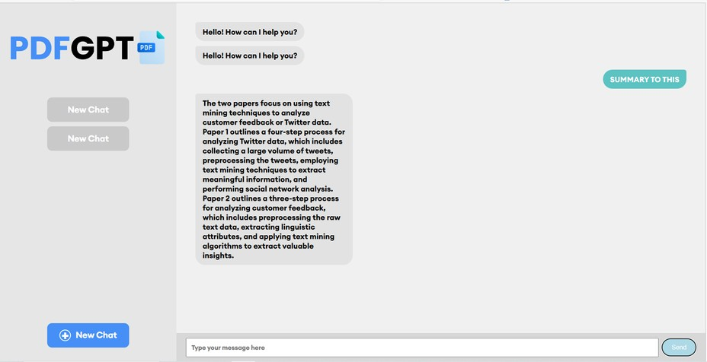
AI POWERED DOCUMENT ASSISTANT

Slide 13
LIST OF ONEAPI TOOLS/LIBRARIES USED
INTEL DATA ANALYTICS ACCELERATION LIBRARY (DAAL)
INTEL 3D RENDERING TOOLKIT
Intel OSPray
Intel OSPray studio
ONEAPI DPC++/SYCL

Slide 14
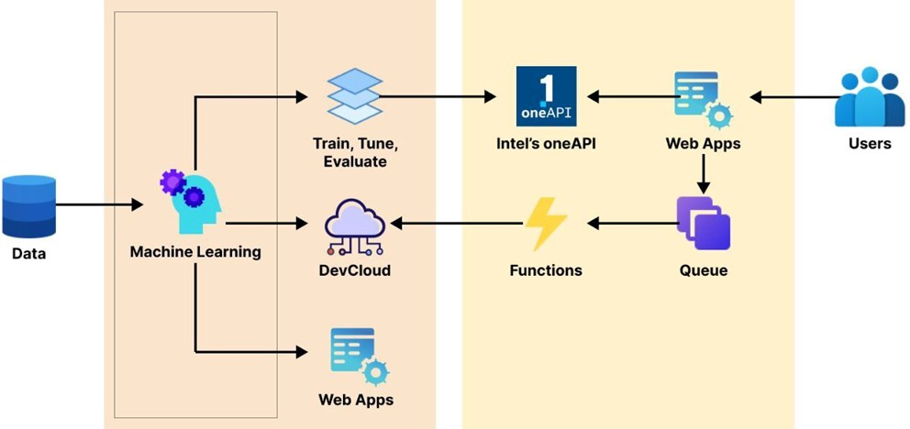
ARCHITECTURAL DIAGRAM

Slide 15
TECHNOLOGIES USED
Machine Learning and AI: Dyslexify uses machine learning and AI technologies such as to develop its features, such as image to speech recognition, text to speech recognition, personalized reading experience.
Intel oneApi Libraries: Intel Data Analytics Acceleration Library (DAAL),oneAPI DPC++/SYCL
Cloud Service :Intel devcloud,Render,WebAR,Pythonanywhere. Framework: Flask, React
Programming Languages: Python,Javascript
APIs and Integrations: OpenAI, GPT 3.5
3D Modeling :Unity ,Blender,Intel OSPray/OSPray Studio

Slide 16






ESTIMATED COST OF/AFTER IMPLEMENTING THE SOLUTION
Dyslexify's low-scale implementation may cost between 20,000 to 1 lakh INR for development and a few thousand to a few tens of thousands of Indian Rupees per month for operation. For a large- scale implementation, the development cost can range from Rs. 3 lakhs to 10 lakhs, and the operating cost can be several lakhs of Indian Rupees per month, depending on various factors.

Slide 17
THANK YOU
17

