Slide 1

THE EFFECTS OF WEATHER AND TIME ON TRAFFIC ACCIDENTS
Joel Meinhardt, Mike Terkhorn,
Brad Vawter and Cindy Ford

Slide 2
Motivation and Summary

Slide 3
Hypothesis and Questions
HYPOTHESES:
Inclement weather increases traffic accidents
Accident rates are higher at certain times of the day (i.e. Rush Hour)
QUESTIONS:
What is the correlation between weather conditions and traffic accidents in Indiana?
What time of day do most accidents occur?
What weather conditions affect severity of accidents?
Where do most accidents occur within a geographical area?
Why:
To demonstrate the most dangerous areas, what time of day is the most likely to have an accident and if weather conditions contributed significantly to the number of accidents or the severity.

Slide 4
Summary
Summary:
We were able to answer the majority of the questions, however we did not find 2020 data.
What is the correlation between weather conditions and traffic accidents in Indiana?
There were fewer accidents recorded during inclement weather conditions vs. the fair weather conditions (cloudy being the highest rate of accidents)
What time of day do most accidents occur?
The highest incidents of traffic accidents in IN was during the morning rush hour (7am-9am) and then there was a significant decrease after 9am.
Do weather conditions have an effect on the number or severity of accidents?
Weather did not have an impact on the number of accidents, but did have an impact on the severity of the accidents, with snow having the highest average severity
Where do most accidents occur within a geographical area?
Within IN the accidents occurred most frequently along major highways and interstates
Nationally, 8 of the top twenty counties with the highest incidents of accidents per population were in South Carolina

Slide 5
Questions and Data
We were able to find a dataset that contained accidents, severity, weather, latitude, longitude, city, state and multiple other data points for accidents across the country from 2016 to 2019.
https://www.kaggle.com/sobhanmoosavi/us-accidents
Utilized census data to normalize the accidents to geographic areas by population
https://www.census.gov/data/datasets/2010/dec/rdo/section-203-determination-pums.html

Slide 6
Exploration and Cleanup

Slide 7
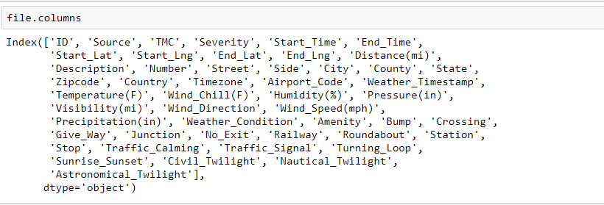
Data Cleanup and Exploration
Exploration
Searched for a dataset that had sufficient data, various measurable factors, and was recent. Ideally, we would have wanted to see 2020 data; however it wasn’t available
The dataset used had ~3M lines and ~50 columns
Expecting to see a larger impact of weather on accidents, but discovered that the most incidents occurred during fairer weather
Expected to be able to locate more free APIs surrounding historical traffic data and weather
Originally, we would have liked to see how the stay-at-home order was effecting current traffic data; however 2020 data was not available, so we had to modify our questions

Slide 8
Data Cleanup and Exploration (cont.)
Data Cleanup
Many of the columns in the dataset were unrelated to the questions, so those columns had to be removed to better view the data
There was approximately 3M lines of data. Initially we narrowed it down to just the data from IN.
We encountered a problem with the weather descriptions not being standardized.
For example, there were conditions such as “Thunderstorms” and “T-Storms” and “Thunder” that were all combined under one condition.
We had around 50 types and consolidated to 8 types by using .map
Census data changed from state name to state abbreviation using a dictionary in order to make the datasets consistent

Slide 9
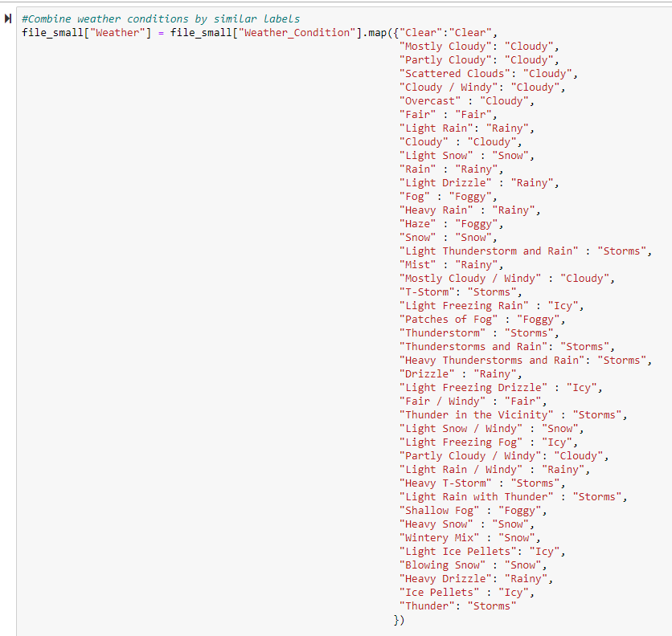

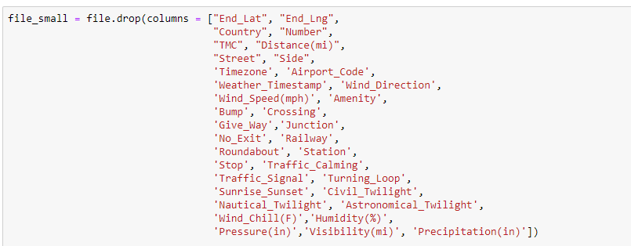
Cleanup Code
Weather Condition Mapping
Renaming a column to be consistent across data sets
Dropping columns to make the data more readable
Notes:
Mapping the state names to the state abbreviations

Slide 10
Data Analysis

Slide 11
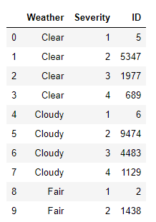
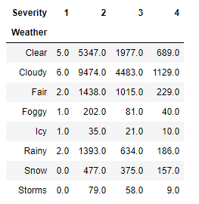
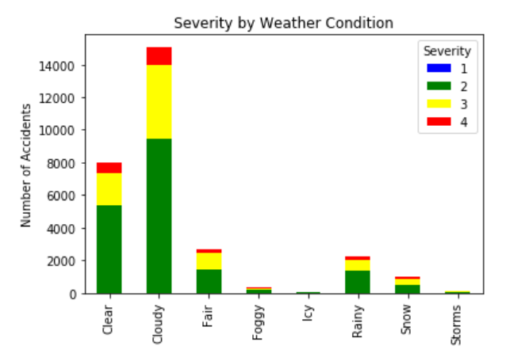

Severity by Weather Condition
Notes:
In order to easily create the stacked bar graph I wanted have one row for each level of severity and a count of accidents by weather condition and severity. I was able to accomplish this by using .pivot on the weather condition giving me a count by weather condition and severity that I could then chart.

Slide 12
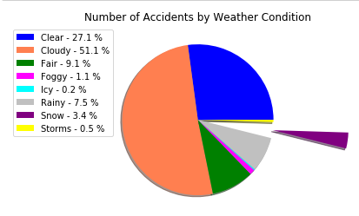
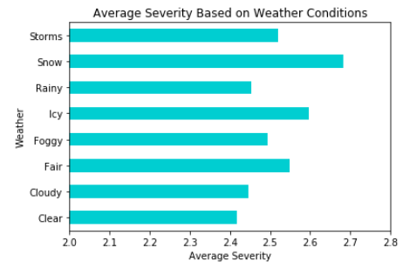
Correlation between weather conditions and traffic accidents in Indiana
Notes:
Steps to analyze the data Pie chart
Reduce the number of weather conditions from 51 to 8 by combining similar conditions
Perform a “groupby” on the weather condition and do a count
Plot the results using Pandas/Matplotlib
Since some of the sections were very small in order to keep the labels from overlapping I chose to include them in the legend instead of on the graph
Steps to analyze BARH
Did a gb Weather then took the average severity
As you can see snow contributed to the most severe accidents, however it was only 3.4% of the total accidents
Severity Shows the severity of the accident, a number between 1 and 4, where 1 indicates the least impact on traffic (i.e., short delay as a result of the accident) and 4 indicates a significant impact on traffic (i.e., long delay).

Slide 13
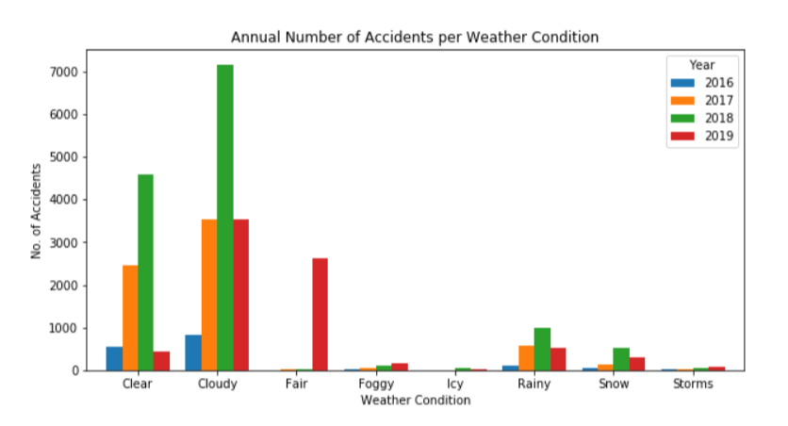
Data Analysis

Slide 14
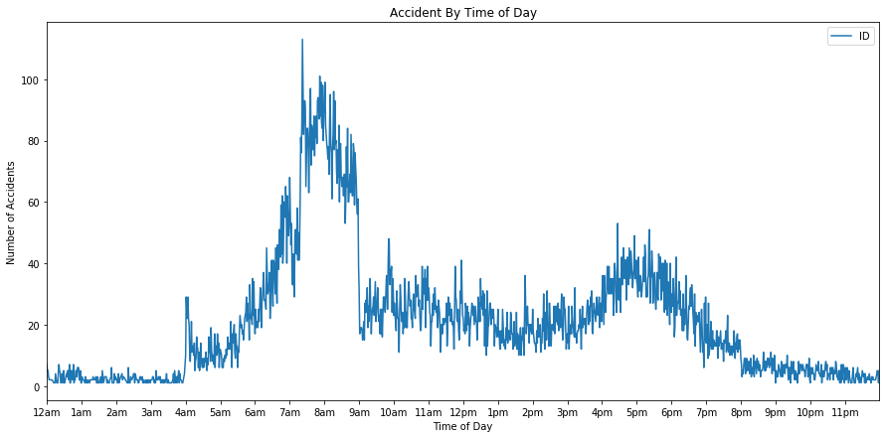
Data Analysis What time of day do most accidents occur?

Slide 15
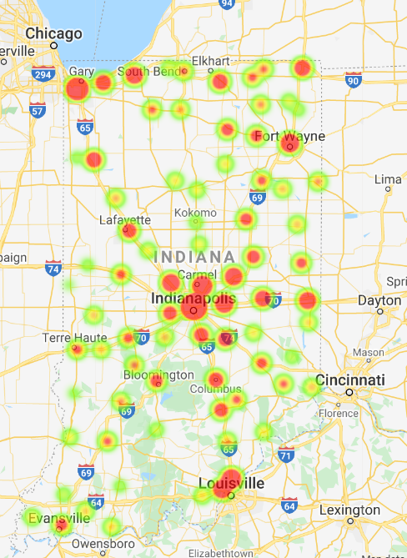
Heat map of Accident magnitude for each county

Slide 16
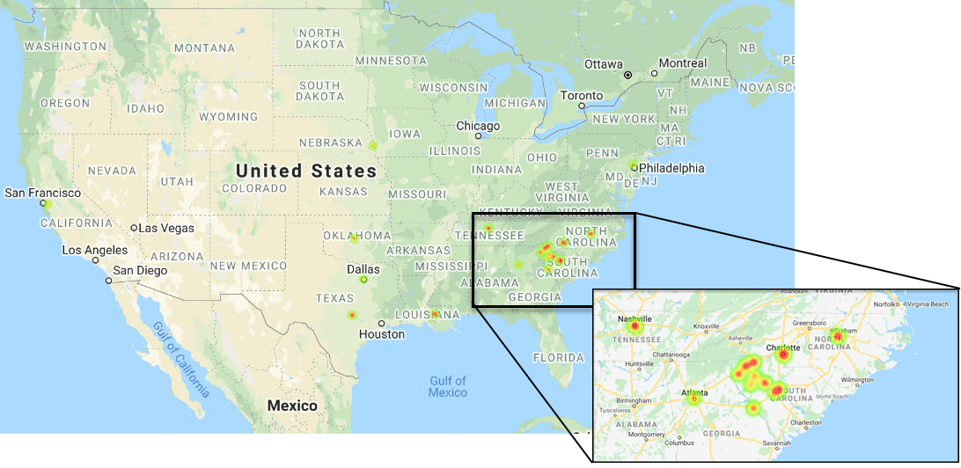
Top 20 counties nationally for accidents per population
13 of 20 counties shown in this blown up region in the Southeast

Slide 17
Discussion and Postmortem

Slide 18
Discussion
Originally wanted more recent data especially in an API, but we couldn't find one that had current and historical data
In Indiana, the majority of the accidents occurred along major interstates and highways
The weather did not significantly effect the number of accidents that occurred, but it could contribute to increased severity
Most accidents occurred during cloudy weather in IN
The highest incidents of accidents occurred during the morning and evening rush hours with a greater spike during the morning

Slide 19
Postmortem
Surprised that normalized accident rates by population were not mostly in higher population density areas or traffic corridors
Struggled with getting the state and county data aligned between the two data sets
The date and time were in one cell and we struggled with extracting time from the data/time format utilized
If there was more time, we would want to be able to do a state by state look to compare the weather conditions and highest incident times across all states
If current data was available, we would have liked to been able to see the effects of the travel bans and stay-at-home orders
2018 had significantly more accidents than any of the other years and it would be interesting to discover why that might have been
Does the time of year effect the number of morning rush hour accidents due to sunrise time

Slide 20

Questions?

