Slide 1
PORTFOLIO LAB
Splunk SOC Mastery Lab with Agentic Threat Triage
5
Custom indexes
Dockerized Splunk Enterprise, custom security telemetry, dashboards, SPL detections, and a read-only analyst agent that produces investigation reports.
5
Dashboards
273K
Indexed events
Built to demonstrate Splunk mastery and SOC investigation process
Splunk SOC Mastery Lab | Agentic Threat Triage
01
Notes:
Open with the outcome: this is a working SOC lab, not just a write-up.
Emphasize that it combines platform engineering, detection engineering, dashboards, and analyst automation.
The proof points are custom indexes, dashboards, indexed events, and the agentic triage report.

Slide 2
RECRUITER SIGNAL
Why This Lab Matters
Splunk Engineering
Detection Engineering
Analyst Automation
App structure
SPL analytics
Read-only agent
Custom indexes
Risk scoring
Prioritized findings
Sourcetypes
Identity threats
Report generation
Saved searches
Endpoint/cloud/web
Human-in-loop
The lab shows hands-on execution across the full SOC workflow: collect, normalize, detect, visualize, triage, and explain.
Splunk SOC Mastery Lab | Agentic Threat Triage
02
Notes:
Frame the lab around employer value: it demonstrates both tool fluency and investigation judgment.
Point out that the project is practical because it starts with data onboarding and ends with analyst-ready reports.
This slide helps non-technical recruiters understand why the lab is more than a dashboard demo.

Slide 3
WORKFLOW
End-to-End Architecture
Telemetry
Splunk
Analytics
Agent
Generated JSONL + optional live Windows/network capture
Dockerized Enterprise, custom app, indexes, sourcetypes
SPL saved searches, lookups, dashboards, pivots
Runs detections, ranks findings, writes reports
Design principle: the agent does not replace Splunk. It sits on top of Splunk searches and summarizes evidence for a human analyst.
Splunk SOC Mastery Lab | Agentic Threat Triage
03
Notes:
Walk from left to right: telemetry enters Splunk, Splunk normalizes it, dashboards and SPL expose investigations, and the agent triages the evidence.
Emphasize that this architecture mirrors a real SOC pipeline at portfolio scale.
Mention that optional live telemetry exists, but the project is safe because it is controlled and permission-based.

Slide 4
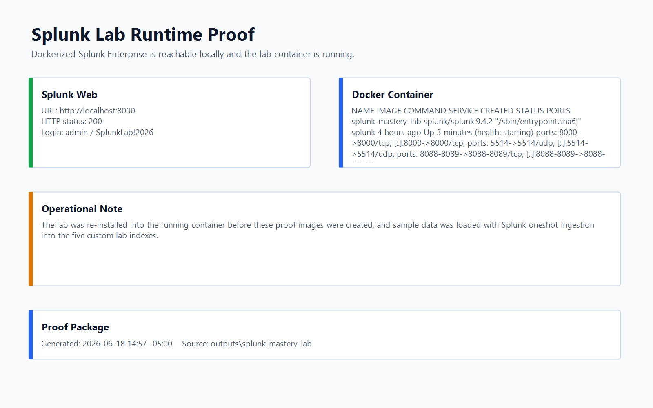
OPERATIONAL
Runtime Proof
Splunk Web
http://localhost:8000
Exposed Ports
8000 Web
8089 Management API
8088 HEC
5514 UDP Syslog
Repeatable setup via Docker Compose and PowerShell install script.
Splunk SOC Mastery Lab | Agentic Threat Triage
04
Notes:
This slide proves the lab is operational locally, not conceptual.
Call out the ports: web UI, management API for the agent, HEC for future ingestion, and UDP syslog for network-style logs.
Mention the install script reloads the app and uses oneshot ingestion to populate the indexes.

Slide 5
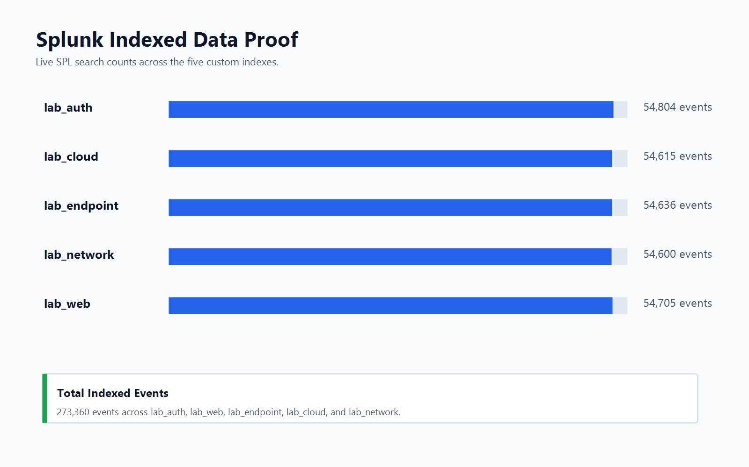
TELEMETRY
Indexed Data Proof
273,360
Total indexed events
5
Telemetry domains
JSON
Normalized sourcetypes
Splunk SOC Mastery Lab | Agentic Threat Triage
05
Notes:
Use this slide to prove the data was actually loaded into Splunk.
Explain each index: identity, web/API, endpoint, cloud, and network.
Mention that the generated data includes normal noise plus deliberate attack storylines for investigation practice.

Slide 6
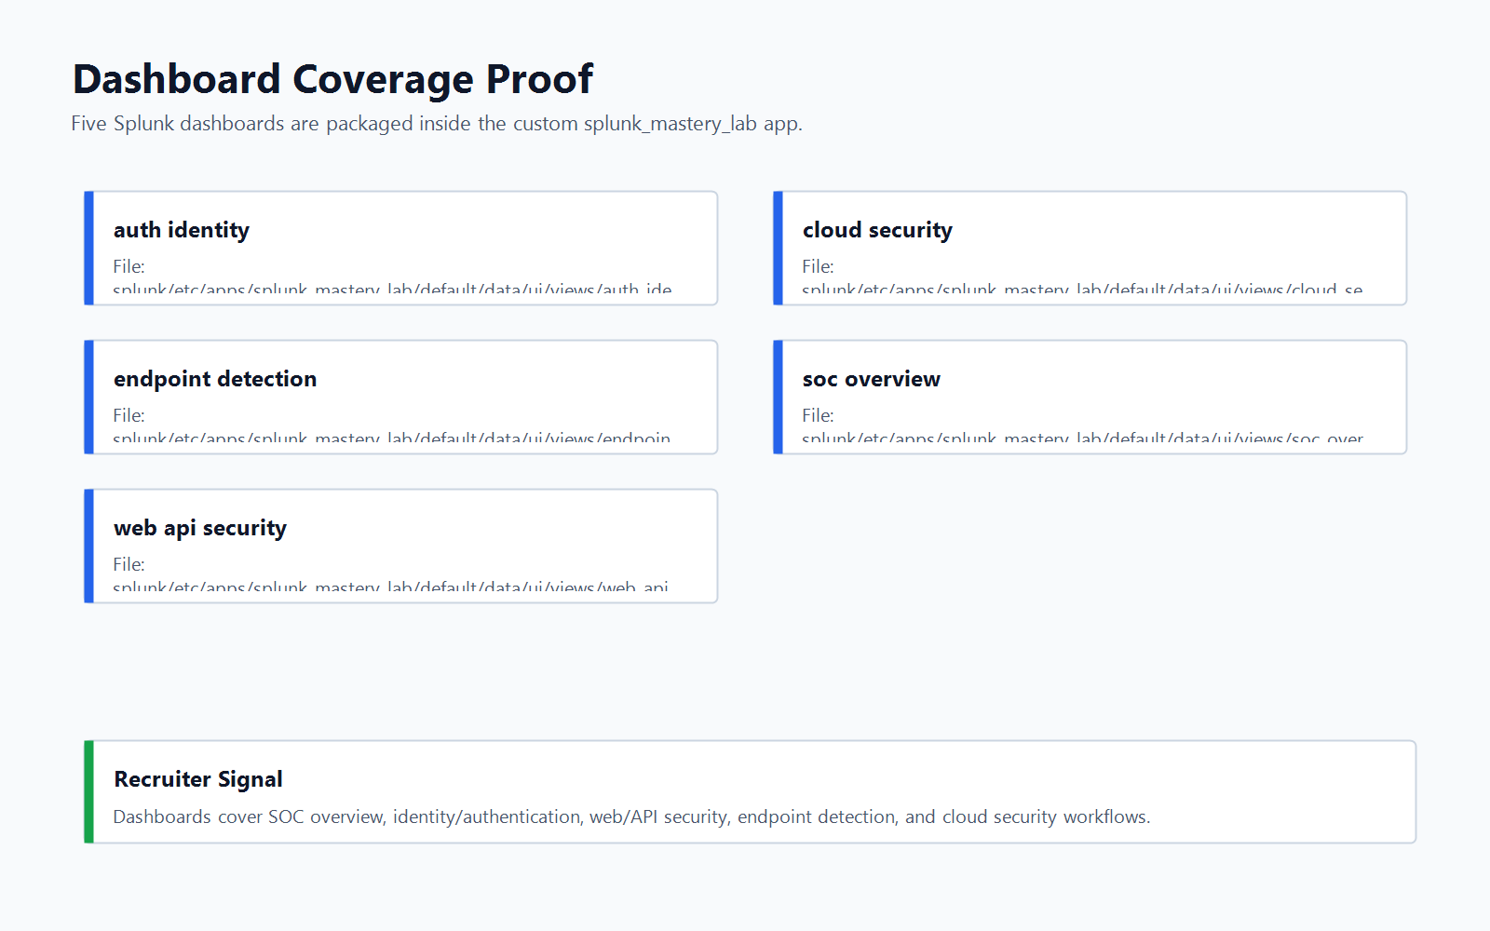
VISUAL ANALYTICS
Dashboard Coverage
SOC Overview: high-level triage and investigation queue
Auth and Identity: brute force, spray, impossible travel
Web/API Security: attacks, risky clients, response health
Endpoint Detection: LOLBins, PowerShell, egress
Cloud Security: IAM-style escalation and API errors
Splunk SOC Mastery Lab | Agentic Threat Triage
06
Notes:
Describe how the dashboards are organized around analyst workflows.
Point out that the views are packaged inside the Splunk app, which is stronger than ad hoc saved searches.
Recruiter takeaway: this shows dashboard design and domain-specific SOC thinking.

Slide 7
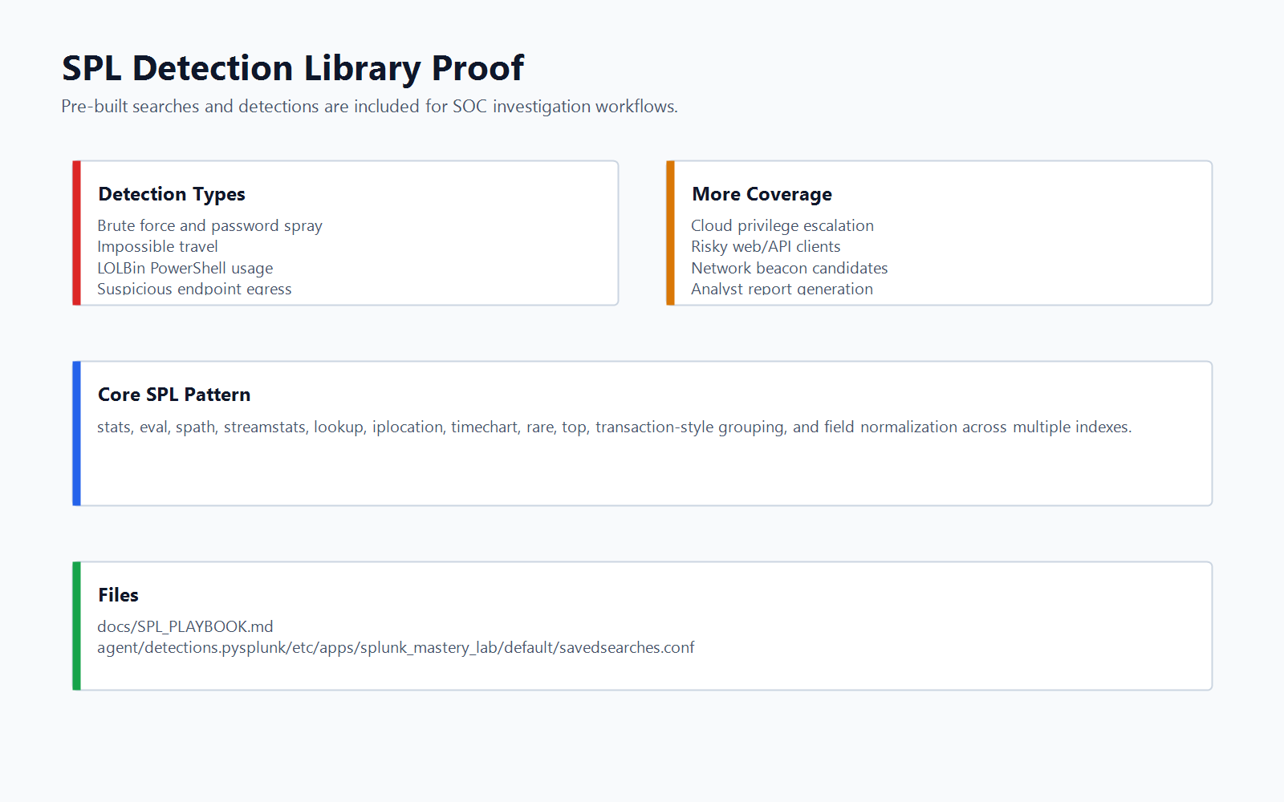
DETECTION ENGINEERING
SPL Detection Library
Detection Coverage
Brute force and password spray
Impossible travel
Suspicious PowerShell and LOLBins
Endpoint egress to risky ports
Cloud privilege escalation
Risky web/API clients and beaconing
SPL patterns: stats, eval, spath, streamstats, lookup, iplocation, top, rare, timechart, and normalized field extraction.
Splunk SOC Mastery Lab | Agentic Threat Triage
07
Notes:
This is the detection engineering slide.
Mention that the SPL is not just counting events; it uses enrichment, grouping, pivots, and risk-style logic.
Tie each detection back to an analyst question: who is affected, where did it come from, and what should be investigated next.

Slide 8
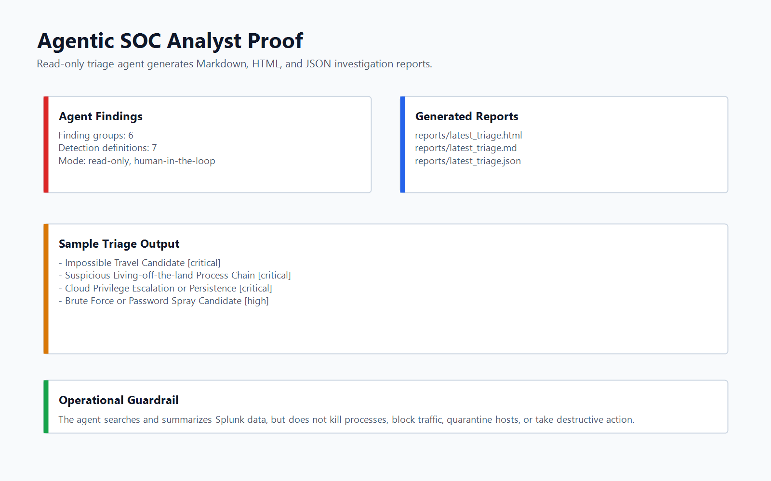
TRIAGE AUTOMATION
Agentic SOC Analyst
1
Select detection mode
2
Run SPL via Splunk API
3
Rank and summarize findings
4
Write MD, HTML, JSON reports
Guardrail: read-only, human-in-the-loop, no blocking, no quarantine, no destructive endpoint actions.
Splunk SOC Mastery Lab | Agentic Threat Triage
08
Notes:
Explain that agentic here means the tool chooses detection tasks, runs them, interprets results, and produces a report.
Stress the safety boundary: it does not take containment action.
This is useful in interviews because it demonstrates automation without overstating autonomous security control.

Slide 9
REPEATABLE OPERATIONS
Script and Process Catalog
Deploy
docker compose up -d
Install
.\scripts\Install-LabIntoContainer.ps1
Validate
splunk search "index=lab_* | stats count by index"
Agent
.\scripts\Run-AgentDashboard.ps1
Capture
.\scripts\Watch-NetConnections.ps1 -Seconds 300
Packet
.\scripts\Start-PktmonCapture.ps1
Splunk SOC Mastery Lab | Agentic Threat Triage
09
Notes:
Use this slide if a recruiter or interviewer asks how the lab is run.
The core operations are start Splunk, install the app and data, validate indexes, run dashboards, and execute the agent.
Mention that the optional telemetry scripts are permission-based and intended for owned systems.

Slide 10
TALK TRACK
Recommended Live Demo Flow
Start Docker Desktop and verify the container.
Open Splunk Web and select the Splunk Mastery Lab app.
Show SOC Overview, then pivot by domain.
Run the five-index validation SPL search.
Run the agent and open the HTML report.
Explain findings, risk, and next pivots.
Interview framing
Close with GitHub README, screenshots, and docs.
Lead with process, then prove it with screenshots and SPL.
Splunk SOC Mastery Lab | Agentic Threat Triage
10
Notes:
This slide is a script for the live conversation.
The strongest presentation flow is: working system, indexed data, dashboards, detection logic, agent triage, and safety boundary.
Keep the walkthrough concise and let screenshots support claims.

Slide 11
DEFENSIVE POSTURE
Safety, Ethics, and Extensibility
Safe by Design
Ethical Capture
Next Steps
Read-only agent
Owned devices only
Add more datasets
No auto-containment
Permission required
Add SOAR-style cases
No destructive actions
Local lab focus
Tune detections
Human review required
Transparent docs
Add CI validation
The lab is intentionally practical: strong enough for portfolio proof, bounded enough for safe demonstration.
Splunk SOC Mastery Lab | Agentic Threat Triage
11
Notes:
This slide is important for cybersecurity interviews.
Make it clear that packet and traffic capture must only happen where permission exists.
The agent is intentionally read-only to keep the project responsible and defensible.

Slide 12
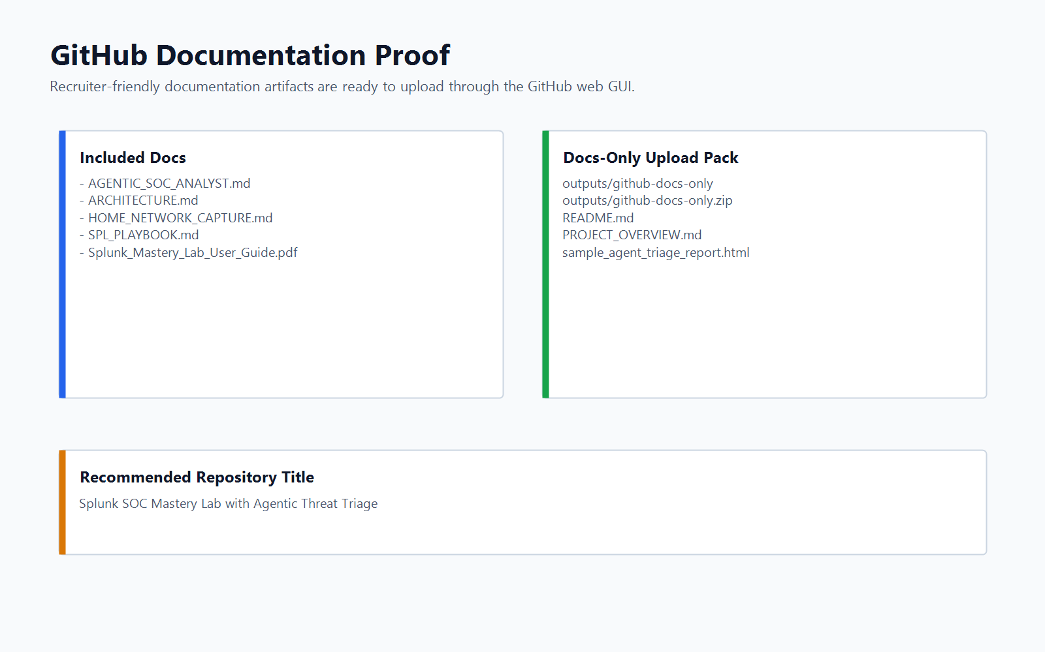
Portfolio Close
Built to prove Splunk mastery through working evidence.
Operational Splunk lab
Realistic security telemetry
Dashboards and SPL detections
Agentic triage report workflow
Recruiter-ready README and screenshots
GitHub title: Splunk SOC Mastery Lab with Agentic Threat Triage
Splunk SOC Mastery Lab | Agentic Threat Triage
12
Notes:
Close by tying the artifact back to employable skills.
This project shows platform deployment, detection logic, dashboards, automation, documentation, and responsible security practice.
Invite the recruiter to review the README first because it includes screenshots, process steps, and scripts.

