Slide 1
SIGNALFORGE
12
SOC Detection
Engineering Lab
EVENTS
6
DETECTIONS
A recruiter-ready walkthrough of detection engineering, triage, threat hunting, automation, and honest vendor validation.
3
CRITICAL
Joel Manglin • Docker • Python • PowerShell • SPL
Notes:
Study objective: open with the outcome, not the technology list. Say: ‘I built SignalForge to demonstrate how I approach a SOC problem end to end: normalize telemetry, write detections, prioritize alerts, document decisions, and automate repeatable validation.’ Then explain that the numbers are deterministic lab results, not inflated production claims.
Recruiter cue: connect the project to advanced SOC analysis, detection content, alert tuning, incident reporting, and scripting within the first 30 seconds.
Likely question: ‘Is this connected to real CrowdStrike or Splunk?’ Answer: ‘No. It deliberately uses synthetic schema-shaped telemetry and portfolio-ready SPL. I document that boundary clearly and would validate against authorized tenants before production use.’
[Sources]
- README.md
- scripts/validate_lab.py

Slide 2
RECRUITER ALIGNMENT
The project mirrors the job’s core operating loop
ROLE EXPECTATION
PROJECT EVIDENCE
Advanced SOC triage
Prioritized queue, severity, entity, MITRE context
Splunk ES/Core
Six production-style SPL searches plus a hunt
Endpoint + email
CrowdStrike- and Proofpoint-shaped events
Cloud + web
Wiz exposure and Zscaler callback context
Automation
Python validation and PowerShell incident export
Continuous improvement
Tuning guidance, tests, CI, troubleshooting record
SIGNALFORGE SOC LAB
02
Notes:
Walk down this slide as a requirements traceability matrix. Avoid saying the project replaces commercial platforms. The point is that it demonstrates the engineering habits the role needs.
Suggested phrasing: ‘For every major responsibility in the posting, I created a visible artifact: detection content, a triage surface, a documented investigation path, tests, and an automation control.’
Recruiter question: ‘Where is your strongest alignment?’ Emphasize SPL logic, endpoint/email correlation, and translating alerts into an investigation narrative.
Technical interviewer question: ‘How would you operationalize this?’ Mention source onboarding, CIM mapping, data-quality monitoring, risk-based alerting, tuning governance, and change-controlled response actions.
[Sources]
- README.md
- docs/DETECTION_CATALOG.md
- splunk/detections/

Slide 3
ARCHITECTURE
Telemetry becomes evidence through a deliberately small pipeline
Synthetic sources
Normalization
Detection engine
SOC evidence
Analyst action
CrowdStrike
Proofpoint
Wiz • Zscaler
Common event
fields + source
identity
Six rules
MITRE mapping
severity
Alerts
metrics
source health
Triage
hunt
report
Control principle
Read-only, synthetic-by-default validation; live response remains outside the lab.
SIGNALFORGE SOC LAB
03
Notes:
Explain the architecture from left to right. The small footprint is intentional: one container and a SQLite database make the lab easy to run and easy to inspect.
Key engineering point: normalization separates source-specific fields from detection logic. That is the same design concern encountered when onboarding data into Splunk CIM or a SOAR enrichment workflow.
Security control: the system does not contain credentials or execute remediation. This protects against accidentally presenting a demo lab as a production integration.
Study prompt: be ready to explain what you would add in production—authentication, RBAC, encrypted secrets, durable queues, retention, observability, and an approval-gated response layer.
[Sources]
- docs/ARCHITECTURE.md
- compose.yaml
- soclab/database.py
- soclab/detections.py

Slide 4
LIVE WALKTHROUGH
A recruiter can reproduce the demo in four commands
01
Clone
git clone …/soc-detection-engineering-lab.git
02
Start
docker compose up --build --wait
03
Validate
python scripts/validate_lab.py
04
Explore
Open http://localhost:8080
SIGNALFORGE SOC LAB
04
Notes:
Use this slide to lead an actual demo. Start with a clean terminal and narrate what each command proves.
1. Clone proves reproducibility. 2. Compose builds and waits for the healthcheck. 3. The validator checks health, safety disclosure, source counts, alert counts, key detections, and the six-rule pack. 4. The dashboard makes the results accessible to a non-developer.
If Docker is already running, the full walkthrough is approximately two minutes. Do not remove the volume during a recruiter demo unless you want to show a reset.
Troubleshooting answer: if localhost does not open, run ‘docker compose ps’ and ‘docker compose logs soc-lab’; then check whether port 8080 is already in use.
[Sources]
- README.md
- docs/SETUP.md
- scripts/validate_lab.py
- docs/TROUBLESHOOTING.md

Slide 5
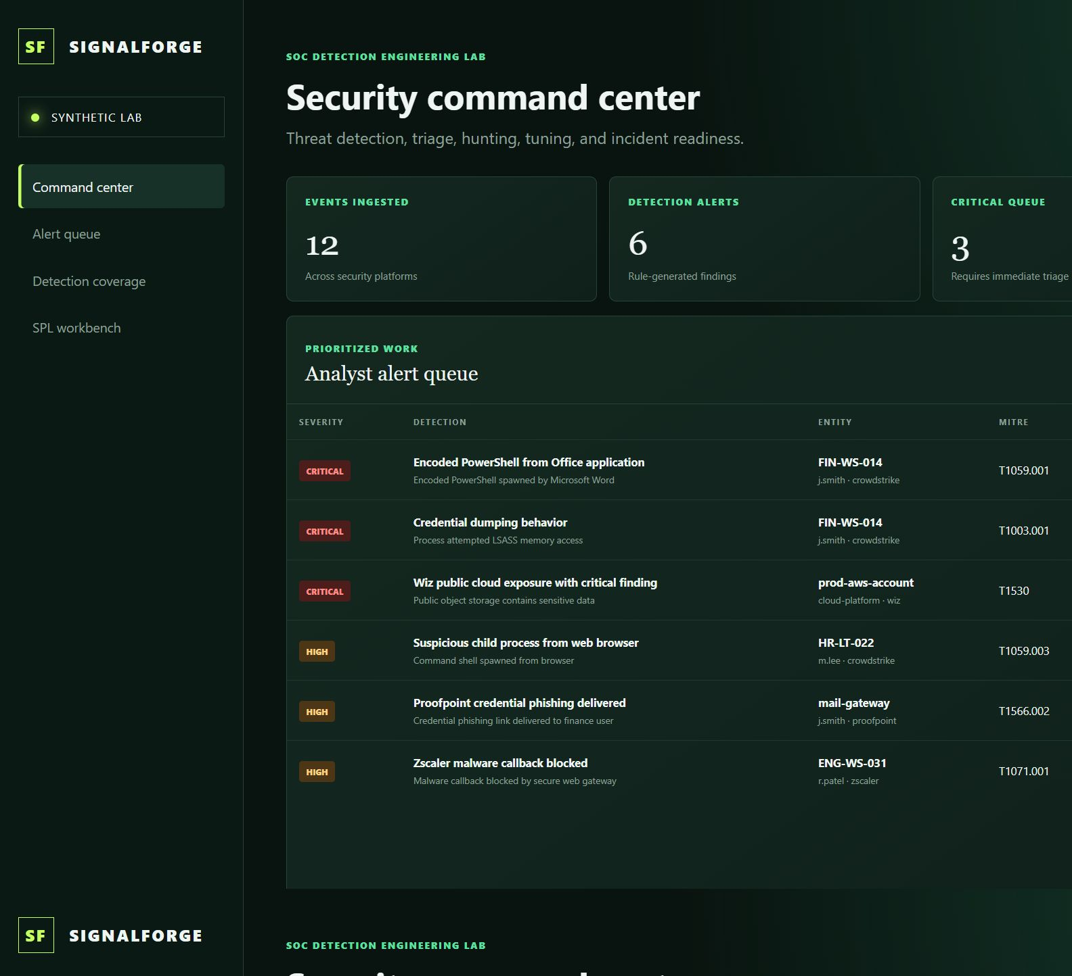
THE LIVE COMMAND CENTER MAKES PRIORITIES VISIBLE
05
Notes:
Pause here and point to the evidence in order: 12 ingested events, 6 rule-generated alerts, 3 critical findings, then the priority queue. Next point out the source health and MITRE coverage areas lower on the full-page capture.
What to say: ‘The dashboard is an analyst surface, not the detection engine. The API and database remain testable independently, which prevents presentation logic from becoming security logic.’
CrowdStrike disclosure: call out the visible statement that events are schema-compatible and synthetic. This is a credibility strength.
Demo action: click Refresh. Explain that the button re-queries the live API and that browser validation confirmed the expected values after the interaction.
[Sources]
- screenshots/soc-command-center.png
- web/app.js
- scripts/validate_lab.py

Slide 6
TRIAGE SCENARIO
Three signals become one defensible incident story
1
2
3
Delivered phish
Encoded PowerShell
LSASS access
Proofpoint
CrowdStrike
CrowdStrike
T1566.002
T1059.001
T1003.001
Analyst decision
Escalate as probable phishing-led endpoint compromise; preserve evidence and scope the user and host.
SIGNALFORGE SOC LAB
06
Notes:
Tell this as an investigation, not three unrelated alerts. The same finance user and host create the correlation story.
Triage sequence: validate email delivery and URL; confirm process ancestry and command line; inspect the endpoint identity and hash; establish whether LSASS access followed; search for additional users, hosts, and network indicators; then document containment recommendations.
Be precise: the lab detects synthetic behaviors. It does not prove malware execution in a real environment. In production, corroborate with Falcon process tree, identity telemetry, DNS/proxy logs, mailbox audit, and asset criticality.
Likely interview question: ‘What would you tune?’ Answer: tune on parent-child relationship, encoded command context, approved automation identities, signed binaries, device group, and recurrence—never on process name alone.
[Sources]
- data/events.jsonl
- soclab/detections.py
- docs/ANALYST_RUNBOOK.md

Slide 7
DETECTION ENGINEERING
The SPL pack separates signal design from dashboard polish
Design review
index=edr sourcetype="crowdstrike:events"
| eval process=lower(FileName), parent=lower(ParentBaseFileName)
| where process="powershell.exe"
AND parent IN ("winword.exe","excel.exe")
| stats count values(CommandLine) BY aid ComputerName UserName
| eval rule_id="SOC-EDR-001", severity="critical"
• Normalize before filtering
• Use parent-child context
• Aggregate by stable endpoint ID
• Attach rule and severity metadata
• Test positive and benign cases
6 detections + 1 hunt
SIGNALFORGE SOC LAB
07
Notes:
Walk through the SPL line by line. Explain why lowercase normalization prevents casing misses, why parent process narrows false positives, why the stable Falcon endpoint identifier matters, and why metadata supports downstream correlation searches or notable events.
Senior-level point: a detection is not finished when the query returns results. It needs ownership, severity rationale, MITRE mapping, expected data sources, false-positive analysis, validation cases, and a tuning/change history.
If asked about Splunk ES, describe how this search could become a correlation search, populate notable/RBA fields, use macros for environment filters, and be validated against the customer’s CIM and sourcetype conventions.
Do not claim the query ran inside Splunk; it is structurally tested and designed for an authorized Splunk environment.
[Sources]
- splunk/detections/encoded_powershell_office.spl
- splunk/macros.conf
- tests/test_spl_content.py
- docs/DETECTION_CATALOG.md

Slide 8
CROWDSTRIKE BOUNDARY
Credibility comes from validating what is real—and labeling what is not
VALIDATED
NOT CLAIMED
• Falcon-style aid and event_simpleName
• ProcessRollup2-like process context
• Positive and benign PowerShell cases
• Source-health and detection assertions
• MITRE-mapped endpoint behaviors
• No tenant or API access
• No Falcon sensor installation
• No proprietary event export
• No RTR or containment execution
• No vendor certification or endorsement
Production next step: validate read-only against an authorized tenant, then review false positives before response actions.
SIGNALFORGE SOC LAB
08
Notes:
This slide is a trust-building moment. Say exactly what was validated and what was not. Recruiters and security leaders value candidates who do not blur a lab demonstration into a production claim.
If asked how you would connect Falcon: obtain written authorization and least-privilege credentials; store secrets outside Git; ingest a redacted sample; compare field names and types; run detections read-only; review results with a Falcon-qualified analyst; enable response only through change control.
Key phrase to memorize: ‘Schema-compatible validation proves my engineering assumptions, not vendor certification.’
The same boundary applies to Proofpoint, Wiz, Zscaler, and Splunk.
[Sources]
- docs/CROWDSTRIKE_VALIDATION.md
- README.md

Slide 9
CONTINUOUS IMPROVEMENT
Troubleshooting became documented engineering evidence
01
02
03
04
Observe
Diagnose
Fix
Verify
Container restarted during fixture ingestion
Blank JSONL lines caused JSONDecodeError
Skip whitespace-only records during loading
Reset only the lab volume; rerun all checks
Senior signal
Scoped recovery, documented root cause, deterministic regression checks.
SIGNALFORGE SOC LAB
09
Notes:
Use this story with the STAR method. Situation: the container restarted on first ingestion. Task: identify the failure without damaging unrelated Docker data. Action: inspect logs, trace JSON parsing, make the loader whitespace-tolerant, remove only the project’s named volume, and rerun tests plus live validation. Result: the container became healthy and all assertions passed.
What this demonstrates: calm incident-style diagnosis, scoped remediation, change verification, and documentation for the next analyst.
Likely question: ‘What would you do differently?’ Answer: add a fixture-lint step before container startup and a malformed-record metric or dead-letter path for production ingestion.
Mention that the troubleshooting guide includes port conflicts, Docker daemon checks, health failures, data reset, and PowerShell execution policy issues.
[Sources]
- docs/BUILD_NOTES.md
- docs/TROUBLESHOOTING.md
- soclab/database.py

Slide 10
THE RECRUITER TAKEAWAY
I can turn noisy security data
into tested, explainable action.
• Detection engineering: SPL + Python rules
• SOC operations: triage + incident narrative
• Platform breadth: endpoint, email, cloud, web
• Automation: repeatable tests + PowerShell reporting
• Judgment: explicit safety, cost, and validation boundaries
github.com/JoelManglin/soc-detection-engineering-lab
10
Notes:
Close by resolving the opening claim. Suggested final statement: ‘SignalForge shows how I work: I make detection logic inspectable, connect alerts into an incident story, automate verification, and state technical boundaries honestly. That operating style is what I would bring to your SOC.’
Then invite depth: ‘I can walk through the SPL, the phishing-to-endpoint scenario, the Docker design, or the troubleshooting decision—whichever is most useful.’
Study checklist before an interview: run the lab once; rehearse the two-minute demo; explain one detection line by line; tell the JSONL troubleshooting story using STAR; distinguish synthetic validation from tenant validation; prepare one example of how you would tune and measure a detection in production.
Do not memorize every sentence. Memorize the sequence: problem, evidence, decision, boundary, next step.
[Sources]
- README.md
- https://github.com/JoelManglin/soc-detection-engineering-lab

