Slide 1
Methodology
Data Preprocessing
No Discretization
No Aggregation
No Feature Selection

Slide 2
Methodology
Mining Techniques
Random Forest
K-Nearest Neighbors

Slide 3
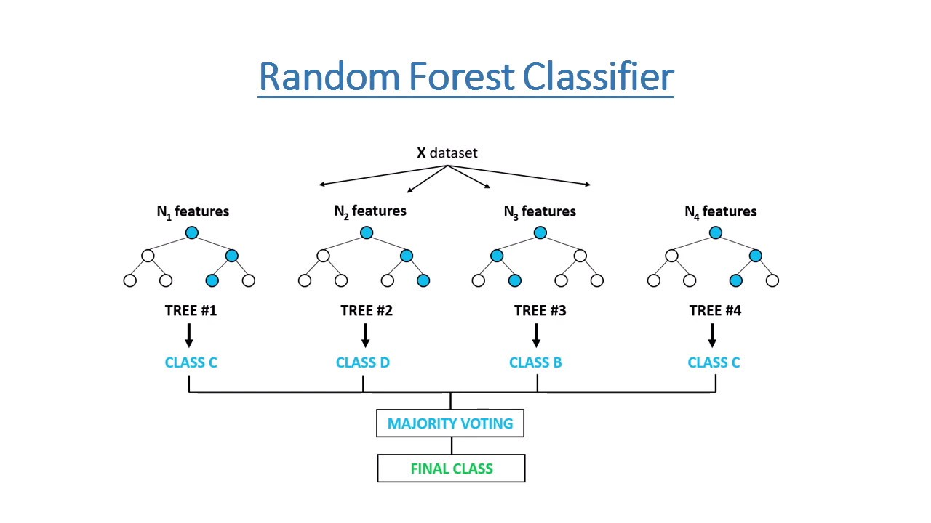
Methodology
Random Forest
Random Forest is an ensemble classification Data mining technique which builds multiple Decision trees and takes the average of all the Decision trees to predict the class.

Slide 4
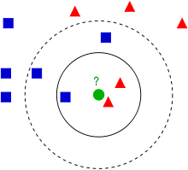
Methodology
K-Nearest Neighbors
K-Nearest Neighbors is a classification Algorithm, as the name suggests the class predicted based on the given number[K] of Nearest Neighbors.

Slide 5
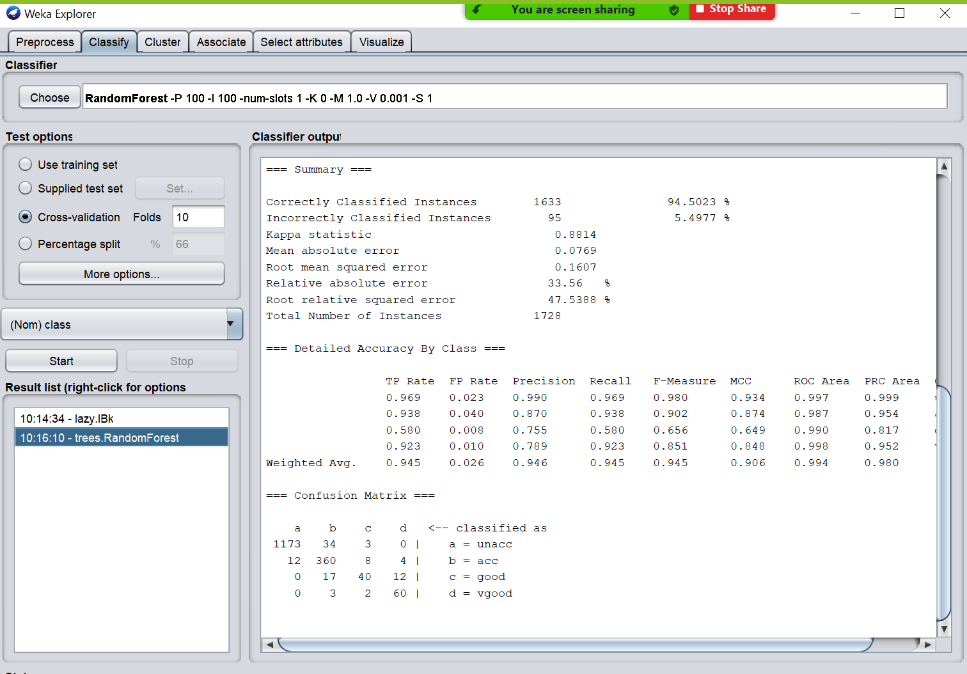
Methodology
Model Performance
Random Forest

Slide 6
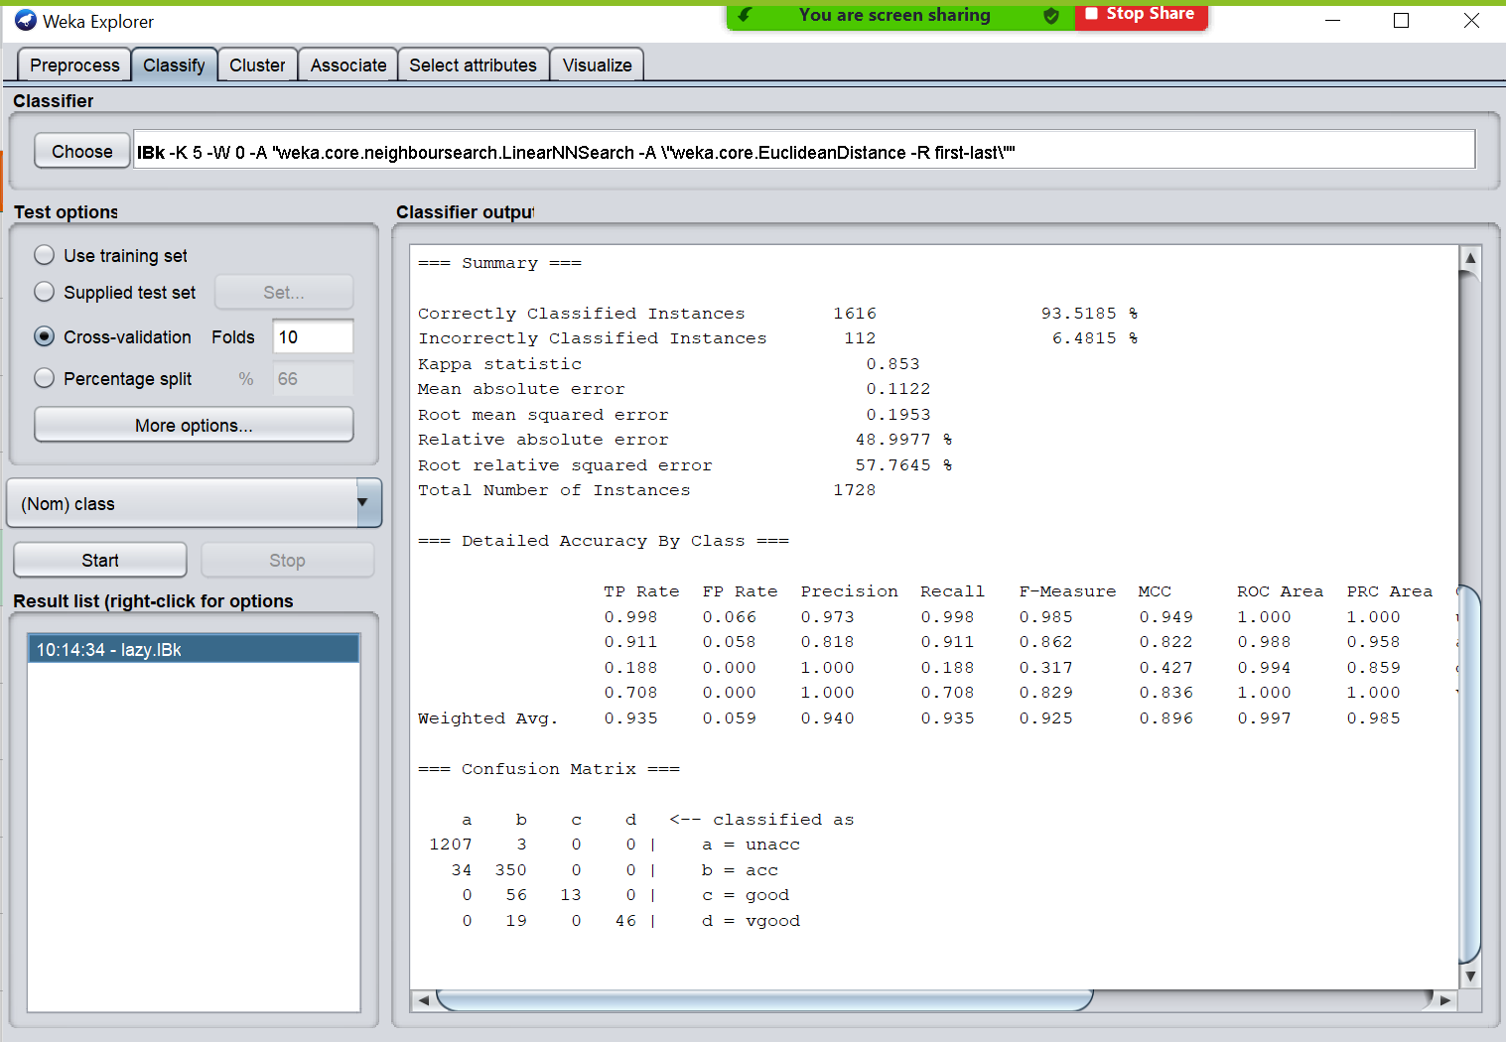
Methodology
Model Performance
K-Nearest Neighbors

