Slide 1

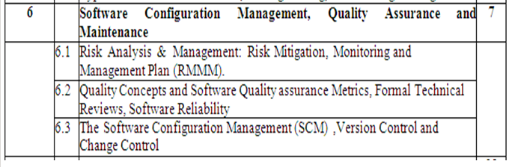
Module-6 Syllabus

Slide 2
Software Risks
Whenever we start any business or any development process,we take into consideration the risks involved in accomplishing that task
Similarly when software development process is started,it is main job of a software manager to look into all types of possible risks involved in the entire process
It involves focusing on the possible risks that could affect the project development process
  Schedule of the development process
  Quality of the application under construction

Slide 3
Software Risks
If the risk management is effective,then it becomes easier to handle all the problems and
It is ensured that the project schedules and budget are within acceptable limits and there is no schedule slippage and ultimately no budget slippage

Slide 4
Software risks characteristics
Uncertainty-the risk may or may not happen;that is,there are no 100% risks
Loss-if the risk becomes a reality,unwanted consequences or losses will occur

Slide 5
Categories of risks
Project risks
Technical risks
Business risks

Slide 6
Project risks-
It threaten the project plan
If project risks become real,it is likely that project schedule will slip and costs will increase
Project risks identify potential budgetary,schedule,personnel(staffing and organization),resource,stakeholder,and requirements problems

Slide 7
Technical risks
It threaten the quality and timeliness of the software to be produced
If a technical risk becomes a reality,implementation may become difficult or impossible
It identify potential design,implementation,interface,verification,and maintenance problems

Slide 8
Business risks
Business risks threaten the viability of the software to be built
Business risks often jeopardize(causes harm/loss) the project or the product
Top 5 business risks are
  Building an excellent product or system that no one really wants(market risks)
  Building a product that no longer fits into the overall business strategy for the company(strategic risks)
  Building a product that the sales force doesn’t understand how to sell(sales risk)
  Losing the support of senior management due to a change in focus or a change in people(management risks)
  Losing budgetary or personnel commitment(budget risks)

Slide 9
General categorization of risks proposed by Charette
Known risks- Are those that can be uncovered after careful evaluation of the project plan, the business and technical environment in which the project is being developed,and other reliable information sources(e.g.unrealistic delivery date,lack of documented requirements or software scope,poor development environment)

Slide 10
General categorization of risks proposed by Charette
Predictable risks-Are extrapolated from past project experience(e.g.,staff turnover,poor communication with the customer,dilution of staff effort as ongoing maintenance requests are serviced
Unpredictable risks-Can and do occur,but are extremely difficult to identify in advance

Slide 11
Risk Strategies
Reactive
Proactive

Slide 12
Reactive Risk Strategy
It monitors the project for likely risks
Resources are monitored to guess the possible risks and deal with them so that they do not become the problems for budget slippage and cost slippage
Software team does nothing about risks until something goes wrong
Then the team flies into action in an attempt to correct the problem rapidly
This is often called a fire-fighting mode
After failure of all these actions,the concept of “crisis management” comes into picture and the project is in deep trouble and uncertainty happens

Slide 13
Proactive Risk Strategy
It is initiated when the actual technical work begins
Potential risks are identified, and the probability and impact are assessed, so that the development team members establish an appropriate plan to manage all these risks
The main goal to avoid the risks initially
But all the risks cannot be avoided,therefore the development team creates a contigency plan that will control the risks in an effective manner

Slide 14
Risk identification
It is a systematic attempt to specify threats to the project plan(estimates,schedule,resource loading,etc)
By identifying known and predictable risks,the project manager takes a first step toward avoiding them when possible and controlling them when necessary

Slide 15
Distinct types of risks for each of the categories
Generic risks- Are a potential threat to every software project
Product-specific risks-Can be identified only by those with a clear understanding of the technology,the people,and the environment that is specific to the software that is to be built
One method for identifying risks is to create a risk item checklist
Checklist is used for risk identification and focuses on some subset of known and predictable risks

Slide 16
Checklist for known and predictable risks generic subcategories
Product size-risks associated with the overall size of the software to be built or modified
Business impact-risks associated with constraints imposed by management or the marketplace
Customer characteristics-risks associated with the sophistication of the customer and the developers ability to communicate with the customer in a timely manner
Staff size and experience-risks associated with the overall technical and project experience of the software engineers who will do the work

Slide 17
Checklist for known and predictable risks generic subcategories
Process definition-risks associated with the degree to which the software process has been defined and is followed by the development organization
Development environment-risks associated with the availability and quality of the tools to be used to build the product
Technology to be built-risks associated with the complexity of the system to be built and the “newness” of the technology that is packaged by the system

Slide 18
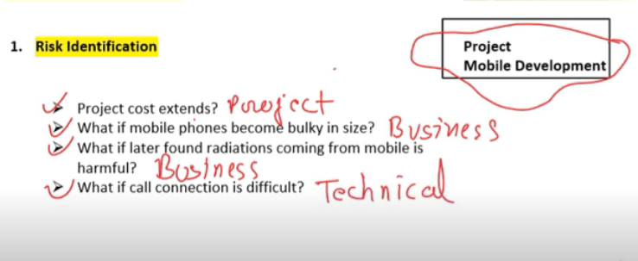

Slide 19
Risk Assessment-Risk Components and Drivers
The factors that affect the risk components are also called as risk drivers
Performance risk-The degree of uncertainty that the product will meet its requirements and be fit for its intended use
Cost risk-The degree of uncertainty that the project budget will be maintained
Support risk-The degree of uncertainty that the resultant software will be easy to correct,adapt and enhance
Schedule risk-The degree of uncertainty that the project schedule will be maintained and that the product will be delivered on time

Slide 20
Impact Categories
The impact of each risk driver on the risk component is divided into
  Negligible
  Marginal
  Critical
  Catastrophic

Slide 21
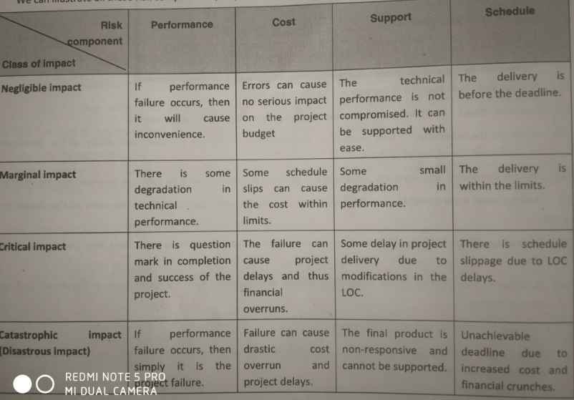

Slide 22
Step 2) Analyze the impact of the risk occurring
Once the risk is identified ,Each risk should be classified on the basis of following two parameters,
  The probability of occurrence
  The impact on the project
  Prepare the risk table

Slide 23
Risk Projection & Building a Risk Table
Risk projection, also called risk estimation, attempts to rate each risk in two ways
- the likelihood or probability that the risk is real and
- the consequences of the problems associated with the risk, should it occur.
The project planner, along with other managers and technical staff, performs four risk projection activities:
  establish a scale that reflects the perceived likelihood of a risk,
  2.define the consequences of the risk,
  3.estimate the impact of the risk on the project and the product, and.
  4.Note the overall accuracy of the risk projection so that there will be no misunderstandings

Slide 24

Building a Risk Table
Risk exposure is a measure of possible future loss (or losses) which may result from an activity or occurrence.
Risk
Probability
Impact
Exposure
RMMM
Text description of the risk
Risk
Mitigation
Monitoring
&
Management
Probability of occurrence
Impact if occurs (Negligible=1…Catastrophic=4)

Slide 25
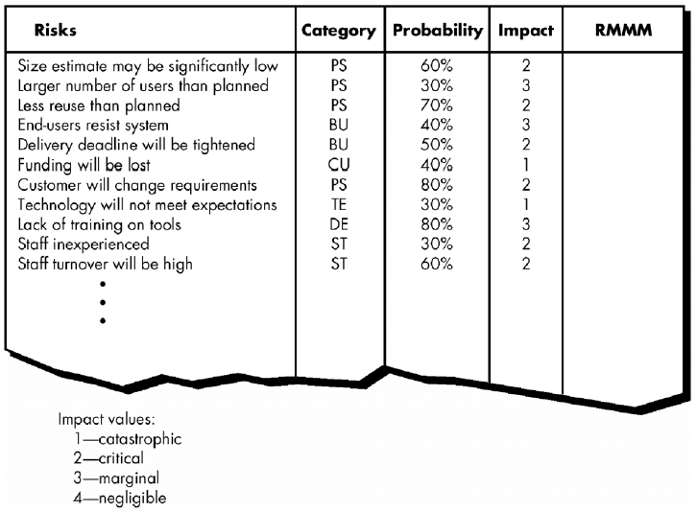
Building Risk Table – table
RMMM = Risk Mitigation, Monitoring and Management Plan

Slide 26
Building the Risk Table
Estimate the probability of occurrence
Estimate the impact on the project on a scale of 1 to 4, where
  4 = low impact on project success
  1 = catastrophic impact on project success
Determine the exposure:
  Risk Exposure = Probability x Impact

Slide 27
Risk Exposure Example
Risk identification. Only 70 percent of the software components scheduled for reuse will, in fact, be integrated into the application. The remaining functionality will have to be custom developed.
Risk probability. 80% (likely).
Risk impact. 60 reusable software components were planned. If only 70 percent can be used, 18 components would have to be developed from scratch (in addition to other custom software that has been scheduled for development).
Since the average component is 100 LOC and local data indicate that the software engineering cost for each LOC is $14.00, the overall cost (impact) to develop the components would be 18 x 100 x 14 = $25,200.
Risk exposure. RE = 0.80 x 25,200 ~ $20,200.

Slide 28
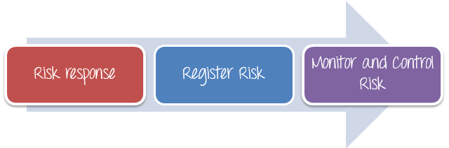
Step 3) Take COUNTER MEASURES to mitigate the risk(RMMM PLAN)

Slide 29
Risk Mitigation, Monitoring, and Management (RMMM)
mitigation—how can we avoid the risk?It is a problem avoidance activity
monitoring—what factors can we track that will enable us to determine if the risk is becoming more or less likely?
It is a project tracking activity with 3 primary objectives
  To assess whether predicted risks do,in fact,occur
  To ensure that aversion steps defined for the risk are being properly applied; and
  To collect information that can be used for future risk analysis properly
management—what contingency plans do we have if the risk becomes a reality?

Slide 30
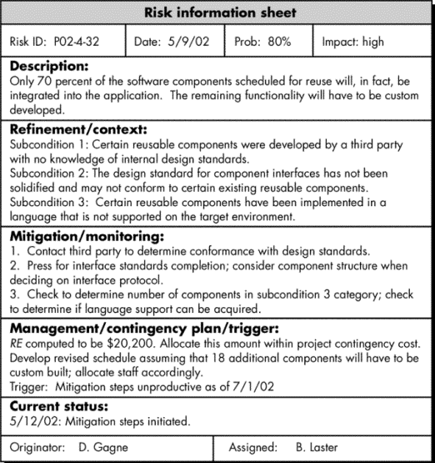

Slide 31
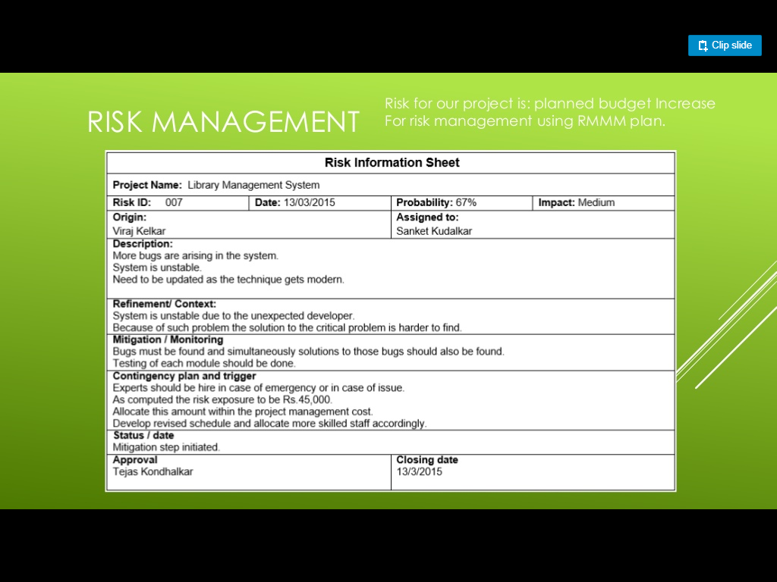

Slide 32
Video Link for RMMM
https://www.youtube.com/watch?v=Azsze5LlrOg

Slide 33
Software Quality
It is defined as conformance to explicitly stated functional and performance requirements,explicitly documented development standards,and implicit characteristics that are expected of all professionally developed software

Slide 34
Software Quality focuses on
Software requirements are the foundation from which quality is measured.Lack of conformance to requirements is lack of quality
Specified standards define a set of development criteria that guide the manner in which software is engineered.If the criteria are not followed,lack of quality will almost surely result
A set of implicit requirements often goes unmentioned(e.g.,the desire for ease of use and good maintainability).If software conforms to its explicit requirements but fails to meet implicit requirements,software quality is suspect

Slide 35
Software Reviews
Software Reviews are a “filter” for the software process.
Reviews are applied at various points during software engineering and serve to uncover errors and defects that can be removed
Software Reviews “purify” the software engineering activities that we have called analysis,design,and coding

Slide 36
Software Reviews
Many different types of reviews can be conducted as part of software engineering
An informal meeting around the coffee machine is a form of review,if technical problems are discussed
A formal presentation of software design to an audience of customers,management,and technical staff is also a form of review

Slide 37
Formal Technical Reviews
A formal technical review (FTR) is a software quality control activity performed by software engineers (and others).
A FTR is the most effective filter from a quality assurance standpoint
The objectives of an FTR are: (1) to uncover er-rors in function, logic, or implementation for any representation of the software;(2)to verify that the software under review meets its requirements; (3) to ensure that the software has been represented according to predeftned standards; (4) to achieve software that is developed in a uniform manner; and (5) to make projects more manageable.
In addition, the FTR serves as a training ground, enabling ju-nior engineers to observe different approaches to software analysis, design, and implementation.
The FTR also serves to promote backup and continuity because a number of people become familiar with parts of the software that they may not have otherwise seen.

Slide 38
Formal Technical Reviews
The FTR is actually a class of reviews that includes walkthroughs and inspec-tions,round-robin reviews,and other small group technical assessments of software
Every Formal Technical Review is performed as a meeting
If FTR is planned,controlled,and attended in correct way then only it becomes successful

Slide 39
Steps in FTR
The review meeting
  Every review meeting should be conducted by considering the following constraints
    Involvement of people- Between 3 to 5 people should be involve in the review
    Advance Preparation-Advance preparation should occur but it should be very short.At the most 2 hours of work for each person can be spent in this preparation
    Short duration-The duration of the review meeting should be less than two hours

Slide 40
Steps in FTR
Rather than attempting to review an entire design,walkthroughs are conducted for each component or small groups of components
The focus of the FTR is on work product(a software component to be reviewed)
The review meeting is attended by the review leader,all reviewers and the producers

Slide 41
Steps in FTR
The review leader is responsible for evaluating the product for its deadline.The copies of product material are then distributed to reviewers
The producer organizes “walkthrough” for the product,explaining the material,while the reviewers raise the issues based on their advance preparation

Slide 42
Review Reporting and Record Keeping
During the FTR, a reviewer (the recorder) actively records all issues that have been raised.
These are summarized at the end of the review meeting, and a re- view issues list is produced.
In addition, a formal technical review summary re- port is completed.

Slide 43
Review Reporting and Record Keeping
A review summary report answers three questions:
      What was reviewed?(Which parts of the product reviewed?)
      Who reviewed it?(Name the people who reviewed)
      What were the findings and conclusions?(The conclusion of the meeting)
The review summary report is a single-page form (with possible attachments).
It becomes part of the project historical record and may be distributed to the project leader and other interested parties

Slide 44
Review Reporting and Record Keeping
The review issues list serves two purposes: (1) to identify problem areas within the product and (2) to serve as an action item checklist that guides the producer as corrections are made.
An issues list is normally attached to the summary report. You should establish a follow-up procedure to ensure that items on the issues list have been properly corrected.

Slide 45
Review Guidelines-The following rep-resents a minimum set of guidelines for formal technical reviews:
During the review meeting, always review the product and do not review the producer who produced it
The review leader should ensure healthy and friendly environment and there should not be any misconduct by any attendee of the review meeting
The review leader should immediately call the meeting cancelled if situation goes out of control

Slide 46
Review Guidelines
Set an agenda and maintain it
For any issue raised, there should be limit in the debate
List the problems and do not try to solve all the problems as it is impossible and people will not be agreed upon
Always take a note of all the issues discussed
Limit the number of participants and insist upon advance preparation.-Keep the number of people involved to the necessary minimum. However, all review team members must prepare in advance.

Slide 47
Review Guidelines
Develop a checklist for each product that is to be reviewed.
Allocate resources and schedule time for FTRs.
Conduct meaningful training for all reviewers. To be effective all re- view participants should receive some formal training. The training should stress both process-related issues and the human psychological side of reviews.
All early reviews must be reviewed

Slide 48
Walkthrough
Walkthrough is a review meeting but it is different from Inspection as it is not a formal process
Generally it is started by the author of code
In walkthrough,document or code is read by author and others can write note on the defects and suggestions about it
Walkthrough is informal way of testing so there is no need of moderator while performing walkthrough

Slide 49
Walkthrough
We can call it as Open Ended discussion because preparation before meeting and creation of a list of observation is not necessary
It is a informal way of review so it does not focus on documentation.Defect tracking is challenging task in walkthroughs

Slide 50
Objectives of Walkthrough
Understand and learn the development of software product till date
Detecting defects in the developed software product
To explain information present in the document
To verify and discuss about the validity of the proposed system
Reporting the suggestions given by the others(other Employees)

Slide 51
Comparison between FTR and Walkthrough

Slide 52
Parameter | FTR | Walkthrough
Concept | FTR is a process performed to give assurance of software quality | Walkthrough is a review meeting but it is different from Inspection as it is not a formal process
Performer | This testing activity is done by software engineers and other persons | Generally it is started by the author of the code
Process | In review,a work product is inspected for defects by individuals other than the person who produced it | In a walkthroughs,the producer describes the product and asks for comments from the participants
Work Product | A work product is any significant deliverable developed through the requirements,design,coding,or testing phase of software development | Walkthroughs generally help to examine source code as opposed to design and requirements documents
Way to perform | It is usually performed as a peer review without management involvement | A walkthrough is particularly helpful for higher-level documents such as requirement specifications and architectural documents

Slide 53
University Questions
Explain FTR(May-19,5 marks)
Explain walkthrough(Dec-19,5 marks)
What is FTR?Explain review guidelines considered during FTR(Dec-19,10 marks)
Compare FTR and Walkthrough(May 16,5 marks)
What is FTR in SQA?What are its objectives?Explain the steps in FTR
Explain the different metrics used for software quality and reliability(Dec-17,10 marks)

Slide 54
Illustrate change control and version control((May-19,10 marks)
Illustrate SCM process(Dec-19,10 marks)

