Slide 1
Phalanx XDR — An Extended Detection and Response Platform
A Unified Open-Source Security Fabric on a .NET 8 + Python Pipeline
Student: Mbaziira Joel Jimmy (Reg ID: 012221086) | Bachelor of Science in Computer Engineering (Final Year)
Guidance: Dr. Mayur Kumar | Department of ECE, FICT, ISBAT University

Slide 2
Overview of the Presentation
01
02
Aim & Objectives
Motivation
Democratizing security with accessible infrastructure
Why resource-constrained organizations face high security gaps
03
04
Literature Survey
Methodology
Examining the commercial vs. open-source SIEM landscape
Engineering a three-tier decoupled collection and analysis pipeline
05
06
Scope & Deliverables
Evidence & Declaration
Technical parameters, codebases, and rule sets produced
System performance validation and formal sign-offs

Slide 3
Aim and Objectives
Core Vision: To bridge the gap between steep commercial licensing fees and robust defense by building an open-source, unified host and network security fabric.
Cost Accessibility
Asynchronous Pipeline
Eliminating licensing overhead by utilizing free, highly optimized runtimes tailored to run smoothly on legacy hardware.
Engineering a decoupled .NET 8 ingestion mechanism and Redis message broker to handle extreme traffic spikes without data loss.
Unified Correlation
Native Active Response
Breaking down traditional IT silos by running a custom YAML engine that evaluates network traffic and endpoint data on a single plane.
Moving beyond simple alerts by automating immediate threat isolation, process termination, and traffic blocking via native OS utilities.

Slide 4
Motivation of the Project Work
The Engineering & Budget Gap
The Phalanx Approach
Disconnected Silos: Standalone firewalls and host monitors hide the attack narrative, scattering indicators across separate logs.
Prohibitive Pricing: Volume-based commercial licensing cuts off small enterprises, schools, and local organizations from standard defenses.
Fragmented Open Source: Traditional tools require complex manual stitching and completely lack cross-layer automated response features.
Architectural Unification: Unified database engine processes network and endpoint events concurrently without performance degradation.
Decoupled by Design: Placing a Redis queue in front of core analysis ensures the system accelerates under pressure instead of dropping events.
Instant Mitigation: Talks directly to low-level OS actuators (nftables, tc, psutil) to neutralize active incidents within seconds.

Slide 5
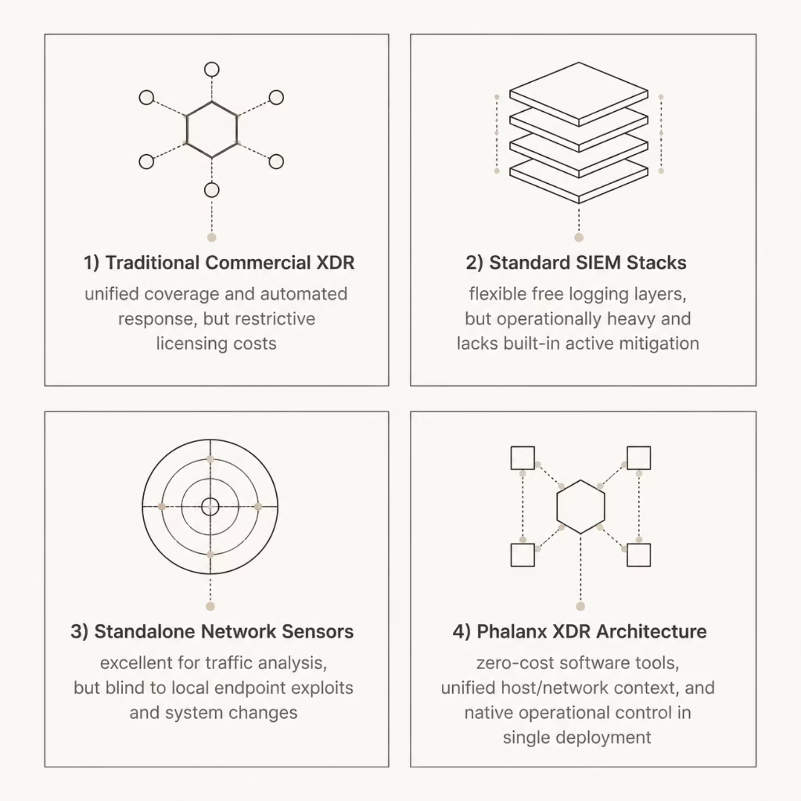
Literature Survey
The security platform landscape presents a clear trade-off between capability and cost. Commercial XDR solutions offer unified coverage but impose restrictive licensing. Standard SIEM stacks provide free logging yet remain operationally heavy without built-in mitigation. Standalone network sensors excel at traffic analysis but are blind to endpoint exploits. Phalanx XDR bridges these gaps by blending zero-cost software tools, unified host/network context, and native operational control inside a single deployment footprint.

Slide 6

Methodology of the Proposed Project Work
Telemetry Collection
Ingestion & Pipeline
Management & Response
The three-tier architecture ensures complete decoupling between data collection, analysis, and response — enabling the system to scale under load without event loss.
Tier 1: Telemetry Collection
Tier 2: Ingestion & Pipeline
Tier 3: Management & Response
Deploys network daemons parsing passive DHCP traffic, DNS sniffing, and flow logs using raw Python sockets. Runs ultra-lightweight endpoint agents capturing process lifecycles, file adjustments, and memory usage metrics.
API Engine: Built on ASP.NET Core to ingest streaming JSON payloads with minimal pipeline latency. Queue Layer: Uses Redis to buffer incoming telemetry spikes smoothly, preventing system backpressure. Correlator Service: Background worker checking incoming logs against stateful YAML detection rule sets.
Console Interface: ASP.NET MVC dashboard delivering real-time alert popups utilizing web sockets. Policy Automation: Orchestration engine matching incoming alert profiles with active mitigation playbooks. Data Engine: Structured database tracking network states, device registries, and alert histories.

Slide 7
Scope of the Project Work
Functional Bounds
Operational Constraints & Future Vectors
Monitored Domains: File integrity, processes, raw sockets, user logins, DHCP states, and active local DNS queries.
Detection Footprint: Over two dozen custom YAML rules explicitly mapped against malicious MITRE ATT&CK techniques.
Active Containment: Scripted network isolation, egress bandwidth throttling, process kills, and local rogue domain sinking.
Environment Boundaries: Engineered and tested directly within multi-VM local laboratory environments.
Target OS Constraints: Native automated network actuators are optimized primarily for Linux kernel configurations.
Scalability Path: Moving toward kernel-level tracing (eBPF) and decentralized cluster routing for multi-tenant installations.

Slide 8
Technical Deliverables Produced
System Documentation
Core Software Repositories
Monograph report covering systems design, logic modeling, and performance evaluation.
Six-step environment deployment runbook and rigorous data schema specifications.
Structured .NET solution split into ingestion modules, engine workers, and dashboard controls.
Optimized, self-contained Python scripts for endpoint collection and network sensing.
Rules & Automation Controls
Custom behavior analysis rule library mapped completely to operational matrix standards.
Production-ready orchestration templates configuration files managing the entire pipeline deployment.

Slide 9
Support Material & System Evidence
YAML Detection Rule Spec
Mitigation Playbook Design
Simple syntax structures identifying high-severity events like web servers spawning local system shells.
Stateful rules aggregating and measuring event patterns over time to completely eliminate false positives.
Automated playbooks triggering immediate host network blocks upon critical security violations.
Built-in traffic rate limits and dry-run testing states to safeguard regular system operational stability.

Slide 10
Declaration & Acknowledgement
Presentation Permission
Information Authenticity
Supervisor is fully informed and approved presentation for this review
All data and metrics provided represent verified engineering implementations
Student Details: Mbaziira Joel Jimmy | Roll No: 012221086 | ISBAT University
Acknowledgement
This project would not have been possible without the guidance and support of several individuals and institutions. I extend my sincere gratitude to all who contributed to the successful completion of this work.
Supervisor
Institution
Peers & Community
Dr. Mayur Kumar Department of ECE, FICT, ISBAT University. For expert technical guidance, consistent mentorship, and invaluable feedback throughout the research and development process.
ISBAT University — Faculty of ICT. For providing the academic infrastructure, laboratory resources, and institutional support necessary to undertake this research.
Fellow students and the open-source community. For collaborative discussions, code reviews, and shared knowledge that enriched the technical depth of this project.

