Slide 1
Data Structure

Slide 2
What is EventKit
allow acces to calender and reminder data
can use it to set alarms, create events, etc.
if change occurs outside the app, event sends update, allowing to sync

Slide 3
EKEventStore
App needs permission from user before accesing calender database
Calender (application) is accesed through EKEventStore

Slide 4
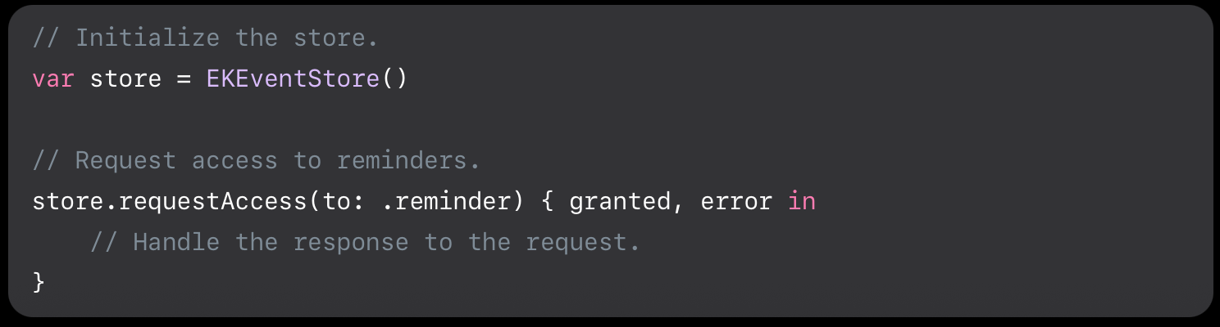
Connect to the Event Store

Slide 5
Privacy Setting
Must include following in Info.plist
  NSCalendarsUsageDescription
  NSRemindersUsageDescription
  NSContactsUsageDescription
Otherwise app will crash for iOS 10.0 or higher

Slide 6
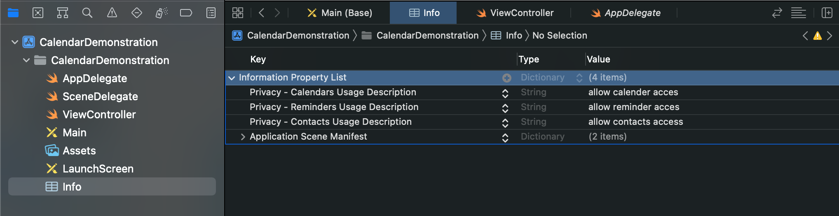
Privacy Setting

Slide 7
EKCalendar
Class that represents calendar in EventKit
Create a calendar with:
init(for: EKEntityType, eventStore: EKEventStore)
EKEntity Type (event or reminder)
All acces to calendar over an EKEventStore

Slide 8
EKCalendar parameters
Title
AllowContentModifications
Source (not created)
IsSubscribed
cgColor
type

Slide 9
EKCalendar types
Following Enums:
local for a local calendar
calDav fo a CalDav or iCloud Calendar
exchange for an exchange Calendar
subscription for a locally subscribed calendar
birthday for a birthday calendar

Slide 10
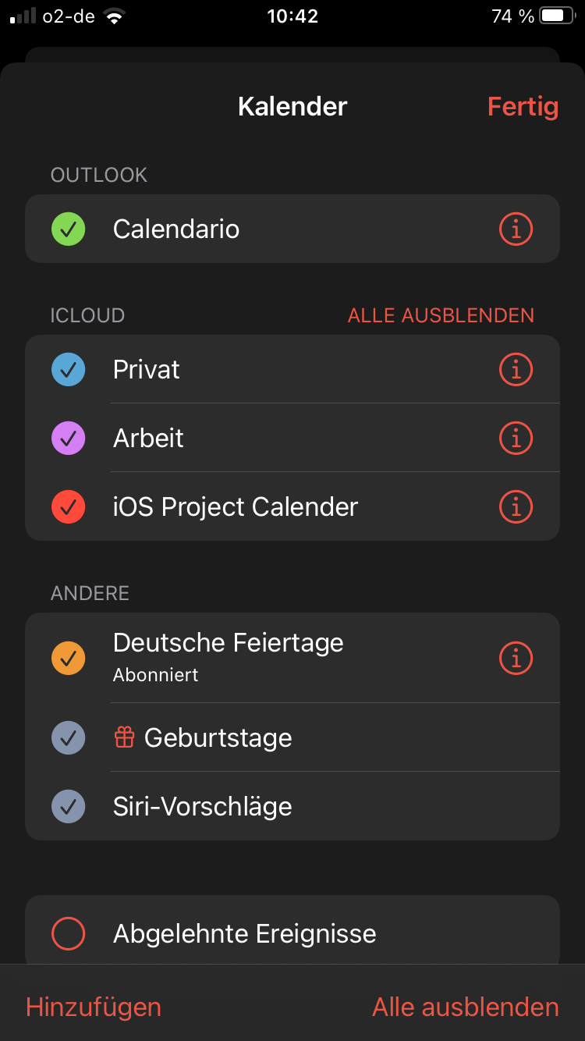
EventStore sources
Returns unordered array of accounts containing calendars
These accounts are not created, rather we choose the source for a calendar

Slide 11
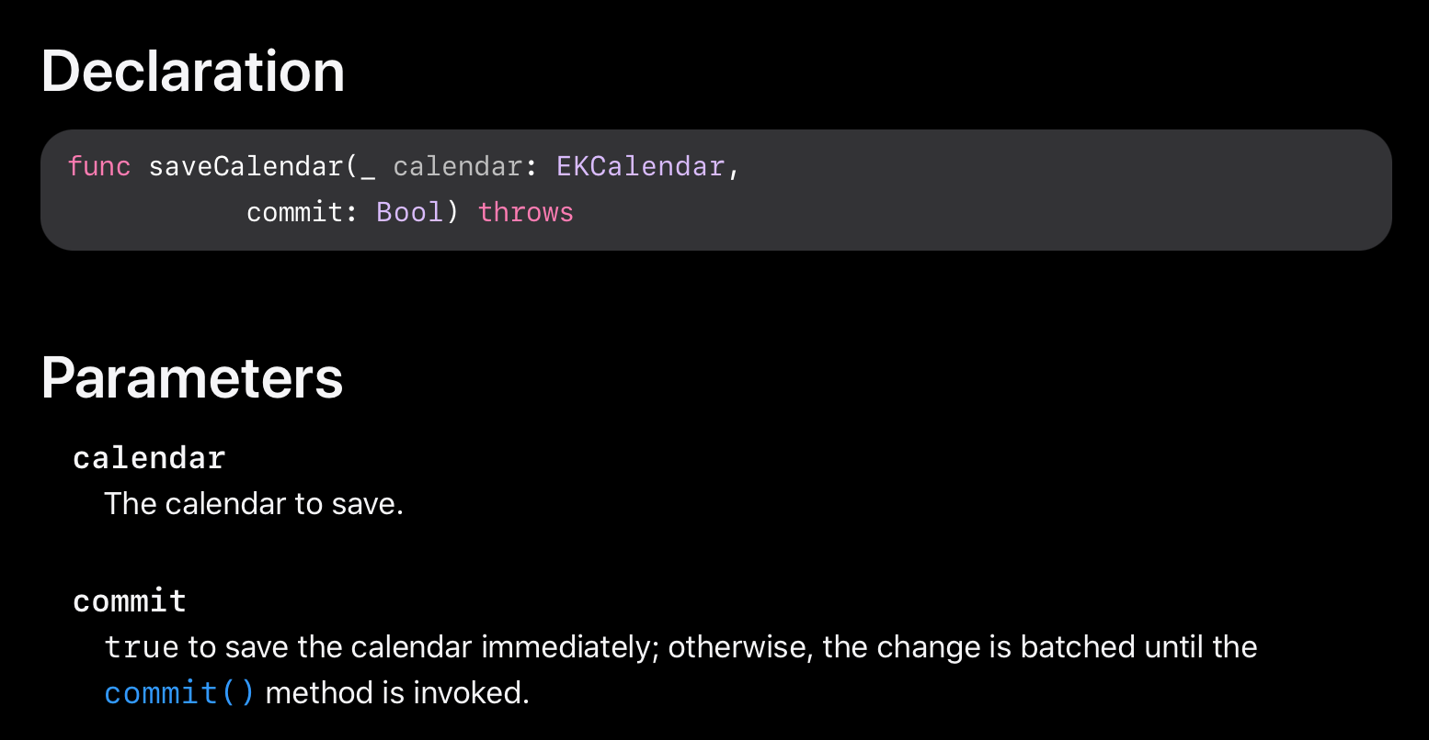
Save Calendar

Slide 12
Edit Calendars
Fetch calendar
Set calendar properties
Save calendar

Slide 13
Add Events
Create Event
  init(eventStore: EKEventStore)
Set all isAllDay to true for all Day Events
Save Event
  func save(EKEvent, span: EKSpan)
  EKSpan only for reocurring events if one wish to delete future events

Slide 14
Add reocurring events
Create reocurance rule
  init(recurrenceWith type: EKRecurrenceFrequency, interval: Int, end: EKRecurrenceEnd?)
Type: Frequeny tipe (e.g weekly, monthly, etc.)
Interval: the interval of the type
End: end of the rule (nil goes till infinity)
Set event.recurrenceRules = [created rule]

Slide 15
Fetch Events
Multiple events with predicates, search queries
  Result is not returned in cronological order!
Search with unique identifier
Note: EventKit only build in with predicate to filter start Date and End Date. Other filters have to be programmed

Slide 16
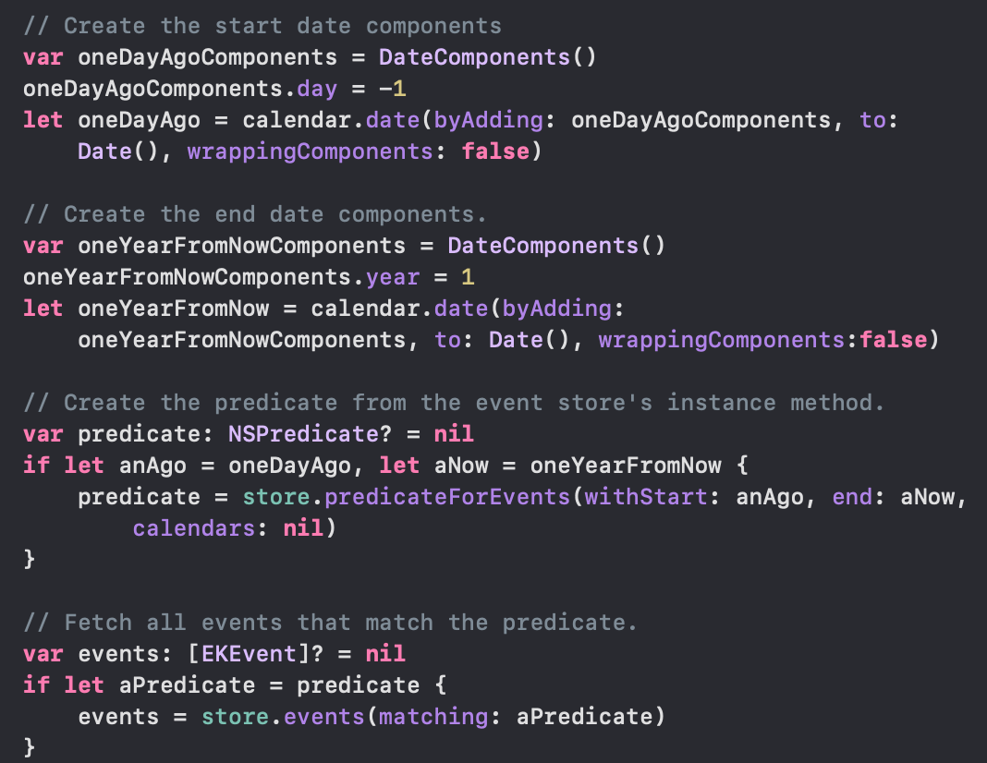
Example fetch events from 1 day ago to next year
Predicate defines which events should be fetched (in this case: events from yesterdy to next year)
Which calendars to fetch from,
nil fetches from all calendars

Slide 17
Fetch Events with unique identifier
If event has been fetched one can acces it’s unique identifier the following way
  event.eventIdentifier
Fetch the event the following way
  event(withIdentifier:)
One can acces more items than events and events with this function
  calendarItem(withIdentifier:)

Slide 18
Delete Event
func remove(_ event: EKEvent, span: EKSpan)
EKEvent to be removed
EKSpan can be set to delete future events in case for reocurring events

Slide 19
Edit Events
Event needs to be fetched first
Edit events propertie
Save event with eventStore

Slide 20
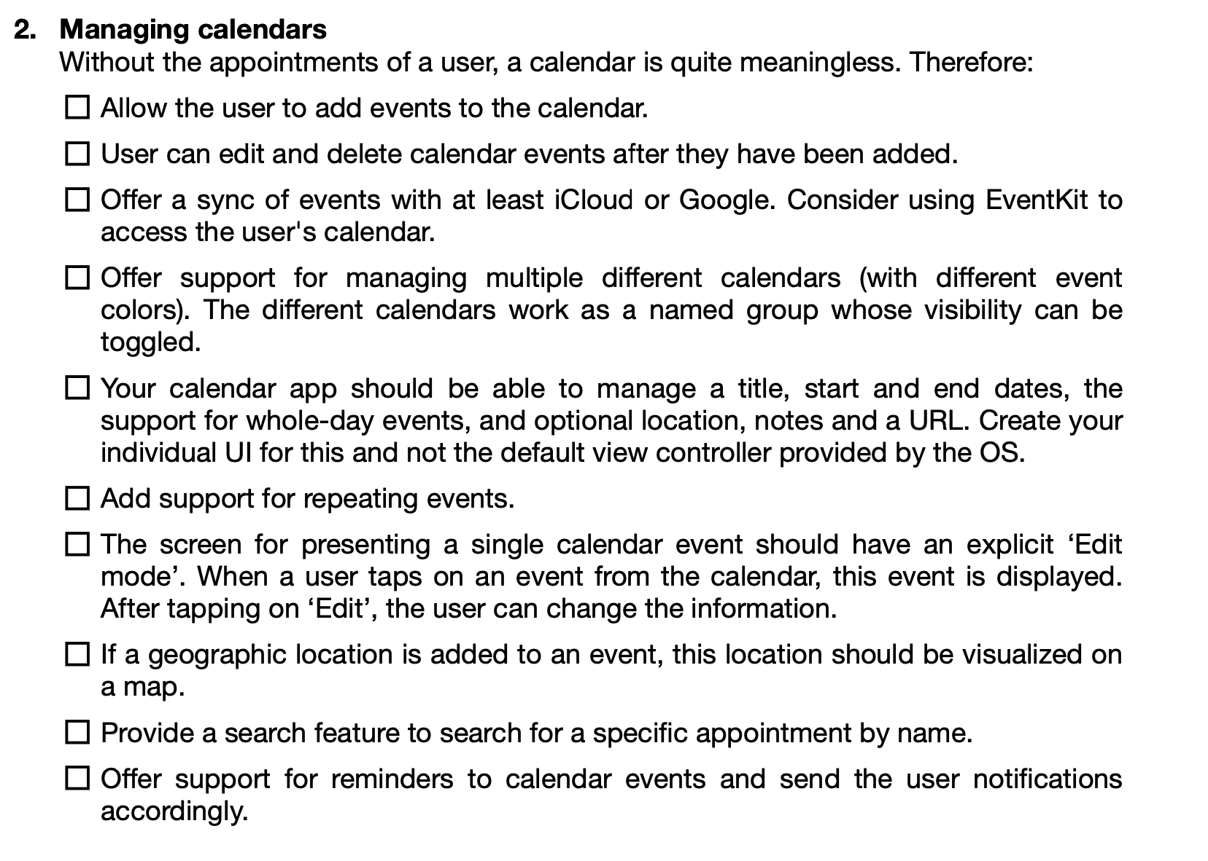
Where are we now?

Slide 21
Next Steps
Finish checkmarks until the line
Research EventKitUI
Add reminders (Joel)
Research mapkit for location in events (Joel)
Implement tasks (Hector and Suraj)

Slide 22
Links
Docs
https://www.andrewcbancroft.com/2015/06/17/creating-calendars-with-event-kit-and-swift/

Slide 23
This work is licensed under a Creative Commons Attribution-ShareAlike 3.0 Unported License.
It makes use of the works of Mateus Machado Luna.

