Slide 1
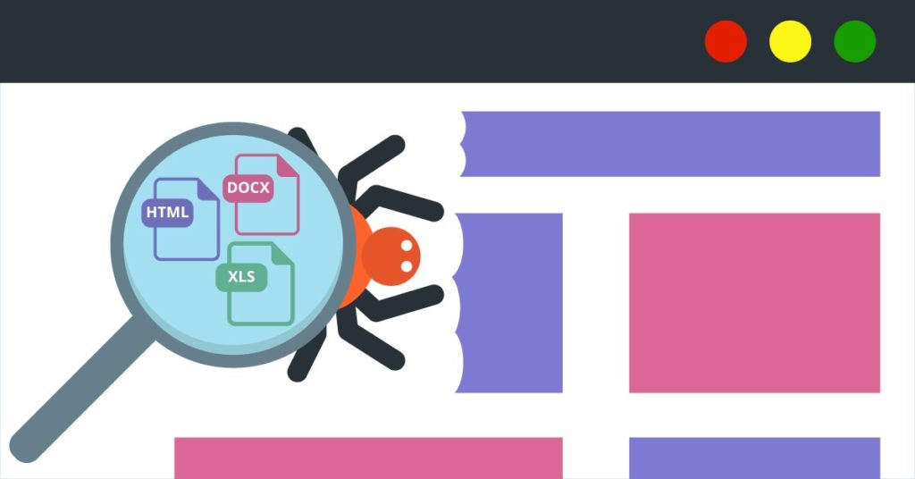
Bachelor Thesis Presentation
Web Scraping for a Database of Court Decision Related Documents
Alec Schürmann
https://geekflare.com/wp-content/uploads/2019/09/4_0Web-Scraping.jpg

Slide 2
Content
Introduction
Steps
Tools
Related Work
Timetable
Introduction to Web Scraping
Example
Comparison of three web scraping methods
Discussion

Slide 3
Introduction
Anonymized documents to protect privacy
Linking rulings with external data makes re-identification possible
Natural Language Processing to automate this process => external data needed
Create structured database from Swiss court decisions related documents

Slide 4
Steps
Identify promising data sources on the web
Analyze the HTML and scrape the documents
Extract the text and data
Structure in a database
Evaluate results

Slide 5

Tools
Python
BeautifulSoup 4
Requests
Tika-Python
https://miro.medium.com/max/4800/1*vEHkp1Txtr0xiO_LMqVrkA.png

Slide 6
Related Work
Rohmat Gunawan et al. Comparison of web scraping techniques: regular expression, html dom and xpath[1]
Importance and uses of web scraping
Comparation by process time, memory usage and data consumption
Daniel Myers et al. Choosing scrapy[2]
Viabilty of «Scrapy» for undergraduate web scraping projects
De S Sirisuriya et al. A comparative study on web scraping[3]
Background of web scraping
Comparing web scraping techniques and software

Slide 7
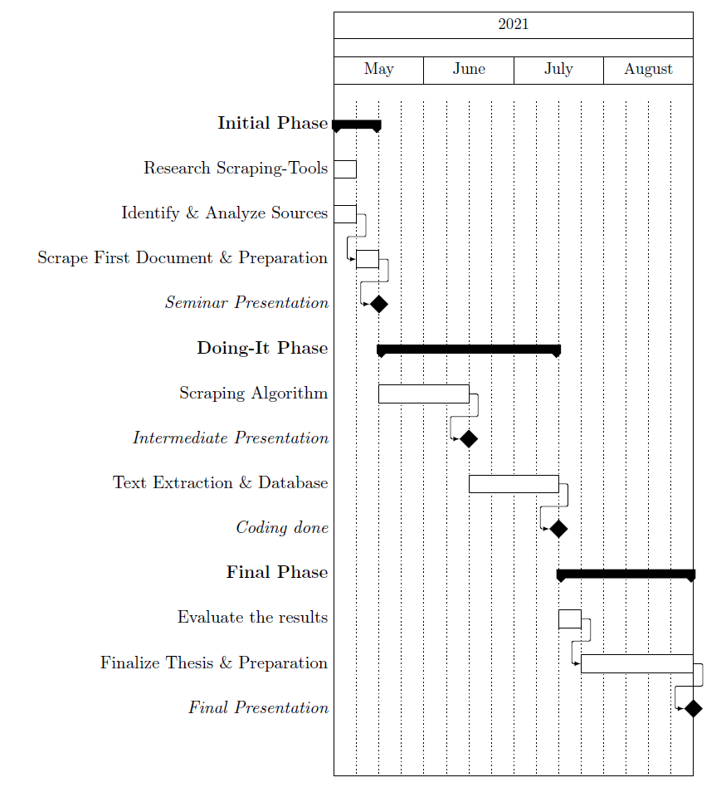
Timetable

Slide 8
Introduction to Web Scraping
Collect & analyze spread out data
Extract unstructured data
Transform into structured data stored in a database
Analyze results
Create spreadsheets, visualizations, etc.
Used for price comparison, market analysis, collect government data and much more…

Slide 9
Introduction to Web Scraping
HTML pages
Scraping technology
Structured data

Slide 10
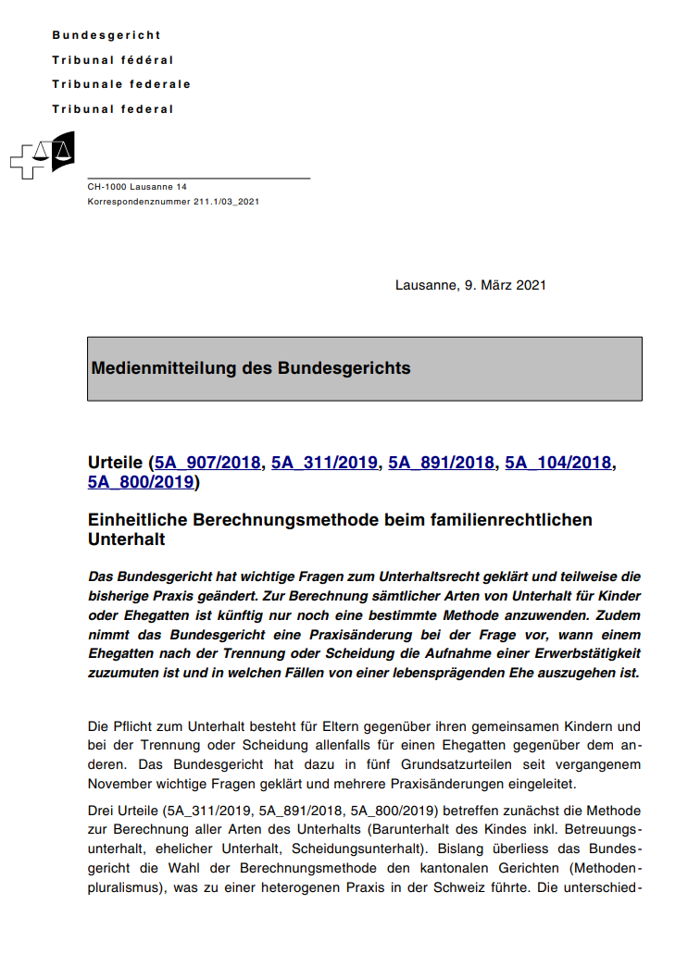
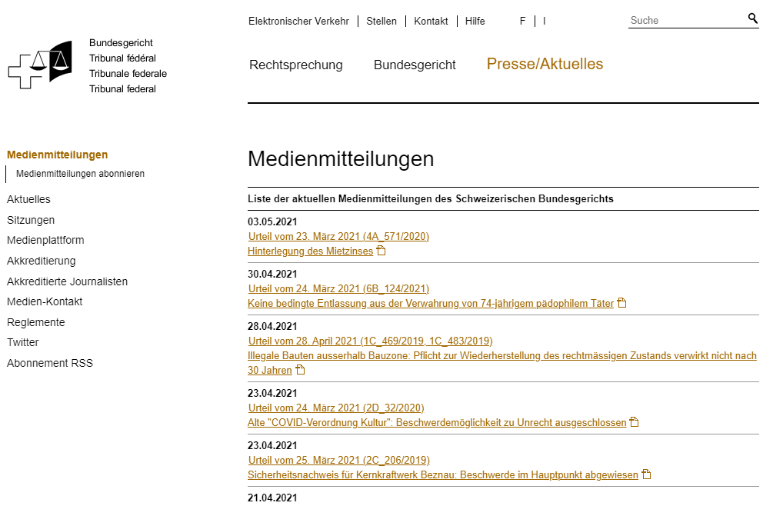
Media messages of the Swiss federal court

Slide 11
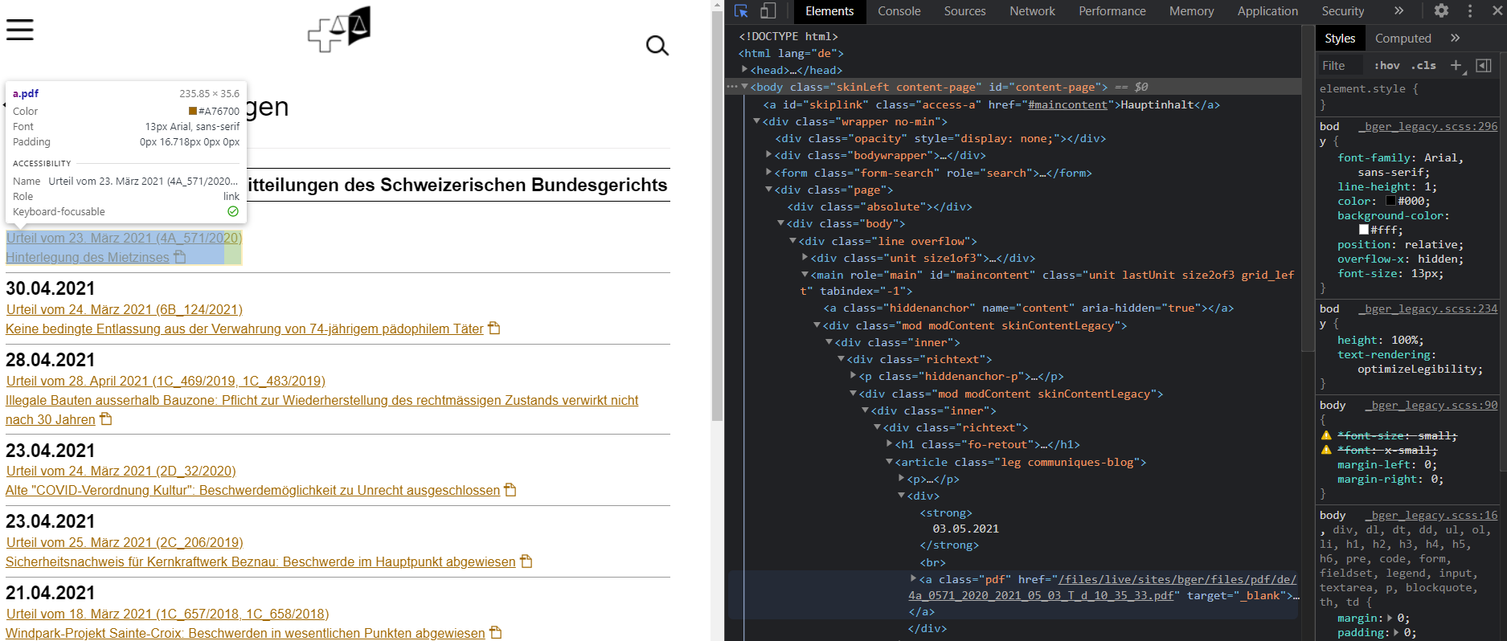
https://www.bger.ch/index/press/press-inherit-template/press-mitteilungen.htm

Slide 12
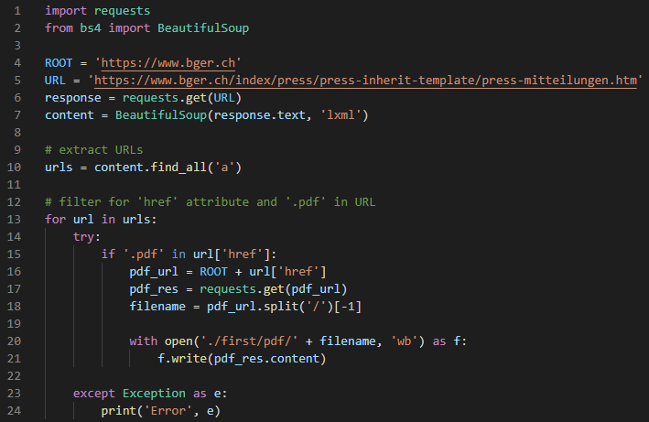
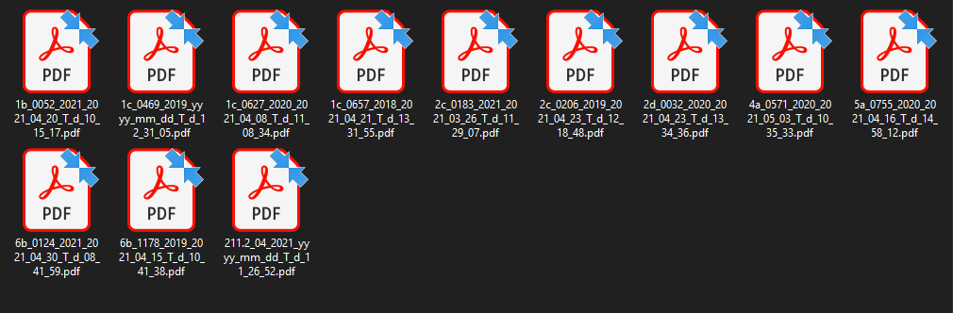

Slide 13
Comparison of three web scraping methods
Regular Expression (Regex)
Match character patterns in a set of strings
HTML Document Object Model (HTML DOM)
Access HTML elements and their objects/properties
XPath
Navigate elements and attributes in XML/HTML
xpath"//*[@id='case_table']/table/tbody/tr[i]/td[j]"
Process time, memory usage, and data consumption are used as measurement parameters
[1] Rohmat Gunawan et al. Comparison of web scraping techniques: regular expression, html dom and xpath

Slide 14
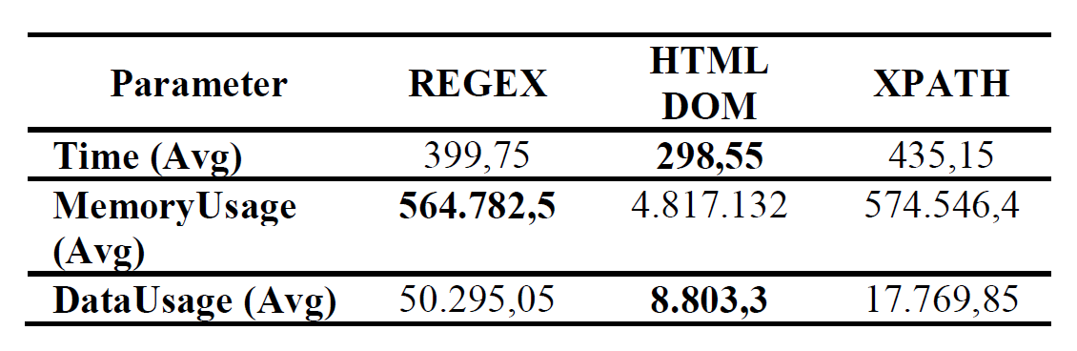
Comparison of three web scraping methods
[1] Rohmat Gunawan et al. Comparison of web scraping techniques: regular expression, html dom and xpath

Slide 15
Conclusion
Scrape court decision related documents with BeautifulSoup4 and Requests
Extract text and metadata
Create structured database
Analyze results

Slide 16
References
Rohmat Gunawan, Alam Rahmatulloh, Irfan Darmawan, and Firman Firdaus. Comparison of web scraping techniques: regular expression, html dom and xpath. In 2018 International Conference on Industrial Enterprise and System Engineering (ICoIESE 2018), pages 283{287. Atlantis Press, 2019.
Daniel Myers and James W McGuffee. Choosing scrapy. Journal of Computing Sciences in Colleges, 31(1):83-89, 2015.
De S Sirisuriya et al. A comparative study on web scraping. Department of Computer Science, Faculty of Computing, General Sir John Kotelawala Defence University, Ratmalana, Sri Lanka, 2015.

Slide 17

Discussion
Image: Wikipedia

