Slide 1

MISPERCEPTION AND NORMS IN
Female Labor Force Participation
A Pilot Information Experiment, Benchmarked Against a 181-Country Panel
Joel Nithish Kumar Murugan
Empirical analysis combining an original N=9 framing experiment with public cross-country labor data (ILO / World Bank, 1990–2025)

Slide 2


What This Study Is About
A claim that people “misperceive” a statistic is only meaningful once that statistic’s actual behavior — relative to a defensible benchmark — has been established. This study treats that benchmarking exercise as a primary part of the analysis, not a preliminary aside.
Component 1: The Pilot
Component 2: The Global Panel
A small original experiment (N=9) testing whether accurate information about India’s FLFPR growth shifts:
Stated support for women’s labor force participation
Perceived social norms around the issue
Beliefs about whether the trend will continue
A 181-country, 36-year panel (1990–2025) used to establish whether there is anything real and unusual to misperceive in the first place:
Is India’s growth genuinely an outlier?
Where does India’s level rank globally?
How do pilot guesses compare to the real distribution — not just the point estimate?
2
Misperception and Norms in Female Labor Force Participation

Slide 3
Three Questions Organize the Analysis
1
Is India’s growth unusual?
Does India’s recent rise in female LFPR stand out in cross-country perspective, or does it only look large viewed in isolation?
2
Where does India’s level sit?
A distinct question from growth: where does India’s current FLFPR rank against the rest of the world?
3
Are guesses well-calibrated?
When respondents estimate India’s FLFPR, how do their guesses compare to the true value — and to where that value falls in the global distribution?
3
Misperception and Norms in Female Labor Force Participation

Slide 4

Data and Methods
Global panel
India state panel
181 countries, 1990–2025. ILO Modelled Estimates via World Bank WDI, processed by Our World in Data. Regional/income aggregates excluded.
State-by-sector FLFPR, 2017-18 vs. 2022-23. 12-row subset from Ravi & Kapoor (2024), an EAC-PM working paper using PLFS microdata.
South Asia comparator
Pilot survey (N=9)
2023–2024 FLFPR for India, Bangladesh, Pakistan, Sri Lanka, Nepal — same ILO/World Bank series, one consistent scale.
Three arms: control, shown-the-statistic, and guess-then-correct. A feasibility exercise, not a powered study.
All computation: base R only (aov, t.test, cor.test, base graphics) — no external package dependencies.
4
Misperception and Norms in Female Labor Force Participation

Slide 5
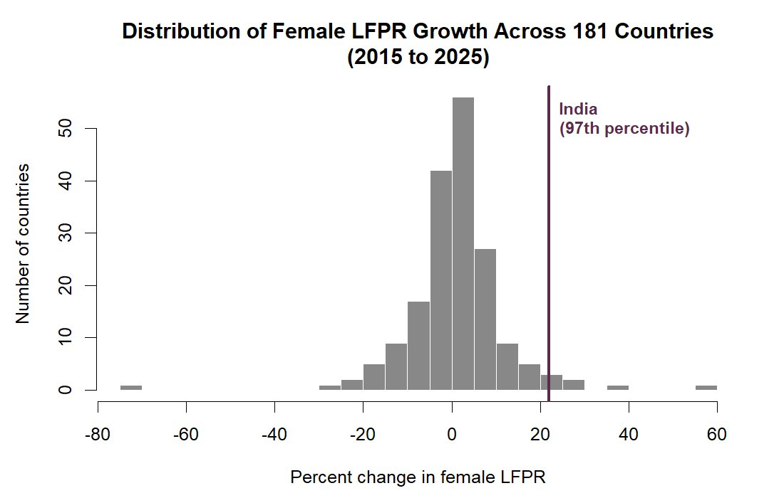
Finding 1
India’s Growth Rate Is an Outlier
97th
percentile of global growth rates, 2015–2025
India: 26.6% → 32.4% over 2015–2025 (+22.0% relative).
Ranked against 181 other countries with comparable data, this growth rate exceeds roughly 97 of every 100 countries in the panel.
Most countries cluster around a modest single-digit change over the decade; India sits far into the right tail, alongside outliers like Saudi Arabia.
5
Misperception and Norms in Female Labor Force Participation

Slide 6
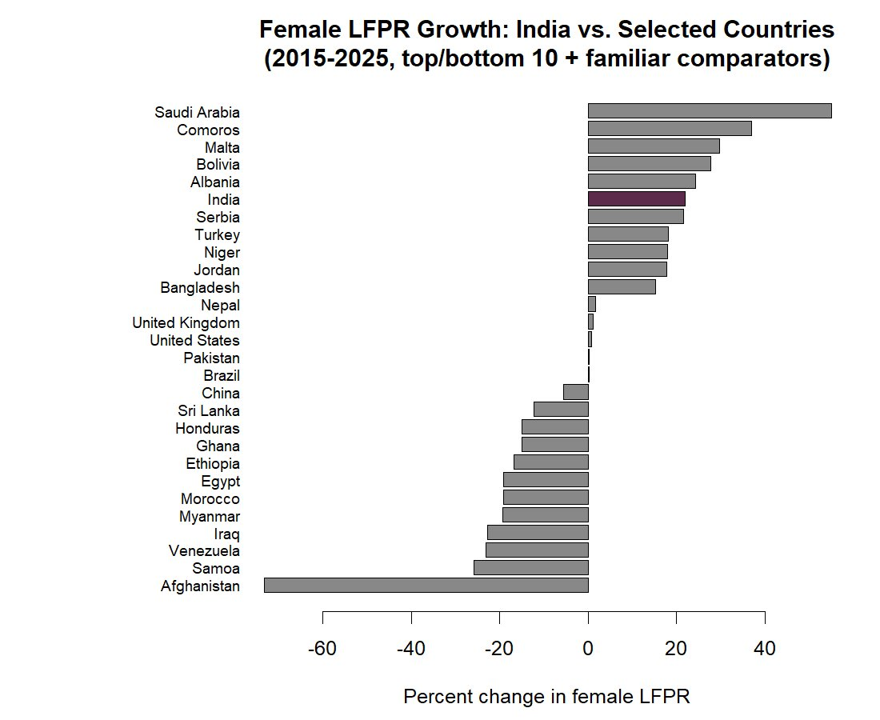
Finding 1, continued
Where India Sits Among Its Peers
Top/bottom 10 growth performers, plus familiar comparators (US, UK, China, Bangladesh, Pakistan, Brazil, Sri Lanka, Nepal).
India sits just below Saudi Arabia, Comoros, Malta, Bolivia, and Albania — near the very top of the full sample.
6
Misperception and Norms in Female Labor Force Participation

Slide 7
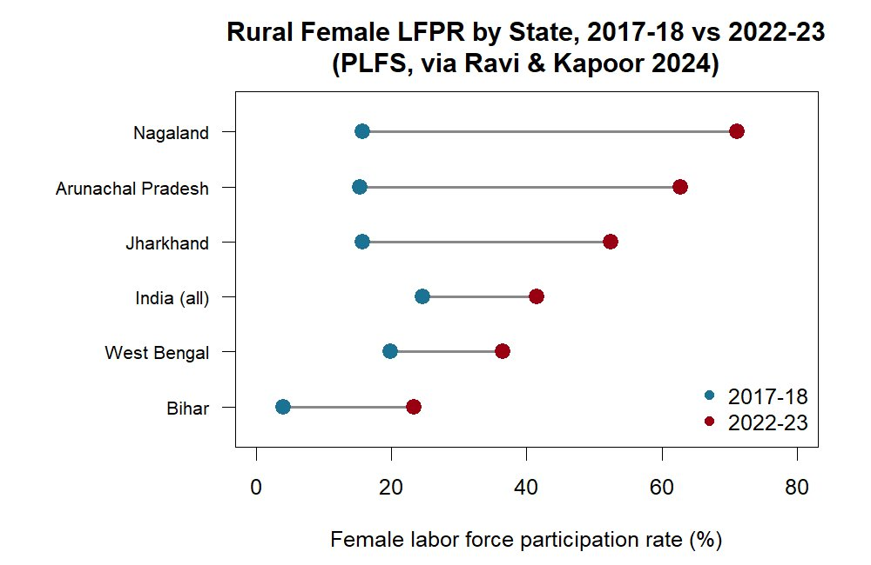
Finding 2
But the Absolute Level Remains Low
11.5th
percentile of global FLFPR level, 2023
A classic “low base” pattern: roughly 88% of countries in the panel have higher female LFPR than India, despite its unusually rapid recent growth.
Growth and level are distinct statistics — climbing fast does not by itself mean catching up.
7
Misperception and Norms in Female Labor Force Participation

Slide 8
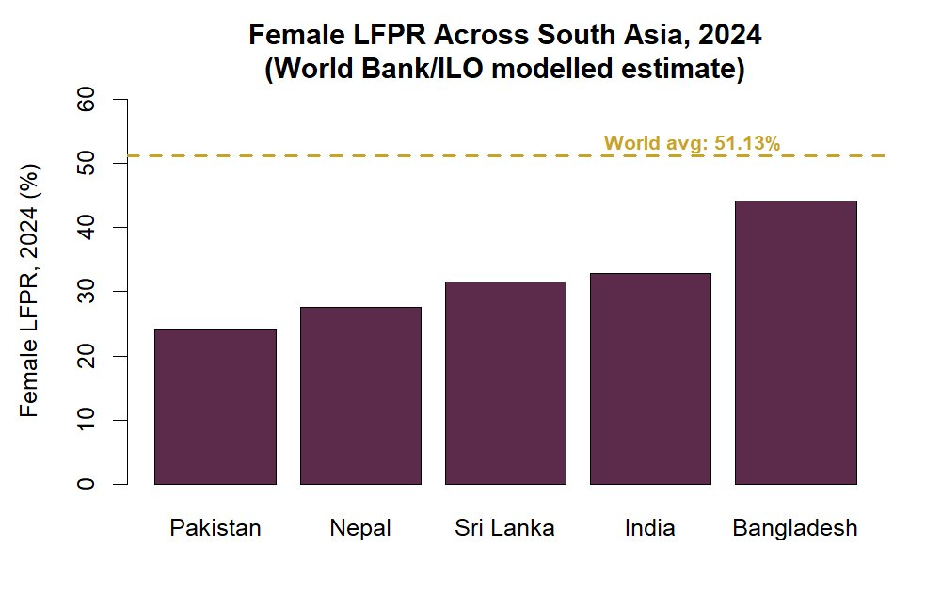
Finding 2, continued
India in Regional Context
Among five South Asian countries on the same internationally harmonized series, India’s 2024 FLFPR (32.8%) sits in the middle:
Below Bangladesh
Comparable to Sri Lanka
Above Pakistan and Nepal
All five sit well below the global average of 51.1%.
8
Misperception and Norms in Female Labor Force Participation

Slide 9
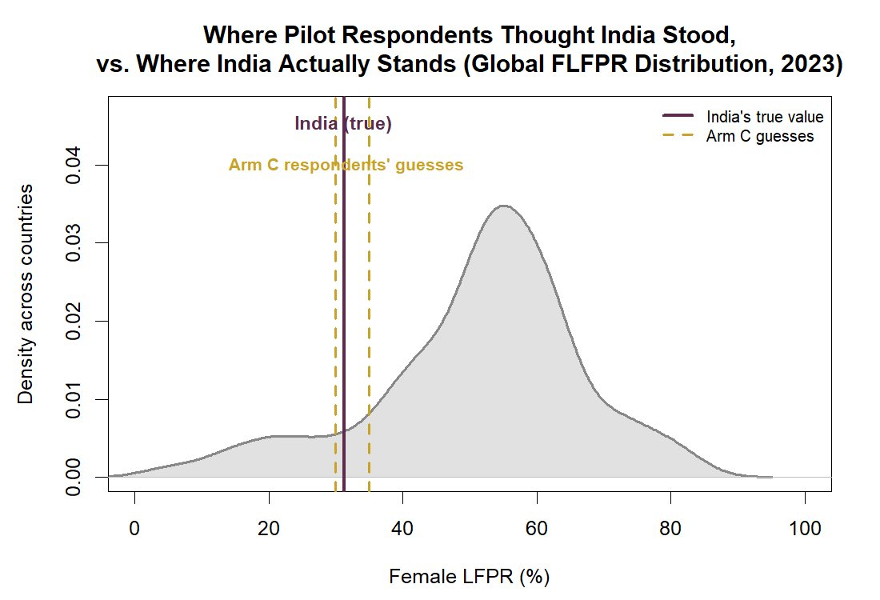
Finding 3
Pilot Guesses, Benchmarked Against the World
Respondent | Guess | True value | Guess %ile | True %ile
C01 | 30% | 31.24% | 10.4 | 11.5
C02 | 30% | 31.24% | 10.4 | 11.5
C03 | 35% | 31.24% | 13.1 | 11.5
Benchmarked against the World Bank/ILO comparator, guesses placed India almost exactly where it actually falls in the global distribution.
This is not a large misperception — respondents’ intuitive sense of India’s relative standing was well calibrated against this particular source.
9
Misperception and Norms in Female Labor Force Participation

Slide 10

The Result Depends on Which “Truth” You Choose
World Bank / ILO series
India’s own PLFS statistic
31.24%
~41–42%
Internationally harmonized definition. Used for the global panel, so all 181 countries are on one scale.
National survey design, slightly later reference period. Not directly comparable to the cross-country series.
→ guesses look well-calibrated
→ guesses look like an underestimate
Both are legitimately “India’s female labor force participation rate.” The choice of benchmark — not measurement error — determines whether the apparent misperception is negligible or large.
10
Misperception and Norms in Female Labor Force Participation

Slide 11

Discussion
India is climbing quickly (97th percentile on growth) from a low starting point (11th percentile on level), in a way broadly consistent with how this small group of respondents intuitively ranked it — at least relative to one credible international series.
The common intuition that “India still lags substantially” is not, on this evidence, a misperception — it is approximately correct.
The more genuine source of potential confusion is not cross-country ranking, but:
Tracking how fast things are changing within India itself
Reconciling India’s national statistics with internationally harmonized series that can diverge by ten percentage points or more — a methodological gap, not a substantive one
11
Misperception and Norms in Female Labor Force Participation

Slide 12

Limitations
The pilot's attitudinal component (N=9, 3 arms) is not powered to detect anything but very large effects — reported as exploratory, not confirmatory.
The India state panel is a 12-row subset reported in a single working paper, not an independently constructed full state-year panel.
The global panel relies on ILO modelled estimates, which combine direct survey data with statistical imputation where country-level data is missing.
The percentile-rank exercise is descriptive: it characterizes where India sits in a distribution, and does not identify the causes of India's growth trajectory.
12
Misperception and Norms in Female Labor Force Participation

Slide 13

Code and Reproducibility
All data cleaning, percentile-rank calculations, the analysis of variance on pilot outcomes, and every figure in this deck were produced by a single R script.
Base R only — no external package dependencies.
Script, raw data, and output tables are included in the project repository.
Joel Nithish Kumar Murugan
Misperception and Norms in Female Labor Force Participation: A Pilot Information Experiment

