Slide 1

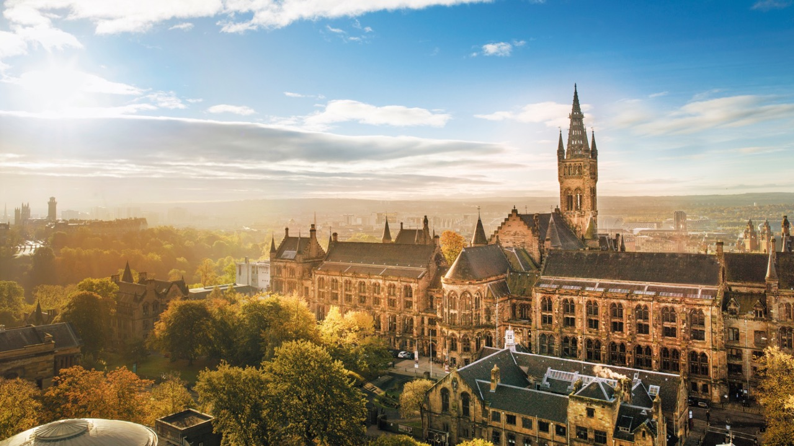



Slide 2
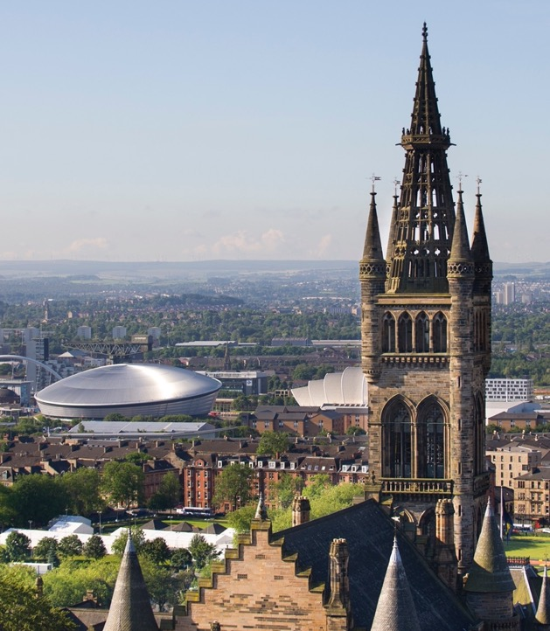
About the University
Established in 1451
Ranked in the top 100 of the world’s universities
Ranked in the top 30 universities in the world for sustainability
Member of the Russell Group of
research-intensive UK universities
Eight Nobel Laureates connected to the University

Slide 5

Change pic to one from Offer holder day presentation

Slide 8
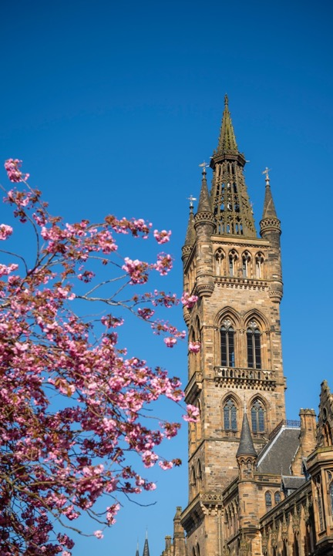

Slide 15

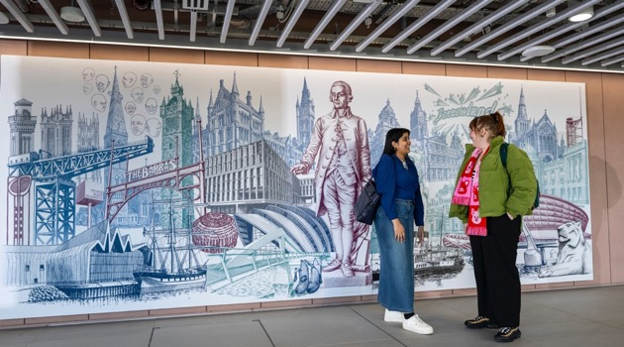

Slide 18
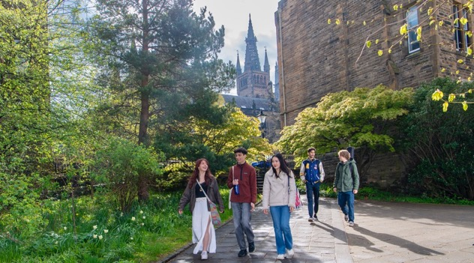



Slide 21
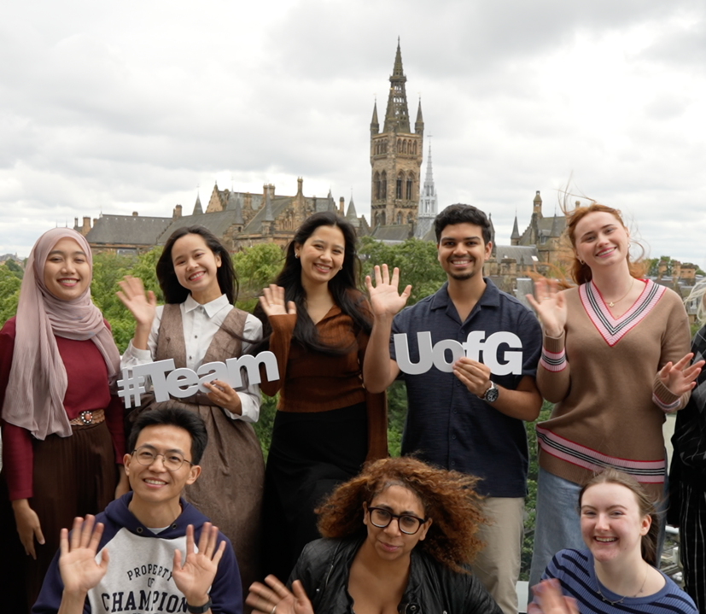

Slide 22


Slide 23


Slide 24


Slide 25


Slide 27


