Slide 1
LR-Miner: Static Race Detection in OS Kernels by Mining Locking Rules
Tuo Li¹, Jia-Ju Bai², Gui-Dong Han², Shi-Min Hu¹,
¹Tsinghua University, ²Beihang University
Notes:
Hello, I am really glad to share our work LR-Miner - Static Race Detection in OS Kernels by Mining Locking Rules. This work aims to detect data races in os kernels through mining locking rules statistically.

Slide 2
Background
Data races
Two threads access the same memory location concurrently
At least one of the accesses is a write
 | Thread1 |  | Thread2
1. 2. 3. 4. 5. | void read(dev) { …… msg = dev->msg; …… } | 6. 7. 8. 9. 10. | void write(dev) { …… dev->msg = msg; …… }
Notes:
A data race generally occurs in concurrent programming when two or more threads access the same memory location simultaneously, with at least one of the accesses being a write operation.
For example, consider the following driver-like code:
In the first thread, the msg field of the dev structure is read, while in the second thread, the msg field of the same dev structure is written.
This introduces a data race between the two accesses, as both threads are accessing the same memory location concurrently without proper synchronization.

Slide 3
Background
Harmfulness of data races
Data corruption
Undefined behavior
Resource Leaks
……
Notes:
Some data races are harmful since they can cause dangerous issues such as data corruption, undefined behavior, and resource leaks.

Slide 4
Background
Harmfulness of data races
Data corruption
Undefined behavior
Resource Leaks
……
 | Thread1 |  | Thread2
 | *p = x00000000 *p = x12345678 |  | a = *p; // a = ?
Notes:
Consider the following example code:
In thread 1, the memory object pointed to by p is first assigned the value 00000000, then 12345678.
In thread 2, the value of the memory object pointed to by p is assigned to the variable a.
So, what will the value of a be? Should it be 00000000 or 12345678?
In fact, the value of a could be 00000000, 12345678, or something else entirely.

Slide 5
Background
Harmfulness of data races
Data corruption
Undefined behavior
Resource Leaks
……
 | Thread1 |  | Thread2
 | *p = x00000000 *p = x12345678 |  | a = *p; // a = ?
0 | 0 | 0 | 0 | 0 | 0 | 0 | 0
Notes:
Consider this scenario:
In thread 1, the memory object pointed to by p is first assigned the value 00000000.
Then, Thread 1 attempts to assign 12345678 to the same memory object.

Slide 6
Background
Harmfulness of data races
Data corruption
Undefined behavior
Resource Leaks
……
 | Thread1 |  | Thread2
 | *p = x00000000 *p = x12345678 |  | a = *p; // a = ?
1 | 2 | 3 | 4 | 0 | 0 | 0 | 0
Notes:
However, while thread 1 is halfway through writing the value to memory,
thread 2 starts reading the value from the memory object pointed to by p.
As a result, the value assigned to the variable a becomes 12340000..

Slide 7
Background
Harmfulness of data races
Data corruption
Undefined behavior
Resource Leaks
……
 | Thread1 |  | Thread2
 | *p = x00000000 *p = x12345678 |  | a = *p; // a = ?
1 | 2 | 3 | 4 | 5 | 6 | 7 | 8
Notes:
Finally, thread 1 completes the write operation, and the memory object pointed to by p is updated to 12345678.
In this case, the value of the variable a is corrupted, which can lead to serious issues.

Slide 8



Background
Operating systems (OS) are race-prone
Intricate code logic
High concurrency
Complex synchronization mechanisms
Data races in OSes can cause serious security issues
Denial of service (DoS) attack
Privilege escalation
Restriction bypassing
Notes:
Operating systems are particularly prone to data races.
First, the code logic of an operating system is highly intricate.
Second, OS kernels are inherently concurrent, and the complexity of their concurrent execution makes them especially vulnerable to race conditions.
Third, OS kernels use complex synchronization mechanisms such as mutex locks, semaphores, and others. Developers can mistakenly implement faulty synchronization, leading to errors.
Data races in an OS kernel can result in severe security vulnerabilities, such as denial-of-service (DoS) attacks, privilege escalation, and security bypasses.
For example, Dirty COW is a critical vulnerability caused by a data race in the Linux kernel's memory management subsystem. By exploiting Dirty COW, an attacker can corrupt critical memory and even gain root privileges.
Therefore, detecting data races in operating systems is both challenging and crucial.

Slide 9
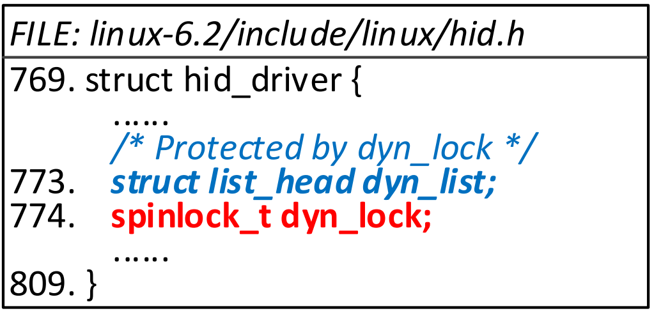
Background
Detection data races
Locking rules: which variable should be protected by which lock
Race detection: identifying locking-rule violations
Notes:
In data race detection, a locking rule specifies which variable should be protected by which lock.
Data races can be identified by checking if a variable access violates any locking rules.
The figure provides an example of locking rules. The annotation from kernel developers indicates that dyn_list should be protected by dyn_lock.
However, most locking rules are poorly annotated or not documented at all, making data race detection quite challenging.

Slide 10
Challenges
C1: Identifying locking rules accurately
Insufficient document
Complex structure layers
C2: Detecting locking-rule violations effectively
Complicated alias relationships
C3: Identifying harmful data races automatically
The code base of OS kernels is very large
The logic of kernel code is very complex
Notes:
In summary, detecting data races in OS kernels presents three main challenges.
First, as mentioned earlier, data race detection involves checking whether a given variable access violates any locking rules.
However, there are two key difficulties.
On one hand, operating systems often lack sufficient documentation specifying which variables should be protected by which locks.
This makes it impossible to directly derive locking rules from documentation.
On the other hand, while variables and their corresponding locks are often in the same data structure, it can be challenging to determine this relationship due to the complex layers created by structure nesting.
As a result, deducing locking rules directly from the code is not always feasible.
Second, the extensive use of pointers and data structures in kernel code creates highly complex aliasing relationships between variables, which significantly complicates the detection of locking-rule violations.
Finally, not all data races are harmful—some are benign and pose no security threat.
Therefore, it is crucial to distinguish between benign and harmful data races.
However, automating this process is difficult, given the large codebase and the intricate logic within OS kernels.

Slide 11
Key Techniques
C1: Identifying locking rules accurately
Feld-aware mining method to deduce locking rules
C2: Detecting locking-rule violations effectively
Alias-aware checking method to check locking-rule violation
C3: Identifying harmful data races automatically
Pattern-based estimation strategy to identify harmful data races
Notes:
To address the above challenges, three key techniques are proposed: A field-aware mining method to deduce locking rules; an alias-aware checking method to check locking-rule violation; a pattern-based estimation strategy to identify harmful data races

Slide 12
Feld-aware mining method
Field graph
Each node represents a ﬁeld
Each edge represents how a lower-layer ﬁeld is accessed from a higher-layer structure
Fields represented by nodes which have the same ancestor are from the same data structure
Field graph update
Field graph is updated by inserting edges according to field access operations
Notes:
First, I introduce the field graph, a tool used to determine whether a variable and a lock are part of the same data structure.
In a field graph, each node represents a field, and each edge illustrates how a lower-layer field is accessed from a higher-layer structure.
Fields represented by nodes that share the same ancestor are part of the same data structure.
The field graph is updated by processing each arrow (->) and dot (.) operator, which denote field access operations.
For each operator, we insert an edge labeled with the accessed field, connecting the node representing the base structure to the node representing the accessed field.

Slide 13
Example
A simplified example
n₁
sd
1. 2. 3. 4. 5. 6. 7. 8. 9. | int get_fmt(…) { …… struct fimc_dev *fimc = sd->dev_priv; struct fimc_ctx *ctx; mutex_lock(&fimc->lock); ctx = (&fimc->vid_cap)->ctx; mutex_unlock(&fimc->lock); …… }
dev_priv
fimc
n₂
Notes:
Here is a simplified example abstracted from the exynos4-is driver code.
At line 3, the field dev_priv is accessed through an arrow operator and assigned to fimc.
Consequently, we insert an edge labeled dev_priv from node n1 to node n2.

Slide 14
Example
A simplified example
n₁
sd
1. 2. 3. 4. 5. 6. 7. 8. 9. | int get_fmt(…) { …… struct fimc_dev *fimc = sd->dev_priv; struct fimc_ctx *ctx; mutex_lock(&fimc->lock); ctx = (&fimc->vid_cap)->ctx; mutex_unlock(&fimc->lock); …… }
dev_priv
fimc
n₂
lock
n₄
Notes:
At line 5, the lock field is accessed through an arrow operator.
Therefore, an edge labeled lock is inserted from node n1 to node n4.
This indicates that the object represented by node n4 can be accessed through the lock field of fimc.

Slide 15
Example
A simplified example
n₁
sd
1. 2. 3. 4. 5. 6. 7. 8. 9. | int get_fmt(…) { …… struct fimc_dev *fimc = sd->dev_priv; struct fimc_ctx *ctx; mutex_lock(&fimc->lock); ctx = (&fimc->vid_cap)->ctx; mutex_unlock(&fimc->lock); …… }
dev_priv
fimc
n₂
vid_cap
lock
n₃
n₄
ctx
n₅
ctx
Notes:
At Line 6, through two arrow operations, we get the final field graph.

Slide 16
Example
A simplified example
n₁
sd
1. 2. 3. 4. 5. 6. 7. 8. 9. | int get_fmt(…) { …… struct fimc_dev *fimc = sd->dev_priv; struct fimc_ctx *ctx; mutex_lock(&fimc->lock); ctx = (&fimc->vid_cap)->ctx; mutex_unlock(&fimc->lock); …… }
dev_priv
fimc
n₂
vid_cap
lock
n₃
n₄
ctx
n₅
ctx
Notes:
In the field graph, the node representing ctx (i.e., n5) and the node representing lock (i.e., n4) share a common ancestor, n2.
This indicates that they are part of the same data structure, as inferred from the field graph.
Therefore, the ctx field is likely to be protected by the lock field, since they are within the same data structure named fimc.

Slide 17
Feld-aware mining method
Locking-rule mining
N_{p}(V, L): Accesses that protected by the lock
N_{a}(V): All accesses (at least on access is a write operation)
T: A threshold set by developers
V should be protected by L if N_{p}(V, L) / N_{a}(V) > T
(locking rule <V, L>)
Notes:
Given a variable V and a lock L that are part of the same data structure, as identified by the field graph,
let Np be the number of accesses to V that are protected by L, and Na be the total number of accesses to V, where at least one access is a write operation.
If the ratio of Np to Na exceeds a given threshold T, then all accesses to the variable V should be protected by the lock L.

Slide 18
Alias-aware checking method
Alias relationships
Variables exist in the same node in the field graph are aliases
Alias-aware Lockset analysis
Lock(L): insert the node representing lock L into the lockset
Unlock(L): remove the node representing lock L from the lockset
Detection of data races
Given a locking rule <V, L>, if V is accessed while the node representing L is not in the lockset, a data race is identified
Notes:
OS kernels have large code bases with complex alias relationships.
Using our field graph, we can determine whether two variables are aliases by checking if they appear in the same node within the graph.
After identifying alias relationships, we use lockset analysis to detect data races.
Specifically, when a lock is acquired, we add the node representing the lock to the lockset; when a lock is released, we remove the node from the lockset.
When the variable V is accessed, for each locking rule such as <V, L>, if V is accessed while the node representing L is not present in the lockset, a data race is identified.

Slide 19
Example
n₁
sd
A simplified example
dev_priv
1. 2. 3. 4. 5. 6. 7. 8. 9. 10. | int get_fmt(…) { …… struct fimc_dev *fimc = sd->dev_priv; struct fimc_ctx *ctx; mutex_lock(&fimc->lock); ctx = (&fimc->vid_cap)->ctx; mutex_unlock(&fimc->lock); int state = ctx->state; …… }
fimc
n₂
vid_cap
lock
n₃
n₄
ctx
n₅
ctx
state
n₆
state
Notes:
In the example, suppose that the field ctx should be protected by the field lock.
The lock is removed from the lockset at line 7, but ctx is accessed at line 8.
Since ctx and the field ctx are aliases, a data race is identified.

Slide 20
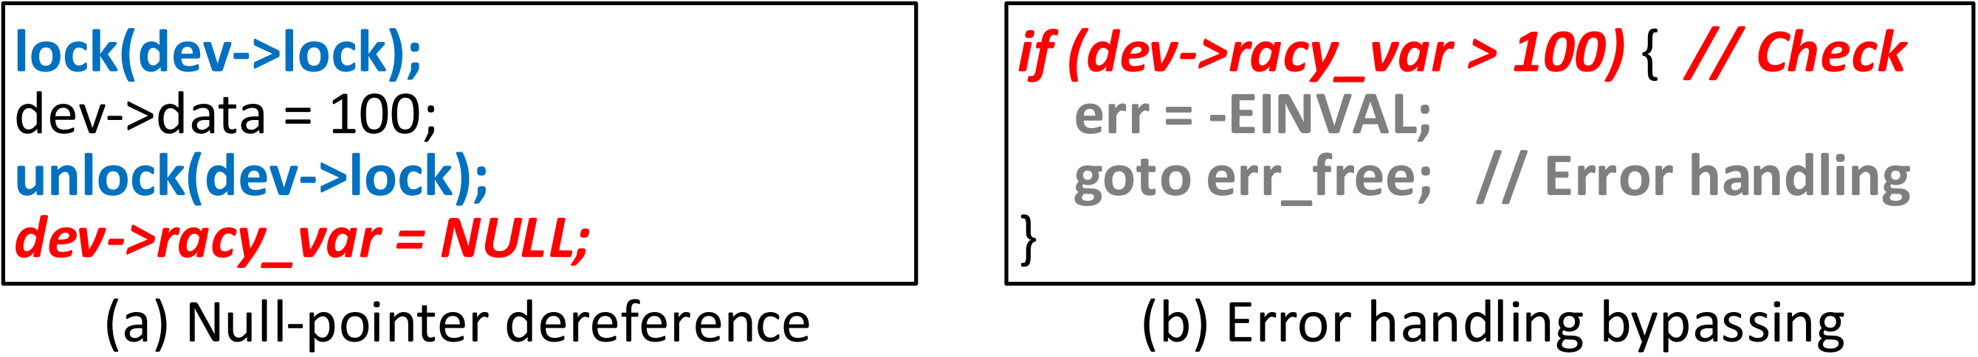
Pattern-based estimation strategy
(a) Null-pointer dereference (NPD)
A racy variable is a pointer that is assigned or checked by NULL
(b) Error handling bypassing (EHB)
A racy variable affects a branch check of error handling
Notes:
To identify harmful data races, we have identified four patterns that can lead to security issues.
First, If a racy variable is a pointer that is assigned or checked for NULL, it can result in a null-pointer dereference.
Second, If a racy variable influences a branch check related to error handling, it can lead to error handling bypass.

Slide 21
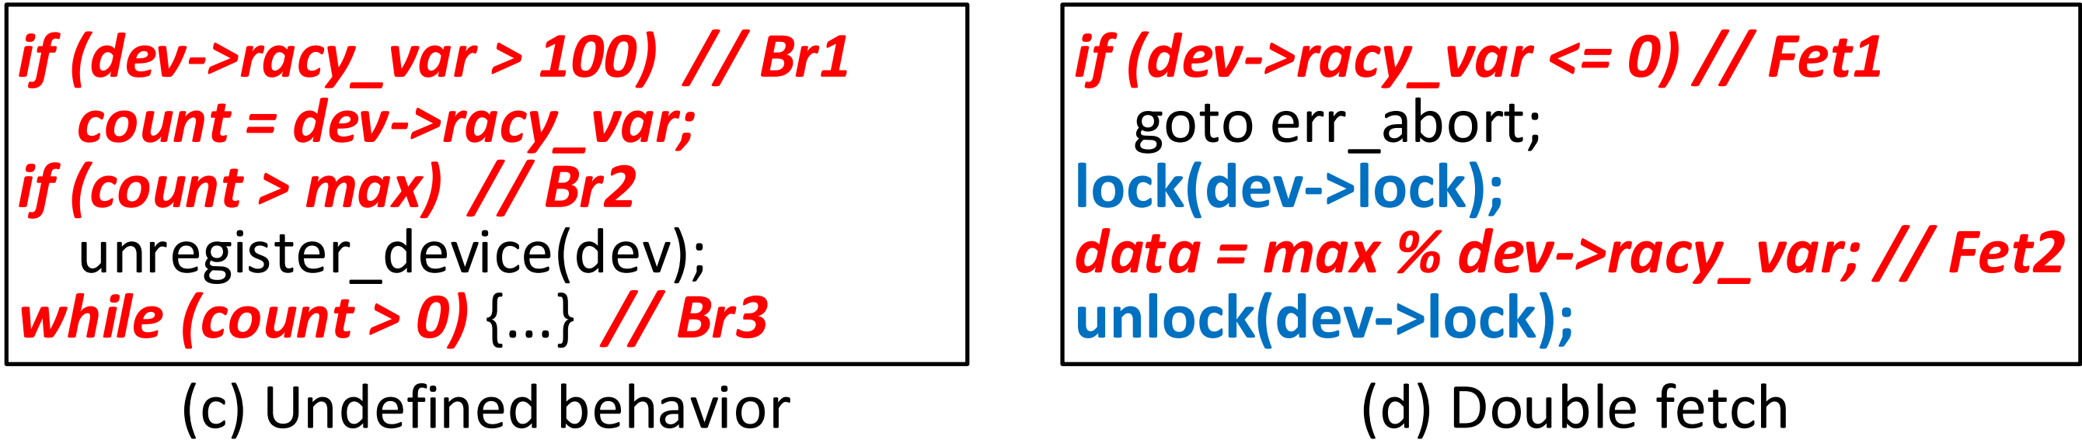
Pattern-based estimation strategy
(c) Undeﬁned behavior (UB)
A racy variable affects multiple (≥3) branches
(d) Double fetch (DF)
A racy variable is checked before being used, but this check and use are not protected by a common lock
Notes:
Thirdly, If a racy variable affects multiple branches, undefined behavior can occur.
Fourthly, If a racy variable is checked before use but the check and use are not protected by a common lock, a double fetch can occur.

Slide 22
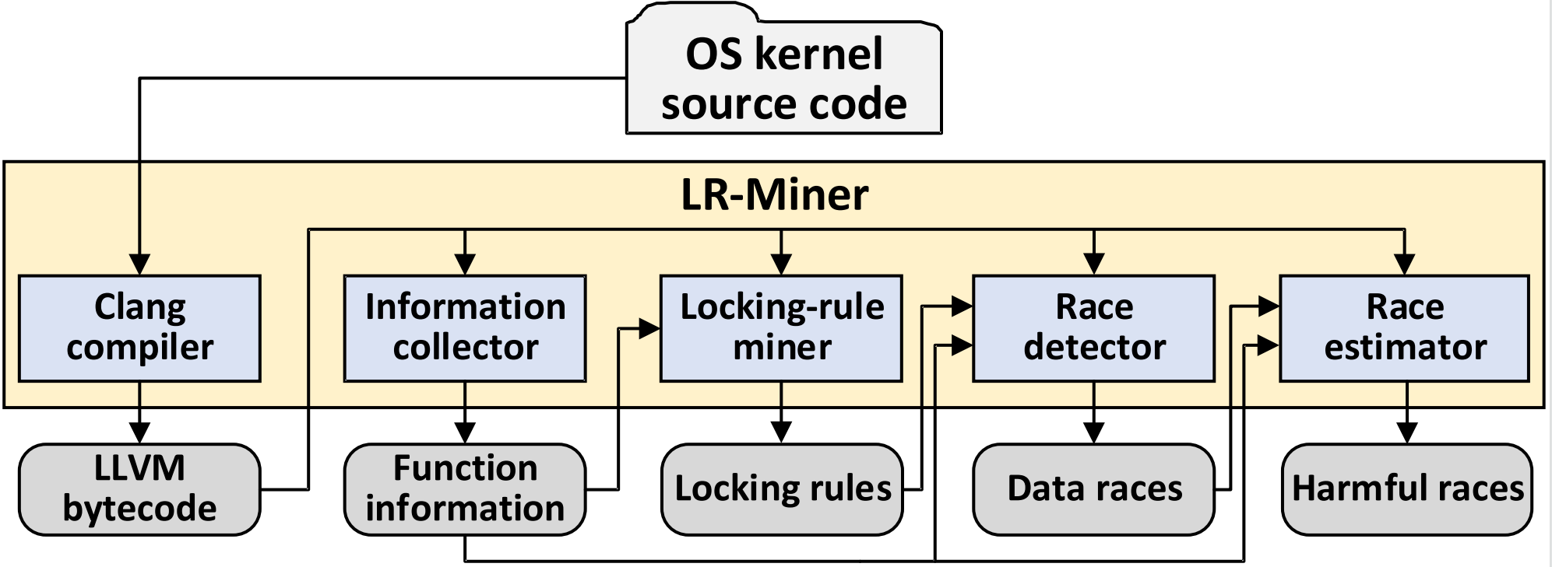
Framework
LR-Miner
Automatic framework to detect data races
Integrate the three key techniques
Report harmful data races
Notes:
Based on the three key techniques, we propose a fully automated framework for detecting data races in OS kernels.
This framework integrates the three key techniques discussed and reports harmful data races.
The figure below illustrates its architecture.
As shown in the figure, LR-Miner contains four main parts, an information collector, a locking-rule miner, a race detector and a race estimator.

Slide 23
Evaluation
Experimental setup
Two widely used operating systems
OS | Version | Source Files (*.c) | LOC
Linux | 6.2 | 28.3K | 14.2M
FreeBSD | 14.0 | 19.6K | 9.2M
Notes:
We have evaluated LR-Miner on both Linux and FreeBSD.
Details about these two operating systems are provided in the table.

Slide 24
Evaluation
Evaluation results
 | Linux | FreeBSD
Source files (analyzed/all) | 22.5K/28.3K | 4.2K/19.6K
Source code lines (analyzed/all) | 13.9M/14.2M | 3.3M/9.2M
Found races (real/all) | 273/341 | 33/41
Harmful races | 173 | 27
Harmful patterns (NPD/EHB/UB/DF) | 26/59/50/38 | 11/6/10/0
Time usage | 21h48m | 9h32m
Notes:
The table presents the evaluation results for LR-Miner.
In total, LR-Miner detected 200 harmful data races, including 37 null-pointer dereferences, 65 error handling bypasses, 60 instances of undefined behavior, and 38 double fetches.
These results demonstrate that LR-Miner can effectively identify harmful data races.

Slide 25
Compared to others
Comparison results
 | Relay | RacerX-like | CPALockator | LR-Miner
Found races | 12,291 | 20,457 | 782 | 385
Real races | 8 in 300 | 6 in 300 | 21 | 274
Harmful races | 4 in 300 | 3 in 300 | 9 | 188
Time usage | 1h7m | 4h38m | 126h15m | 5h51m
Notes:
We also compared LR-Miner with three other data race detection tools.
The results show that LR-Miner identifies more data races with fewer false positives.

Slide 26
Conclusion
Detection of data races in OS kernels is complex
LR-Miner
Feld-aware mining method to deduce locking rules
Alias-aware checking method to checking locking-rule violation
Pattern-based estimation strategy to identify harmfule data races
Find 200 harmful data races in Linux and FreeBSD
Outperform three well-known tools to detect data races
Notes:
In conclusion, detecting data races in OS kernels is a complex task.
We have developed a novel method, LR-Miner, to effectively address this challenge.
LR-Miner employs three key techniques:
A field-aware mining method to deduce locking rules.
An alias-aware checking method to detect locking-rule violations.
A pattern-based estimation strategy to identify harmful data races.
We evaluated LR-Miner on Linux and FreeBSD and identified 200 harmful data races.
Additionally, we compared LR-Miner with three well-known data race detection tools and found that it outperforms them.

Slide 27
Thanks
Tuo Li
islituo@163.com
Notes:
That’s all, thanks for listening.

