Slide 1

Twitter Sentiment and the Covid-19 Vaccine
Group B
Joel Cox, Zachary Gibbs & Kevin Gray

Slide 2
Does Twitter Show an evolution in sentiment toward Covid-19 vaccines?
Landscape: Surveys of U.S. adults by Boston Consultancy Group (BCG) and a poll of adults in 23 nations conducted by The Johns Hopkins Center for Communication Programs (CCP); find that roughly 37-40 percent of eligible adults are hesitant to take or plan to refuse to take a Covid-19 vaccine.
We wondered does Twitter reflect this attitude and how, if at all, has sentiment evolved since the successful release of three U.S. vaccines; and various others worldwide

Slide 3
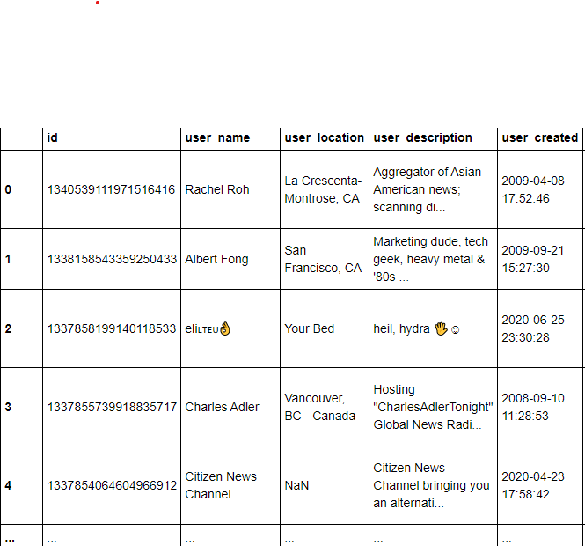
Limitations/obstacles
Access to the Twitter Enterprise API costs $5,000/month
Limited capacity to perform API calls
No reliable geographic information about tweet origins
Slow response for access to low-rung Twitter API

Slide 4
Solutions
Utilized a tweet dataset, found on Kaggle, compiled by data scientist Gabriel Preda
The dataset, had some likely weaknesses, but was updated twice during our work allowing us to pull tweet data from 20-Dec through 3-March.
All told, the dataset included 19,945 tweets

Slide 5
Process
Compile tweets from December-March containing specific keywords
Format data using Pandas
Run sentiment analysis VADER
Create and app and webpage to house it
Create visualizations using Tableau
Analyze findings
Deploy project through Netlify

Slide 6
Determining Sentiment - vader
VADER = Valence Aware Dictionary and sEntiment Reasoner
Open-source lexicon & rule-based sentiment analysis tool specifically attuned to sentiments expressed in social media
https://github.com/cjhutto/vaderSentiment
Hutto, C.J. & Gilbert, E.E. (2014). VADER: A Parsimonious Rule-based Model for Sentiment Analysis of Social Media Text. Eighth International Conference on Weblogs and Social Media (ICWSM-14). Ann Arbor, MI, June 2014.

Slide 7
deployment
Static Website deployed through Netlify
Embedding of Tableau visuals (JS)
Base HTML page/CSS/Bootstrap

Slide 8
Tools
Pandas
CSS/Bootstrap
Tableau
Netlify

Slide 9
conclusions
We do see a shift to more neutral sentiment after Inauguration Day, with decreases in positive and neutral
Tweets and hashtags on average were neutral
Verified users are more likely to be sentiment neutral than unverified users
We could’ve drawn more definitive conclusions with access to a larger data set

