Slide 1

Twitter Sentiment and the Covid-19 Vaccine
Group B
Joel Cox, Zachary Gibbs & Kevin Gray

Slide 2
Does Twitter Show an evolution in sentiment toward Covid-19 vaccines?
Landscape: Surveys of U.S. adults by Boston Consultancy Group (BCG) and a poll of adults in 23 nations conducted by The Johns Hopkins Center for Communication Programs (CCP); find that roughly 37-40 percent of eligible adults are hesitant to take or plan to refuse to take a Covid-19 vaccine.
We wondered does Twitter reflect this attitude and how, if at all, has sentiment evolved since the successful release of three U.S. vaccines; and various others worldwide

Slide 3
Tools
Pandas
CSS/Bootstrap
Tableau
Heroku

Slide 4
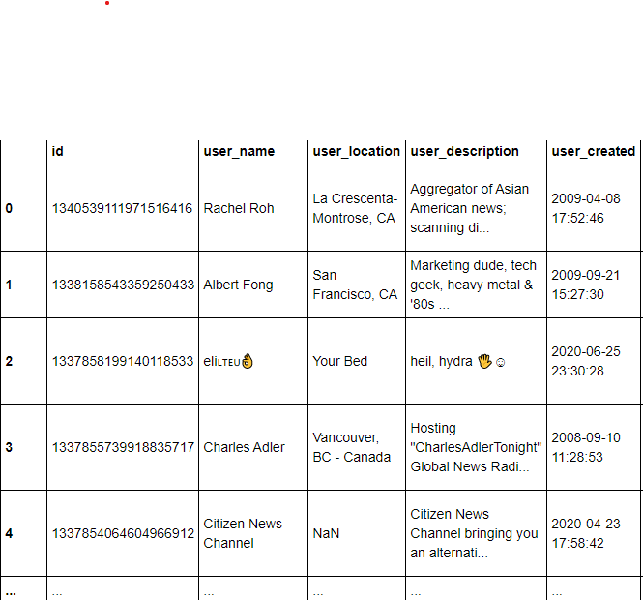
Limitations/obstacles
Access to the Twitter Enterprise API costs $5,000/month
Limited capacity to perform API calls
No reliable geographic information about tweet origins
Slow response for access to low-rung Twitter API

Slide 5
Solutions
Utilized a tweet dataset compiled by data scientist Gabriel Preda
The dataset, had some likely weaknesses, but was updated twice during our work allowing us to pull tweet data from 20-Dec through 3-March.
All told, the dataset included 19,945 tweets

Slide 6
Process
Compile tweets from December-March containing specific keywords
Format data using Pandas
Create and app and webpage to house it
Create visualizations using Tableau
Analyze findings
Deploy project through Heroku

Slide 7
Determining Sentiment - vader
VADER = Valence Aware Dictionary and sEntiment Reasoner
Open-source lexicon & rule-based sentiment analysis tool specifically attuned to sentiments expressed in social media
https://github.com/cjhutto/vaderSentiment/blob/master/README.rst
Hutto, C.J. & Gilbert, E.E. (2014). VADER: A Parsimonious Rule-based Model for Sentiment Analysis of Social Media Text. Eighth International Conference on Weblogs and Social Media (ICWSM-14). Ann Arbor, MI, June 2014.

Slide 8
deployment
De

Slide 9
Findings

Slide 10
conclusions

