Slide 1
What is Differential Gene Expression (DEG)?
● The question: for a given gene, is its activity (expression) statistically different between two groups of patients?
● Why we care: genes that differ between ACS (acute heart attack) and CCS (stable coronary disease) patients point to which immune processes distinguish an acute event from stable disease.
● Output: for every gene, a fold-change (how much higher/lower) and a p-value (how confident we are it's real, corrected for testing thousands of genes at once).
● Terminology: a "DEG" is a gene that passes both thresholds, large enough fold-change and statistically significant. That's what we count and plot.
Following sc-best-practices chapter 18 (Differential Gene Expression Analysis).

Slide 2
Why pseudobulk, not testing individual cells?
The problem: cells from the same patient are not independent measurements. They share that patient's biology. Testing at the cell level treats 50,000 correlated cells as 50,000 independent data points, which inflates false positives (FDR).
● The fix, pseudobulk: sum all raw counts from one patient's cells (at one timepoint, for one cell type) into a single profile. The patient-timepoint, not the cell, becomes the statistical unit.
● Field consensus: sc-best-practices (chapter 18.4) and the wider single-cell field agree pseudobulk is the statistically sound default. Historically single-cell-level testing was also used, but pseudobulk is now recommended.
● Tooling: PyDESeq2 (Python port of DESeq2) tests the pseudobulk counts; decoupler builds the pseudobulk profiles and applies quality filters.
sc-best-practices.org/conditions/differential_gene_expression.html, sections 18.1 and 18.4.

Slide 3
Pseudobulk: what actually happens to the numbers
Before
73,278 individual cells (all ACS-sterile timepoints + CCS). Each cell is one noisy, mostly-zero row of gene counts.
The operation
for every (patient, timepoint, cell type) combination, add up the raw counts across all its cells into one row. dc.pp.pseudobulk(mode="sum")
After
493 pseudobulk samples. Example: T-cell-CD4 alone collapses from thousands of individual cells down to 78 samples (62 ACS patient-timepoints + 16 CCS).
Why it matters
DESeq2 then tests 493 samples, not 73,278 cells. That ~150x reduction is exactly what fixes the false-positive problem: the patient, not the cell, is the statistical unit.
Numbers from the ACS vs CCS comparison (Harmony, named cell types) after sample-level QC filtering.

Slide 4
Our pipeline
Five steps, in order. Aggregation happens once, first, before anything else touches the data
1
Aggregation
Sum raw counts per patient x timepoint x cell type. dc.pp.pseudobulk(mode='sum')
2
Sample-level QC
Drop pseudobulk rows built from fewer than 10 cells or fewer than 1000 total counts. dc.pp.filter_samples
3
Gene filtering
Remove genes too lowly expressed to test reliably. dc.pp.filter_by_expr
4
One model per cell type
Separate PyDESeq2 fit for each cell type: sizes range 60 to 52,875 cells, too heterogeneous to share one dispersion trend.
5
Statistical testing
Wald test on the comparison of interest, giving log2 fold-change, standard error, and adjusted p-value (padj).
Restricted to cell types with adequate pseudobulk sample sizes; rarer types excluded per QC panel.

Slide 5
Sample overview
6 unique sample categories (conditions) across 109,504 cells, 119 patient-timepoint samples
Condition | Cells | Samples (patient-timepoints)
ACS_sterile | 60,712 | 62
ACS_infection | 9,734 | 15
ACS_subacute | 9,903 | 9
CCS | 12,566 | 16
non-CCS | 11,372 | 10
Sclerosis | 5,217 | 7
Total | 109,504 | 119
Condition is the unique sample category used to define comparison groups. Derived from the classification field in adata.obs.

Slide 6
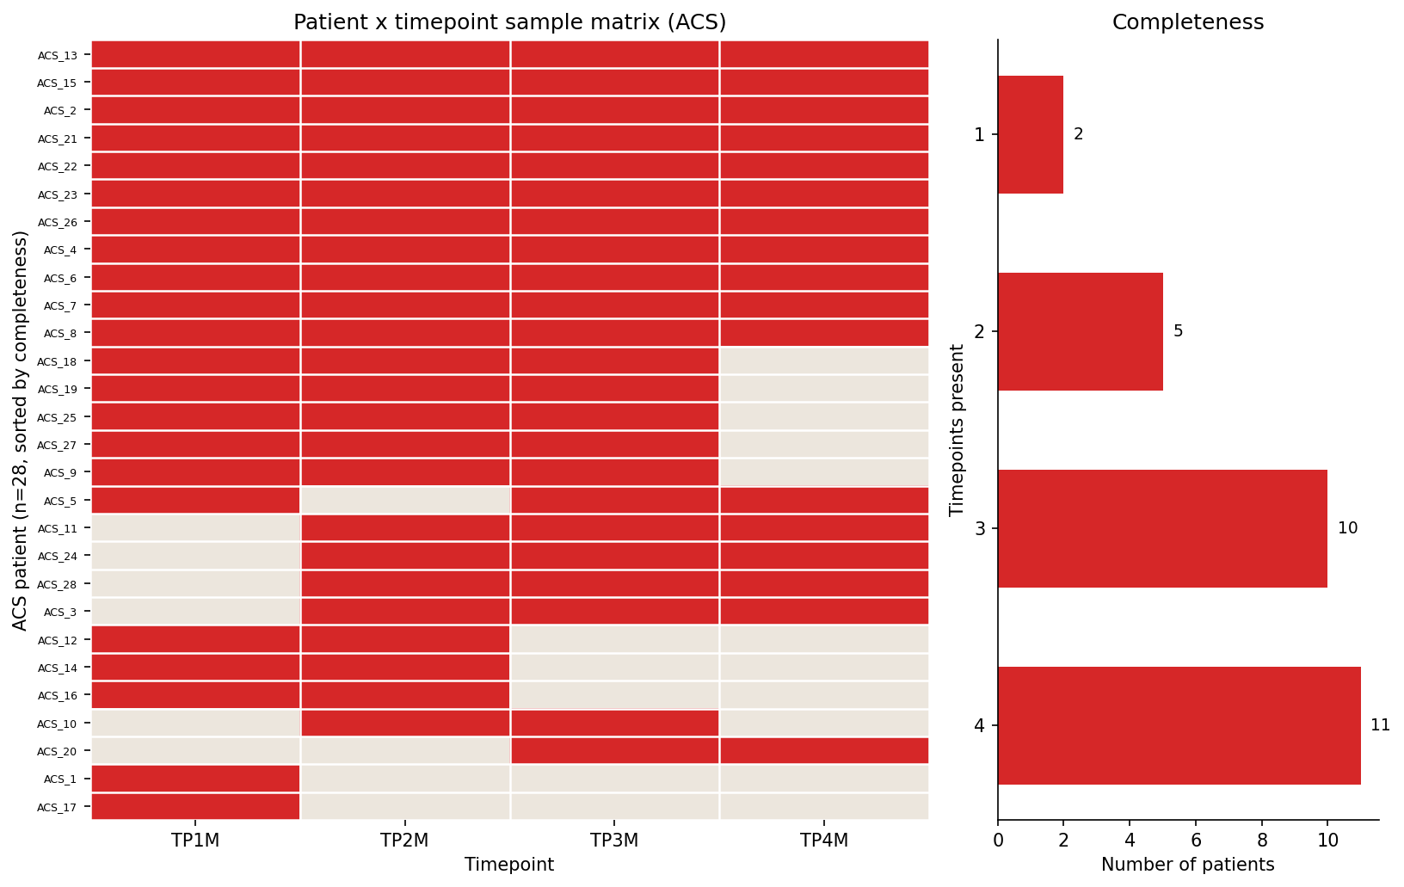
Timepoint structure
CCS, non-CCS, and Sclerosis are single-draw (TP0M only). Only ACS has multiple timepoints (TP1M-TP4M)
● Timepoint derivation: parsed from the sample ID (display_name), e.g. "2.1" to TP1M, "2.4" to TP4M. No suffix (single-draw samples) to TP0M.
11 of 28 ACS patients have all 4 timepoints sampled; the longitudinal comparison uses only patients with both TP1M and TP4M present.

Slide 7
Our three comparisons
Cohort design follows Pekayvaz et al. 2024 (Nat Med); the DESeq2 pseudobulk analysis itself is our own
CROSS-SECTIONAL
ACS vs CCS
Acute heart attack patients (all 4 blood draws, TP1M-TP4M) vs stable disease patients (CCS)
~ patient_id + condition blocked by patient, since ACS patients contribute up to 4 samples each
CROSS-SECTIONAL
ACS vs non-CCS
Acute heart attack (first blood draw only) vs patients where coronary disease was ruled out, pooled with mild sclerosis as "Control"
~ condition one sample per patient; not a comparison the source paper makes
LONGITUDINAL
ACS: early vs late blood draw
Same acute heart-attack patients, peri-interventional (TP1M) vs pre-discharge (TP4M). Tracks immune resolution
~ patient_id + timepoint paired: same patient in both groups
patient_id blocking avoids pseudoreplication when a patient contributes more than one sample to a comparison.

Slide 8
Results: how many significant genes per comparison
padj < 0.05, |log2FC| > 1. Repeated across 4 cell-type groupings for robustness
Grouping | ACS vs CCS | ACS vs non-CCS | Longitudinal
Harmony_leiden (25 clusters, in object) | 264 | 83 | 173
Harmony_named (Scanorama labels) | 351 | 57 | 128
DRVI_leiden (32 clusters, in object) | 333 | 70 | 147
DRVI_named (Scanorama labels) | 339 | 60 | 128
Robustness signal
Harmony_named vs DRVI_named agree closely: 351/339, 57/60, 128/128.
Raw-Leiden runs find more DEGs, finer clusters catch sub-type signal.
● The rest of this deck: shows the full, detailed results for the two named-cell-type groupings (Harmony_named and DRVI_named), one slide per comparison per method.
● Restricted to reliable cell types: T-cell-CD4/CD8, NK, B-cell, Monocytes-CD14/CD16, Dendritic. Progenitor/Megakaryocytes excluded as untestable (too few cells).
Full per-comparison, per-grouping CSVs in deg_conditions/.

Slide 9
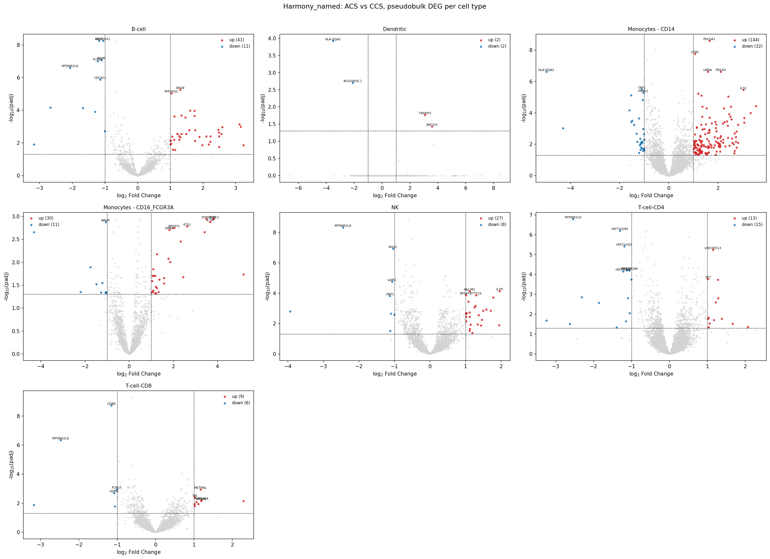
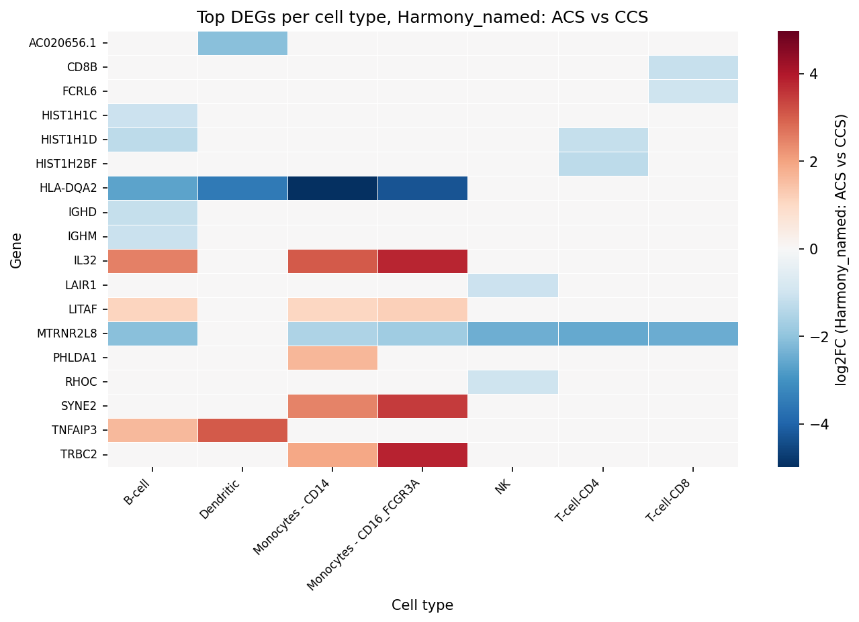
Harmony, named: ACS vs CCS
351 significant DEGs (padj < 0.05, |log2FC| > 1)
Left: volcano per cell type. Right: top DEGs per cell type, log2FC direction.

Slide 10
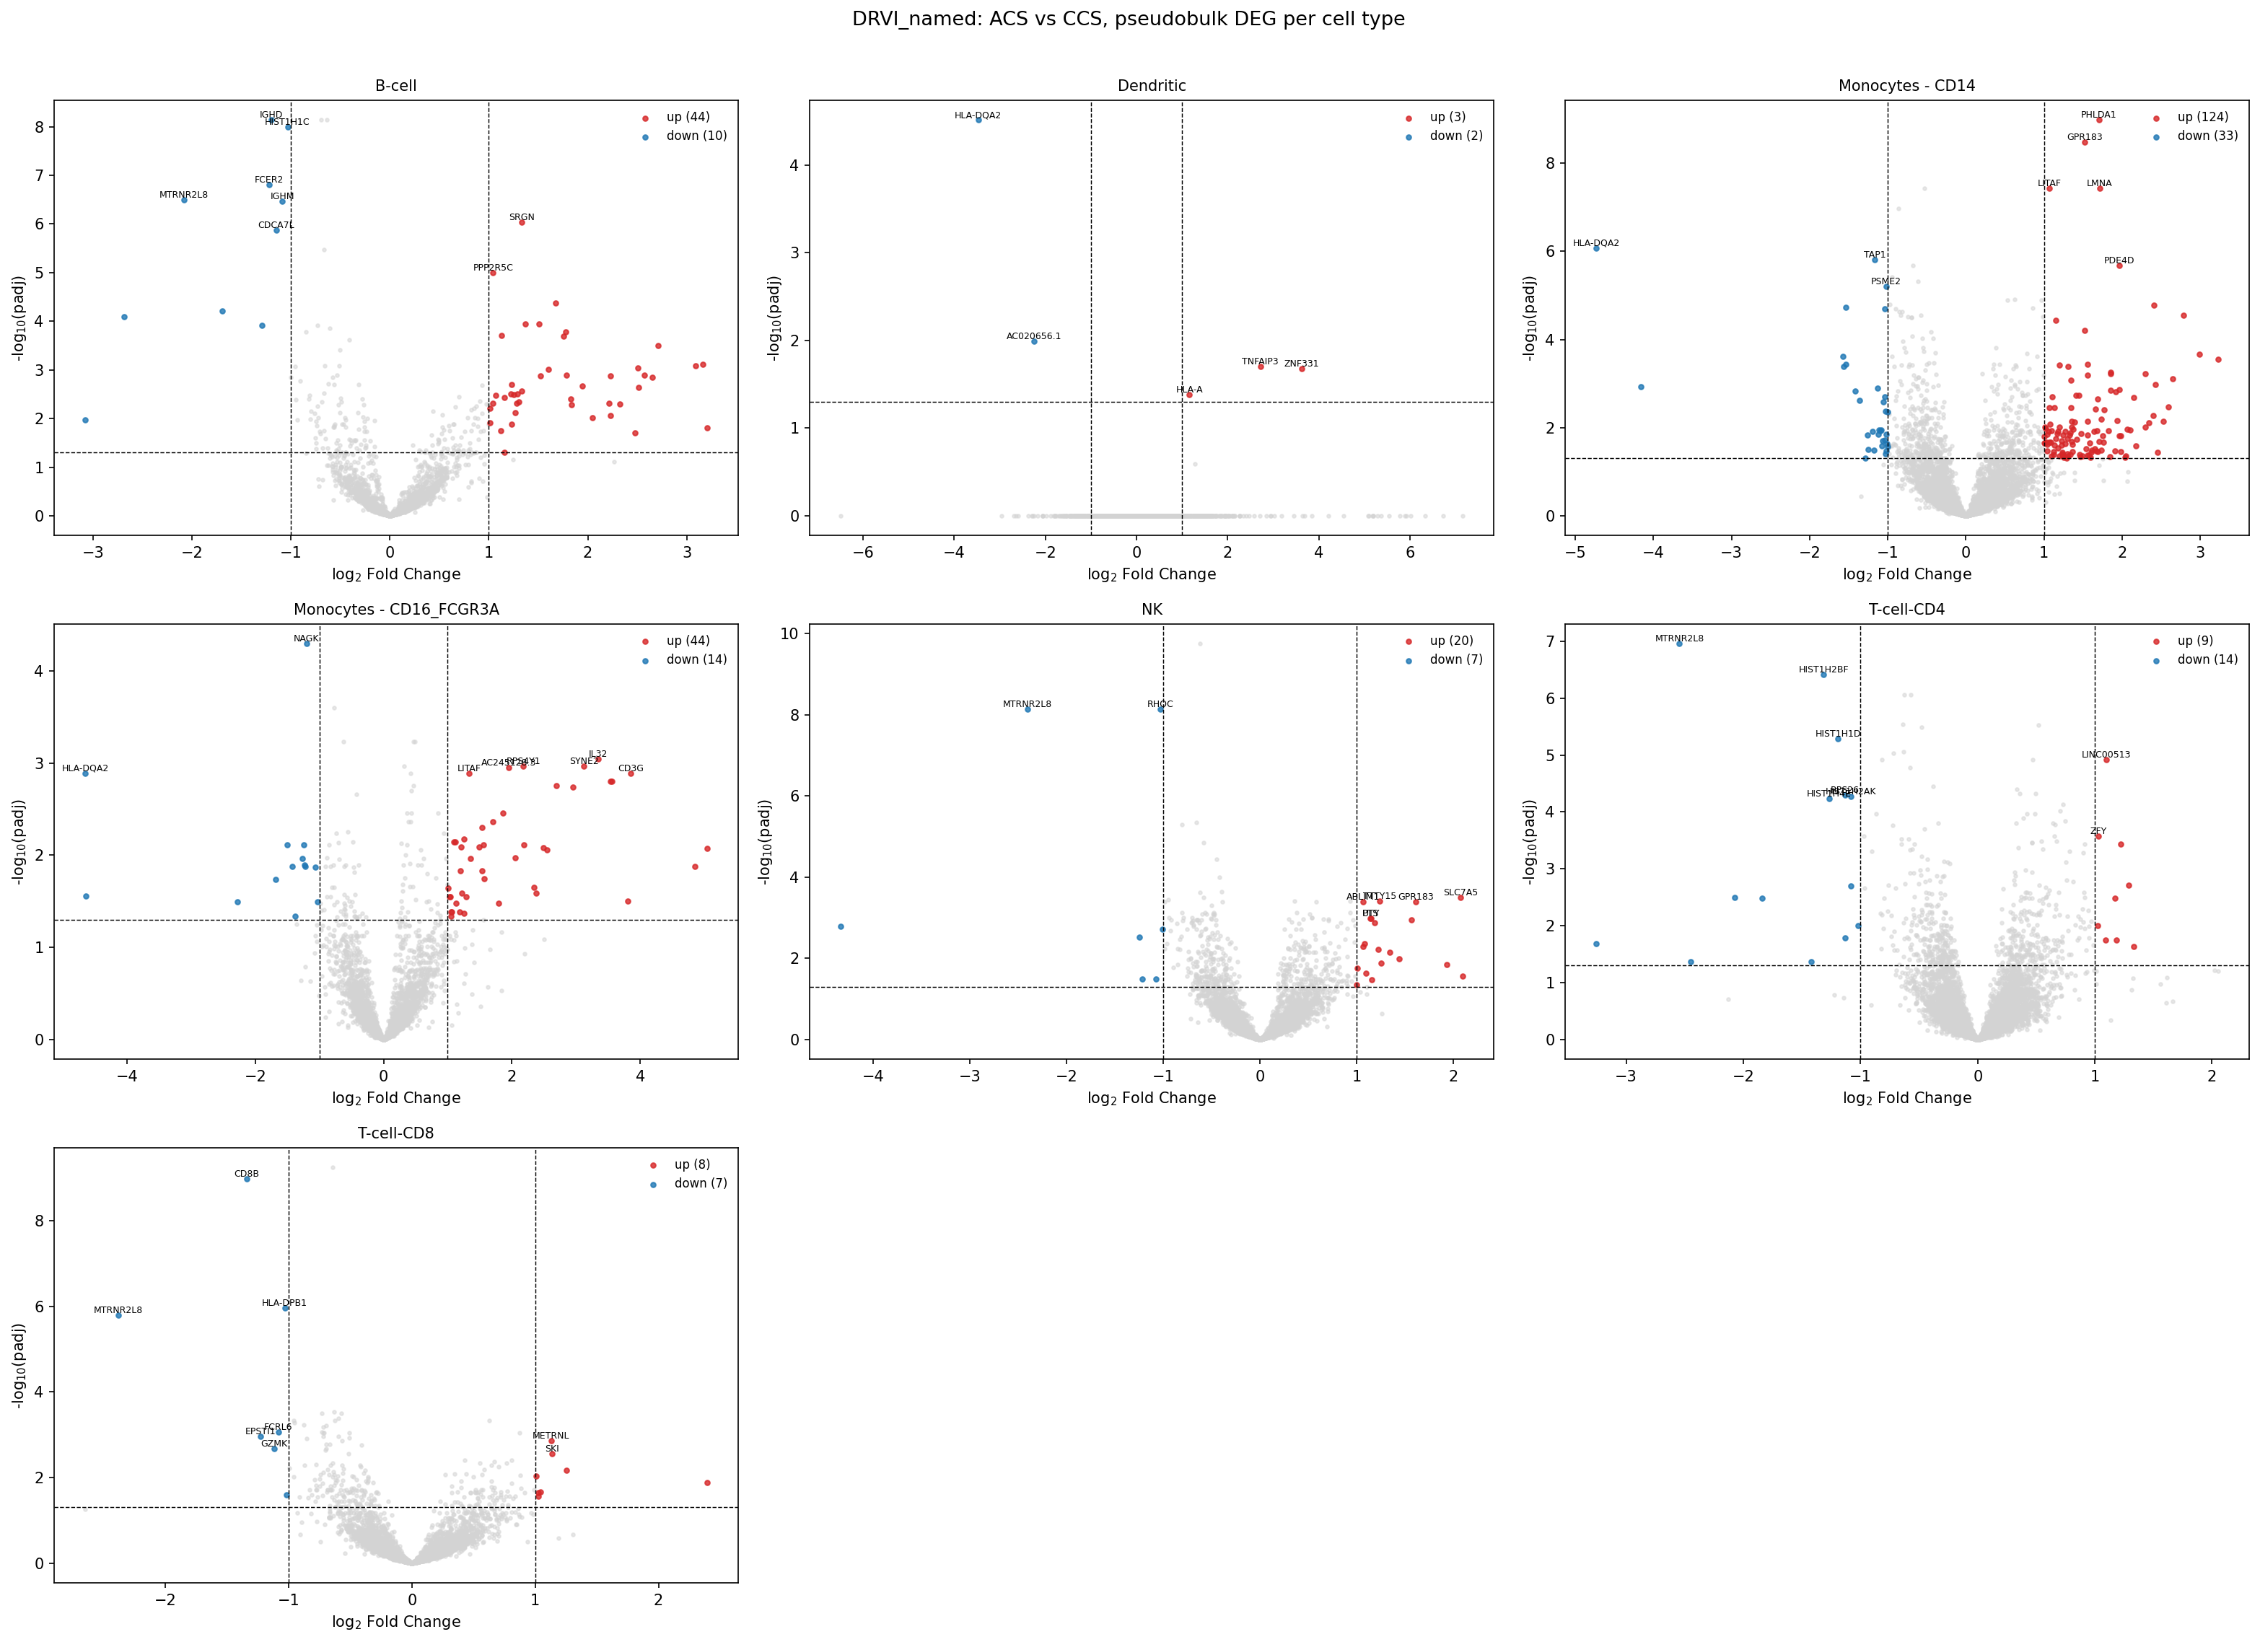
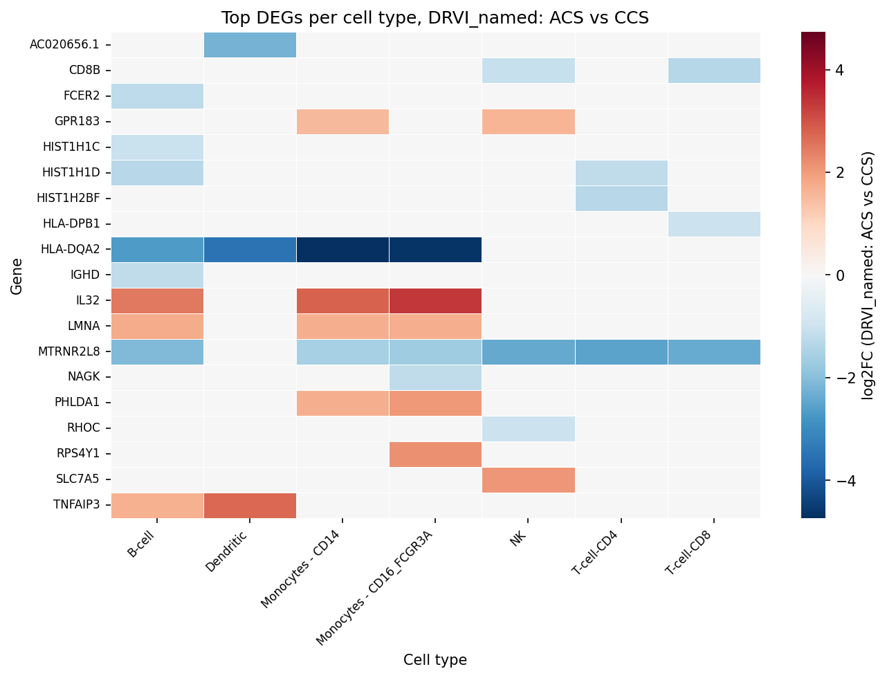
DRVI, named: ACS vs CCS
339 significant DEGs (padj < 0.05, |log2FC| > 1)
Left: volcano per cell type. Right: top DEGs per cell type, log2FC direction.

Slide 11
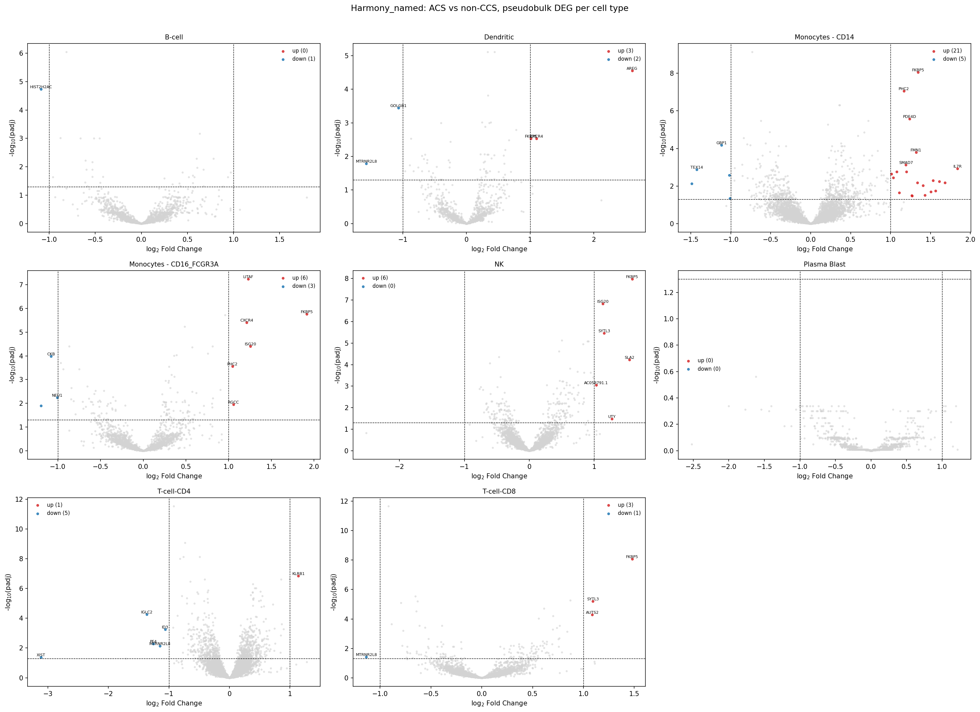
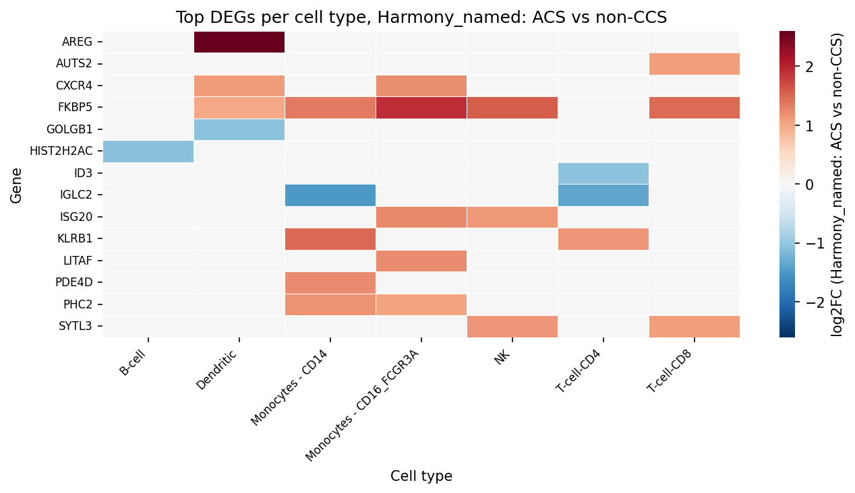
Harmony, named: ACS vs non-CCS
57 significant DEGs (padj < 0.05, |log2FC| > 1)
Left: volcano per cell type. Right: top DEGs per cell type, log2FC direction.

Slide 12
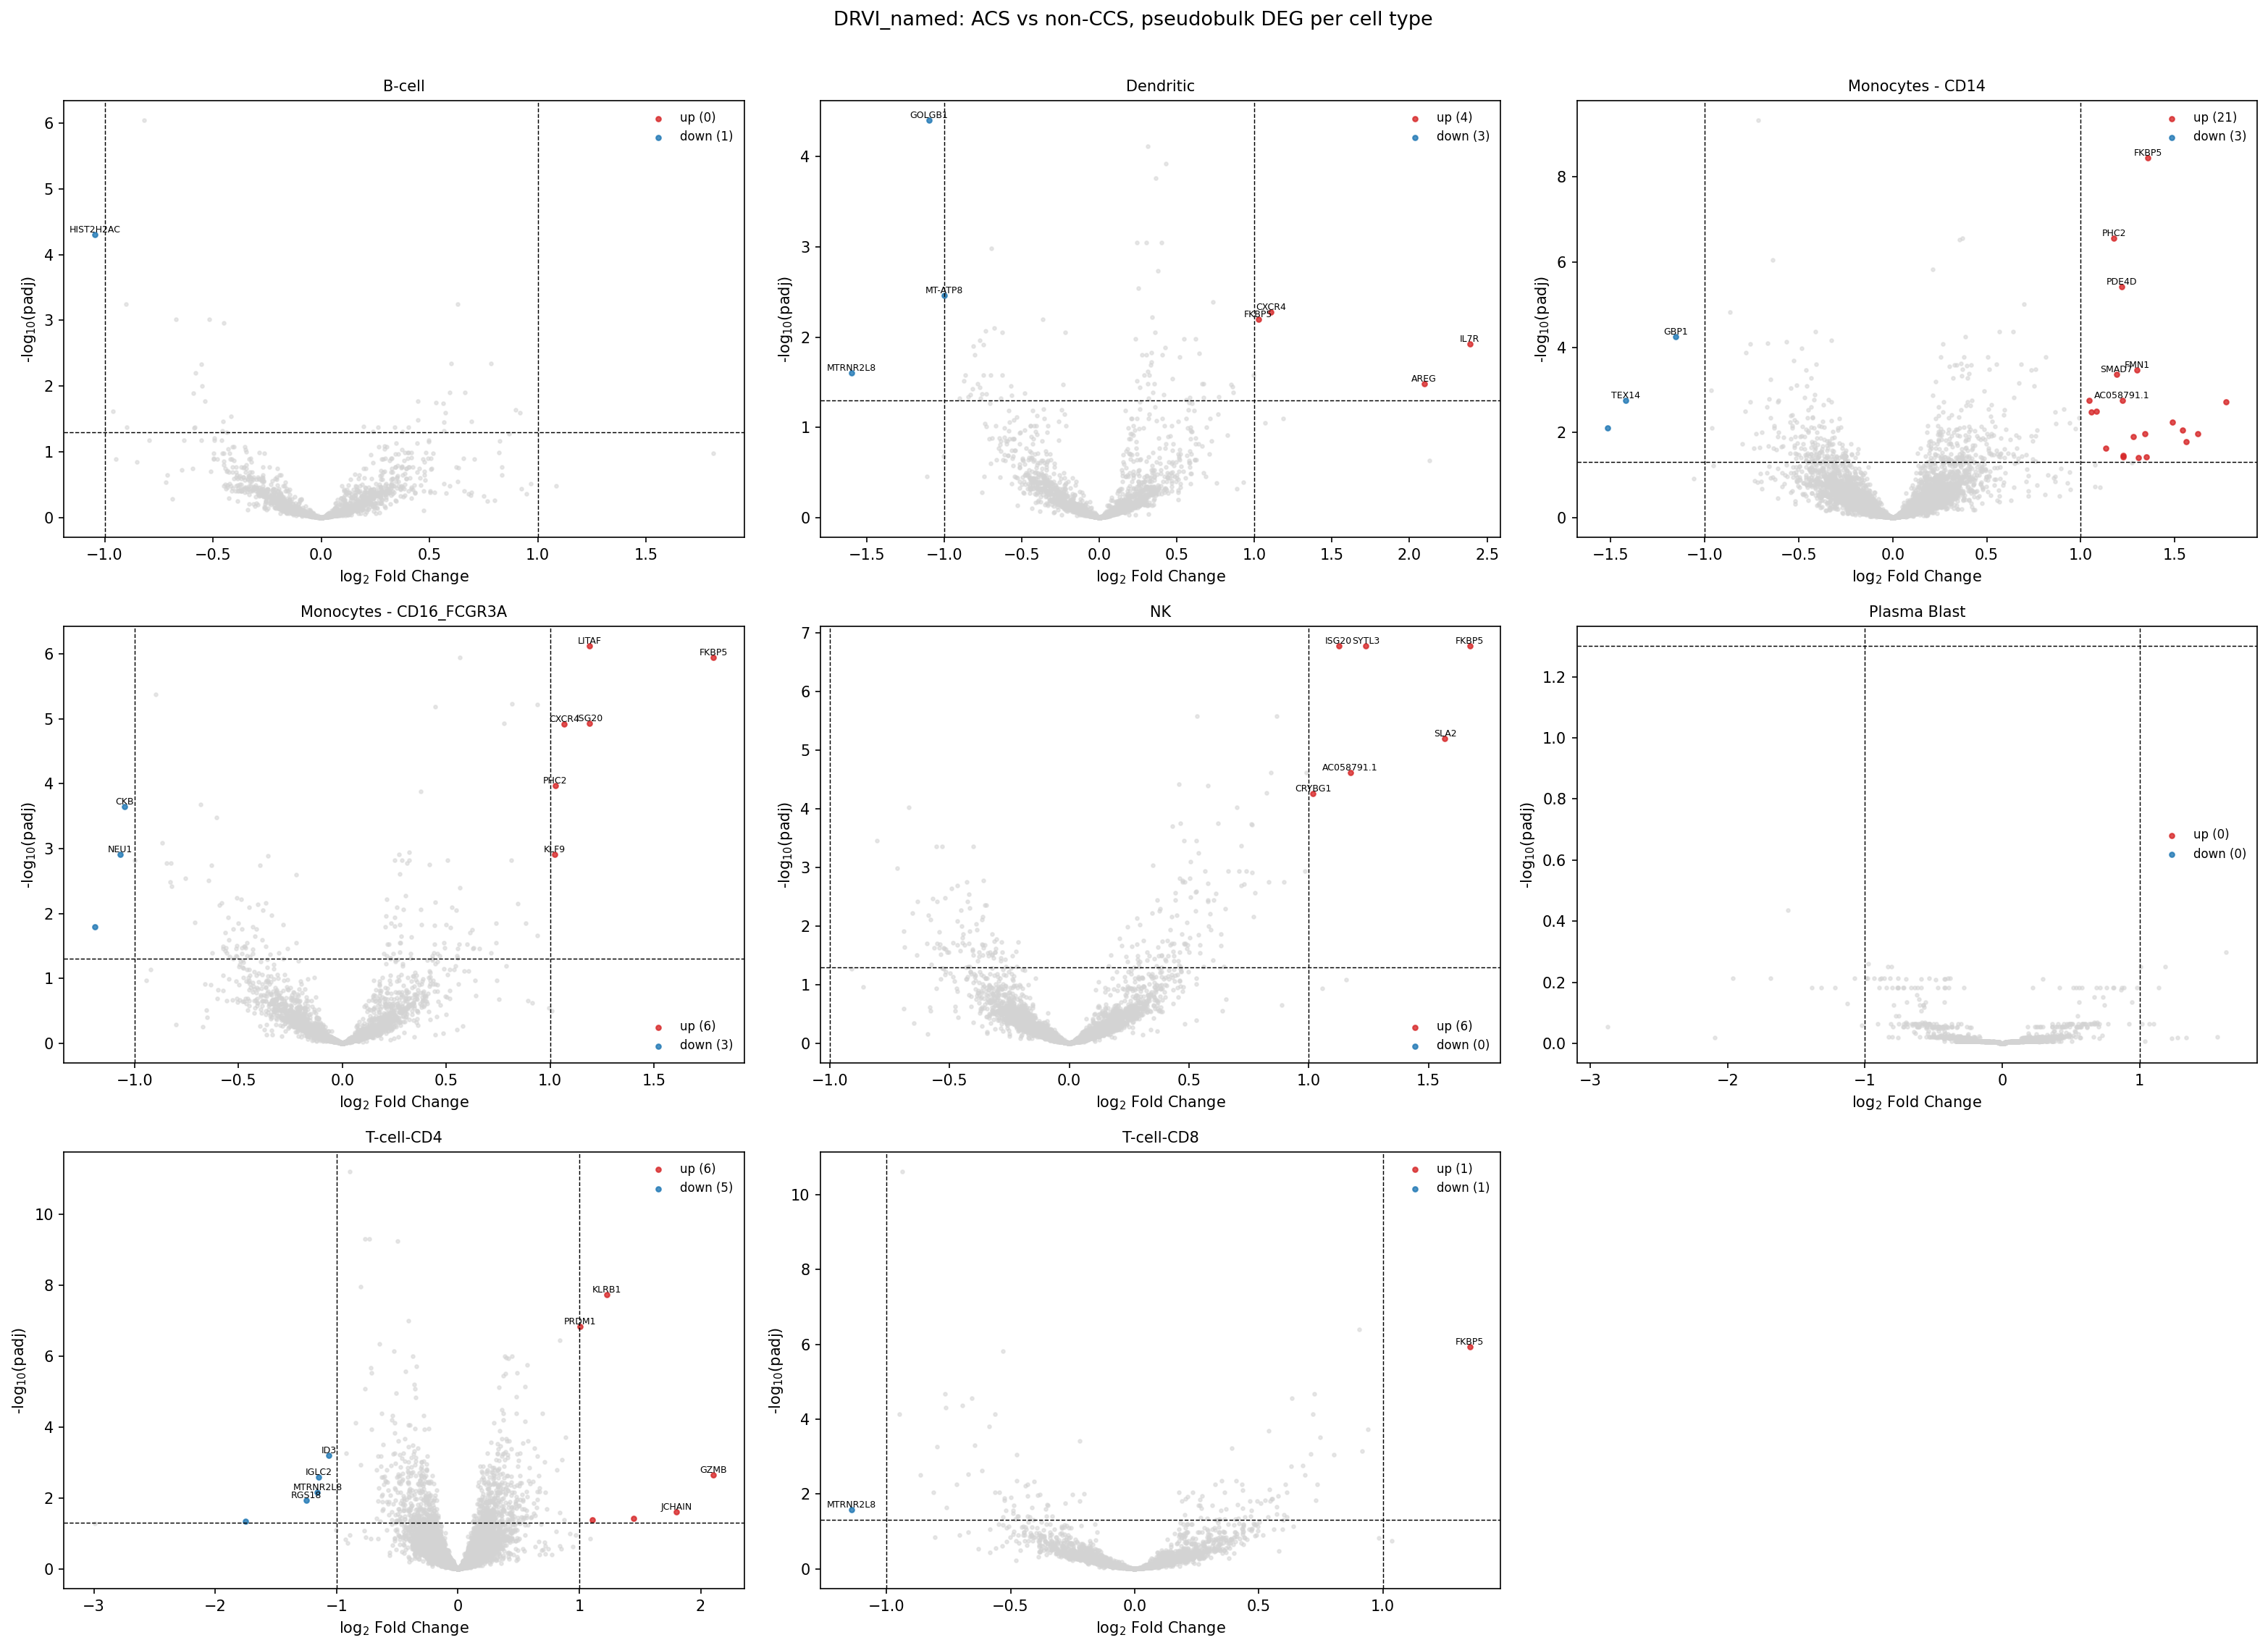
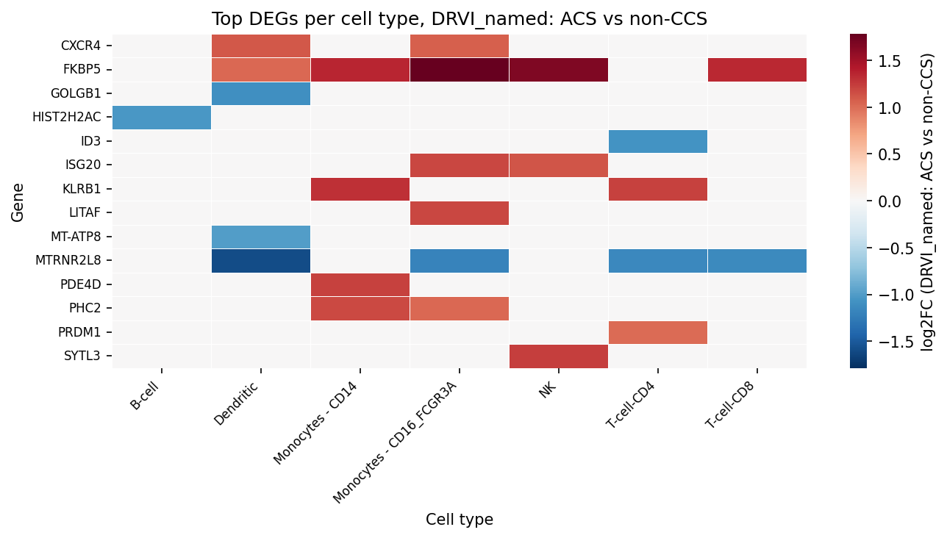
DRVI, named: ACS vs non-CCS
60 significant DEGs (padj < 0.05, |log2FC| > 1)
Left: volcano per cell type. Right: top DEGs per cell type, log2FC direction.

Slide 13
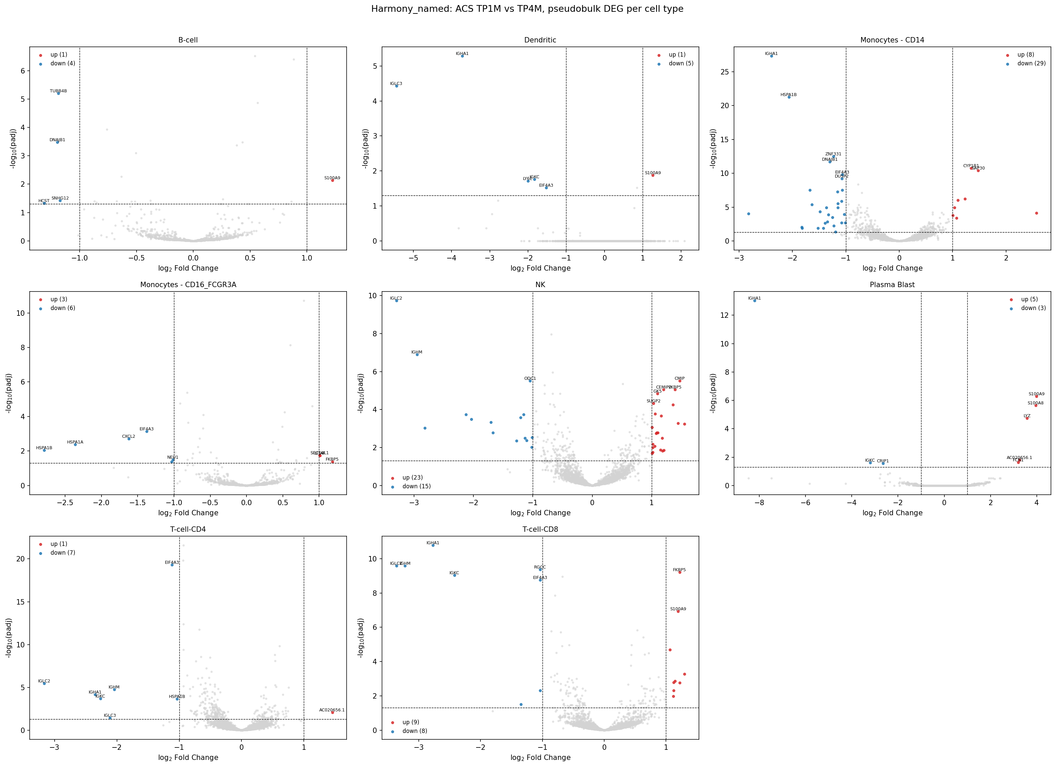
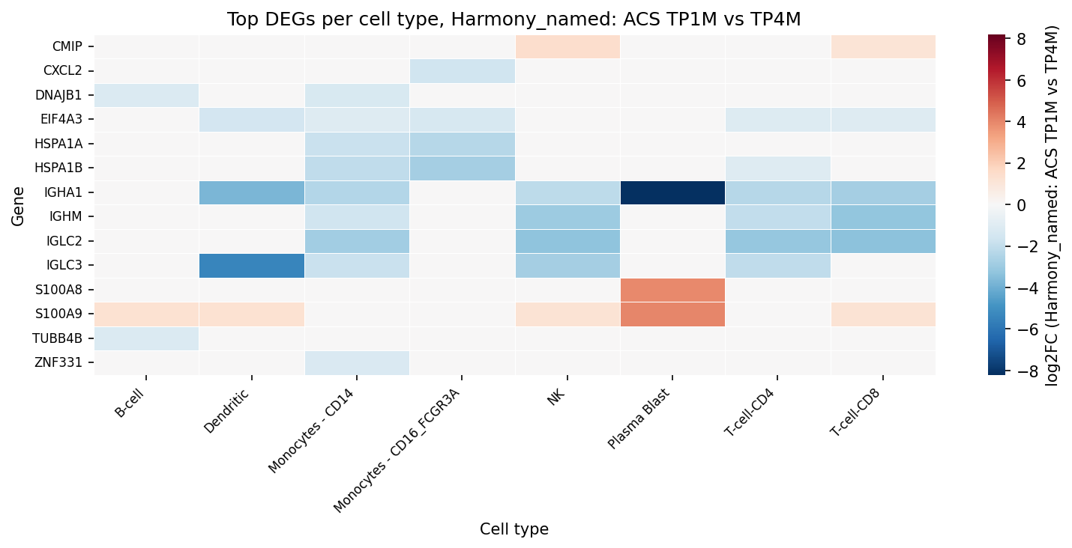
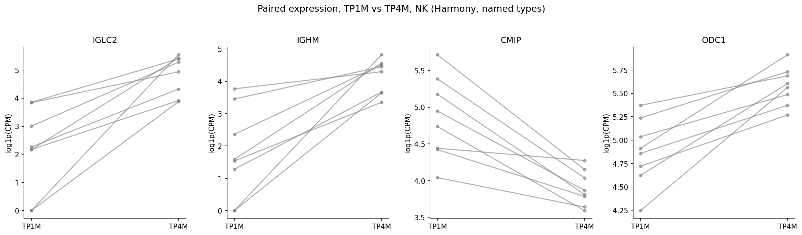
Harmony, named: Longitudinal (TP1M vs TP4M)
128 significant DEGs. Paired plot: NK, n=8 paired patients
Bottom: each grey line is one patient, moving from TP1M (acute) to TP4M (pre-discharge).

Slide 14
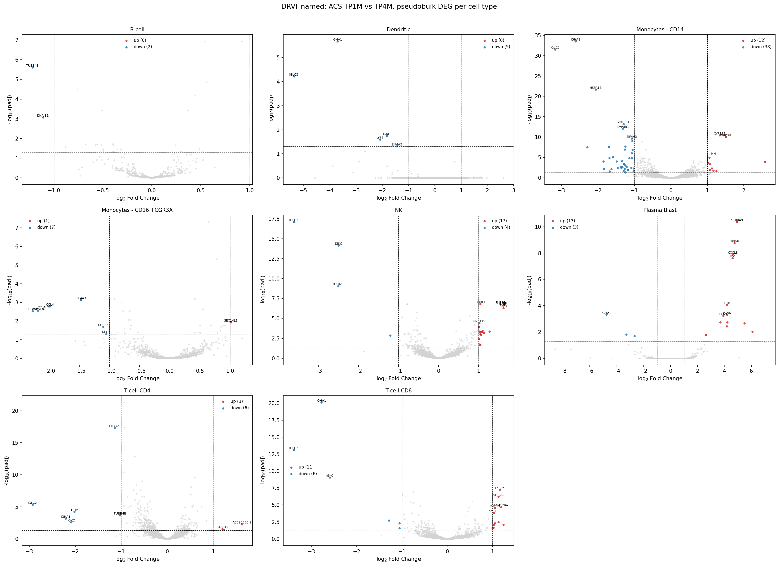
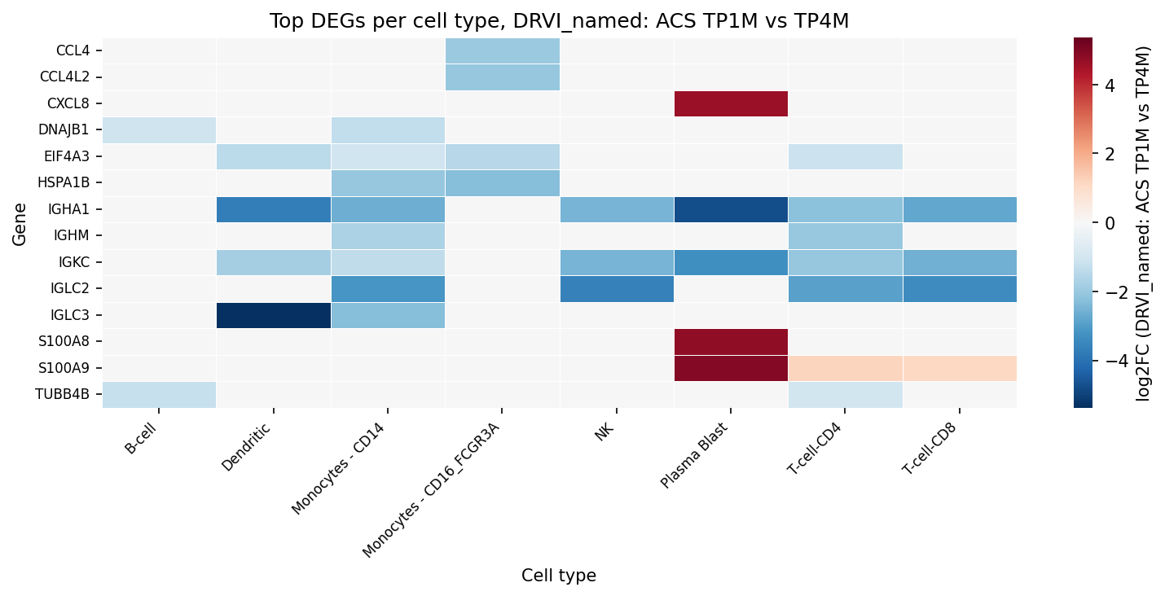
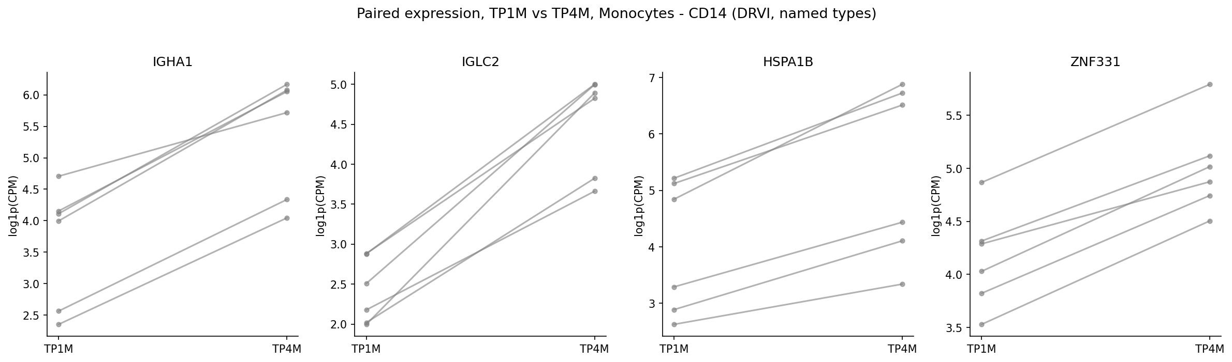
DRVI, named: Longitudinal (TP1M vs TP4M)
128 significant DEGs. Paired plot: Monocytes - CD14, n=6 paired patients
Bottom: each grey line is one patient, moving from TP1M (acute) to TP4M (pre-discharge).

Slide 15
Aggregation mode check: sum vs mean
Same comparison (ACS vs CCS, Harmony, named cell types), only dc.pp.pseudobulk(mode=...) changed
Mode | Genes tested (Monocytes-CD14) | Significant DEGs (total)
sum (used throughout) | 7,485 | 351
mean | 133 | 0
● Why the difference: DESeq2 models raw counts with a negative-binomial distribution and needs count-scale magnitudes for size-factor and dispersion estimation.
● Mean pseudobulk breaks this: averaging across hundreds of cells produces small fractions (e.g. 0.2 instead of 9). After rounding to integers for DESeq2, almost all signal is lost.
● Conclusion: sum is the statistically appropriate aggregation for DESeq2-based DEG testing, matching the tutorial's own choice throughout (mode="sum", never mean).
Checked directly as a sanity check per instructions to try both aggregation modes.

Slide 16
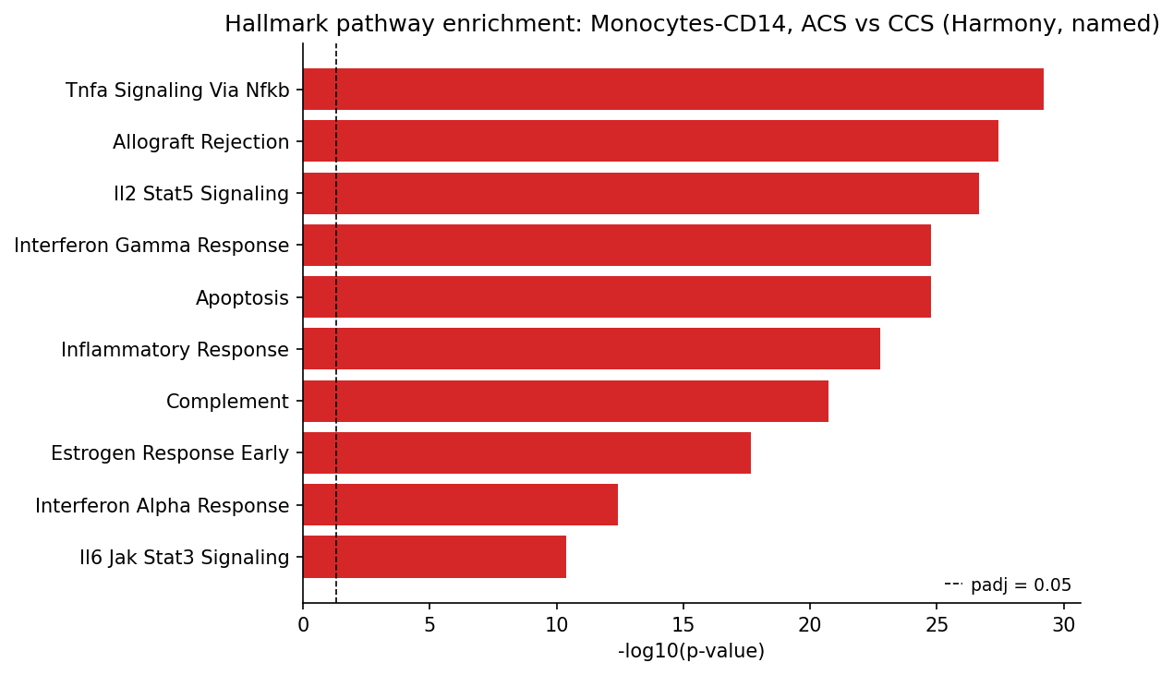
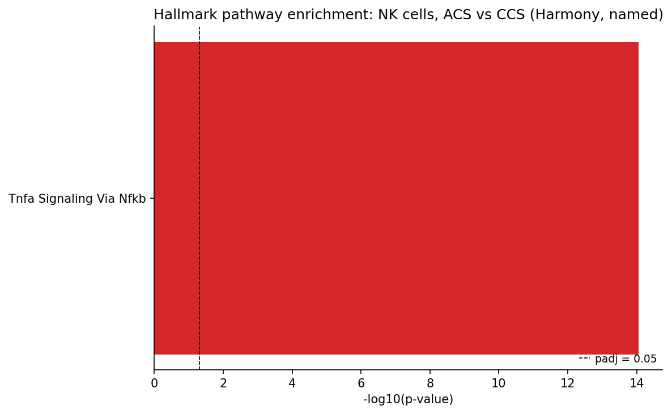
From gene lists to biology: pathway enrichment
Hallmark gene sets (MSigDB), over-representation analysis (dc.mt.ora) on significant DEGs. ACS vs CCS, Harmony named types
Monocytes-CD14: 176 significant genes
NK cells: 35 significant genes
TNF-alpha signaling and interferon response dominate in both cell types, a coherent acute-inflammation signature, not just a list of gene symbols.

